Slide 1

Angular App

Slide 2
Front-End App
Presentation Layer
HTML UI + Events + Event Functions + Data Properties
Front-End Models
Data Models aka Data Objects + Front-End
Biz Logic
External Calling Layer for External HTTP / Socket calls with Async Programming
Front-End Utilities
Reusable Functions e.g. Common Search Function, String Utilities
Views
Model + Controllers

Slide 3
Common Code Sharing for Front-End Apps
Angular App
React App
Vue.js App
TypeScript Common Code Base
String Manipulation
Array Utilities
Date/Time Operations
HTTP Calls
SVG / Charts

Slide 4
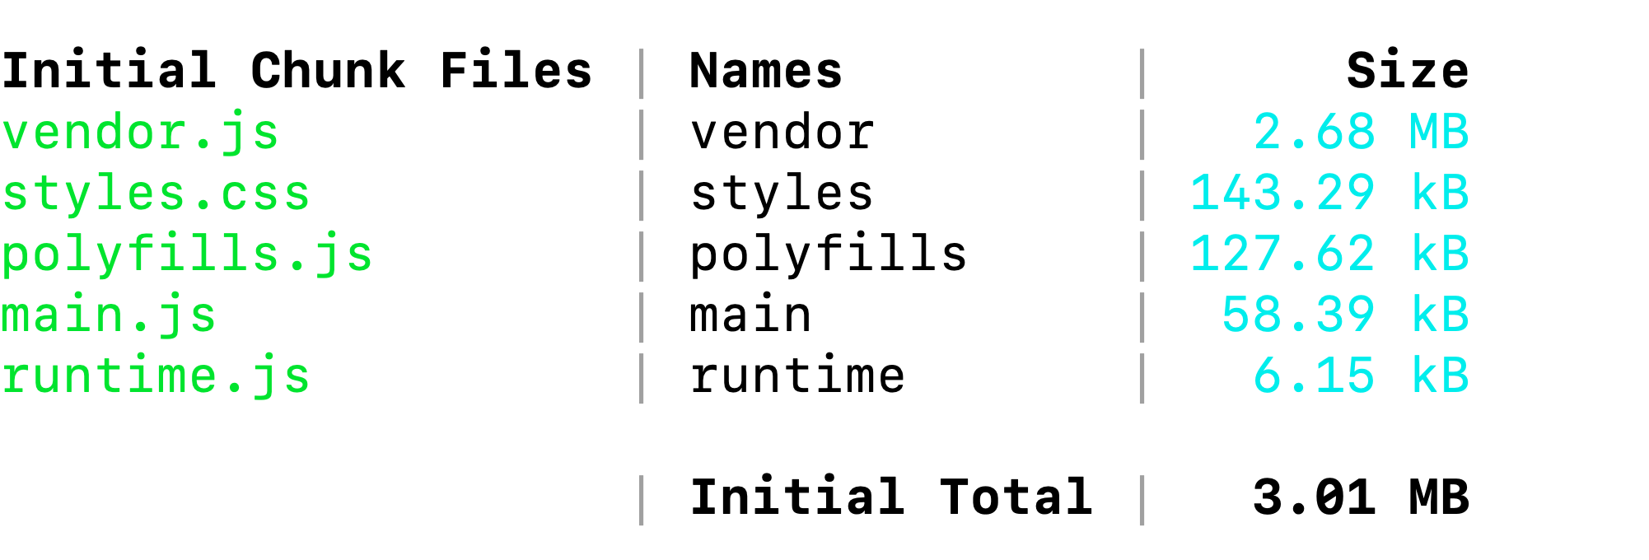
Transpilation of Standard Angular Packages
The Single CSS file for All CSS Classes
The file for Managing ES. For Browser so that the app is executed
The Transpilation of the Source code written by the developer
The WebPack loader instructions used by browser to execute the Angular app in browser
Development Build

Slide 5
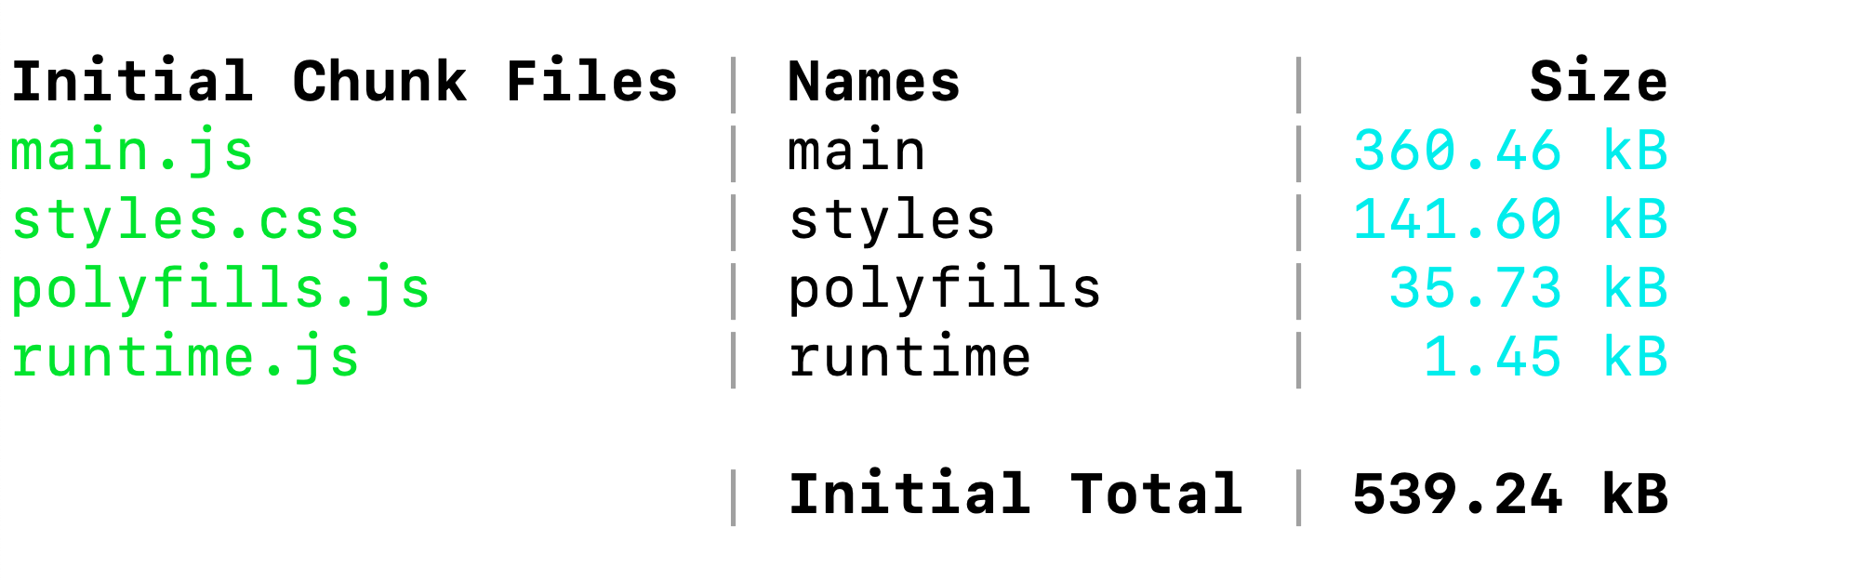
Ng serve –prod will transpile all standard Angular Packages and merge them into main.js along with the developer written code (app code)

Slide 6
Model
View
Controller

Slide 7
Model (Entity Class with Validations)
Domain Layer
Update the Model based on request
Response with Updated Data
2
What Data Acceptance Rules are tested for Validations
3
4b
View
Presentation Layer for End-Users
4a
Controller
Actions for Request Processing
Controller Decides the view to be responded
Request for Action(s)
Responded View
5
1

Slide 8
Form
Class Employee{
EmpNo: number,
EmpName:string,
Salary:number
}
EmpNo
EmpName
Traditional Individual Mapping with ngModel
Salary
Submit

Slide 9
Form
Class Employee{
EmpNo: number,
EmpName:string,
Salary:number
}
EmpNo
EmpName
Bind the entire object to the form so that when the form is posted the actual object is used for the processing instead of individual properties of the object.
This include domain specific validations applied on each property of the object
Salary
Submit

Slide 10
Angular App
Index.html (jQuery OM)
Angular UI with Object Model
React UI Object Model
React App
Angular app / React App / jQuery

Slide 11
Parent Component
Communication Across 2 Components having Same Parent
Child Component 1
Properties
Of
Parent
Child Component 2

Slide 12
Index.html
Service will be Injected as constructor Injection
Bootstrap Component 1
Bootstrap Component 2
Angular
Service as Singleton
NgModule Container Providers as ‘root’

Slide 13
Index.html
Angular Components’ from Module 1
Team 1
Angular Components’ from Module 2
Team 2
Angular Components’ from Module 3
Team 3
Common Angular Module registering the Angular Service as ‘Platfortm’

Slide 14
Angular App
External REST APIs
Open Accessible OR
Secure Calls to REST APIs
Identity with Credentials OR Credentials + Tokens
Async Request
Angular
Service
Observable
Async Response

Slide 15
Creating Shared Modules
Lazy Loading Shared Modules
Role Base Access to the Route
Server-Side App
JSP / ASP.NET/MVC /ASP.NET Core / SpringBoot
Angular Client as SPA
Public
REST
End-
Points
Register for Guest /
Set Access based on Role
Domain
Layer
Biz. Workflows
DAL
Auth
Module
Admin
Module
Manager
Module
HTTP Channel
Operator
Module
Guest
Module
Runtime.js / polyfills.js / Styles.css / main.js

Slide 16
Angular App with Angular Service for Http calls and Interceptor
Original Http request
Modified Http Request by in receptor
HttpInterceptor
Component
Service
Request
Handling
Response
Response

