Slide 1

Angular App

Slide 2
Front-End App
Presentation Layer
HTML UI + Events + Event Functions + Data Properties
Front-End Models
Data Models aka Data Objects + Front-End
Biz Logic
External Calling Layer for External HTTP / Socket calls with Async Programming
Front-End Utilities
Reusable Functions e.g. Common Search Function, String Utilities
Views
Model + Controllers

Slide 3
Common Code Sharing for Front-End Apps
Angular App
React App
Vue.js App
TypeScript Common Code Base
String Manipulation
Array Utilities
Date/Time Operations
HTTP Calls
SVG / Charts

Slide 4
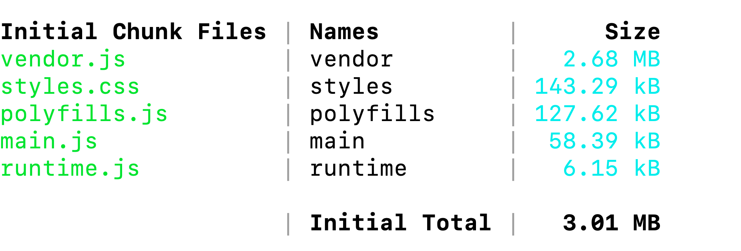
Transpilation of Standard Angular Packages
The Single CSS file for All CSS Classes
The file for Managing ES. For Browser so that the app is executed
The Transpilation of the Source code written by the developer
The WebPack loader instructions used by browser to execute the Angular app in browser
Development Build

Slide 5
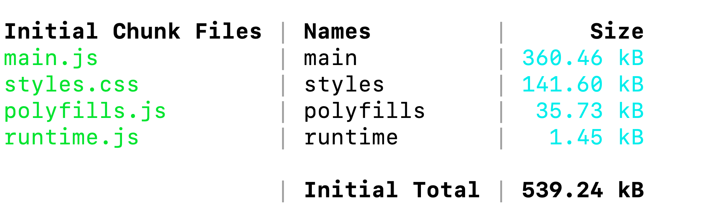
Ng serve –prod will transpile all standard Angular Packages and merge them into main.js along with the developer written code (app code)

