Slide 1
Mounted Root
Parent Component
<Ch1 v1={x}/>
<Ch2 v2={x}/>
….
<Chn vn={x}/>
Emitting data to pareent
Const [x, setX] = useState(0)
Ch1
Ch2
Ch3
Ch4
Chn
Props.v1
Props.v2
Props.v3
Props.v4
Props.vn

Slide 2
Context
Mounted Root
React.createContext
Key | Value
PropertyName | Value
Callback Fn | implementation
Parent Component
Subscribe to Context to Read properties from it so that its values can be referred
<Context.Provider value={}>
<Child/>
<Child2/>
</Context.Provider>
Child 1
Child 2
useContext(ContextObject);
Context.Consumer (Internally used)
The value is an object that will use properties and callback fns so that child components can use their value
Child1 and Child2 will subscribe to Context and read values of properties provided by the parent component

Slide 3
React lifecycle

Slide 4
React
Lifecycle Stages
Initial Render
Props Change
State Change
Component Unmount

Slide 5
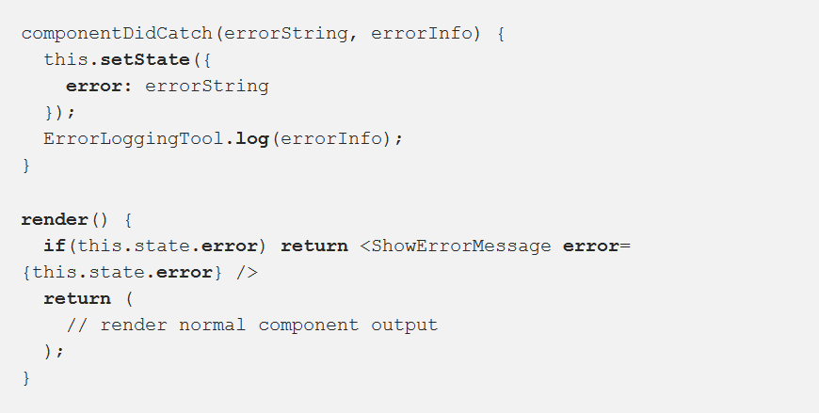
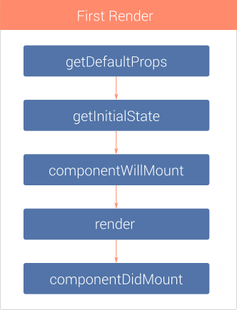
Ini­tial Render
Deprecated
componentDidCatch(errorString, errorInfo)
New is 16.x
http://javascript.tutorialhorizon.com/2014/09/13/execution-sequence-of-a-react-components-lifecycle-methods/

Slide 6
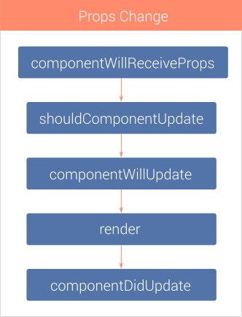
Props Change
Deprecated
http://javascript.tutorialhorizon.com/2014/09/13/execution-sequence-of-a-react-components-lifecycle-methods/

Slide 7
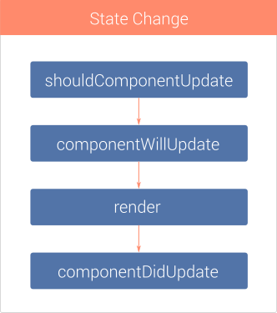
State Change
nextProps, nextState, nextContext
Depricated
prevProps, prevState, prevContext
http://javascript.tutorialhorizon.com/2014/09/13/execution-sequence-of-a-react-components-lifecycle-methods/

Slide 8
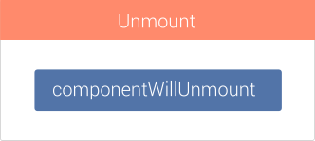
Com­po­nent Unmount
http://javascript.tutorialhorizon.com/2014/09/13/execution-sequence-of-a-react-components-lifecycle-methods/

Slide 9
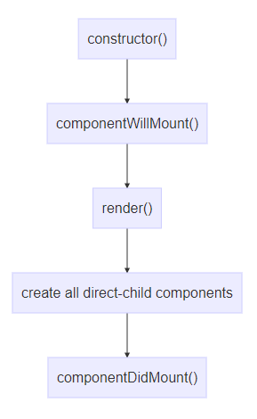
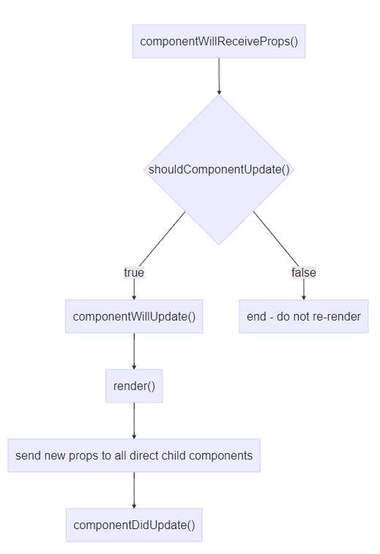
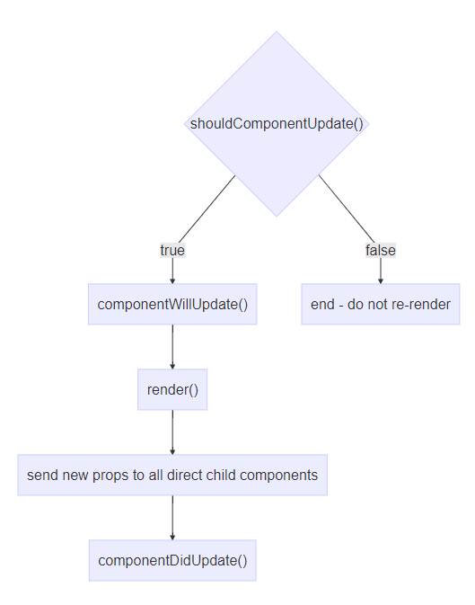
Component re-rendering due to re-rendering of the parent component
Component re-rendering due to internal change (e.g. a call to this.setState())
Component creation
https://medium.com/@baphemot/understanding-reactjs-component-life-cycle-823a640b3e8d

Slide 10
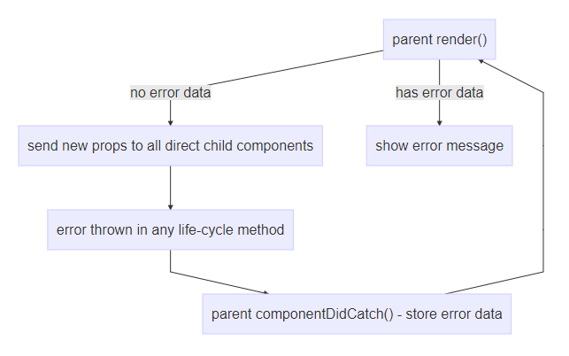
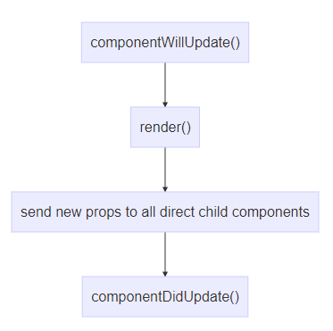
Component re-rendering due to call to this.forceUpdate
Component re-rendering due to catching an error
https://medium.com/@baphemot/understanding-reactjs-component-life-cycle-823a640b3e8d

Slide 11
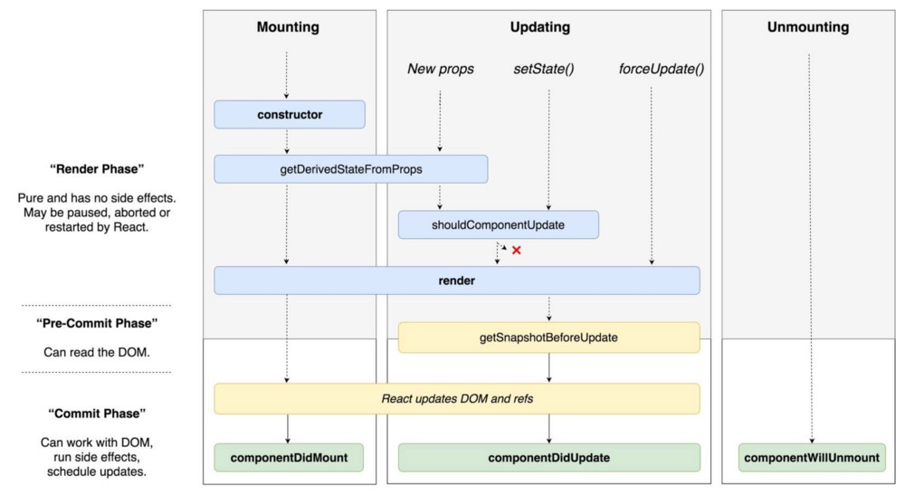
React 16.x

Slide 12
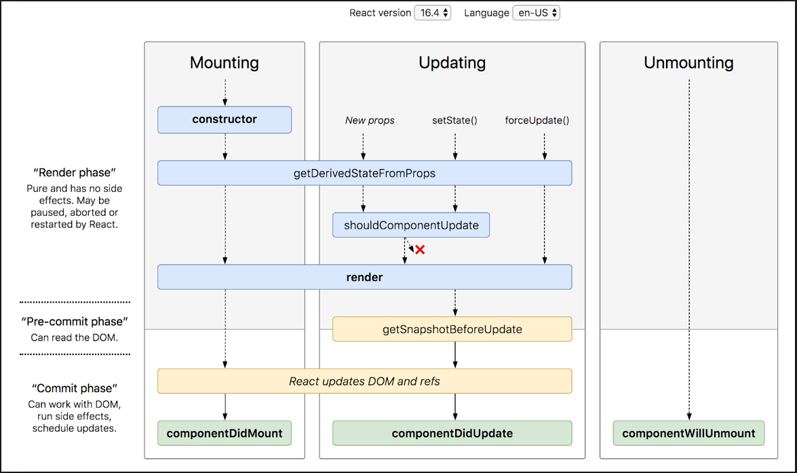

Slide 13
Single Page Applications SPA
Route Table
Url | Resource / Page /Components
/ | Home
/index | Index
/about | About
Landing Page aka Master Page aka Container Page
View Container
Query
UI Of the Utility Page
Utility Pages
All Utility Pages with their paths and parameters are registered in the Route Table

Slide 14
C1
C5
AJAX

Slide 15
UI Component 1
UI Component 4
UI Component 3
UI Component 2
Search Component
Parent Component

Slide 16
Front-End App
https://www.myui.com
Server-Side with API
https://www.myserapp.com
HTML Page for front-end app

