Slide 1
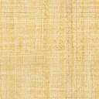
Angular Client App
Customers
REST
Service
Customers
Data
CustomersClient
Service
Component
Uses
forkJoin()
To Read Observables
Orders
REST
Service
OrdersClient
Service
Orders
Data

Slide 2
Angular Client App
Electronics Products
REST
Service
Electronics Products
Data
ElectronicsClient
Service
Combine data using combineLatest()
Electrical Products
REST
Service
ElectricalClient
Service
Electrical Products
Data
The Angular Component

