Slide 1
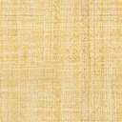
Angular Client App
Customers
REST
Service
Customers
Data
CustomersClient
Service
Component
Uses
forkJoin()
To Read Observables
Orders
REST
Service
OrdersClient
Service
Orders
Data

