Slide 1
ShopSmart
Prompt Engineering - Final Project
Sai Durga Mahesh Bandaru - 07-16-2024

Slide 2
ShopSmart is an intelligent e-commerce platform designed to enhance users shopping experience using Generative AI

Slide 3
Objectives
AI-powered product question answering system
Leverages user reviews to provide insights
Enhancing product research and buying decisions
Simplify product research process for online shoppers
Provide accurate answers to product questions using real user experiences
Improve shopping decisions through aggregated user knowledge

Slide 4
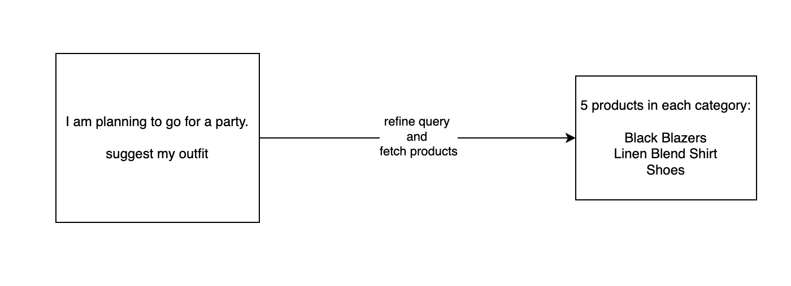
How ShopSmart Works
Search in ShopSmart
User can ask what he needs .System analyses the query to understand the information need
User Can add products that he liked into cart

Slide 5
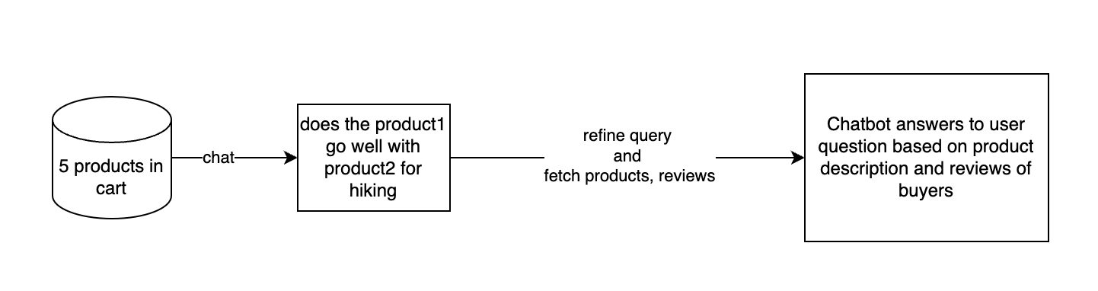
How ShopSmart Works
Cart in ShopSmart
User can ask questions about products in cart before buying. All relevant user reviews are retrieved and added into context for answering user queries.

Slide 6
Project Description
ShopSmart is an innovative AI-powered system designed to revolutionize the online shopping experience by providing intelligent answers to product-related questions using real user reviews. The system integrates advanced natural language processing techniques with a vast database of user-generated content to offer shoppers quick, accurate, and relevant information about products they're interested in purchasing.

Slide 7
Benefits for Shoppers
Access to real user experiences and opinions
Quick answers to specific product questions
Reduced time spent reading through numerous reviews
More informed purchasing decisions
Increased confidence in product selection

Slide 8
Architecture Overview
Key Components
Frontend: Streamlit for user-friendly interface
Backend: FastAPI for efficient query processing
Database: Snowflake for storing and accessing review data
AI Integration: OpenAI for natural language understanding and response generation

Slide 9
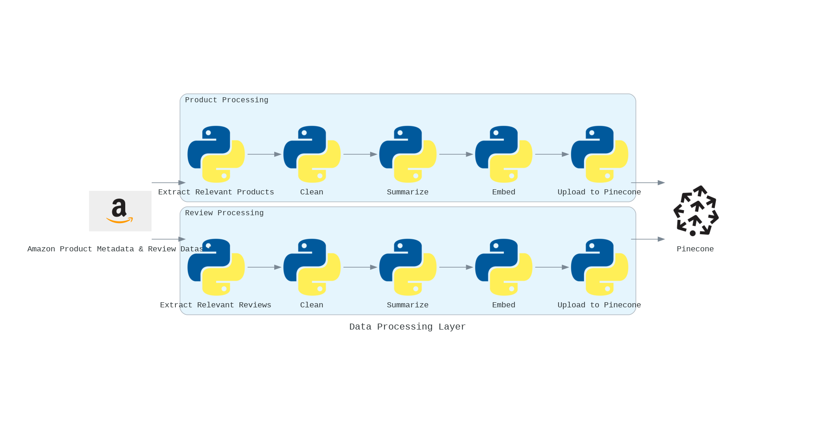
Architecture
Data Processing

Slide 10
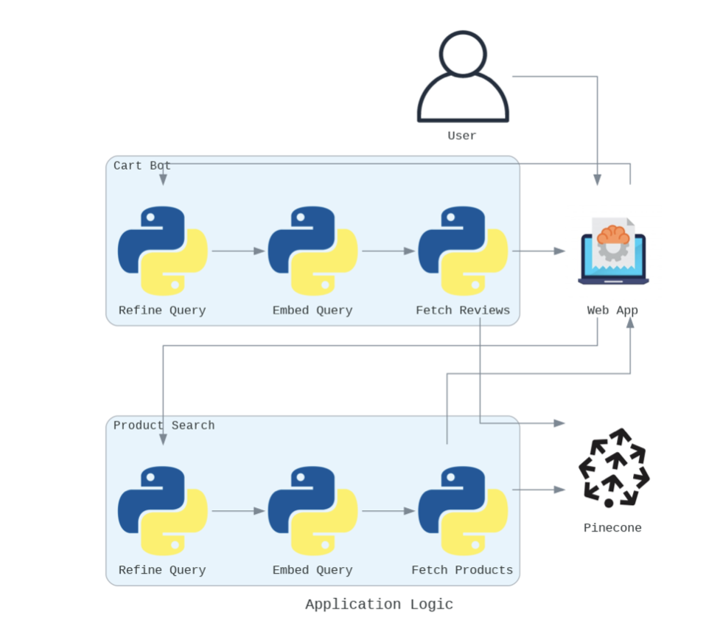
Architecture
Application Flow

Slide 11
RAG Implementation
Data processing
Extract
Collect and clean information of product from 10 different categories in amazon scrapped dataset
Collect and clean user reviews of all the above products
Clean
Preprocess the review and product info (tokenization, removing stop words, etc.)
Clean the reviews to remove offensive words without losing context

Slide 12
RAG Implementation
Embedding Generation and Indexing
Summarise
Summarise the product info of each product
Summarise the reviews in different chunks for each product
Embed and Upload to pinecone
Create dense vector representations (embeddings) for each product and review chunk
Use a pre-trained language model (e.g., BERT, RoBERTa) for embedding generation
Store embeddings alongside the metadata in pinecone

Slide 13
RAG Implementation
Query Processing
Search
Identify Category user is referring to with Text Classification model
Develop a prompt to sequentially identify and analyze key query aspects (features, occasions, sub-queries) using a step-by-step reasoning process.
Embed each refined Sub-Query with same embedding model used in data processing
Cart-Bot
Develop a prompt to identify key aspects of the query (e.g., products user is referring to based on chat history, specific features, occasions)

Slide 14
RAG Implementation
Retrieval System
Search
Use embedding of subqueries to retrieve products from pinecone.
Experiment with different similarity matching techniques to find balance between accuracy and latency
Return the retrieved products for each sub-query
CartBot
Extract summaries of reviews matching user question from Pinecone for each product in cart
Extract product summaries for each product in cart

Slide 15
RAG Implementation
Context Preparation
Search
Use product info/summary for all the products fetched in each subquery
Cart Bot
Use product summaries and matched review chunks for each product in cart.

Slide 16
RAG Implementation
Answer Generation
Search
Develop prompts that effectively combine the query, retrieved context, and desired output format to present the retrieved products for each subquery and create sales text that convinces the user that the given products match their needs for the occasion
CartBot
Develop prompts that effectively combine the query, retrieved context, and desired output format to answer user questions about products in cart

Slide 17
Testing
Review Relevance Precision:
How accurately the retrieved reviews match the specific aspects of the user's product query.
Review Coverage Recall:
The ability to retrieve a comprehensive set of reviews that cover all aspects mentioned in the user's query.
Answer Relevance:
How well the generated answer addresses the user's specific question using the information from the retrieved reviews.
Noise Robustness:
The system's ability to handle unclear, poorly worded, or off-topic queries without a significant decrease in answer quality.

Slide 18
Testing
Answer Consistency:
The degree to which ShopSmart provides consistent answers to similar queries across different sessions or users.
Answer Completeness:
The extent to which the generated answer provides all necessary information to fully address the user's query.
Factual Accuracy:
The correctness of factual information presented in the generated answers based on the available review data.
Answer Coherence:
The logical flow and overall readability of the generated answer, ensuring it's well-structured and easy to understand.

Slide 19
ShopSmart Evaluation Methodology
Test Set
1000 diverse product queries across 10 categories
10,000 associated user reviews (1000 per category)
Metric | Automated | Manual | Frequency
Review Relevance & Coverage | ✓ (NLP model) | - | All queries
Answer Relevance & Completeness | ✓ (BERT-based) | ✓ | 20% of queries
Consistency & Coherence | ✓ (Language model) | ✓ | 20% of queries
Factual Accuracy | ✓ (Cross-reference) | ✓ | 25% of queries
Noise Robustness | ✓ (Perturbed queries) | - | 25% of queries
Information Synthesis | - | ✓ (Experts) | 10% of queries

Slide 20
Future Work
Multi-modal Analysis:
Incorporate image and video review content alongside text
Develop AI models to extract insights from visual product reviews
Voice Interface:
Integrate speech recognition for voice-based queries
Develop a conversational AI interface for more natural interactions
Comparative Analysis:
Enhance the system to handle comparative queries between multiple products
Provide side-by-side feature comparisons based on user reviews

Slide 21
Key Takeaways
There's vast potential for AI in simplifying complex e-commerce decisions
Leveraging AI to transform raw user reviews into valuable shopping guidance.
Developing a robust RAG pipeline capable of handling diverse product categories and high query volumes.

