Slide 1

IIHC:2022
IIHC-2022: International Interdisciplinary Humanitarian Confe rence for Sustainability Sri Venkateshwara College of Engineering Bengaluru, India, November 18-19, 2022
Title Of Paper:
Urban Sound Classification using ANN
Presentation by,
Mahesh SP
KS Harshavardhan

Slide 2

IIHC:2022
RV College of
Engineering
Agenda
Introduction
Objectives
Dataset details
Methodology
Architecture
Novelty
Detailed results
Conclusion
Poster

Slide 3
IIHC:2022
RV College of
Engineering
Introduction
There is a good amount of research in related audio fields such as speech and music but work on Urban sound classification is scarce.
There is a plethora of real world applications for this research, such as:
• Smart home use cases such as 360-degree safety and
security capabilities
• Automotive where recognizing sounds both inside outside
of the car can improve safety.
• Industrial uses such as predictive maintenance.
• Assisting deaf individuals in their daily activities.

Slide 4
IIHC:2022
RV College of
Engineering
Objectives
To use Deep neural network model to classify the given urban sounds correctly.
To compare with Existing systems made out of Machine learning Algorithms such as Random Forest and SVM.
To train the model to classify any random urban sound file correctly.
To provide an efficient model which classifies the given urban sound accurately.

Slide 5
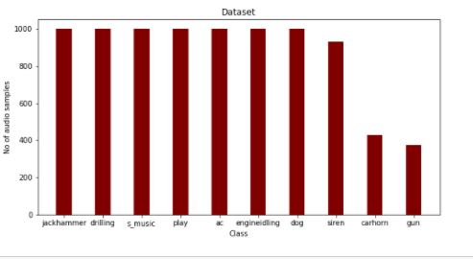
IIHC:2022
RV College of
Engineering
Dataset Details
For this we will use a dataset called Urbansound8K. The dataset contains 8732 sound excerpts (<=4s) of urban sounds from 10 classes, which are:
• Air Conditioner • Car Horn • Children Playing • Dog bark • Drilling • Engine Idling • Gun Shot • Jackhammer • Siren • Street Music

Slide 6
IIHC:2022
RV College of
Engineering
Methodology
Input Audio
Pre-processing
Extract Features(MFCC)
Evaluating the model
Building ANN model

Slide 7
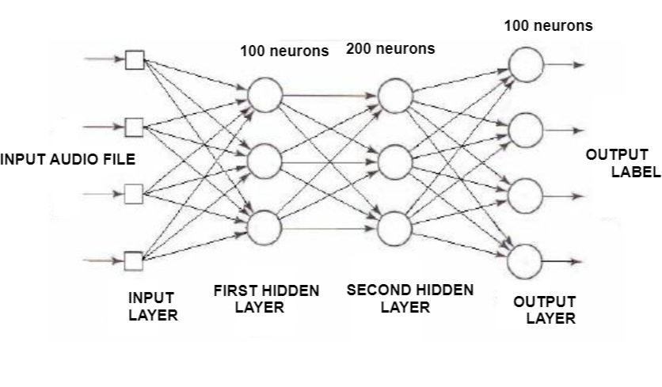
IIHC:2022
RV College of
Engineering
ARCHITECTURE
Figure 1: Detailed architecture of the proposed model

Slide 8
IIHC:2022
RV College of
Engineering
Novelty in the project
MFCC technique was used for feature extraction.
The model was built using Deep neural network(ANN)
It was previously observed, that it is difficult to classify the difference between some of the classes. In particular, the following sub-groups which are similar in shape.
• Repetitive sounds for air conditioner, drilling.
• Sharp peaks for dog barking and gun shot.
• Similar pattern for children playing and street music.
The classifier performs well with new audio data.

Slide 9
IIHC:2022
RV College of
Engineering
Detailed results
In our initial attempt, we were able to achieve a Classification Accuracy score of:
• Training data Accuracy: 75.3%
• Testing data Accuracy: 73%
Later accuracy improved on doing Hyperparameter tuning.
Many evaluation metrics were used like classification accuracy, confusion matrix, classification report

Slide 10
IIHC:2022
RV College of
Engineering
Detailed results
Model was validated using k-fold cross validation technique.
Again the model was validated using a sample of various copyright free sounds that were not part of either our test or training data.
Algorithms | Accuracy
SVM | 68%
Random Forest | 66%
Proposed model | 89%

Slide 11
IIHC:2022
RV College of
Engineering
Conclusion
An efficient and robust model was built using deep learning techniques.
The model overcame many of the limitations in the existing systems.
The final model performs well when presented with a new .wav file with a duration of a few seconds and returns a reliable classification.
There is still scope for improvement in our model in differentiating slightly similar sounds like “Drilling” and “Jackhammer”

Slide 12


