Slide 1
Retail Sales Report (SQL) Analyzing monthly & regional sales trends using SQL
Sql project for data analytics

Slide 2
Slide 2 – Project Overview
Objective:
Analyze retail sales data to identify top-performing regions, categories, and monthly trends.
Support business strategy with data-driven insights.
Tools Used:
MySQL Workbench – SQL Queries

Slide 3
Dataset Description
Database: retail_sales_db
Tables:
customers – Customer details
products – Product details
regions – Region mapping
sales – Sales transactions

Slide 4
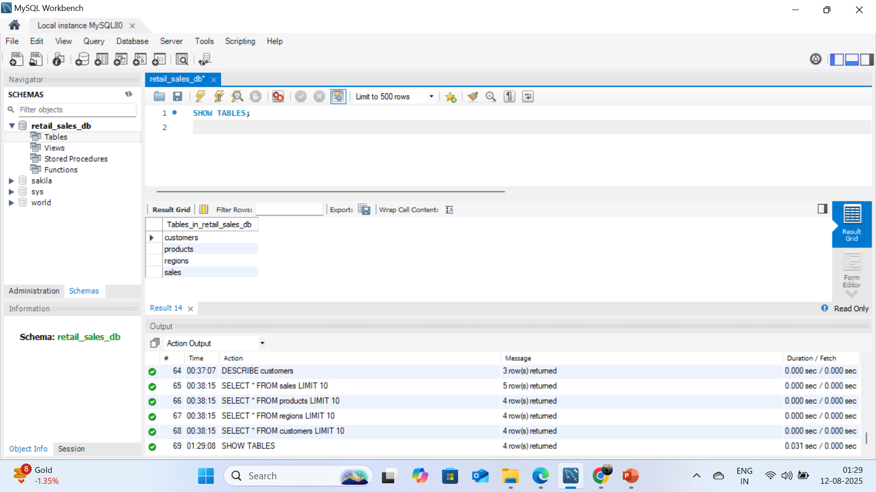

Slide 5
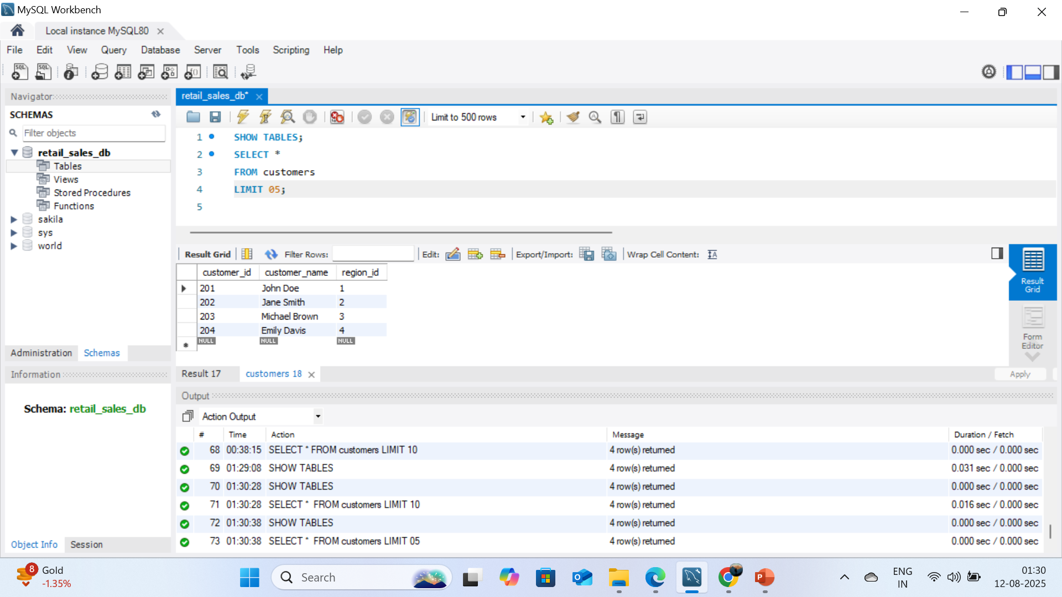

Slide 6
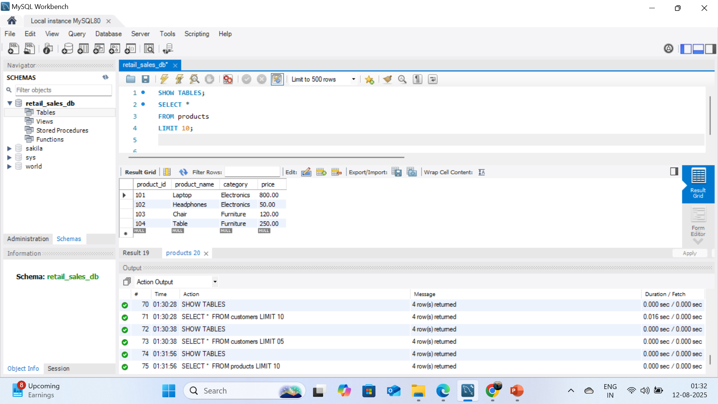

Slide 7
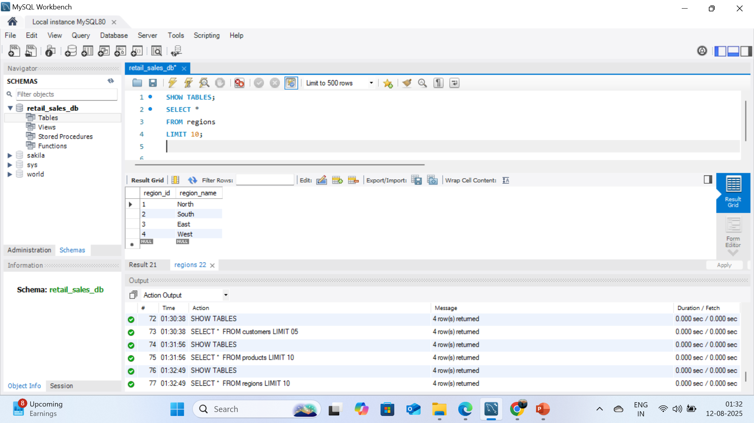

Slide 8
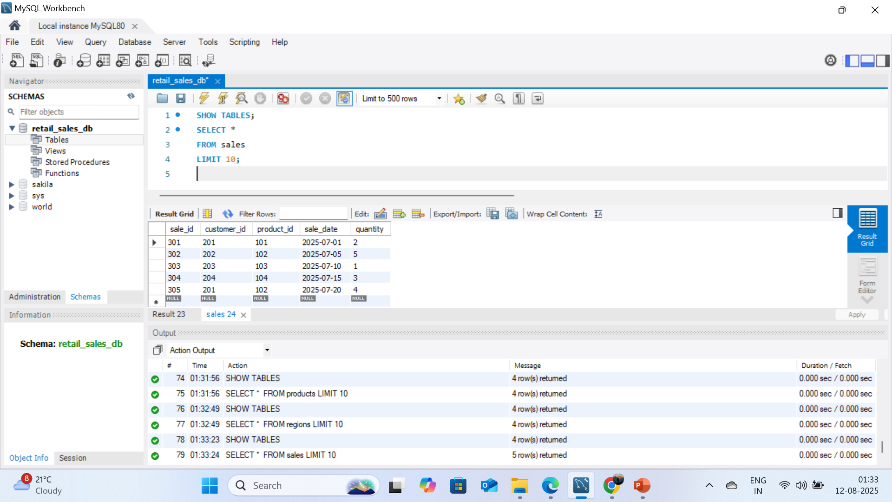

Slide 9
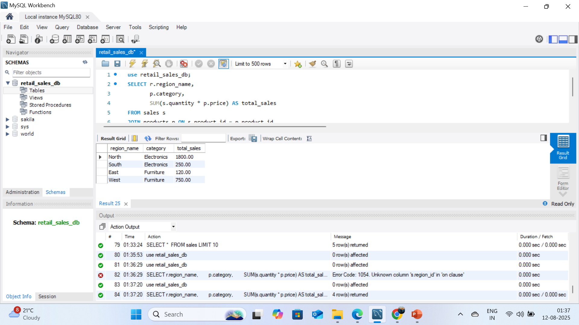
Query 1: Sales by Region & Category
SELECT r.region_name,
p.category,
SUM(s.quantity * p.price) AS total_sales
FROM sales s
JOIN products p ON s.product_id = p.product_id
JOIN customers c ON s.customer_id = c.customer_id
JOIN regions r ON c.region_id = r.region_id
GROUP BY r.region_name, p.category;

Slide 10
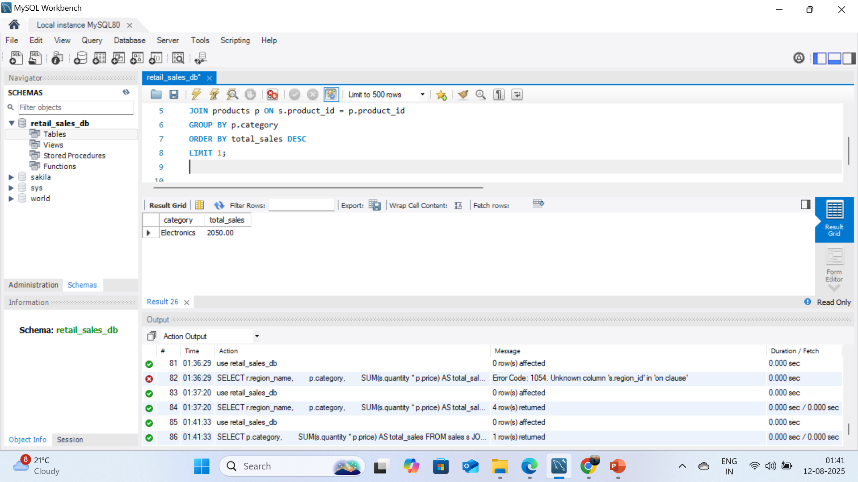
Query 2: Top Category Overall
SELECT p.category,
SUM(s.quantity * p.price) AS total_sales
FROM sales s
JOIN products p ON s.product_id = p.product_id
GROUP BY p.category
ORDER BY total_sales DESC
LIMIT 1;

Slide 11
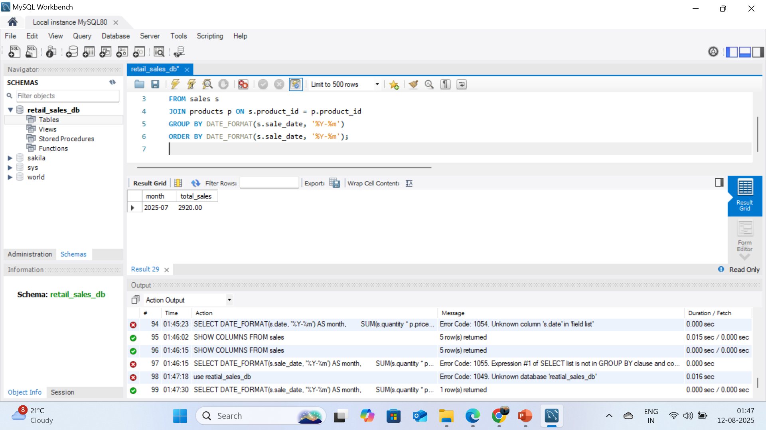
Query 3: Monthly Sales Trends
SELECT DATE_FORMAT(s.sale_date, '%Y-%m') AS month,
SUM(s.quantity * p.price) AS total_sales
FROM sales s
JOIN products p ON s.product_id = p.product_id
GROUP BY DATE_FORMAT(s.sale_date, '%Y-%m')
ORDER BY DATE_FORMAT(s.sale_date, '%Y-%m’);

Slide 12
Key Insights
Top Region: North (INR 1800 revenue in Electronics)
Best Category: Electronics dominates overall sales share.
Monthly Trend: Sales peak during July & November → Seasonal promotions.

Slide 13
Conclusion
SQL helped uncover sales performance patterns.
Insights can guide inventory planning, promotions, and regional targeting.
Future scope: Predictive sales modeling & automated dashboards.

Slide 14
Thank
You

