Slide 1








PCA-based player rankings for fair and effective base price hikes in IPL auctions
By- Mahesh, Akanksha
IMARTICUS, Pune

Slide 2
Introduction
Cricket is very old and world wide spread game.
In 19th and 20th centuries it developed globally and yet the most popular game in the world.
In 2008 IPL was founded by the Board of Cricket (BCCI) in India.
Indian Premier League (IPL) is a professional Twenty20 championship cricket league in India and it become very popular all cricket fans worldwide.

Slide 3
OBJECTIVE
“To rank the Batsman, Bowlers and All rounders who played in the Previous seasons of the IPL according to their Performance for Next year Auctions using PCA ”

Slide 4
PROCESS FLOW
DATA COLLECTION
(2 Days)
DATA PRE-PROCESSING
(3 Days)
DATA VISUALIZATION
(EDA)
(5 Days)
APPLYING PCA ALGORITHM
(2 Days)
CONCLUSION AND SUGGESTIONS
(1 Day)
READING RESEARCH PAPERS
(2 Days)

Slide 5




TOOLS AND PLATFORM USED
Tools : Python, Tableau
Platform : Jupyter Notebook
Library Used : Scikit-learn

Slide 6
CHALLENGES
In original dataset all the data of Bowlers, Batsman and All Rounders was mixed so, For my project I separate the Data and Analyzed Further for each Category of Players.

Slide 7
DATA DESCRIPTION
Source of the data – www.kaggle.com (This is an unsolved data)
BATSMEN
Name | Name of the Batsman
Runs | Total runs made by Player in entire one Season
Highest | Highest Runs made by Player in any Match
Average | Average Runs in season = (Total Runs/no. of matches)
Batting Strike Rate | Strike rate = (Runs Scored / Balls faced) * 100
Fifties | How many time Player made fifty runs
Fours | Total no. of Boundries hit by a Player
Sixes | Total no. of Sixes hit by a Player
BOWLERS
Name | Name of the Bowler
Wickets | Total no. of Wickets Taken by a Player
Economy | The average number of runs Player have conceded per over bowled
Bowling Average | No. of runs Player conceded/ No . Of Wickets taken by Him
Bowling Strike Rate | The average number of balls bowled per wicket taken

Slide 8
ALL-Rounders
Name | Name of the Player
Runs | Total runs made by Player in entire one Season
Highest | Highest Runs made by Player in any Match
Average | Average Runs in season = (Total Runs/no. of matches)
Batting Strike Rate | Strike rate = (Runs Scored / Balls faced) * 100
Fifties | How many time Player made fifty runs
Fours | Total no. of Boundries hit by a Player
Sixes | Total no. of Sixes hit by a Player
Wickets | Total no. of Wickets Taken by a Player
Economy | The average number of runs Player have conceded per over bowled
Bowling Average | No. of runs Player conceded/ No . Of Wickets taken by Him
Bowling Strike Rate | The average number of balls bowled per wicket taken

Slide 9
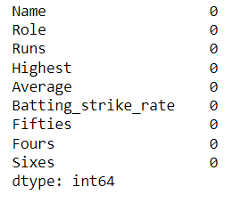
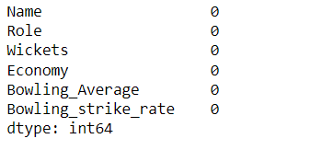
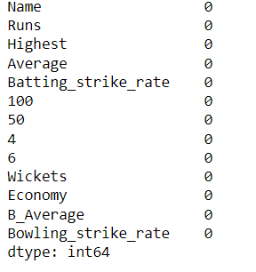
EXPLORATORY DATA ANALYSIS
OUTLIERS
In PCA algorithm we first Scale the data by Standard Scaling Method or
Min Max scaler.
BATSMEN
BOWLERS
ALL-ROUNDERS
THERE IS NO MISSING VALUES IN DATA

Slide 10
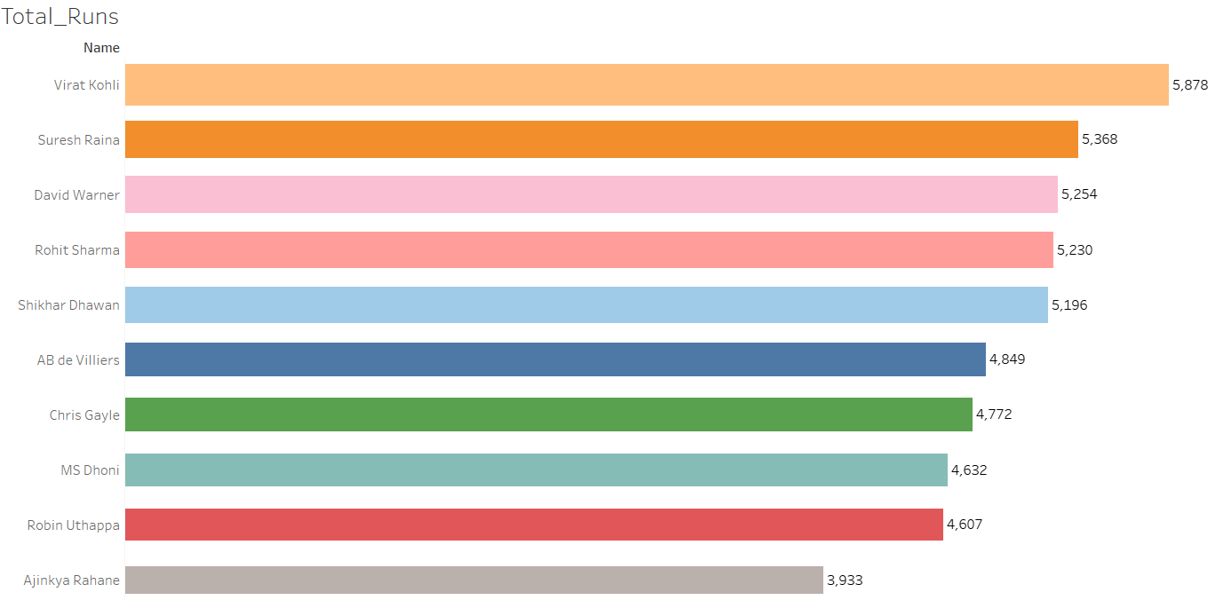
Performance of Batsmen

Slide 11
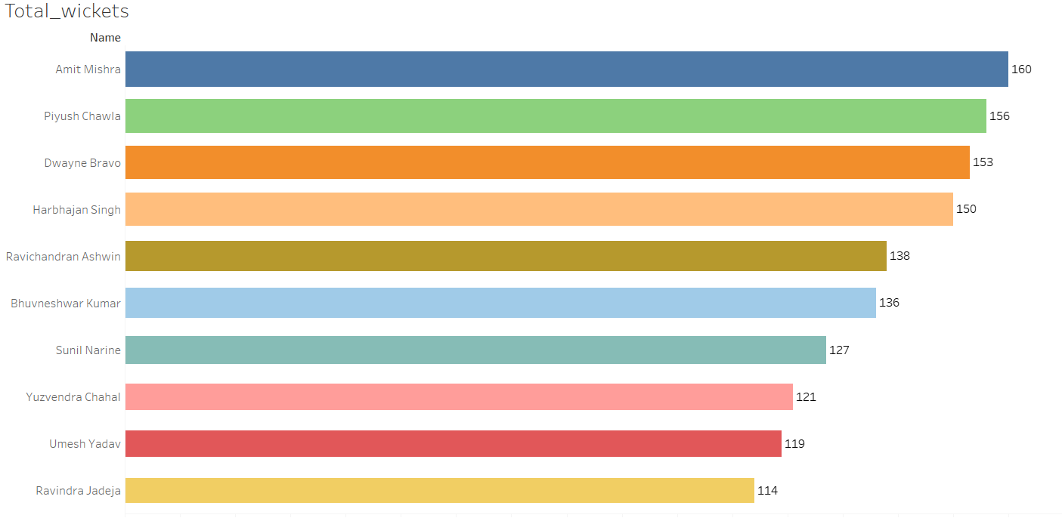
performance of bowlers

Slide 12
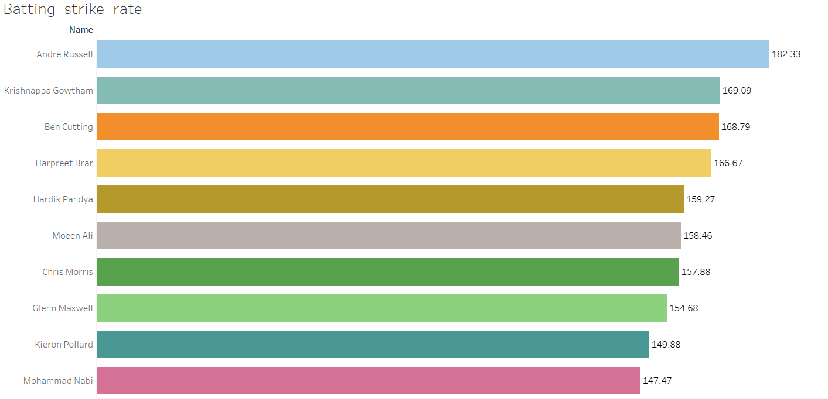
PERFORMANCE OF ALL-ROUNDERS WITH RESPECT TO BATTING STRIKE RATE

Slide 13
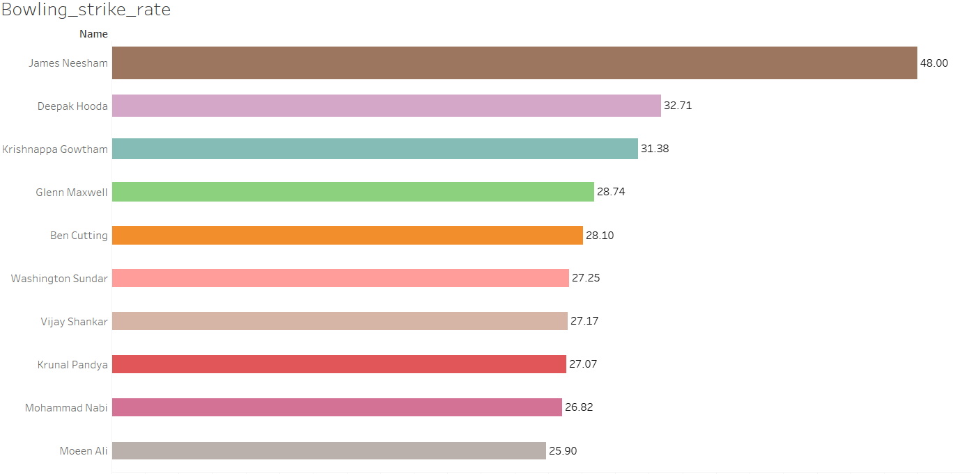
PERFORMANCE OF ALL-ROUNDERS WITH RESPECT TO BOWLING STRIKE RATE

Slide 14
Principal component analysis
Principal component analysis, or PCA, is a Dimensionality-reduction method that is often used to reduce the dimensionality of large data sets, By transforming a large set of variables into a smaller one that still contains most of the information in the large set.
PROCESS OF PCA
Correlation Matrix(To check multi-collinearity in Data)
Calculating Eigen Value(To find no. of PCs) and Eigen Vector.
Calculating Data explained by PCA.

Slide 15
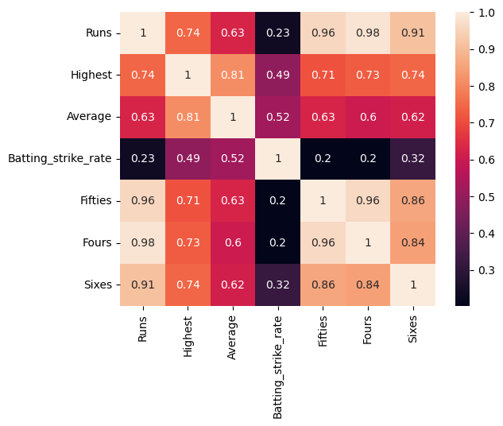
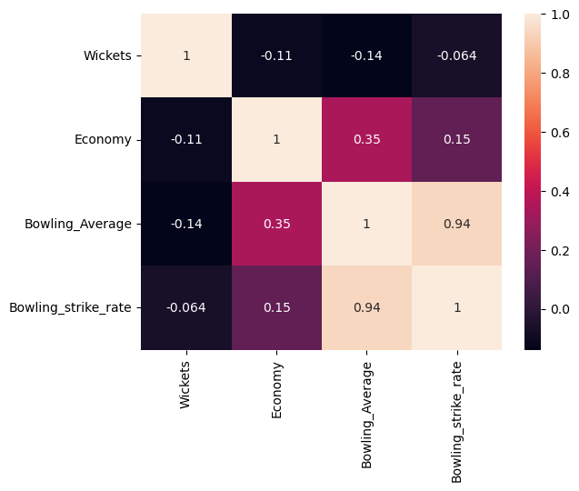
1. CoRRELATION matrix
Batsmen
Bowlers
HEATMAP is a graphical representation of data that uses a system of color-coding to represent Correlations.

Slide 16
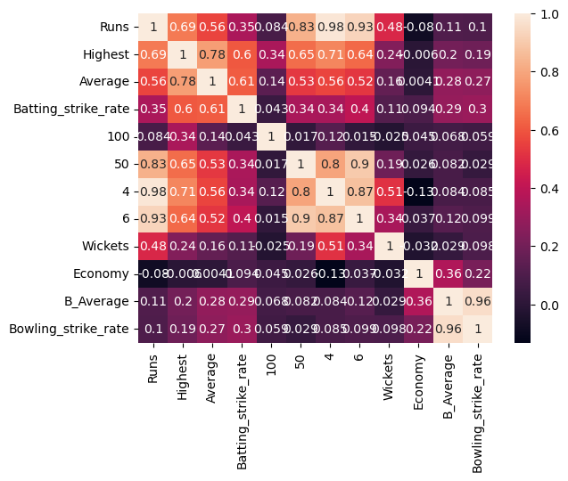
ALL-ROUNDERS

Slide 17
2. EIGEN VALUES AND EIGEN VECTORS
Eigen values are coefficients applied to eigenvectors that give the vectors their length or magnitude
Eigen values (Batsman)- [5.133, 1.147, 0.393]
Eigen values (Bowlers)- [2.11, 1.02, 0.88]
Eigen values (All-Rounders)- [5.366, 2.253, 1.219, 0.892]
We form PCs until Eigen value comes smaller than 1.
So we are going to form 2 PCs for Batsmen and Bowlers and
3 PCs for All-Rounders.

Slide 18


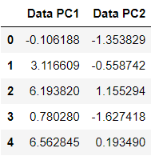
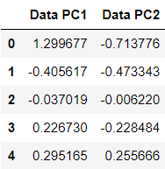
DIMENSION REDUCTION
Batsmen
Bowlers

Slide 19

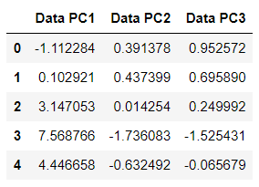
All-Rounders

Slide 20
3. EXPLAINED VARIANCE
The Explained Variance explains how much Variance can be attributed to each of Principal Component.
Threshold of explained variance is more than 60% .
For Batsmen Data Explained variance for First Principal Component is 73% and for second Principal Component 16% .
Overall it is 89%.
For Bowlers Data Explained variance for First Principal Component is 52% and for second Principal Component 25% .
Overall it is 77%.
For All-Rounders Data Explained variance for First Principal Component is 44% , for second Principal Component 18%
and for Third Principal Component is 10%
Overall it is 72%.

Slide 21

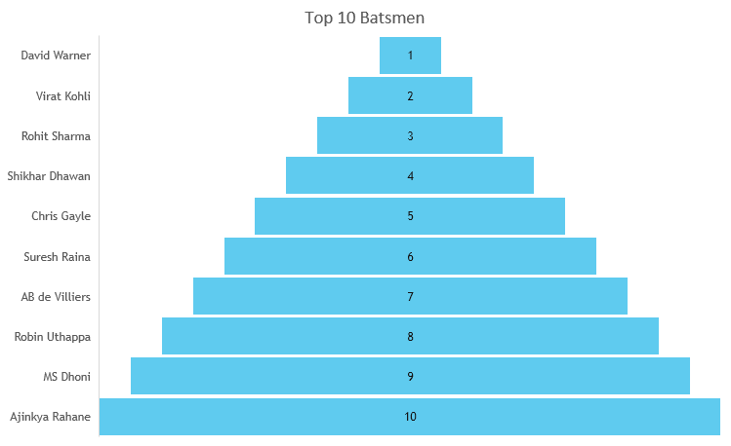

Output AS RANKINGS
These are the Top 10 Players according to their Performance in Previous Season.
Ranking is based on Eigen Vectors . By adding Eigen Vectors (Row-wise) of all Principal components and by arranging them into Decreasing order.

Slide 22
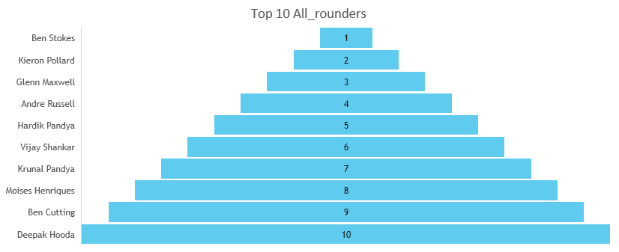
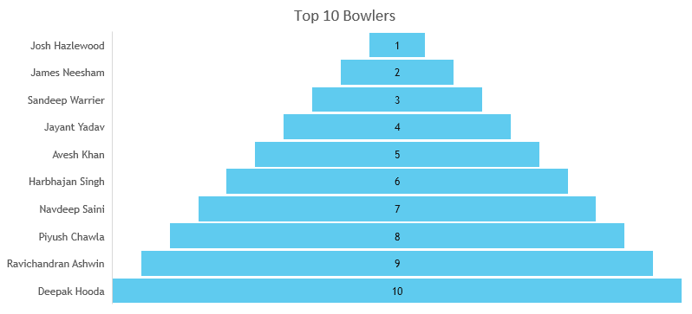

Slide 23
conclusion
The Highest Total runs made by Virat Kohli, Suresh Raina and David Warner .
Most Wickets are taken by Amit Mishra , Piyush Chawla and Dwayne Bravo .
The all-rounder with Highest Batting strike rate are Andre Russel and Krishnappa Gowtham.
The all-rounder with Highest Bowling strike rate is James neehsam and Deepak Hooda.

Slide 24
Franchise can select best players for their teams and can increase their chances to winning the IPL.
Compared Year-on-Year Auction Price of Top 10 Player & suggestions for Next year same Ratio hike for these Players.
SUGGESTIONS TO THE BUSINESS
For example
Year | Base-Price | Ratio of Hike | Selling price | Ratio of Hike in Selling Price
2016 | 1 cr 2 lakh 50 thousand | 0.5% | 12 cr | 4.17%
2017 | 1 cr 3 lakhs | 0.5% | 12 cr 50 lakhs | 4.17%
2018 | 1 cr 7 lakhs | 0.39% | 17 cr | 36%
2019 | 1 cr 8 lakhs | 0.9% | 17 cr | 0.000%
2020 | 1 cr 9 lakhs | 0.9% | 17 cr 50 lakhs | 2.9%

Slide 25
Improvements
PCA Algorithm Has some drawback
1. It gives higher important to PC1 as compared to PC2
2. Most of a Variable will go in PC1
Tackle Drawback as refer for Research paper is Factor Analysis.
Factor Analysis give equal important to Every Factor
It assumes that each observed variable is influenced by a set of underlying factors and that these factors are responsible for the observed correlations among the variables.

Slide 26
LEARNINGS
My learnings by doing this Project is “How can we apply Machine Learning Algorithms on real world Data and can improve the Business and can solve Business Problems”.
PCA concept
Problem solving ability and Time management skills.

Slide 27
REFERENCES - Research paperS
Application of Principal Component And Factor Analysis to Cricket Data by Alanya.P. Register No.CCATMST003 Duckworth, F. C., & Lewis, A.J. (2004). A successful operational research intervention in one-day cricket. Journal of the Operational Research Society, 55, pp. 749–759
Fernando, M., Manage, A.B.W., & Scariano, S. (2013). Is the home-field advantage in limited overs one-day international cricket only for day matches? South African Statistics Journal, 47, pp. 1–13
Lemmer, H.H. (2013). Team selection after a short cricket series. European Journal of Sport Science, 13, pp. 200–206

Slide 28
THANK you

