Slide 1
By- Mahesh Thube
PGA-35
IMARTICUS
COTTON LEAF DISEASE PREDICTION

Slide 2
Introduction
Cotton is a soft, fluffy, natural fiber that grows around the seeds of the cotton plant.
Cotton is grown in warm and humid regions around the world, with the largest producers being China, India, and the United States.
The plant requires a lot of sunshine, moderate rainfall, and well-drained soil to grow properly.
Cotton plants can be affected by several types of diseases, which can have a significant impact on their growth and yield

Slide 3
OBJECTIVE
“To develop a CNN-based model that accurately detects and classifies cotton leaf diseases based on images of the plants.”

Slide 4
PROCESS FLOW
DATA COLLECTION
MODEL ARCHITECTURE
MODEL TRAINING
IMAGE PRE-PROCESSING
VALIDATION AND TESTING
MODEL EVALUATION
CONCLUSION AND IMPROVEMENTS

Slide 5






TOOLS AND PLATFORM USED
Tools : Python
Platform : Jupyter Notebook
Library Used : Numpy, Pandas, matplotlib, TensorFlow,Open-CV,
Keras

Slide 6
Source of the data – www.kaggle.com
DATA DESCRIPTION
Bacterial-blight | 0
Curl-virus | 1
Fusarium-wilt | 2
Healthy | 3

Slide 7
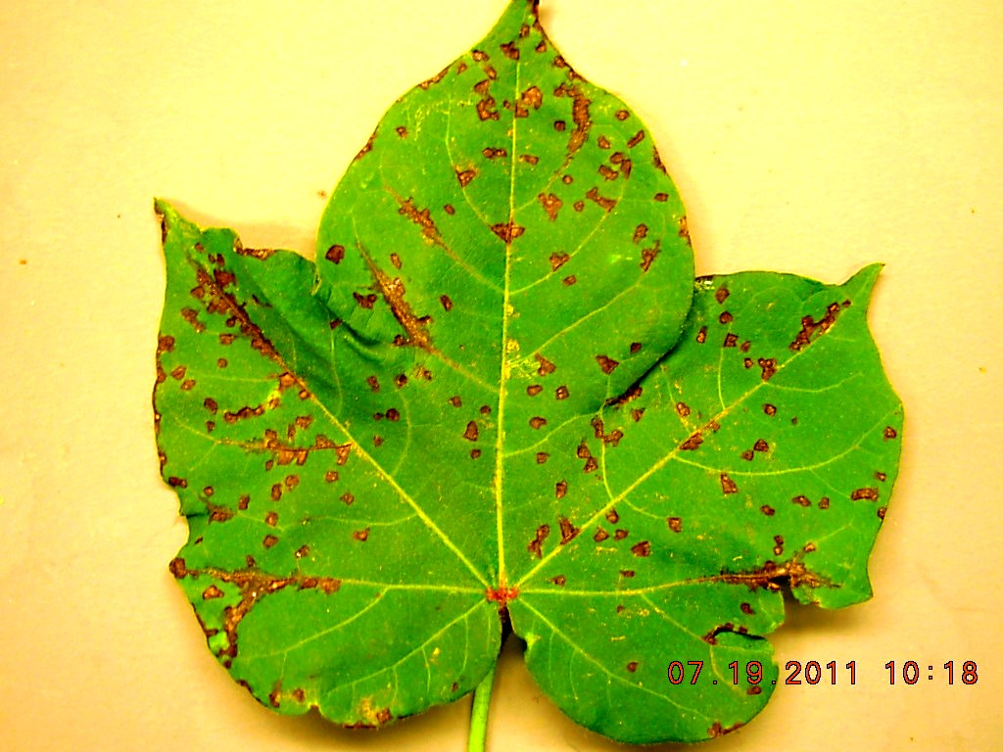
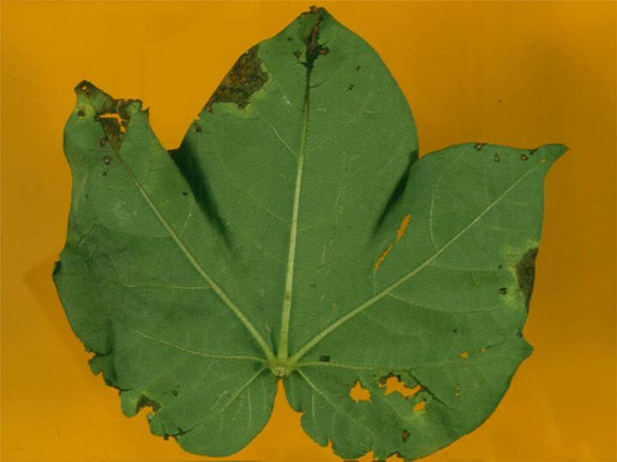
Bacterial-blight DISEASE
This disease causes angular leaf spots that turn brown or black, and can eventually cause defoliation and yield loss.

Slide 8
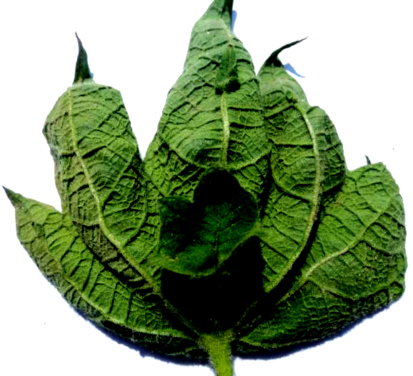
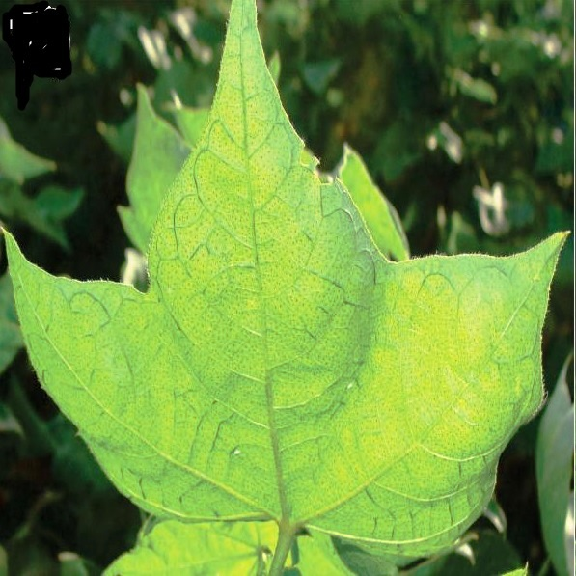
Curl-virus
It is caused by a group of viruses in the family Geminiviridae and is transmitted by the whitefly Bemisia tabaci.
Symptoms are:- Leaf curling, yellowing

Slide 9
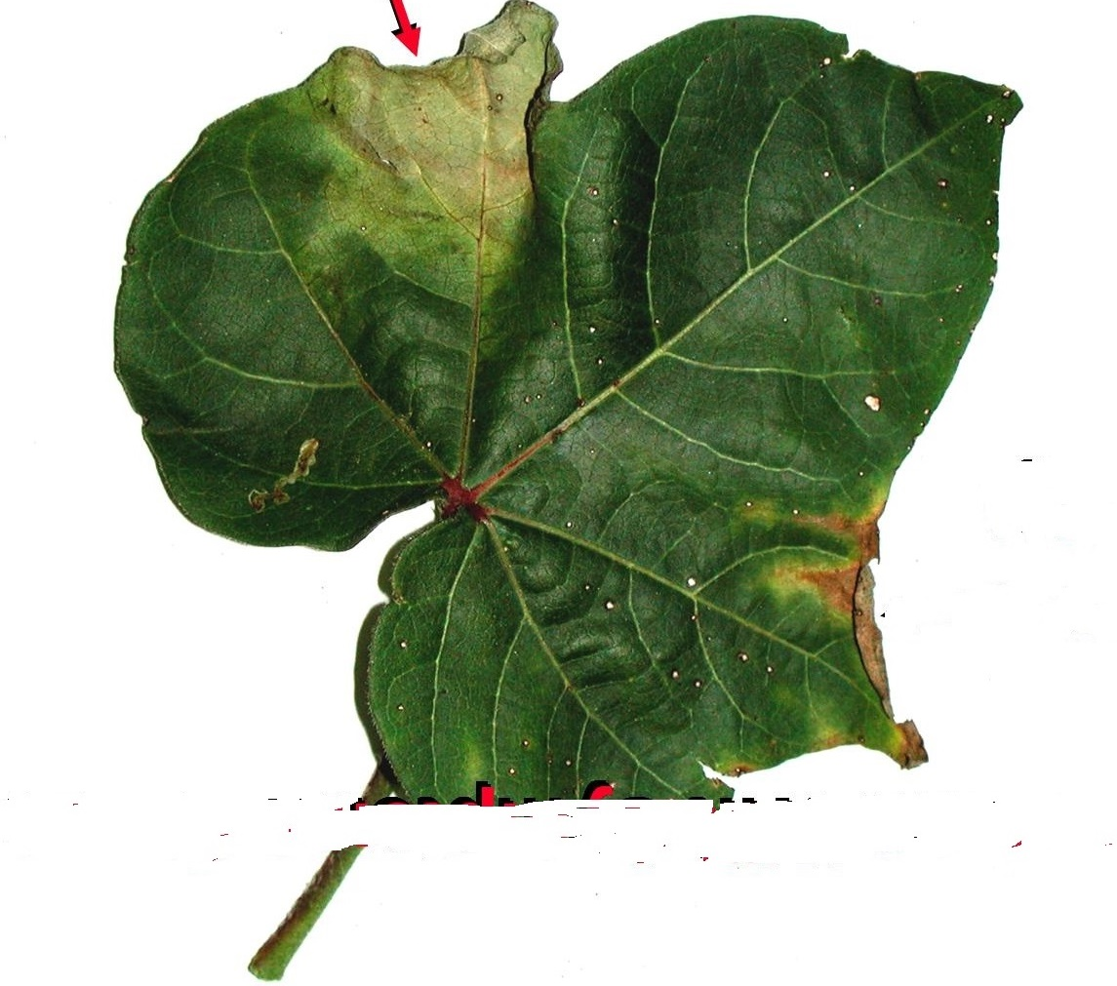
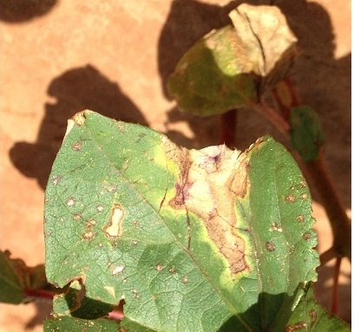
Fusarium-wilt
This soil-borne fungus can cause wilting, yellowing, and eventual death of the plant, and can be difficult to control once it has become established in a field

Slide 10
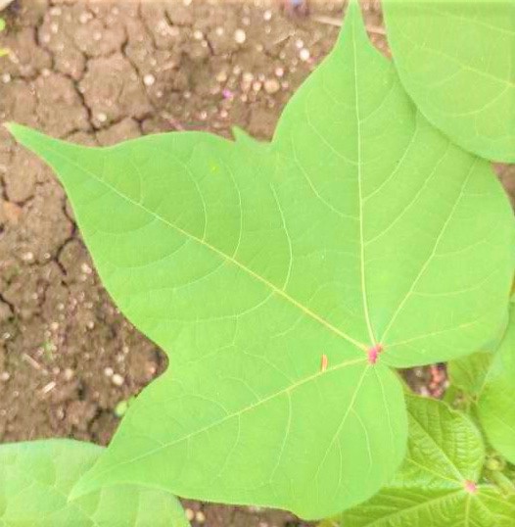
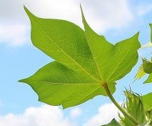
Healthy LEAF
The leaves of a healthy cotton plant are typically a dark green color, indicating that the plant is producing chlorophyll and undergoing photosynthesis.

Slide 11
MODEL ARCHITECTURE
CONOVOLUTIONAL LAYER
Convolution is a mathematical operations that is used in single processing to filter patterns in signals.
In a convolutional layer, all neurons apply Convolution operation to the inputs, hence they are called convolutional neurons.
RELU LAYER
It simply returns the input if it is positive, and zero otherwise
Pooling layer
Pooling layer function is to progressively reduce the spatial size of representation to reduce the amount of parameter and computation in the network – control overfitting and shortens the training time.
There are different types of pooling:-
Max_pooling
Average_pooling
Sum_pooling

Slide 12
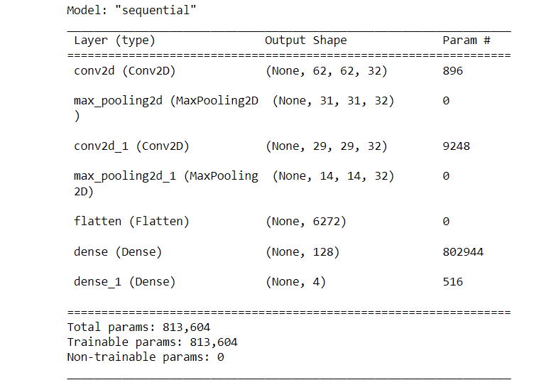
Flatten LAYER
To convert our 3D data to 1D , because Fully connected layer can only accept 1D data
fully connected layer
This layer receives an input vector and produces a new output vector, it applies a linear combination and then possibly an activation function to the input value received.
MODEL SUMMARY
OPTIMIZER= “adam”
LOSS= “categorical_crossentropy”
BATCH_SIZE= 32

Slide 13
IMAGE pre-processing
DATA PARTITION
DATA(100%)
410 IMAGES OF EACH CLASS
TRAIN(70%)
328 IMAGES OF EACH CLASS
TEST(30%)
82 IMAGES OF EACH CLASS
DATA NORMALIZATION
Normalizing the pixel values of the input image.
IMAGE RESIZING
The images need to be resized to a specific size to fit the input shape of the CNN model.

Slide 14
TRAIN_SET
rescale = 1./255,
TEST_SET
shear_range = 0.2,
zoom_range = 0.2
target_size = (64, 64),
batch_size = 32,
class_mode = ‘categorical’
rescale = 1./255,
shear_range = 0.2,
zoom_range = 0.2
target_size = (64, 64),
batch_size = 32,
class_mode = ‘categorical’

Slide 15
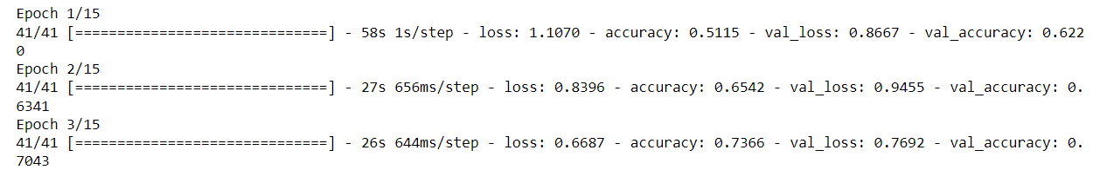
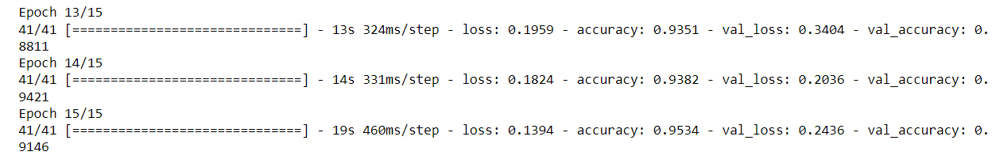
MODEL TRAINING AND EVALUATION
Model training with 15 epochs(iterations)
.
.
.
FINAL ACCURACY : 95.34%

Slide 16
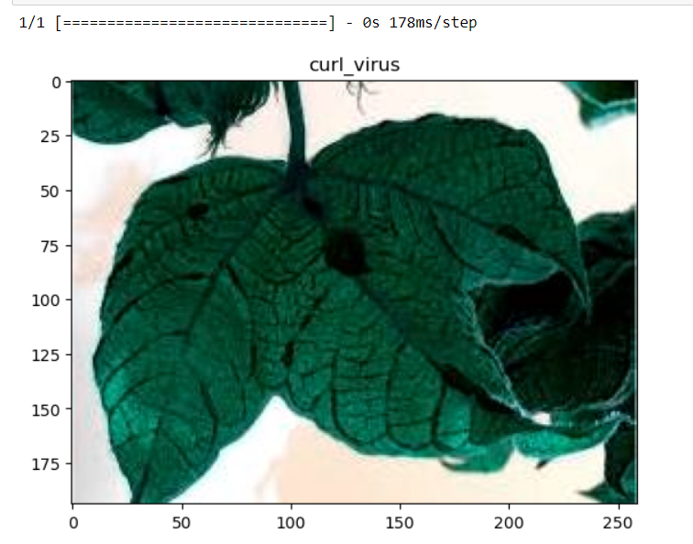
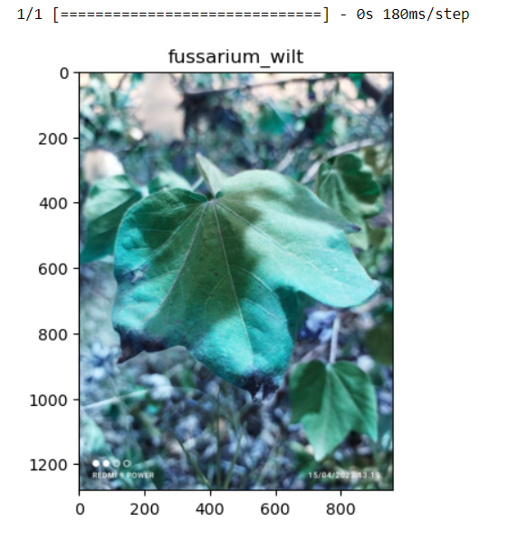
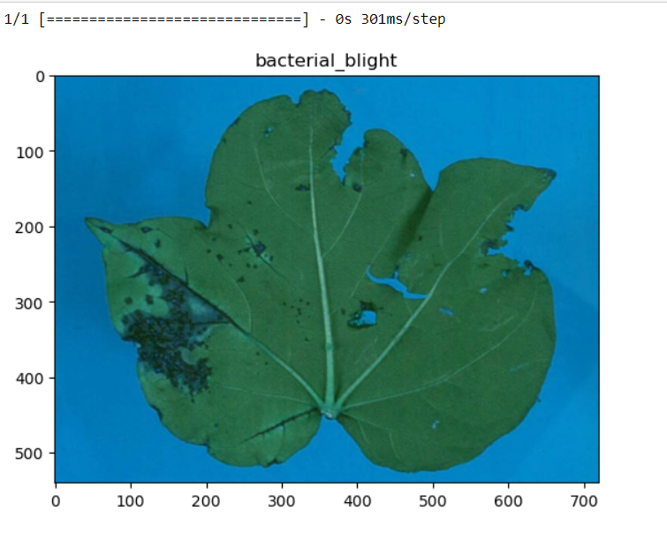
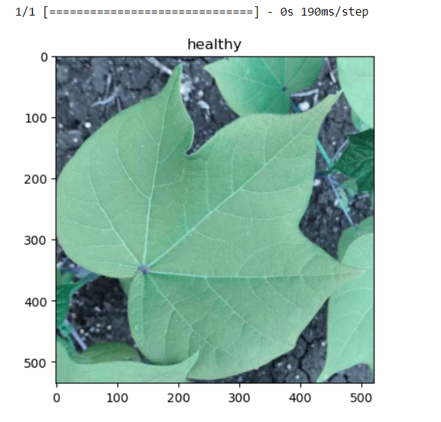
TESTING THE MODEL ON LIVE DATA
OUTPUT

Slide 17
CONCLUSION
MODEL is predicting correct disease of cotton leaf.
Model accuracy is 95.34% .
(CNN) is the most commonly used neural network model for Automatic detection of plant diseases and it would solve the matter of pricey domain professional.
Detection of plant diseases in early stage would facilitate farmers to boost the crop yield, that successfully improves country’s gross domestic product.

Slide 18
IMPROVEMENTS
We can deploy the model by making mobile application in which this model work and detect the disease of any plant.
Not only detecting app can suggest medicines or pests to be used by farmer so that they can prevent the disease at early stage.

Slide 19
REFERENCES
A sturdy Deep-Learning-Based Detector for Real-Time Tomato Plant Diseases and Pests Recognition , Alvaro Fuentes 1, Sook Yoon 2,3, Sang Cheol Kim 4 and Dong Sun Park Sensors 2017, 17, 2022.
Deep Neural Networks Based Recognition of Plant Diseases by Leaf Image Classification Dubravko Culibrk,2 and Darko Stefanovic1 Hindawi Publishing Corporation Computational Intelligence and Neuroscience Volume 2016, Article ID 3289801
Thomson L.J., Macfadyen S., Hoffmann A.A. Predicting the effects of climate change on natural enemies of agricultural pests. Biol. Control. 2010;52:296–306. doi: 10.1016/j.biocontrol.2009.01.022

Slide 20
THANK you

