Slide 1
Overview of Swagger API

Slide 2
What is Swagger API?
Definition:
Swagger is the most popular tool for designing, building and documenting RESTful APIs
Notes:
Official Definition :
easy to create Spring Application –
Started off as a dependency injection framework but over the time grown to be a huge framework providing solutions for multiple common concerns.
Multiple setup steps and configuration steps.
No starting point, you have to figure out on your own.
Spring boot abstracts all these pain points and makes it easy to get started with the application.
Stand-alone – runs on its own
Production grade – Not just hello world. Creates an application that can actually deployed to production
Just run – lets say what is required to bootstrap a spring web application. At the bare minimum, you would require
A project structure, complete with a Maven build file including required dependencies. At the very least, you’ll need Spring MVC and the Servlet API expressed as dependencies.
A web.xml file (or a WebApplicationInitializer implementation) that declares Spring’s DispatcherServlet.
A Spring configuration that enables Spring MVC.
A controller class that will respond to HTTP requests with “Hello World”.
A web application server, such as Tomcat, to deploy the application to.
But with Spring boot you can just bootstrap an application and just run it to see it in action.

Slide 3
Integration Swagger with Spring Boot
Notes:
requirements
bootstrapping a project

Slide 4
Requirement
To use it in conjunction with Spring we need to add following two dependencies to Maven pom.xml
<dependency>
<groupId>io.springfox</groupId>
<artifactId>springfox-swagger2</artifactId>
<version>2.6.1</version>
</dependency>
<dependency>
<groupId>io.springfox</groupId>
<artifactId>springfox-swagger-ui</artifactId>
<version>2.6.1</version>
</dependency>

Slide 5
Configuration options
Configure Swagger by enable the @EnableSwagger2 annotation on the main class or config class.
Docket is a plugin which is used to document Restful APi service.
RequestHandlerSelectors and PathSelectors configure the predicates for selection of RequestHandlers.
ApiInfo() method is used to set properties like title, author and description.

Slide 6
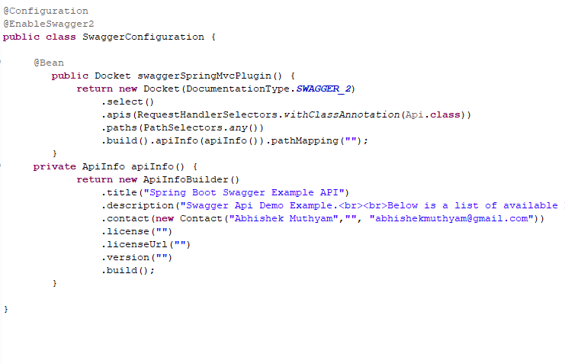

Slide 7
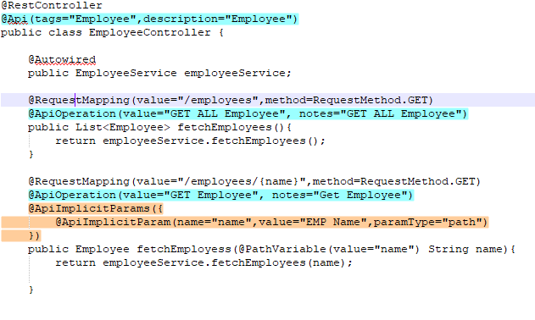

Slide 8
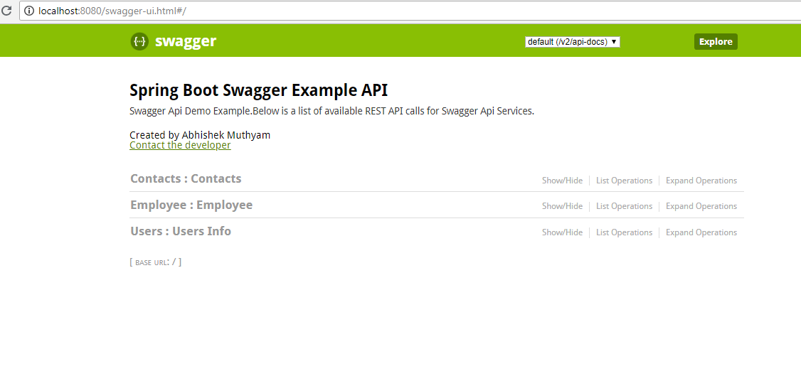
Swagger UI
Notes:
lets do it manually and see whats really going on

Slide 9
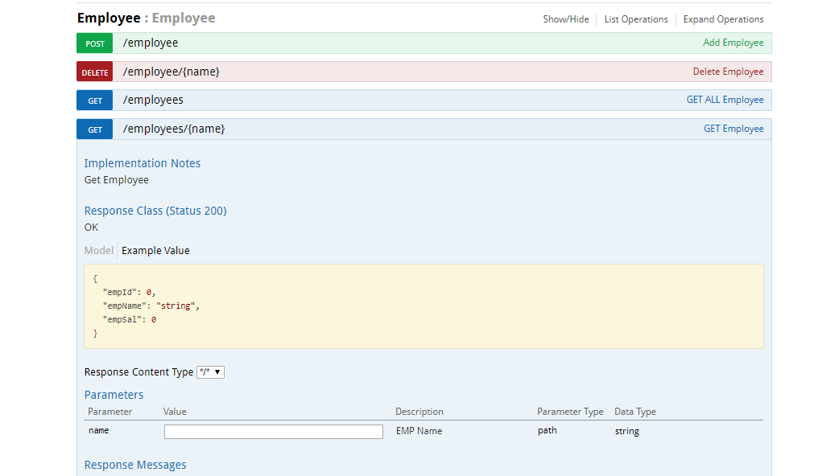
RestFull Services in Swagger UI
Notes:
This example shows you creating a contacts-api project

Slide 10
THANKS

