Slide 1
Selenium

Slide 2
Selenium WebDriver Theme
Keep the costs down.
Emulate the user.
Prove the drivers work…
…but you shouldn't need to understand how everything works.
Lower the bus factor.
Have sympathy for a Javascript implementation.
Every method call is an RPC call.
We are an Open Source project.

Slide 3
Complexity to Easy consider the following methods from the original Selenium API, each of which can be used to set the value of an input element:
Type
typeKeys
typeKeysNative
keypress
keyup
keydownNative
keypressNative
keypressNative
keyupNative
attachFile
Keysdown
Here's the equivalent in the WebDriver API:
sendKeys

Slide 4
Layers & JavaScript
WebDriver
Selenium Core
ATOMS
Closure Library

Slide 5
Upgrades
Originally Core and WebDriver had many areas of congruent code
FirefoxDriver.prototype.getElementAttribute =
function(respond, parameters) {
var element = Utils.getElementAt(parameters.id,
respond.session.getDocument());
var attributeName = parameters.name;
respond.value = webdriver.element.getAttribute(element, attributeName);
respond.send();
};

Slide 6
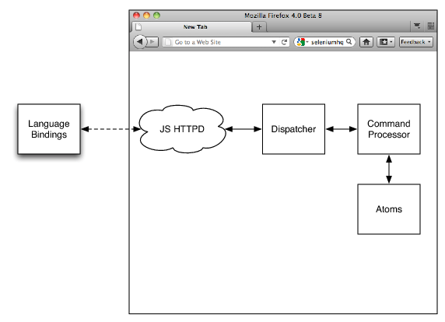
Firefox Architecture

Slide 7
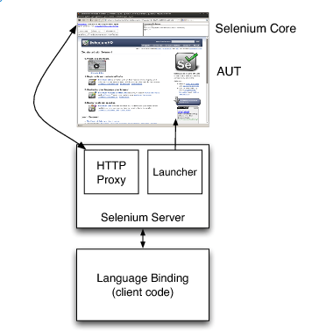
Selenium RC's Architecture

Slide 8
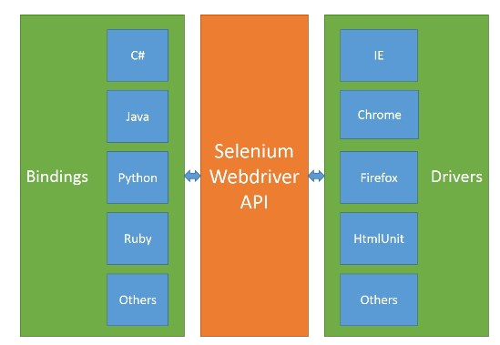
Selenium WebDriver Architecture

Slide 9
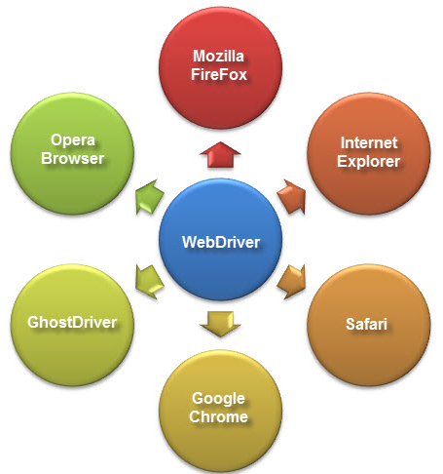
Final Output

