Slide 1
Why are we here?

Slide 2
Does your organization currently test APIs?

Slide 3
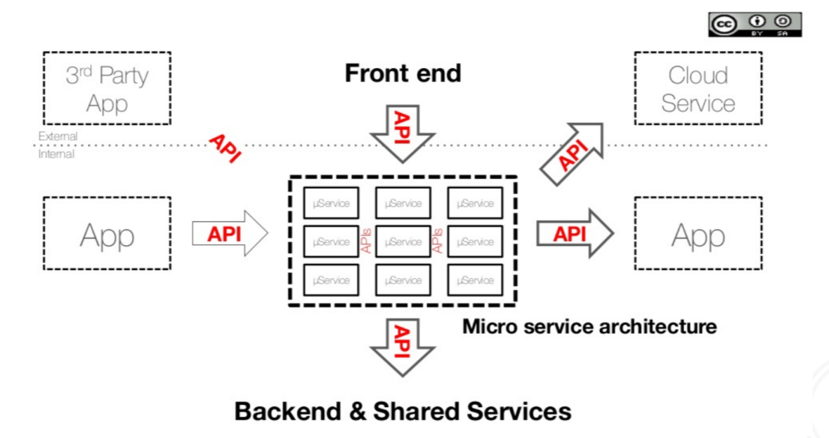
What is API?

Slide 4
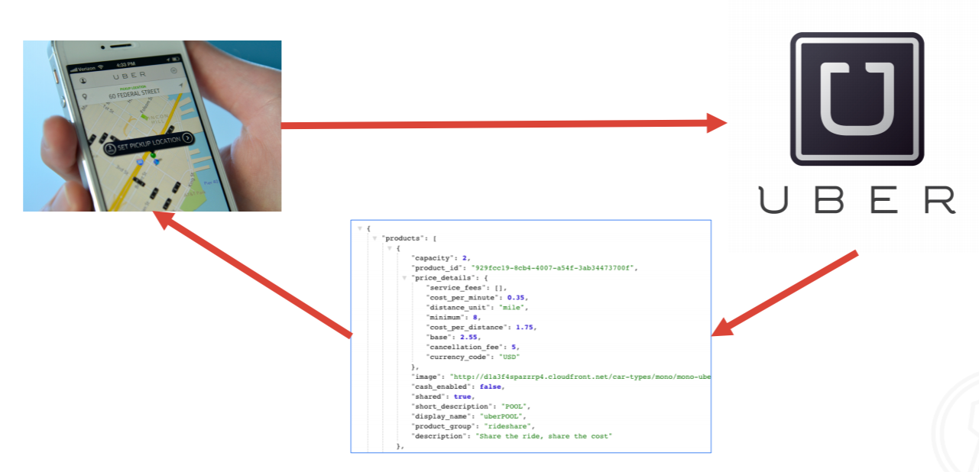
Simple

Slide 5
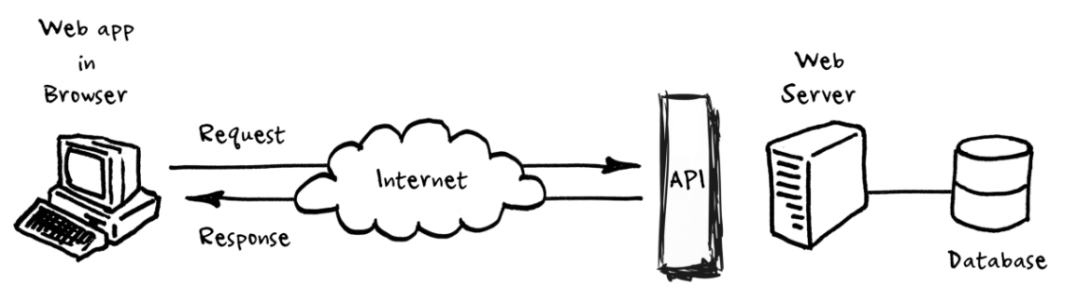
An API is a set of programming code that enables data transmission between one software product and another. It also contains the terms of this data exchange.

Slide 6
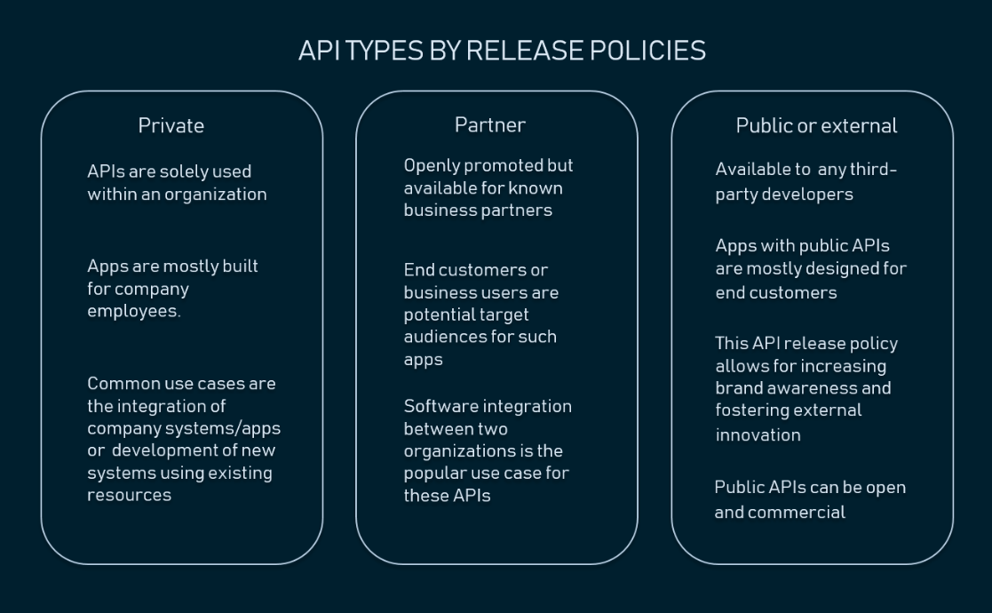
Types of API’s

Slide 7
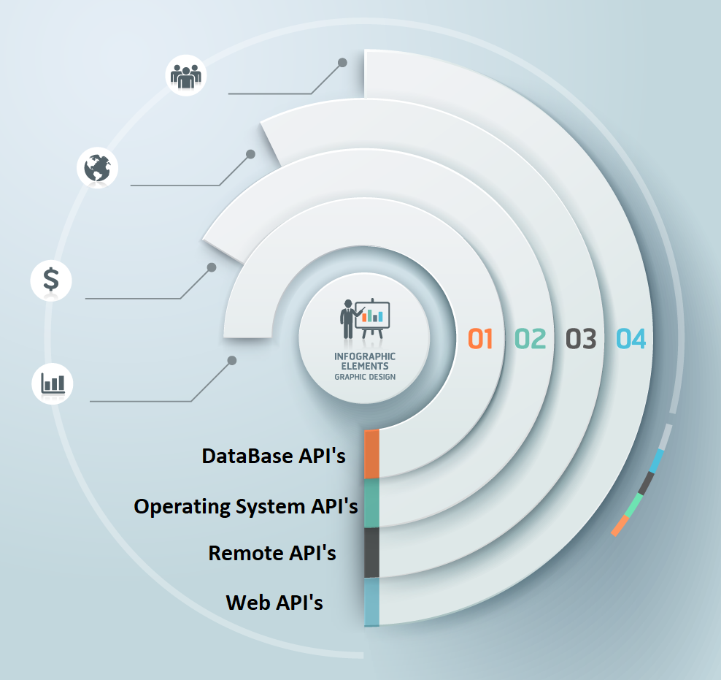

Slide 8
DataBase API’s
Database APIs enable communication between an application and a database management system.
Developers work with databases by writing queries to access data, change tables
The Drupal 7 Database API, for example, allows users to write unified queries for different databases, both proprietary and open source (Oracle, MongoDB, PostgreSQL, MySQL, CouchDB, and MSSQL).

Slide 9
Operating System API’s
This group of APIs defines how applications use the resources and services of operating systems.
Every OS has its set of APIs
Apple provides API reference for macOS and iOS in its developer documentation. APIs for building applications for Apple’s macOS desktop operating system are included in the Cocoa set of developer tools.

Slide 10
Remote API’s
Remote APIs define standards of interaction for applications running on different machines.
In other words, one software product accesses resources located outside the device that requests them, which explains the name. Since two remotely located applications are connected over a communications network, particularly the internet, most remote APIs are written based on web standards.
Java Database Connectivity API and Java Remote Method Invocation API are two examples of remote application programming interfaces.

Slide 11
Web API’s
This API class is the most common. Web APIs provide machine-readable data and functionality transfer between web-based systems which represent client-server architecture.
These APIs mainly deliver requests from web applications and responses from servers using Hypertext Transfer Protocol (HTTP).
Developers can use web APIs to extend the functionality of their apps or sites. Google Maps API enables the addition of a map with an organization’s location.

Slide 12
API specifications/protocols
Remote Procedure Call (RPC)
Service Object Access Protocol (SOAP)
Representational State Transfer (REST)
GraphQL

Slide 13
Remote Procedure Call (RPC)
Web APIs may adhere to resource exchange principles based on a Remote Procedure Call. This protocol specifies the interaction between client-server based applications. One program (client) requests data or functionality from another program (server), located in another computer on a network, and the server sends the required response.
RPC is also known as a subroutine or function call. One of two ways to implement a remote procedure call is SOAP.

Slide 14
Service Object Access Protocol (SOAP)
SOAP is a lightweight protocol for exchanging structured information in a decentralized, distributed environment, according to the definition by Microsoft that developed it.
APIs that comply with the principles of SOAP enable XML messaging between systems through HTTP or Simple Mail Transfer Protocol (SMTP) for transferring mail.
SOAP is mostly used with enterprise web-based software to ensure high security of transmitted data.
SOAP APIs are preferred among providers of payment gateways, identity management and CRM solutions, as well as financial and telecommunication services. PayPal’s public API is one of the commonly known SOAP APIs.

Slide 15
Representational State Transfer (REST)
The term REST was introduced by computer scientist Roy Fielding in a dissertation in 2000. Unlike SOAP, which is a protocol, REST is a software architectural style
REST is considered a simpler alternative to SOAP, it makes data available as resources. Each resource is represented by a unique URL, and one can request this resource by providing its URL.
Web APIs that comply with REST architectural constraints are called RESTful APIs. These APIs use HTTP requests to work with resources: GET, PUT, POST, DELETE & some other.
RESTful systems support messaging in different formats, such as plain text, HTML, YAML, XML, and JSON, while SOAP only allows XML.

Slide 16
GraphQL
The need for faster feature development, more efficient data loading due to increased mobile adoption, and a multitude of clients, made the developers look for other approaches to software architecture. GraphQL, initially created by Facebook in 2012 for internal use.
GraphQL is a query language for APIs. It allows the client to detail the exact data it needs and simplifies data aggregation from multiple sources, so the developer can use one API call to request all needed data. Another special feature of GraphQL is that it uses a type system to describe data.
Apps using GraphQL control what data they need to fetch from a server, which allows them to run fast even when the mobile connection is slow.

Slide 17
CRUD
Create - Post
Read - Get
Update - Put
Delete - Delete

Slide 18
Methods
The four main HTTP methods (GET, PUT, POST, and DELETE) can be mapped to CRUD operations as follows:
GET retrieves the representation of the resource at a specified URI. GET should have no side effects on the server.
PUT updates a resource at a specified URI. PUT can also be used to create a new resource at a specified URI, if the server allows clients to specify new URIs. For this tutorial, the API will not support creation through PUT.
POST creates a new resource. The server assigns the URI for the new object and returns this URI as part of the response message.
DELETE deletes a resource at a specified URI.

Slide 19
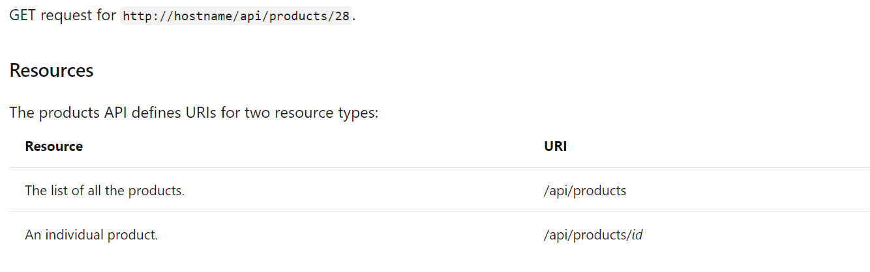
Basics of CRUD The products API will expose following methods.
Action | HTTP method | Relative URI
Get a list of all products | GET | /api/products
Get a product by ID | GET | /api/products/id
Get a product by category | GET | /api/products?category=category
Create a new product | POST | /api/products
Update a product | PUT | /api/products/id
Delete a product | DELETE | /api/products/id

