Slide 1

External Project Presentation of Computer Networking(CSE 3034) on [A console-based Internet Download Manager (IDM) using Java]
Presented by
Shiv Shankar Malla(2141013058)
Pritish Mishra ( 2141013125)
Neha Mohanta (2141013315)
Maheshwar Nag (2141014002)
Shivangi Nayak (2141014086)
Supervisor
Asutosh Chakrabarthy
(Professor)
Department of Computer Science and Engineering
Institute of Technical Education & Research (FET)
Siksha ‘O’ Anusandhan Deemed to be University, Bhubaneswar
Jan, 2024

Slide 2
Contents
Introduction
Problem statement
Methodology
Implementation
Result and Interpretation
Conclusion

Slide 3
Introduction
The project is a console-based Internet Download Manager (IDM) implemented in Java. The IDM allows users to download files from specified URLs and save them to designated local paths. The program is designed to be executed from the command line, requiring users to provide the file URL and destination path as command-line arguments. Utilizing Java’s URLConnection , the IDM’s core functionality is encapsulated in the downloadFile method, which reads from the input stream and writes to the output stream

Slide 4
Problem Statement
To Develop a console-based Internet Download Manager (IDM) using Java.
Learning Outcomes:
Socket programming, HTTP request management
Features:
• Multiple File Downloads: Simultaneously download various files.
• Resume Interrupted Downloads: Capability to resume downloads from the point of interruption
• (due to network issues, system shutdown, etc.).
• Queue Management: Prioritize downloads, allowing users to manage the order and timing of
• their downloads.
• File Management: Organize downloaded files by categories and store them in specified folders

Slide 5
Methodology
1. Start
2. Input: Accept the file URL and destination path as command-line arguments.
3. Validate Input:
i. Ensure that both the URL and destination path are provided.
ii. Exit the program with an error message if validation fails.
4. Download File:
a. Define a method downloadFile(url: String, destinationPath: String):
i.Create a URL object from the provided URL.
ii. Open a connection to the URL using ‘URLConnection’.
iii. Create input and output streams for reading from the connection and writing to the local file.
iv. Initialize a buffer for data transfer.
b. Use a loop to read data from the input stream and write it to the output stream until the end of the file is reached.
c. Close the input and output streams.
5. Main Program:
a. Invoke the downloadFile method with the provided URL and destination path.
b. Handle exceptions:
i. Catch and handle IOExceptions that may occur during the download process.
c. Print a success message if the download is completed successfully.
6. End

Slide 6
Implementation
1. Download a New File:
o Choose option 1, enter a valid download link (e.g., jpeg/png/zip/pdf), and watch your download start.
2. Show Ongoing/Paused Downloads:
o Option 2 displays a list of ongoing and paused downloads.
3. Pause a Download:
o Select option 3, enter the download number, and pause an ongoing download.
4. Resume a Download:
o Choose option 4, specify the download number, and resume a paused download.
5. Cancel a Download:
o Pick option 5, enter the download number, and cancel a download.
6. Get Detailed Info of a Download:
o Select option 6, input the download number, and view detailed information about a download.
7. Exit:
o Choose option 7 to exit the program.

Slide 7
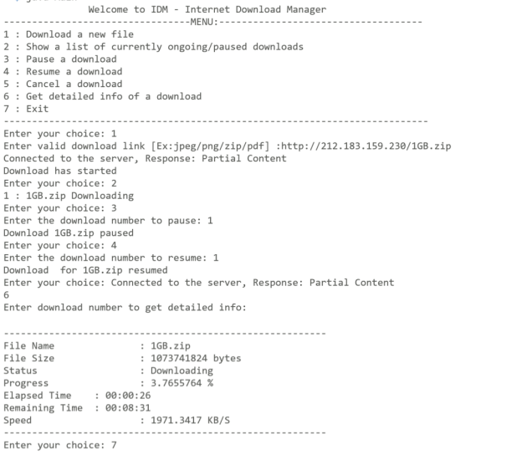
Result and Interpretation

Slide 8
Conclusion
The development of a console-based Internet Download Manager (IDM) using Java presents a successful integration of core programming concepts to create a versatile and efficient tool for managing file downloads. This project has provided valuable insights into the implementation of networking protocols, multithreading, and user interface design within a console environment.
Overall, this project serves as a testament to the capabilities of Java in creating powerful and functional software tools even within a console-based environment.
Future Avenues
HTTP URL Connection:
Third-Party Libraries
Web Scraping

Slide 9
References
[1] Computer Networks, Andrew S. Tannenbaum,4
th Edition, Pearson India.
[2] Java Network Programming by Harold, O’Reilly (Shroff Publishers).
[3] https://en.m.wikipedia.org/wiki/Internet_Download_Manager
[4]https://www.baeldung.com/java-download-file

Slide 10


Slide 11


