Slide 1


Team - 09
CSA4351 –Internet Programming for Web App Development
SIMATS ENGINEERING
SAVEETHA INSTITUTE OF MEDICAL AND TECHNICAL SCIENCES
Capstone project presentation
Smart Hospital Resource and Appointment Management Portal
Guided By
Dr. Sairam A &
Dr. Alphonsa J
Presented by:
P. Parthasaradhi (192372226)
S. Sameer Ahammed (192211941)
V. Veera Lohith Reddy (192311248)
B. Jagan Mohan Reddy (192311144)
M. Jaswanth (192110642)

Slide 2
INTRODUCTION
The Smart Hospital Resource and Appointment Management Portal is a web-based system designed to automate and streamline hospital management processes.
It provides a centralized platform for maintaining patient records and managing appointment scheduling efficiently.
The system helps track doctor and staff availability, reducing scheduling conflicts and improving workforce management.
It monitors hospital resources such as beds, medical equipment, and facilities to ensure their effective utilization.
By reducing manual record-keeping and generating administrative reports, the portal improves efficiency, accuracy, and overall patient care.

Slide 3
OBJECTIVES
To develop a centralized system for managing patient records, doctor information, and appointments.
To automate appointment scheduling and reduce booking conflicts.
To efficiently manage hospital resources such as beds, rooms, and medical equipment.
To monitor doctor and staff availability for better workforce management.
To improve data accuracy, accessibility, and security through digital record management.
To generate reports and analytics that support administrative decision-making.
To enhance operational efficiency and improve the overall patient experience.

Slide 4
PROBLEM STATEMENT
Hospitals often use disconnected systems or manual methods to manage appointments, doctor schedules, and hospital resources, leading to inefficiencies.
Manual management can cause appointment conflicts, long patient waiting times, and difficulties in tracking patient and staff information.
Separate management of beds, rooms, and medical equipment results in poor resource allocation and reduced operational efficiency.
Data inconsistencies and lack of centralized information can affect decision-making and the quality of patient care.
The Smart Hospital Resource and Appointment Management Portal provides a centralized solution to manage appointments, staff availability, patient records, and hospital resources, improving efficiency, accuracy, and overall healthcare services.

Slide 5
METHODOLOGY
Requirement Analysis: Gather and analyze the requirements for patient management, appointment scheduling, resource allocation, and administrative functions.
System Design: Design the system architecture, database schema, user interfaces, and workflow for each module.
Database Development: Create and manage databases for patients, doctors, appointments, staff schedules, and hospital resources.
Module Implementation: Develop modules for Patient and Appointment Logging, Doctor and Staff Schedule Management, Hospital Resource Management, and Administration Dashboard.
Data Validation and Integration: Implement validation checks and integrate all modules into a centralized platform.

Slide 6
Literature Review
No | Year | Article Name | Reference | Focus | Methods | Result
01 | 2025 | Patient Flow Optimization in Hospitals Using Queueing Theory | T. Wang | Improving patient flow to reduce overcrowding and delays | Queueing models, simulation of OPD and emergency services | Reduced patient waiting time and better utilization of hospital resources
02 | 2025 | Impact of Online Appointment Systems on Patient Satisfaction | P.K. Betancor et al. | Evaluating effectiveness of online hospital appointment booking | Surveys and staff–patient feedback analysis | Higher patient satisfaction and fewer missed appointments
03 | 2025 | Privacy-Preserving Appointment Scheduling in Smart Healthcare Systems | S. Zhang | Ensuring secure and privacy-safe hospital appointment booking | Encryption techniques, secure login | Improved data security and increased patient trust
04 | 2024 | Design and Development of a Smart Hospital Management System Portal | G. Gaikwad | Developing a web-based smart HMS portal | PHP, MySQL database, role-based web system implementation | Faster processing, efficient data handling, and reduced paperwork
05 | 2025 | Global Market Trends in Patient Flow and Hospital Digital Solutions | RootsAnalysis | Analyzing adoption of digital patient-flow and HMS technologies | Market statistics, industry reports, and trend analysis | Growth in digital healthcare adoption and smart hospital investments

Slide 7
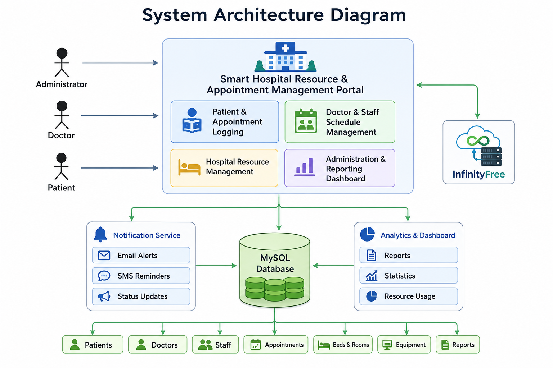

Slide 8
Module 1 –Patient Appointment Management
Enable patients to book, reschedule, and cancel appointments through a centralized system, reducing waiting times and improving access to healthcare services.
Maintain accurate patient information and appointment records to ensure efficient communication and seamless appointment management.
Allow patients to view available doctors, consultation timings, and appointment status in real time for better scheduling convenience.
Generate appointment confirmations and reminders to minimize missed appointments and improve patient engagement.
Provide quick access to appointment history and patient records, supporting efficient healthcare service delivery.

Slide 9
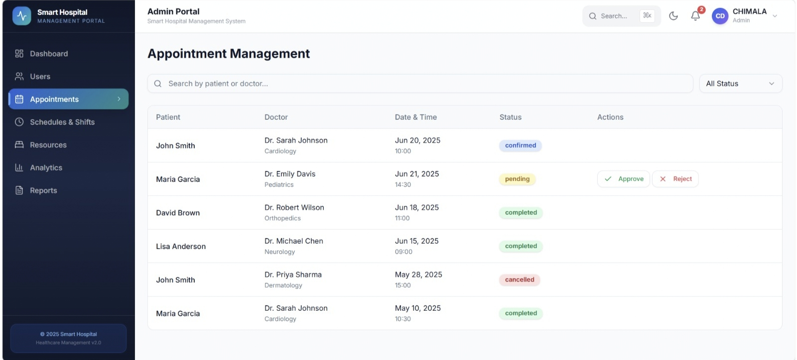

Slide 10
Module 2 – Doctor & Staff Management
Manage doctor and staff profiles, including personal details, specialization, contact information, and professional records.
Create and maintain work schedules, duty rosters, and shift assignments to ensure proper workforce allocation.
Track staff attendance, availability, and leave requests to support effective hospital operations.
Prevent scheduling conflicts by monitoring doctor consultation hours and staff duty timings.
Enable administrators to efficiently manage workforce resources and maintain adequate staffing levels.

Slide 11
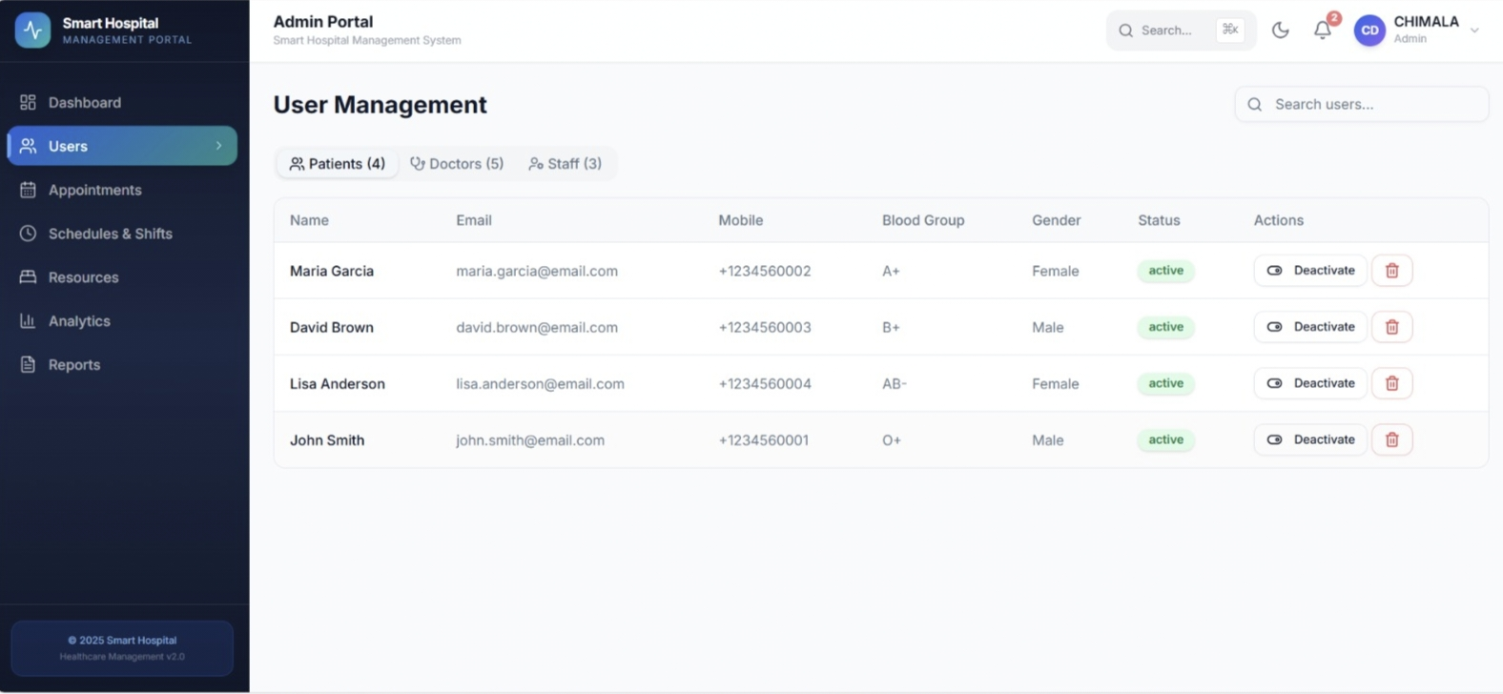

Slide 12
Module 3 — Hospital Resource Management
Monitor and manage the availability of hospital resources such as beds, rooms, medical equipment, and other facilities.
Allocate resources efficiently based on patient requirements, availability, and priority levels.
Track resource utilization and occupancy status in real time to improve operational efficiency.
Schedule and monitor maintenance activities for medical equipment to ensure reliability and continuous availability.
Generate resource usage reports that help optimize hospital capacity planning and resource allocation.

Slide 13
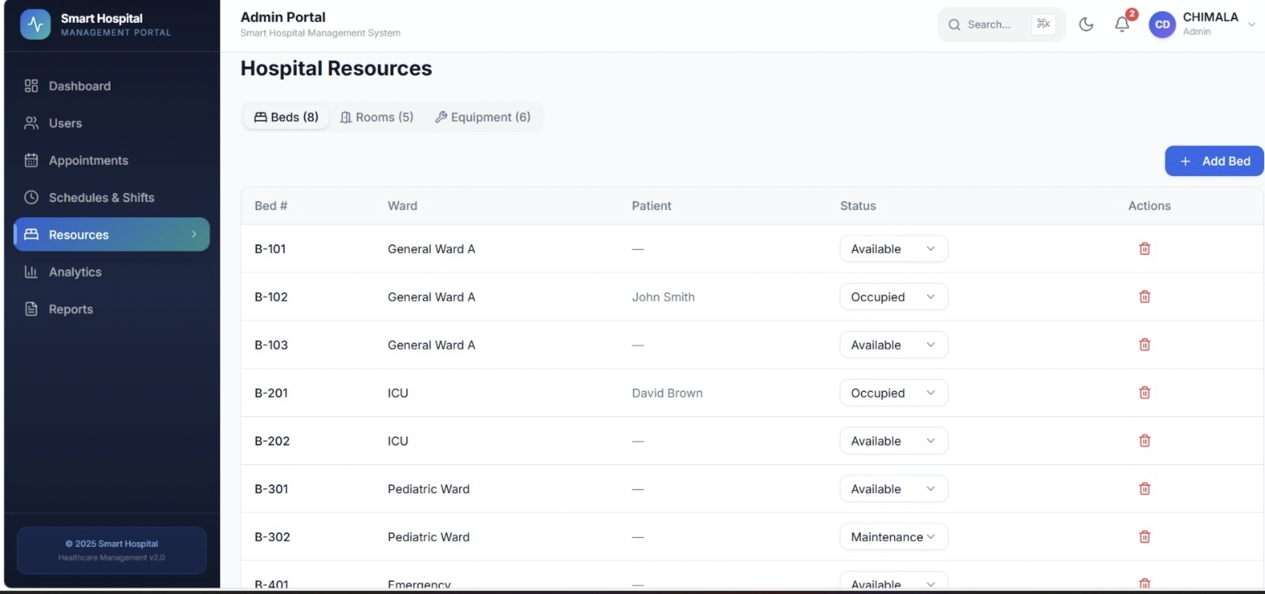

Slide 14
Module 4 – Administration & Analytics Dashboard
Provide administrators with a centralized dashboard for monitoring hospital operations, appointments, staff activities, and resource utilization.
Generate detailed reports and analytics on patient visits, appointment trends, staff performance, and resource usage.
Manage user accounts, access permissions, and system settings to ensure secure and controlled system operation.
Display real-time statistics and performance indicators through charts, graphs, and dashboards for informed decision-making.
Support strategic planning and operational improvements by providing data-driven insights and comprehensive hospital analytics.

Slide 15
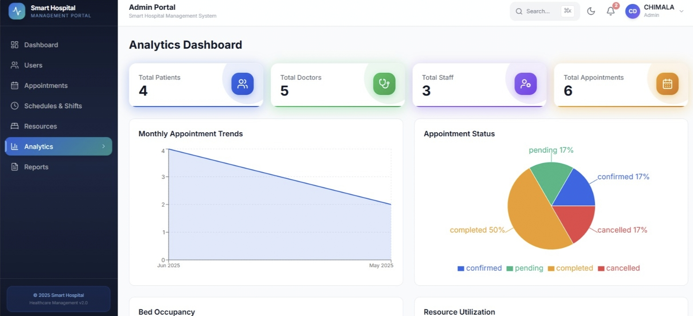

Slide 16
Module 5 – Reports & Performance Analytics
Generate comprehensive appointment reports, including scheduled, completed, canceled, rescheduled, and missed appointments, with filtering options based on date, department, doctor, and patient demographics.
Track and evaluate doctor and staff performance by monitoring consultation counts, working hours, attendance records, patient handling capacity, shift allocations, and overall productivity metrics.
Analyze hospital resource utilization through detailed reports on room occupancy, equipment usage, resource availability, maintenance schedules, and allocation efficiency to ensure optimal resource management.
Provide advanced analytical insights into patient flow, peak service hours, department-wise demand, appointment trends, and operational performance to support strategic planning and decision-making.

Slide 17
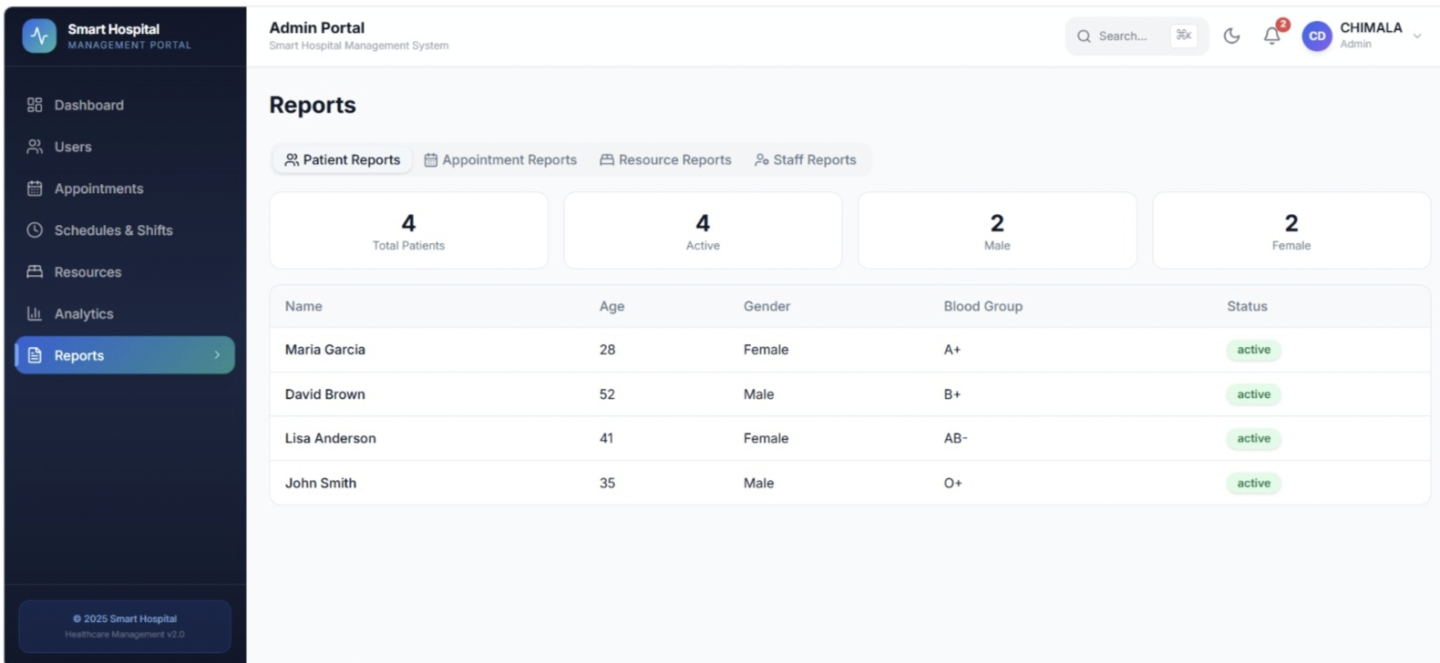

Slide 18
RESULT
The Smart Hospital Resource and Appointment Management Portal was successfully designed and developed to streamline hospital operations through the integration of patient appointment management, doctor and staff management, hospital resource management, and administrative analytics. The system effectively maintains digital records, automates appointment scheduling, and provides centralized access to hospital information.
The portal enables efficient management of patient appointments, reduces scheduling conflicts, improves doctor and staff coordination, and optimizes the utilization of hospital resources such as beds, rooms, and medical equipment. The Administration and Analytics Dashboard provides real-time monitoring and comprehensive reports that support better decision-making and operational planning.

Slide 19
FUTURE SCOPE
Integration with Artificial Intelligence (AI): Implement AI-based appointment scheduling, doctor recommendations, and patient flow prediction to improve hospital efficiency.
Mobile Application Support: Develop Android and iOS mobile applications that allow patients and hospital staff to access the system anytime and anywhere.
Online Consultation and Telemedicine: Integrate video consultation features to enable remote healthcare services and virtual doctor appointments.
Real-Time Notifications: Enhance the system with SMS, email, and mobile push notifications for appointment reminders, schedule updates, and emergency alerts.
Electronic Health Records (EHR) Integration: Connect the portal with electronic health record systems to provide comprehensive patient medical history and improve clinical decision-making.

Slide 20
CONCLUSION
The Smart Hospital Resource and Appointment Management Portal provides an efficient and centralized solution for managing hospital operations, including patient appointments, doctor and staff schedules, hospital resources, and administrative activities. The system replaces traditional manual processes with a digital platform that improves accuracy, reduces paperwork, and enhances overall operational efficiency.
By integrating appointment management, workforce coordination, resource allocation, and analytical reporting into a single system, the portal helps hospitals optimize resource utilization, minimize scheduling conflicts, and improve patient satisfaction. The Administration and Analytics Dashboard further supports informed decision-making through real-time monitoring and comprehensive reports.
Overall, the proposed system demonstrates the importance of digital transformation in healthcare management and serves as a reliable, scalable, and user-friendly solution for improving the quality and efficiency of hospital services.

Slide 21
REFERENCES
Rajkumar Buyya, James Broberg, and Andrzej Goscinski, Cloud Computing: Principles and Paradigms, Wiley Publications, 2011.
Ian Sommerville, Software Engineering, 10th Edition, Pearson Education, 2015.
Roger S. Pressman and Bruce R. Maxim, Software Engineering: A Practitioner's Approach, 8th Edition, McGraw-Hill Education, 2014.
Elmasri, R. and Navathe, S.B., Fundamentals of Database Systems, 7th Edition, Pearson Education, 2016.
K. H. Rosen, Discrete Mathematics and Its Applications, McGraw-Hill Education, 2018.
World Health Organization (WHO), Digital Health and Health Information Systems.World Health Organization (WHO)

Slide 22


