Slide 1


Team - 07 CSA4305 –Internet Programming
SIMATS ENGINEERING
SAVEETHA INSTITUTE OF MEDICAL AND TECHNICAL SCIENCES
Capstone project presentation
Smart healthcare resource allocation and appointment scheduling system
Guided By Dr. SUDHAGAR D
Presented by:
G.Pradeep reddy (192311289)
B.Vishnuvardhan (192311267)
M.Reshwanth(192411235)
B.Maheshwar (192411195)

Slide 2

INTRODUCTION
A Smart Hospital Resource and Appointment Management Portal is a web-based system for managing hospital activities.
It helps patients book appointments with doctors quickly and easily.
The system stores patient, doctor, and hospital resource information in one place.
It reduces paperwork, saves time, and avoids scheduling conflicts.
It improves hospital efficiency and provides better service to patients.

Slide 3
OBJECTIVES
Develop a centralized system to manage patients, doctors, appointments, and hospital resources.
Automate appointment scheduling to reduce waiting time and booking conflicts.
Improve the management of beds, rooms, equipment, and staff availability.
Provide secure records, real-time monitoring, and reports for better hospital management.
Enhance the overall patient experience by providing faster, reliable, and efficient healthcare services.

Slide 4
PROBLEM STATEMENT
Hospitals often use manual or separate systems to manage patient records and appointments.
Appointment scheduling conflicts can lead to long waiting times and inconvenience for patients.
Poor management of beds, rooms, and medical equipment reduces hospital efficiency.
Lack of centralized data makes it difficult to track patients, doctors, staff, and resources.
A centralized hospital management portal is needed to improve efficiency, accuracy, and the quality of healthcare services.

Slide 5
Literature Review
No | Year | Article Name | Reference | Focus | Methods | Limitations
01 | 2025 | Patient Flow Optimization in Hospitals Using Queueing Theory | T. Wang | Improving patient flow to reduce overcrowding and delays | Queueing models, simulation of OPD and emergency services | Limited to patient flow management
02 | 2025 | Impact of Online Appointment Systems on Patient Satisfaction | P.K. Betancor et al. | Evaluating effectiveness of online hospital appointment booking | Surveys and staff–patient feedback analysis | Limited to appointment booking
03 | 2025 | Privacy-Preserving Appointment Scheduling in Smart Healthcare Systems | S. Zhang | Ensuring secure and privacy-safe hospital appointment booking | Encryption techniques, secure login | Focuses mainly on security and privacy
04 | 2024 | Design and Development of a Smart Hospital Management System Portal | G. Gaikwad | Developing a web-based smart HMS portal | PHP, MySQL database, role-based web system implementation | Limited real-time resource monitoring
05 | 2025 | Global Market Trends in Patient Flow and Hospital Digital Solutions | RootsAnalysis | Analyzing adoption of digital patient-flow and HMS technologies | Market statistics, industry reports, and trend analysis | Provides analysis, not an actual system

Slide 6
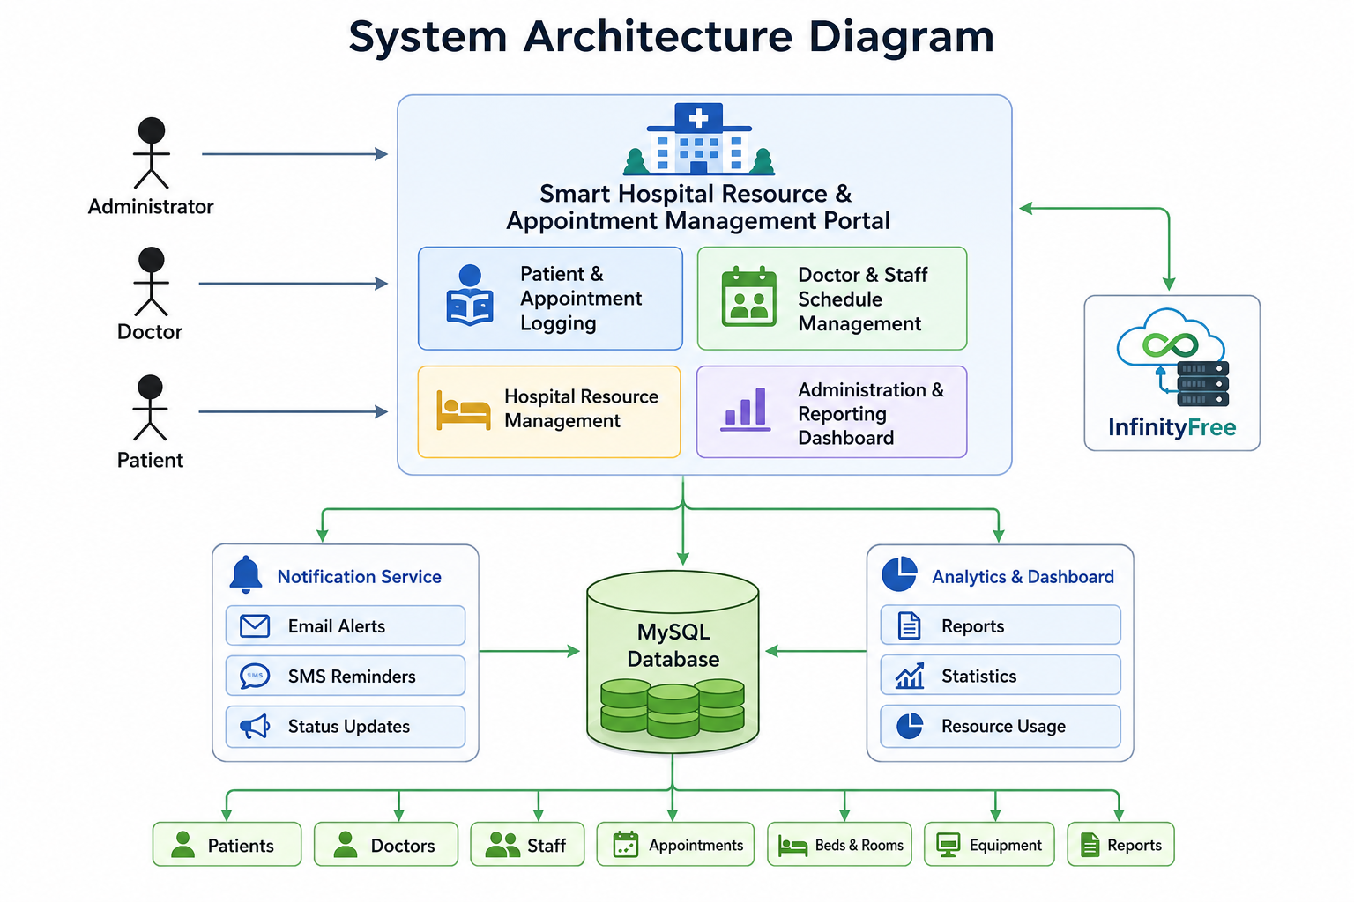
System Architecture
Priority scheduling of patients

Slide 7
Module 1 Patient Appointment Management
purpose:
To provide an efficient system for managing patient appointments, records, and doctor scheduling in a centralized platform.
Key Points:
Register and manage patient records.
Book appointments with available doctors.
Reschedule or cancel appointments.
View doctor consultation schedules.
Send appointment reminder notifications.
Output:
A streamlined appointment management system that reduces waiting time and improves patient service.

Slide 8
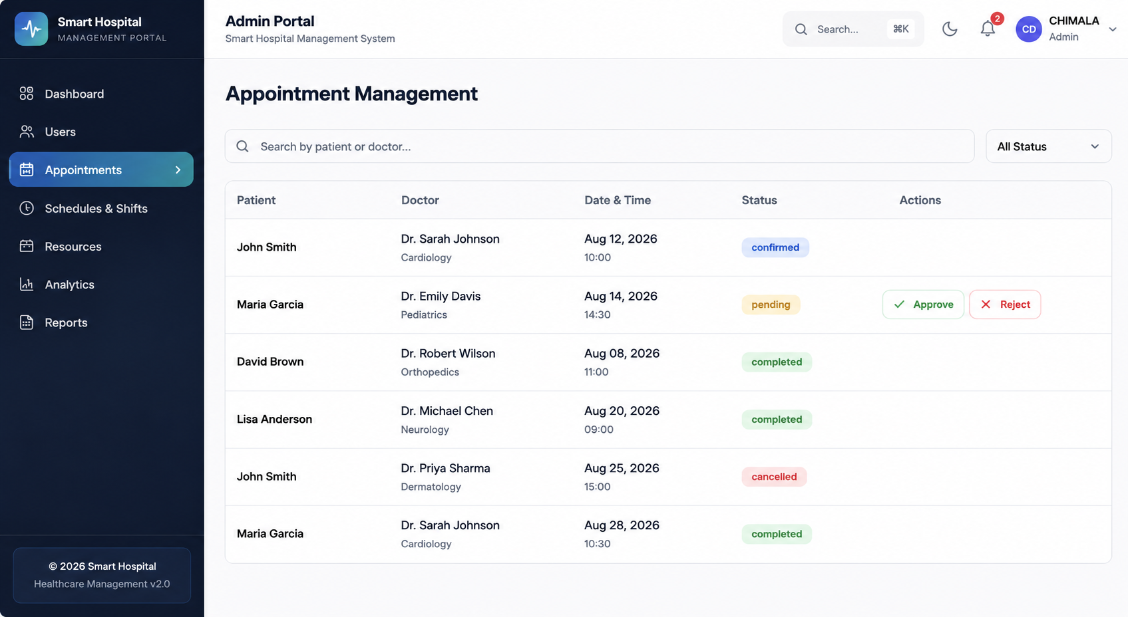
OUTPUT:

Slide 9
Module 2
Doctor & Staff Management
Aim:
To efficiently manage doctor and staff information, schedules, attendance, and availability for smooth hospital operations.
Key Points:
Maintain doctor and staff profiles.
Create duty schedules and shifts.
Track attendance and leave records.
Monitor doctor availability regularly.
Prevent scheduling conflicts efficiently.
Output:
An organized workforce management system that improves staff coordination and operational efficiency.

Slide 10
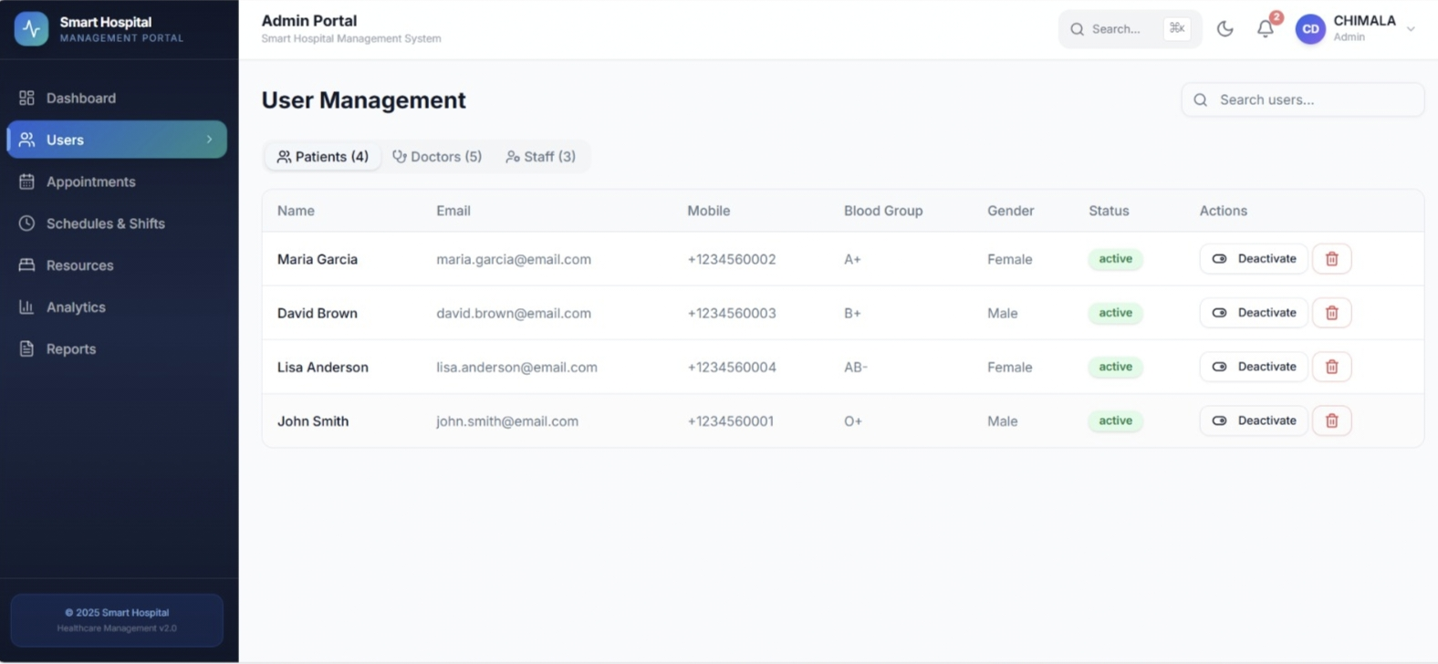
OUTPUT:

Slide 11
Module 3 Hospital Resource Management
Aim:
To monitor and manage hospital resources effectively for better utilization and uninterrupted healthcare services.
Key Points:
Monitor beds and room availability.
Allocate resources based on needs.
Track medical equipment usage.
Schedule equipment maintenance regularly.
Generate resource utilization reports.
Output:
An efficient resource management system that optimizes hospital facilities and improves service quality.

Slide 12
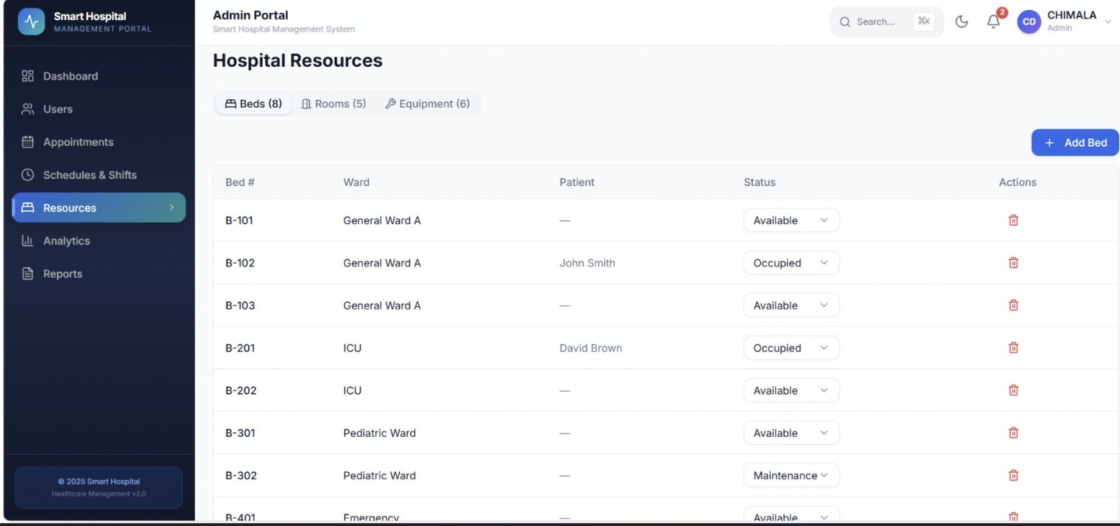
OUTPUT:

Slide 13
Module 4
Administration & Analytics Dashboard
Aim:
To provide administrators with centralized monitoring, reporting, and analytical tools for effective hospital management.
Key Points:
Monitor overall hospital activities.
Manage users and permissions securely.
Generate reports and analytics.
Display real-time performance dashboards.
Support better administrative decisions.
Output:
A centralized dashboard that provides real-time insights and supports better decision-making in hospital administration.

Slide 14
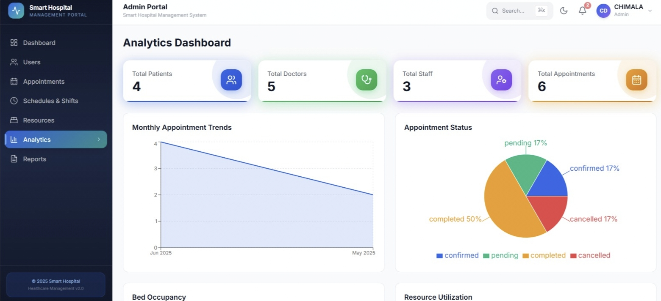
OUTPUT:

Slide 15

CONCLUSION
The portal provides a centralized platform for managing hospital operations efficiently.
It simplifies patient appointments, doctor schedules, and hospital resource management.
The system reduces paperwork, improves accuracy, and saves valuable time.
Overall, it enhances hospital efficiency and delivers better healthcare services to patients.

Slide 16
SDG CODES:
SDG 3 – Good Health and Well-Being
Improves healthcare access, appointment scheduling, patient service, and hospital resource utilization.
SDG 9 – Industry, Innovation and Infrastructure
Promotes digital innovation and efficient management of hospital infrastructure and resources.
SDG 16 – Peace, Justice and Strong Institutions
Supports secure, organized, and transparent management of hospital information.

Slide 17
REFERENCES
Rajkumar Buyya, James Broberg, and Andrzej Goscinski, Cloud Computing: Principles and Paradigms, Wiley Publications, 2011.
Ian Sommerville, Software Engineering, 10th Edition, Pearson Education, 2015.
Roger S. Pressman and Bruce R. Maxim, Software Engineering: A Practitioner's Approach, 8th Edition, McGraw-Hill Education, 2014.
Elmasri, R. and Navathe, S.B., Fundamentals of Database Systems, 7th Edition, Pearson Education, 2016.
K. H. Rosen, Discrete Mathematics and Its Applications, McGraw-Hill Education, 2018.
World Health Organization (WHO), Digital Health and Health Information Systems.World Health Organization (WHO)

Slide 18


