Slide 1
Digital Portfolio
STUDENT NAME:Maheshwara
REGISTER NO AND NMID:222407869 & 22DC93072A0B805AC0A4BB5885B5AF1F
DEPARTMENT: Bsc. Computer science with Data science
COLLEGE:Tagore college of arts & science /Madras university

Slide 2
PROJECT TITLE
maheshwara— web Developer Portfolio Website
Ganesan R — Game Developer Portfolio Website

Slide 3


AGENDA
Problem Statement
Project Overview
End Users
Tools and Technologies
Portfolio design and Layout
Features and Functionality
Results and Screenshots
Conclusion
Github Link
3/21/2024 Annual Review

Slide 4

PROBLEM STATEMENT
Creating a professional, interactive, and responsive online portfolio is essential for showcasing technical skills, academic background, and projects to potential employers, collaborators, and clients.

Slide 5

PROJECT OVERVIEW
This project is a modern portfolio website designed to highlight my journey in game development, including development, design, and testing skills. It serves as a single place to view my education, skills, selected projects, and contact details.

Slide 6

WHO ARE THE END USERS?
Recruiters looking for game developers/testers.
Potential collaborators for indie or professional game projects.
Friends, teachers, or mentors who wish to view my progress and achievements.

Slide 7

TOOLS AND TECHNIQUES
HTML5 — For semantic structure.
CSS3 — For styling, layout, and animations.
Google Fonts — For modern typography.
(Optional future additions: JavaScript frameworks like React.js)

Slide 8
POTFOLIO DESIGN AND LAYOUT
Modern, card-based layout.
Clean typography with gradient accents.
Sticky navigation for smooth browsing.
Profile picture with hover effects.
8

Slide 9
FEATURES AND FUNCTIONALITY
Fully responsive UI (mobile and desktop friendly).
Education, Skills, Projects, and Contact sections.
Hover and focus effects for better user experience.
Accessible navigation with keyboard support.

Slide 10
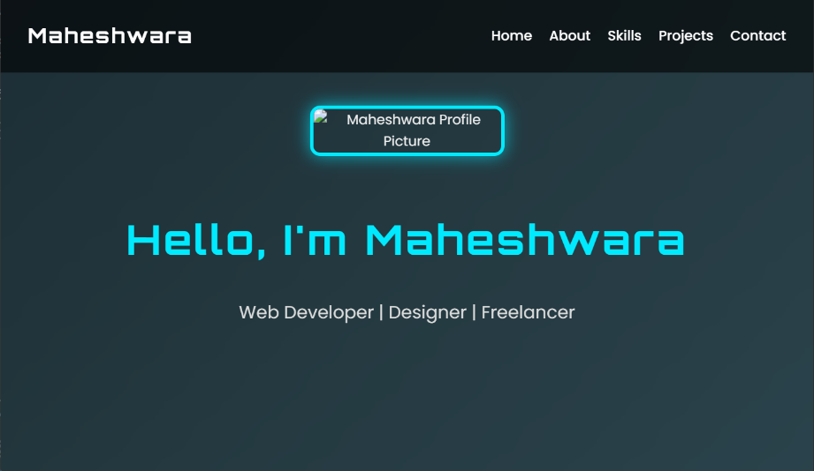
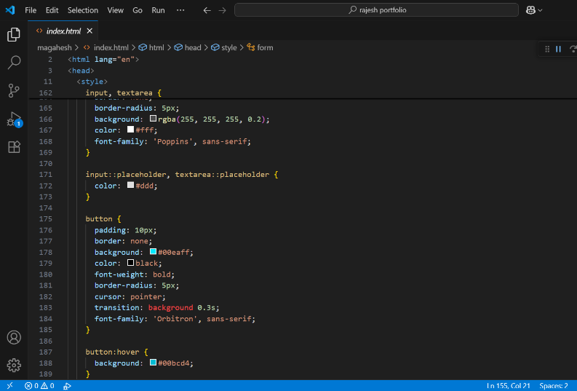
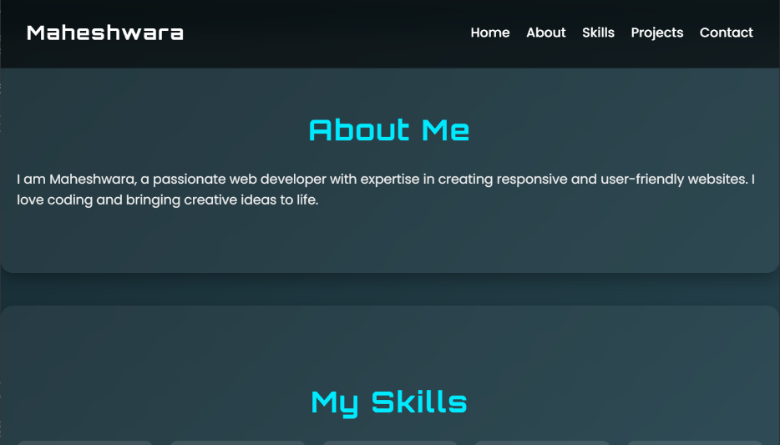
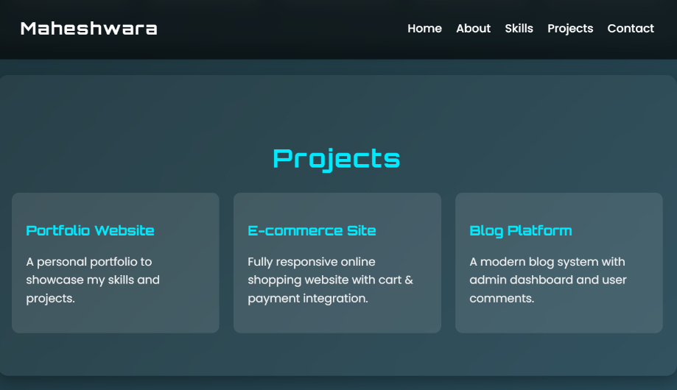
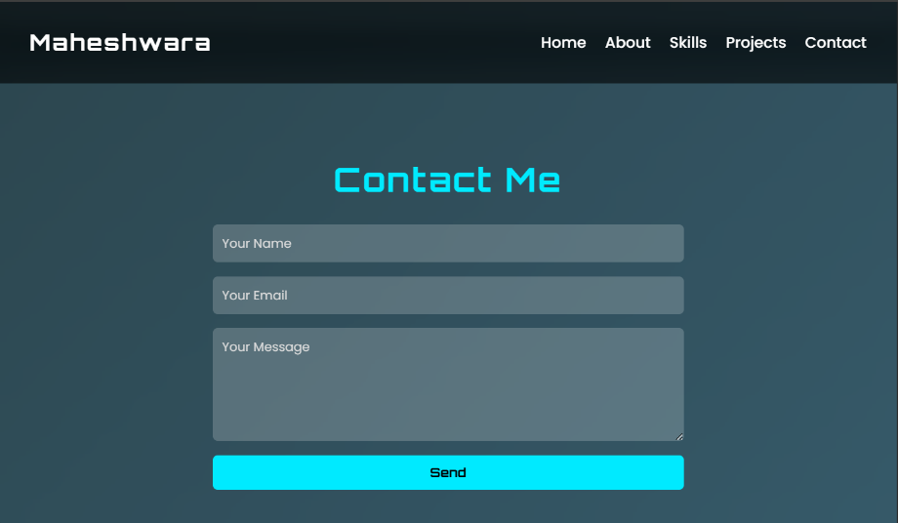
RESULTS AND SCREENSHOTS
3/21/2024 Annual Review
10

Slide 11
CONCLUSION
This portfolio helps present my work professionally, improves my visibility, and serves as a foundation for future enhancements, including more projects and interactive features.
11

Slide 12
GITHUB LINK
https://github.com/maheshwara-spec/maheshwaraportfolio.git

