Slide 1
Employee Data Analysis using Excel
STUDENT NAME: MAGESHWARI R
REGISTER NO :312203925
DEPARTMENT :COMMERCE
COLLEGE :ANNAI THERESA ARTS AND SCIENCE COLLEGE

Slide 2
PROJECT TITLE
Visualizing Employee Attendance Trends with Excel Charts

Slide 3


AGENDA
Problem Statement
Project Overview
End Users
Our Solution and Proposition
Dataset Description
Modelling Approach
Results and Discussion
Conclusion
3/21/2024 Annual Review

Slide 4

PROBLEM STATEMENT
The company currently records employee attendance data in spreadsheets but lacks effective visualization tools to analyze this data comprehensively.
This gap hampers the ability to quickly interpret attendance trends and make data-driven decisions. To address this issue, the company needs to utilize Excel charts to create visual representations of attendance data, focusing on daily, weekly, and monthly trends.
This visualization will support better workforce management, enhance strategic planning, and improve overall organizational efficiency.

Slide 5

PROJECT OVERVIEW
This project aims to enhance the analysis of employee attendance data by utilizing Excel charts for clear and actionable insights.
Key tasks include collecting and preparing attendance data, then creating various charts to visualize daily, weekly, and monthly trends.
The project will develop an interactive dashboard for easy data interpretation and decision-making. Feedback from stakeholders will be incorporated to refine the visualizations.
The final output will facilitate better workforce management, highlight attendance patterns and anomalies, and support strategic planning. Training will be provided to ensure effective use of the new tools.

Slide 6

WHO ARE THE END USERS?
Human Resources (HR) Managers:
Utilize charts to monitor overall attendance patterns, manage employee absences, and implement attendance policies.
Department Managers:
Assess attendance trends within their teams to address staffing issues and ensure adequate coverage.
Operations Managers:
Analyze trends to optimize scheduling and operational efficiency, reducing the impact of attendance fluctuations.

Slide 7

OUR SOLUTION AND ITS VALUE PROPOSITION
Our solution involves developing a comprehensive suite of Excel charts to visualize employee attendance trends effectively.
By transforming raw attendance data into intuitive, interactive charts and dashboards, we provide clear insights into daily, weekly, and monthly attendance patterns.
This visualization enables end users to quickly identify trends, peak periods, and anomalies. The value proposition includes enhanced data clarity, improved decision-making capabilities, and streamlined workforce management.

Slide 8
Dataset Description
Employee ID: Unique identifier for each employee.
Employee Name: Full name of the employee.
Name –Text
Date: Specific dates of attendance or absence.
Attendance Status: Daily status indicators such as Present, Absent

Slide 9

THE "WOW" IN OUR SOLUTION
Dynamic Dashboards:
Interactive dashboards allow users to filter data, drill down into specifics, and view real-time updates.
Customizable Visuals: Tailored charts such as heat maps, trend lines, and bar graphs highlight key patterns and anomalies.
User-Friendly Interface:
Intuitive design ensures ease of use for all levels of users, from HR managers to senior executives.
3/21/2024 Annual Review
9

Slide 10
MODELLING
1. Data Preparation
2. Data Analysis
3. Chart Development
4. Dashboard Creation
5. Visualization Enhancement
6. Testing and Validation
10

Slide 11
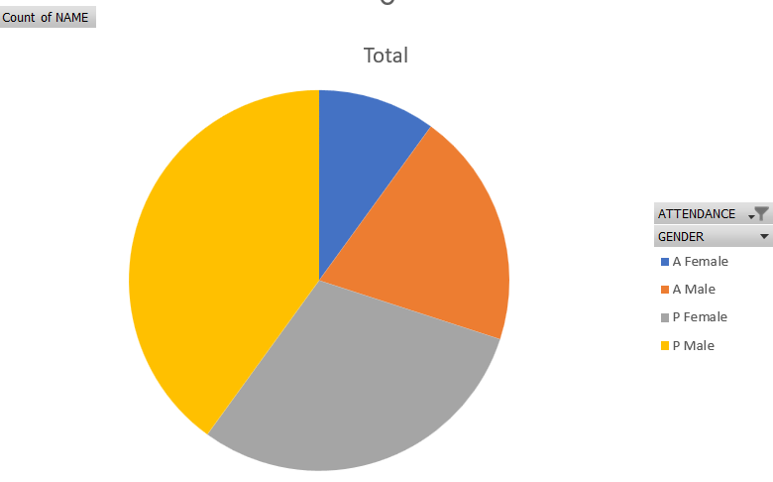
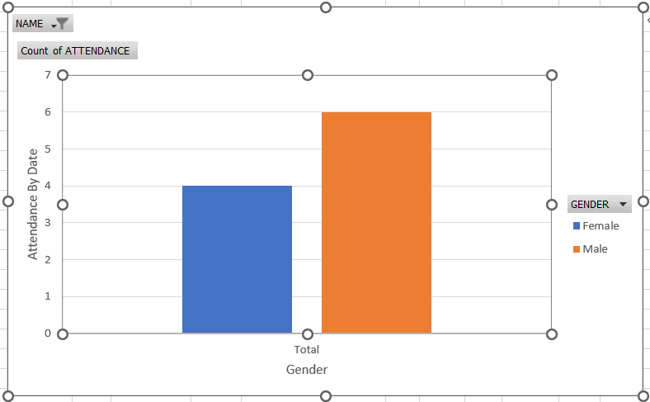
RESULTS
11

Slide 12
conclusion
The implementation of Excel charts for visualizing employee attendance trends provides a powerful tool for analyzing and understanding workforce dynamics.
By transforming raw data into intuitive charts, organizations gain valuable insights into attendance patterns, peak periods, and anomalies.
This enhanced visibility supports more informed decision-making, from managing absenteeism to optimizing staffing and resource allocation.
Overall, this solution drives better workforce management, improves operational efficiency, and supports strategic planning, ultimately contributing to a more effective and responsive organizational environment.

