Slide 1

DEPLOYING A NAS SERVER USING OPENMEDIAVAULT
Name : Maheshwari B

Slide 2
1
2
3
4
5
CONTENT
Tools and setup
Outcomes and Learning
Storage and Sharing
Access and Testing
Project overview

Slide 3
1
2
3
4
5
Tools and setup
Storage and Sharing
Access and Testing
Project overview
Conclusion

Slide 4
PROJECT OVERVIEW
1.1 Objective of the NAS Setup To deploy a Network Attached Storage (NAS) server using OpenMediaVault, allowing centralized file storage, sharing, and management over a network.
1.2 Relevance of NAS in Modern IT NAS plays a key role in small to enterprise environments for shared access, backups, and collaboration. This project demonstrates real-world system administration, file sharing, and storage configuration.

Slide 5
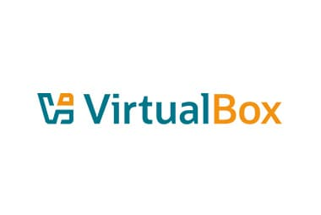
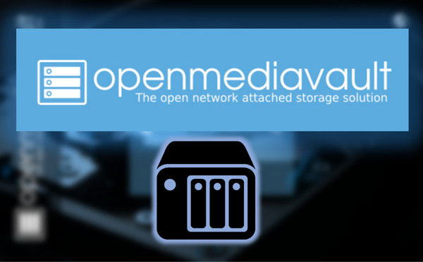
TOOLS AND SETUP
2.1 Tools Used
Oracle VirtualBox
(to create a virtualized environment)
OpenMediaVault ISO
(for NAS server installation)

Slide 6

2.2 Virtual Machine Configuration
OS Type : Linux
Subtype : Debian (64-bit)
Memory : 1.5GB
Processors : 1 CPU allocated
Storage : 15.16 GB allocated
ISO : Attached via IDE controller
File type : VDI (VirtualBox Disk Image)
STEP 1
STEP 2
STEP 3

Slide 7
2.3 Installation Process
Booted into OMV ISO
Chose language, region, hostname
Created root password
Selected and formatted disk for installation
Rebooted VM and accessed OMV via web interface

Slide 8
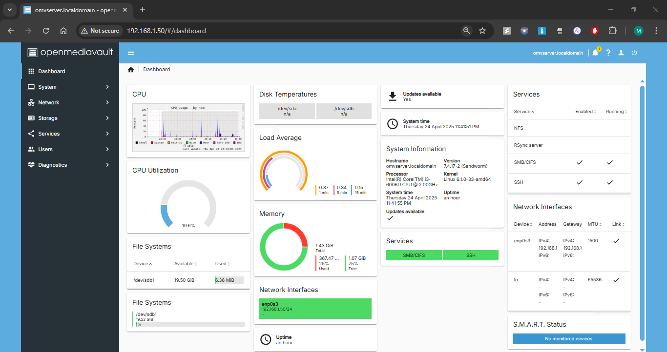
RESULT : OMV via web interface

Slide 9
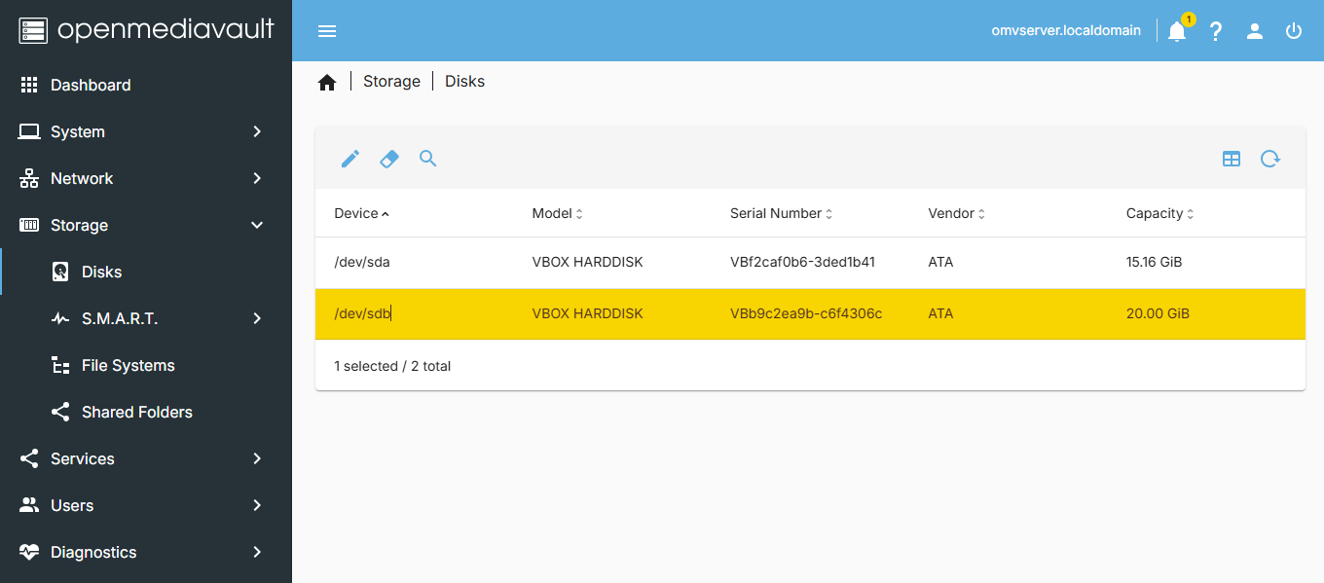
STORAGE AND SHARING
3.1 Disk & File System Setup
Scanned and initialized additional disk using GPT (GUID Partition Table)

Slide 10
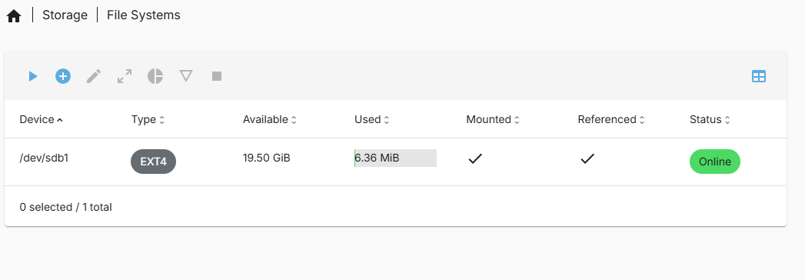
Created EXT4 file system
Mounted disk and applied changes

Slide 11
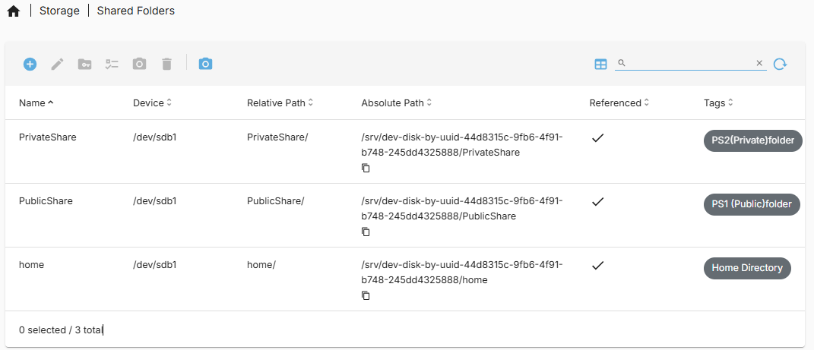
3.2 Shared Folder Creation
Created folders

Slide 12
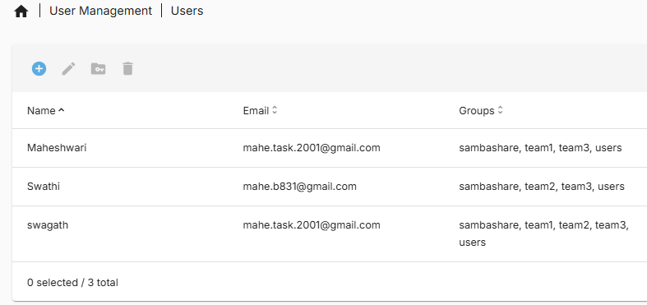
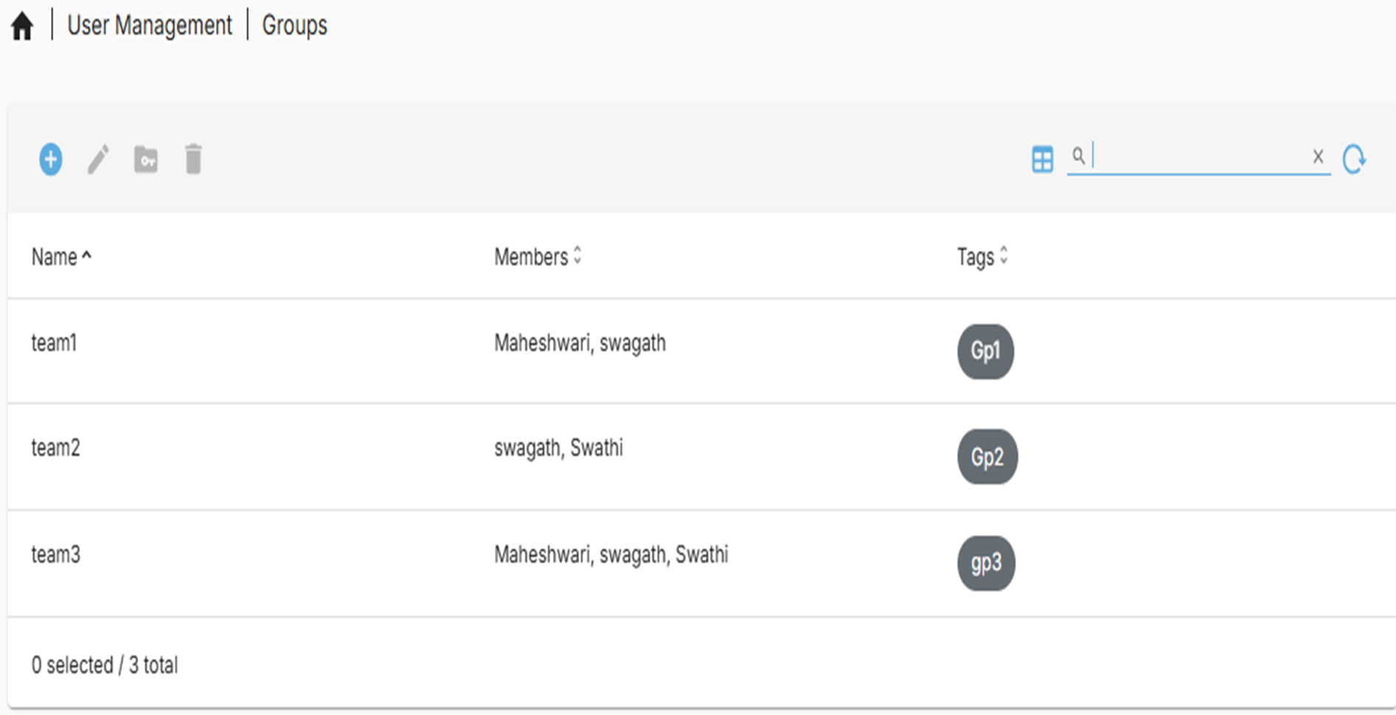
Created Users and groups

Slide 13
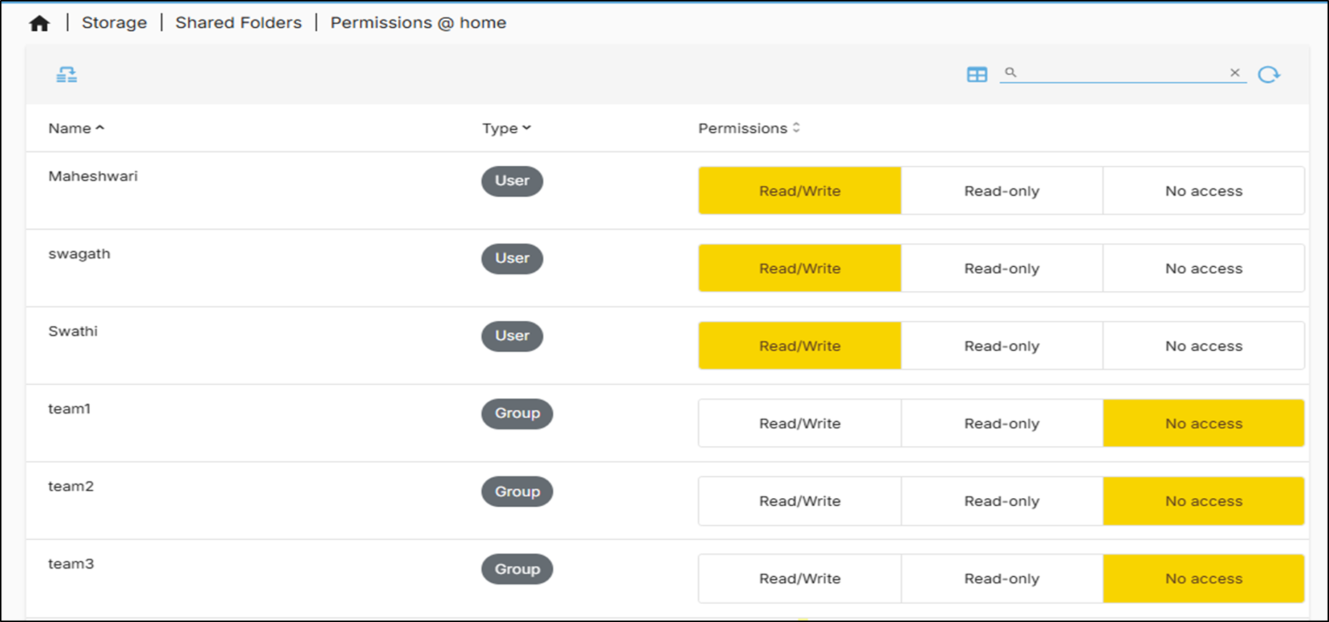
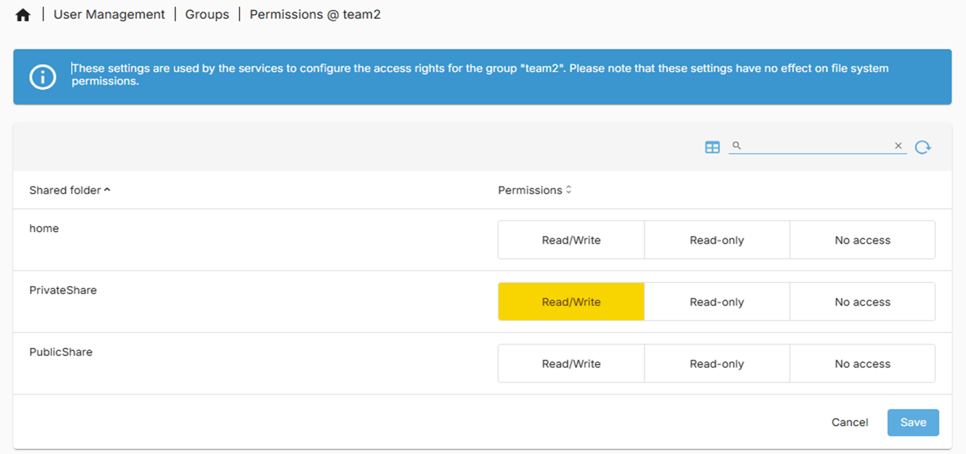
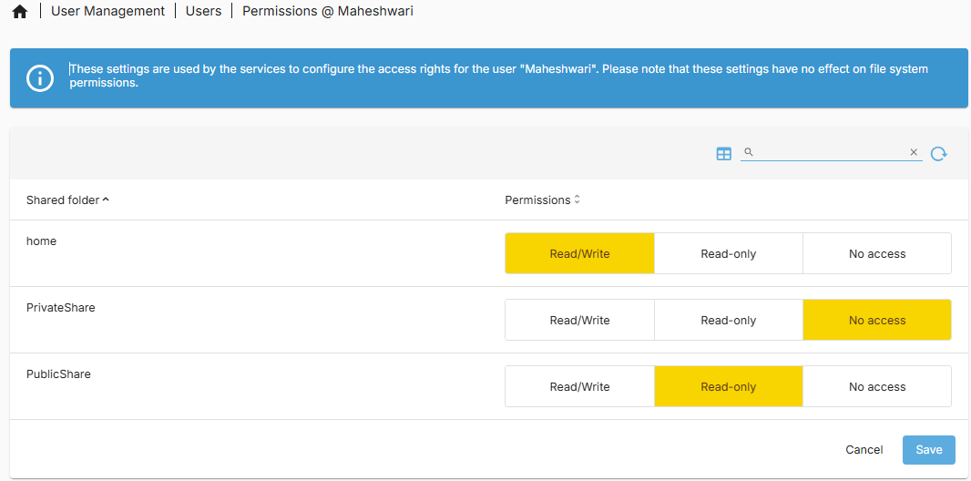
Applied appropriate permission levels
Example: 1 USER ,1 GROUP and HOME folder permission allocation

Slide 14
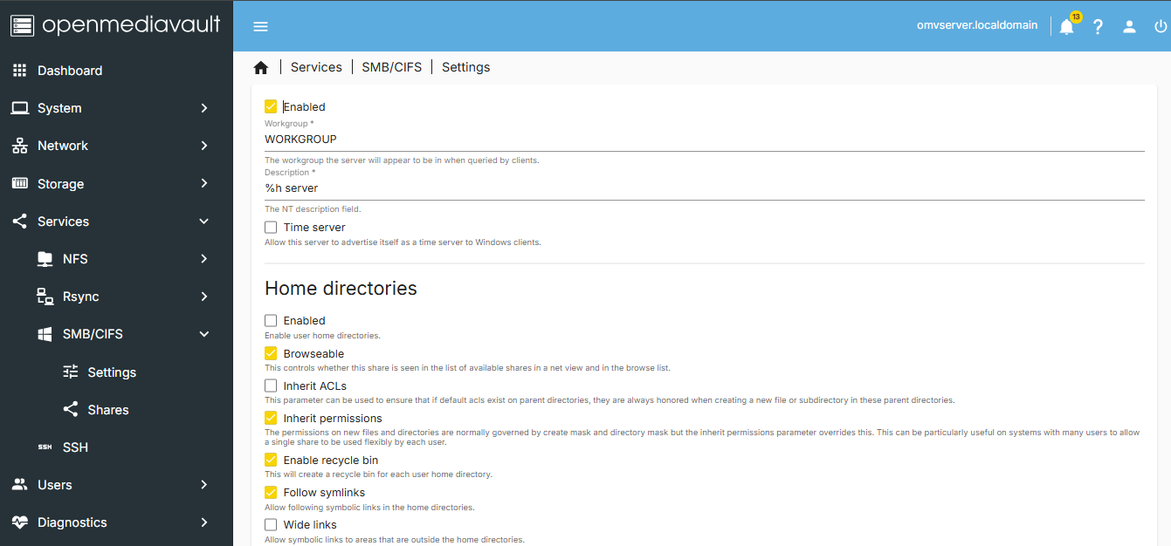

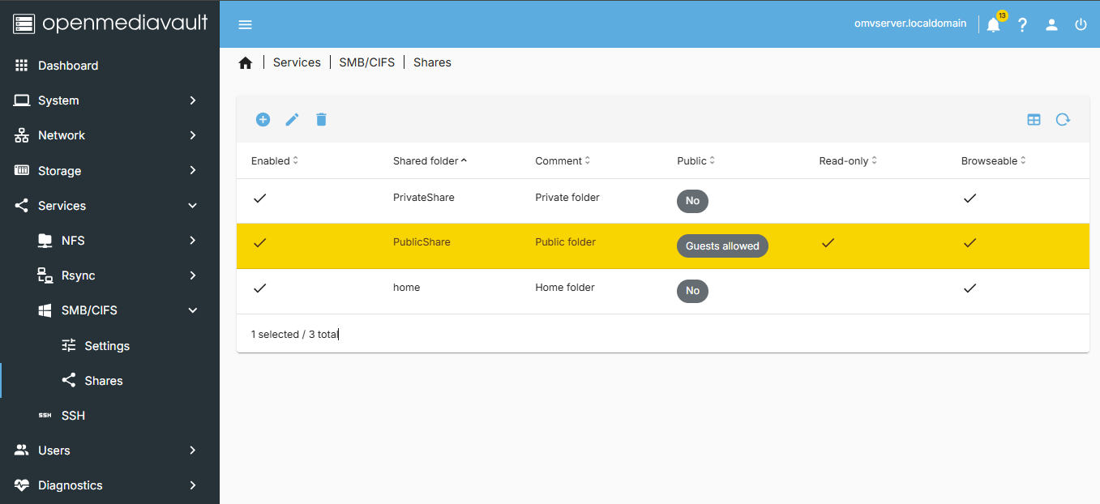
3.3 Enabling File Sharing Protocols
Enabled SMB/CIFS services
Created shares and linked them to shared folders

Slide 15
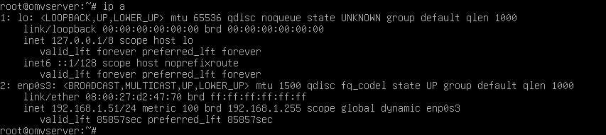
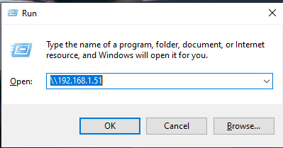
ACCESS AND TESTING
4.1 Network Access
Accessed NAS via IP shown in OMV console
On Windows: \\<OMV-IP>\

Slide 16
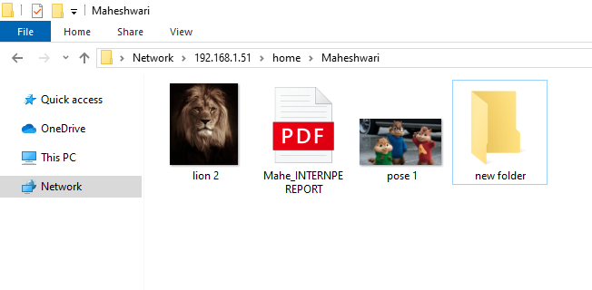
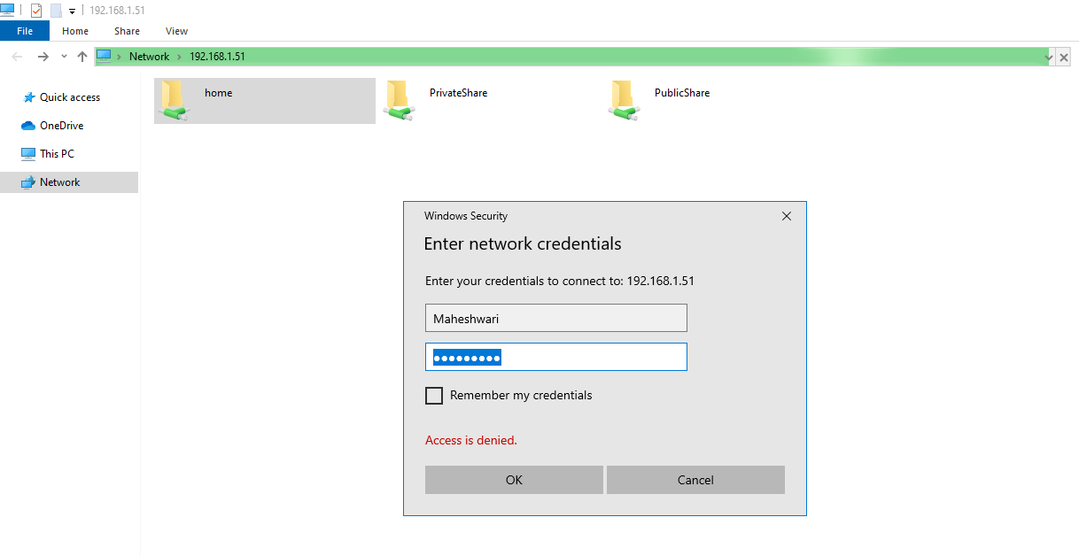
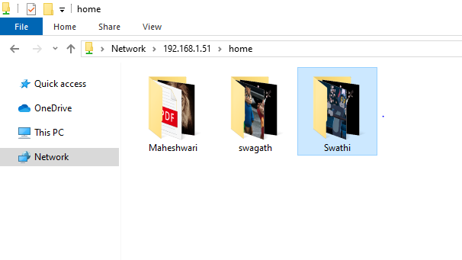
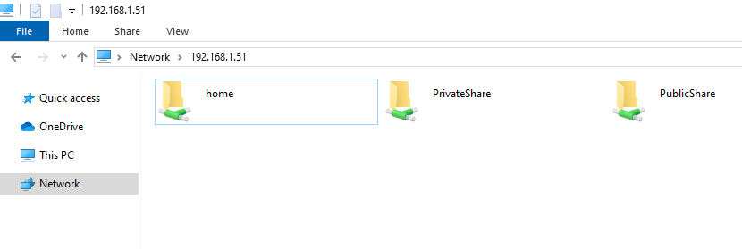
4.2 Permission Verification
Verified access from different OS platforms (Windows/Linux)
Users had access only to their folders
Verified write/read restrictions worked correctly

Slide 17
CONCLUSION
Deployed a fully functional NAS Server using OpenMediaVault in a virtualized
environment
Configured storage, shared folders, and enabled SMB/CIFS protocol
Tested multi-device access with user-specific permissions

