Slide 1
Memories
FULLSTACK II PROJECT
SESSION:2020-21

Slide 2
Group Members
Anushka Pandey(181500125)
Naman Maheshwari (181500411)
Nikhil Baghel (181500424)
Mentor: Pankaj Kapoor Sir

Slide 3
Objective
The objective is to build a Website which includes Front-end and Back-end in which we implement all the the concept of Technology like HTML, CSS, Bootstrap, NodeJS , mongoDB ,express JS , etc .

Slide 4
About this project
In this project, We have build a FullStack Mern Application “Memories” ,it is a simple social media app where you can post your memories and socialize with your friends.It contains three sections.
Header section: In this section , there is a header called as "Memories" with a logo of a picture.
Cards section: In this section, there is a place for cards on left side of the page, u will see all the post here which are uploaded ,these cards have the information of who posted it and date of upload and the actuall memory with a photo , it also have tags and you can see the likes on that post.
Form section: In this section , there is a form to post the memories which you want to upload with a picture you want to share and you can also add tags . You have add your name on it.

Slide 5
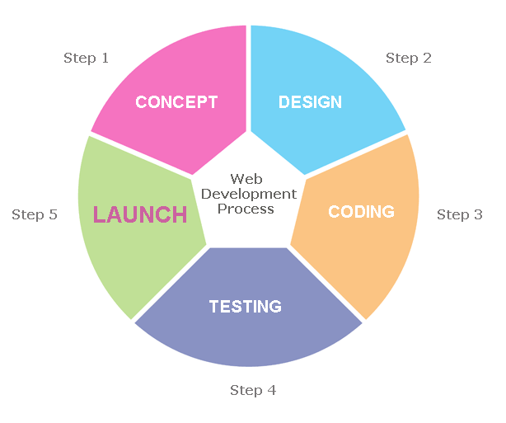
This figure showing the different steps involved in Web development process

Slide 6
Software and Hardware Requirements
Hardware : PC or Laptop containing (i3 processor or above), RAM 4GB or more and Hard Disk 500GB or above)
Software: Window 7/8/10
VS code
Github
Google chrome

Slide 7
Technology Used
HTML : It is used by developers to define structure of the webpage. Every page you see on browser is written using HTML. Web-Browser read and understand the markup text in HTML.
CSS : CSS stands for Cascading Style Sheets. To define style of the Web Page that is, type of font, its size, background-color etc. ,we use CSS. Using CSS, you can define, how each element of your web-page should look. Browser read HTML and CSS together to define the web page.

Slide 8
React : React is an open-source, front end, JavaScript library for building user interfaces or UI components. It is maintained by Facebook and a community of individual developers and companies. React can be used as a base in the development of single-page or mobile applications. However, React is only concerned with state management and rendering that state to the DOM, so creating React applications usually requires the use of additional libraries for routing, as well as certain client-side functionality.
JavaScript : JavaScript is a client-side scripting language of web developed by Netscape in 1995 with the name LiveScript. JavaScript is used to build interactive websites with dynamic features and to validate form data. JavaScript is high-level, dynamic and browser interpreted programming language, supported by all modern web browsers. Apart from web browser, JavaScript is also used to build scalable web applications using Node JS. JavaScript is also being used widely in game development and Mobile application development.

Slide 9
NodeJS : Node.js is an open-source, cross-platform, back-end JavaScript runtime environment that runs on the V8 engine and executes JavaScript code outside a web browser. Node.js lets developers use JavaScript to write command line tools and for server-side scripting—running scripts server-side to produce dynamic web page content before the page is sent to the user's web browser. Consequently, Node.js represents a "JavaScript everywhere" paradigm, unifying web-application development around a single programming language, rather than different languages for server-side and client-side scripts.
MongoDB : MongoDB is a source-available cross-platform document-oriented database program. Classified as a NoSQL database program, MongoDB uses JSON-like documents with optional schemas. MongoDB is developed by MongoDB Inc. and licensed under the Server Side Public License (SSPL).

Slide 10
SCREENSHOTS
FROM THE WEBSITES

Slide 11

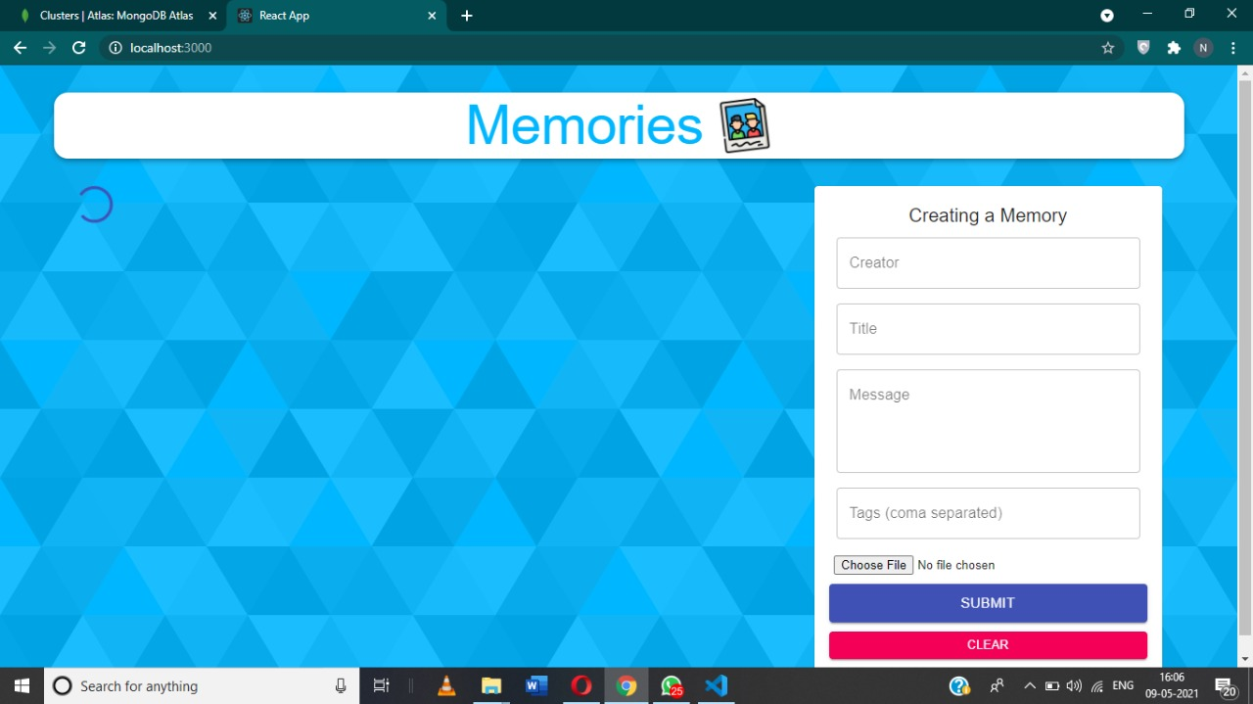

Slide 12
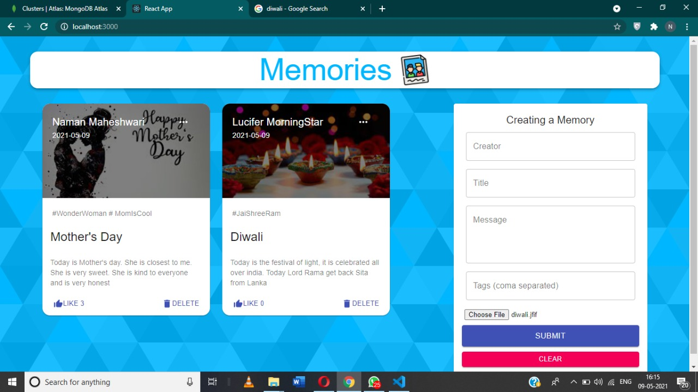

Slide 13
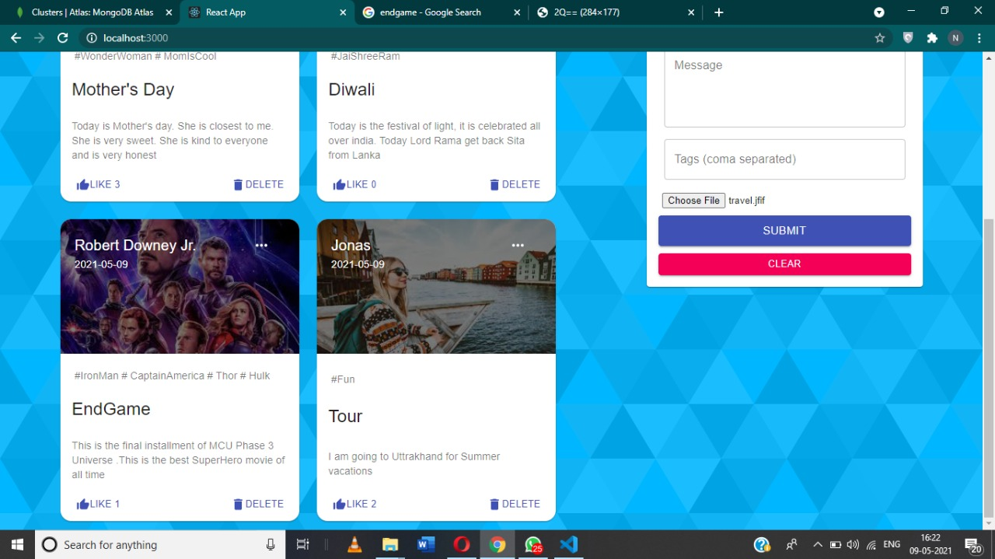

Slide 14
Few Limitations
People who are not familiar with computers or using online websites can’t use this software
There is always a scope of improvement in the software so in this also, like we will like to improve its user interface, add more features like we can add login, signup page , we can link it with social media accounts.

Slide 15
Thank
You…

