Slide 1
Technocrats
Shikha Maheshwari
Sowmya S
Akash Kumar
Prateek Sharma
Breaking Knowledge Silos
with AI-Powered
Team Intelligence

Slide 2
Problem Statement / Abstract
Knowledge Silo Challenges
Critical knowledge confined to senior team members.
Slow incident resolution, especially during off-hours
Teams blocked for hours/days waiting for answers
Strong dependency on Subject Matter Experts (SMEs)
Onboarding new team members takes weeks
No troubleshooting guide
Authentication service ownership unclear → Incident delayed
API documentation location unknown → Development blocked
Countless hours lost in productivity
Knowledge loss during team transitions
Our Solution
AI-powered intelligent assistant that:
Aggregates multi-source data into a unified knowledge base
Enables natural language querying
Provides contextual, accurate, and visual responses
Debug CI/CD pipeline failures instantly
Understand system architecture with diagrams and explanations
Provide personalized onboarding guidance

Slide 3
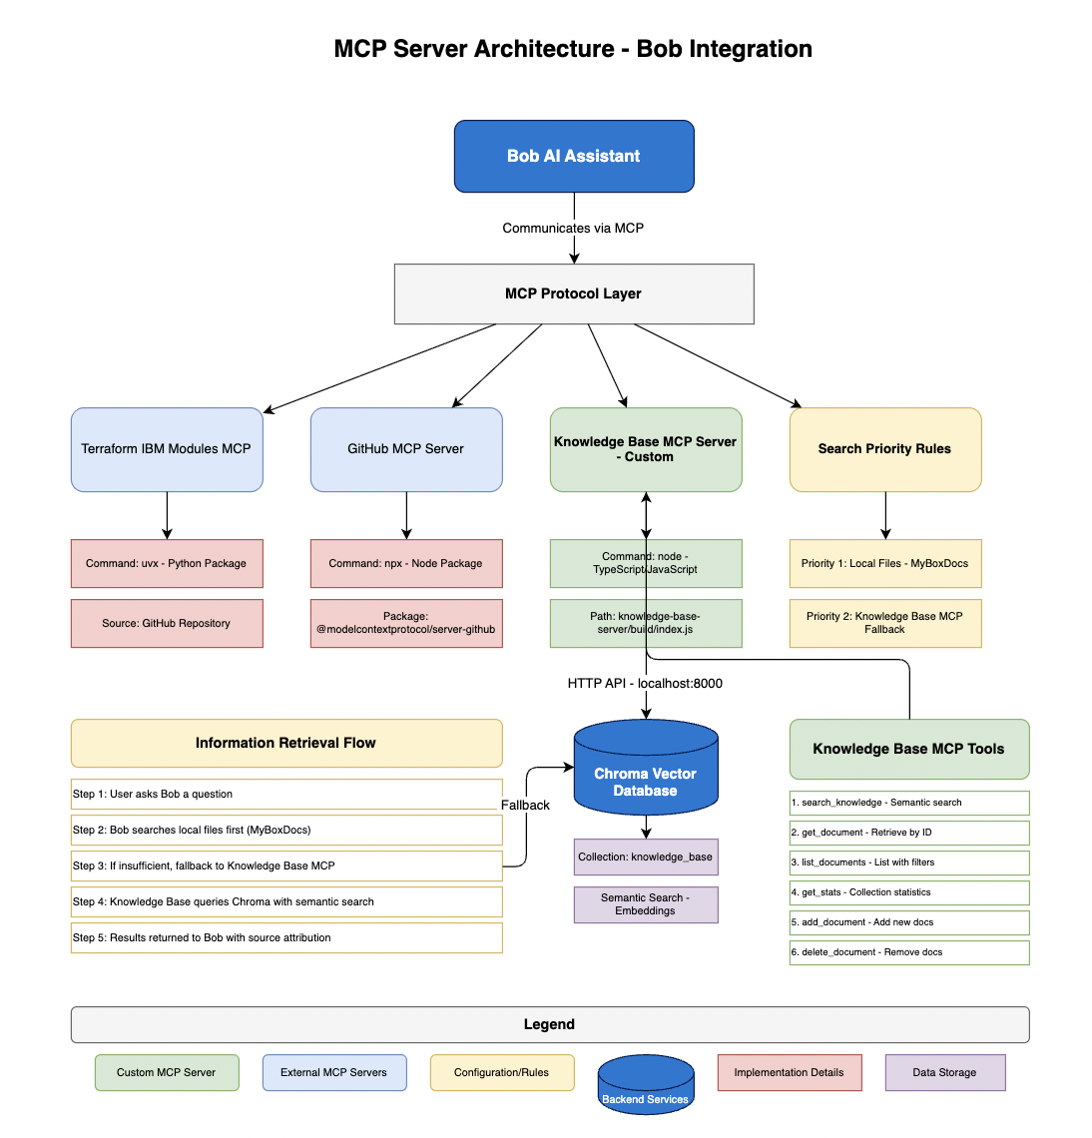
How we used Bob ?
Multi-Source Intelligence - Integrations
• Git MCP Server: Extracts code and repository-level insights
• Terraform IBM Modules MCP Server: Provides infrastructure and configuration context
• Box Notes: Ingested into Chroma DB for semantic search
What We Built ?
Unified query interface across all sources
Context-aware retrieval using embeddings (Chroma DB)
Intelligent Response = Code + Documentation + Infrastructure + Notes
Key Learnings from Bob
Enabled agent-based orchestration across multiple tools
Simplified integration of heterogeneous data sources
Eliminated need for complex custom orchestration
Delivered contextual answers instead of keyword-based search
Building an Intelligent Knowledge Assistant

Slide 4
Outcomes & Impact
(Before vs After)
Measurable Transformation | Before | After
Knowledge Retrieval | 30 to 60 mins | Seconds
Incident Resolution | Hours | Minutes
Onboarding Time | Weeks | Days
SME Dependency | High | Significantly Reduced
Business Impact
• Increased team productivity and efficiency
• Faster development and delivery cycles
• Improved system reliability and response time
• Democratized access to knowledge across teams
Final Vision
An intelligent team member that:
• Is always available
• Never forgets knowledge
• Continuously learns and improves
• Ensures no question goes unanswered

