Slide 1
A Critical Productivity Bottleneck
Knowledge Silos Challenge:
Critical knowledge confined to senior team members
Information fragmented across disconnected systems
Teams blocked for hours/days waiting for answers
Single points of failure when key personnel is unavailable
Real-World Scenarios:
CI/CD pipeline fails → No troubleshooting guide
Authentication service ownership unclear → Incident delayed
API documentation location unknown → Development blocked
Challenges Faced:
Countless hours lost in productivity
Amplified in remote/distributed teams
Knowledge loss during team transitions

Slide 2
Slide 1: Problem Statement / Abstract
Intelligent Knowledge Assistant for Engineering Teams
The Problem
• Knowledge is scattered across multiple sources:
GitHub repositories, Terraform modules, runbooks
Chat conversations, Box notes, internal wikis
• Strong dependency on Subject Matter Experts (SMEs)
• Slow incident resolution, especially during off-hours
• Onboarding new team members takes weeks
• Critical institutional knowledge is often lost
Our Solution
• AI-powered intelligent assistant that:
Aggregates multi-source data into a unified knowledge base
Enables natural language querying
Provides contextual, accurate, and visual responses
Key Use Cases
Debug CI/CD pipeline failures instantly
Understand system architecture with diagrams and explanations
Provide personalized onboarding guidance

Slide 3
Slide 2: How We Used Bob (Our Learnings)
Building with Bob: Multi-Source Intelligence
Architecture Flow
Sources → MCP Servers → Bob → ChromaDB → Intelligent Responses
Integrations
• Git MCP Server:
Extracts code and repository-level insights
• Terraform IBM Modules MCP Server:
Provides infrastructure and configuration context
• Box Notes:
Ingested into ChromaDB for semantic search
What We Built
• Unified query interface across all sources
• Context-aware retrieval using embeddings (ChromaDB)
• Intelligent response generation combining:
Code + Documentation + Infrastructure + Notes
Key Learnings from Bob
Enabled agent-based orchestration across multiple tools
Simplified integration of heterogeneous data sources
Eliminated need for complex custom orchestration
Delivered contextual answers instead of keyword-based search

Slide 4
Slide 3: Outcomes & Impact
Measurable Impact & Transformation
Before vs After
• Knowledge retrieval:
Before: 30–60 minutes
After: Seconds
• Incident resolution:
Before: Hours
After: Minutes
• Onboarding:
Before: Weeks
After: Days
• Dependency on SMEs:
Before: High
After: Significantly reduced
Business Impact
Increased team productivity
Faster development and delivery cycles
Improved system reliability
Democratized access to knowledge
Final Vision
An intelligent team member that:
Is always available
Never forgets knowledge
Continuously learns and improves
Ensures no question goes unanswered

Slide 5
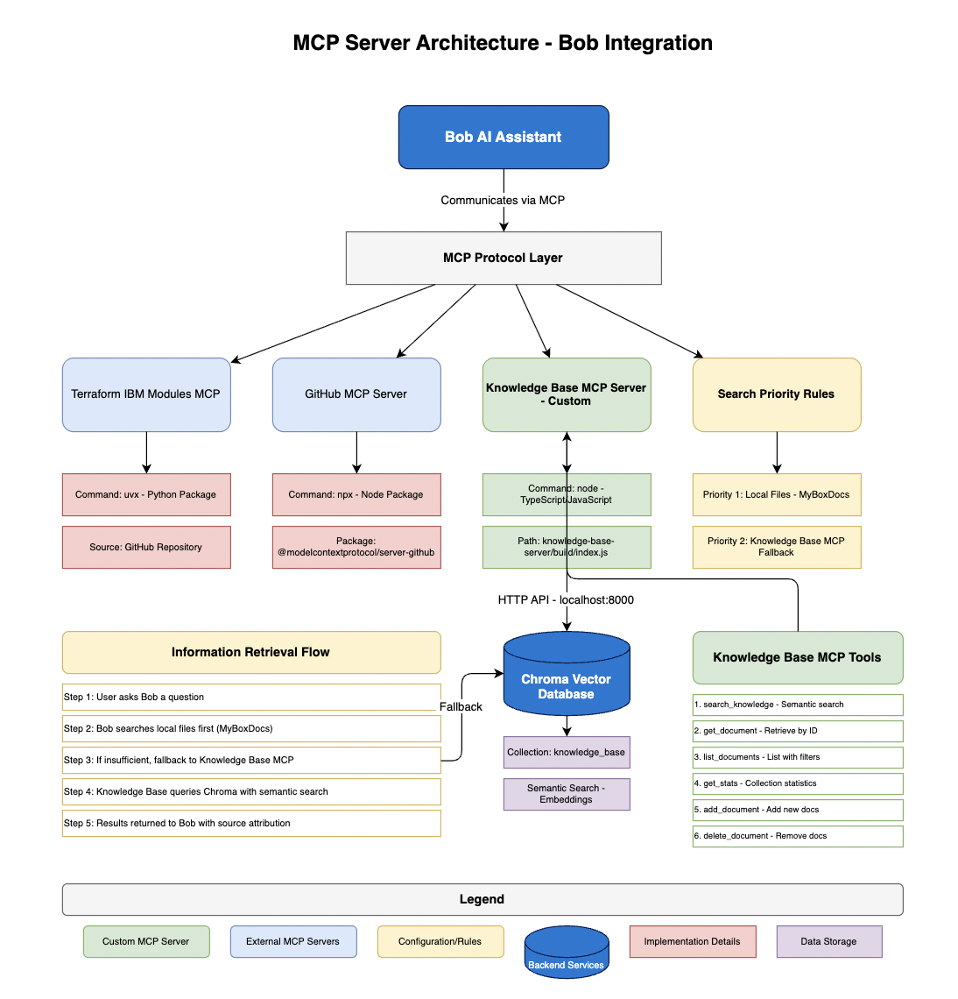
Building an Intelligent Knowledge Assistant
MCP Integration Architecture:
• Bob communicates via MCP Protocol Layer
• Enables integration with multiple specialized servers
• Unified interface for diverse tools and data sources
Intelligent Search Strategy :
• Defined priorities
•
• Optimizes for both speed and coverage
Other Learnings:
• Modularity, Extensibility, Scalability
• Source traceability and transparency
• Mix of external packages and custom servers

Slide 6
Outcomes & Impact
Measurable Transformation
• Knowledge Retrieval: 30 to 60 mins → Seconds
• Incident Resolution: Hours → Minutes
• Onboarding Time: Weeks → Days
• SME Dependency: High → Significantly Reduced
Business Impact
• Increased team productivity and efficiency
• Faster development and delivery cycles
• Improved system reliability and response time
• Democratized access to knowledge across teams
Final Vision
• Always available
• Never forgets knowledge
• Continuously learns and improves
• Ensures no question goes unanswered
An intelligent team member that’s always available, never forgets, and continuously improves

