Slide 1

  Disease Specific Diet-Planner Database
  Suresh Maheshwari
  BAI-23S-006
  Bhawana Dhera
  BAI-23S-049

Slide 2
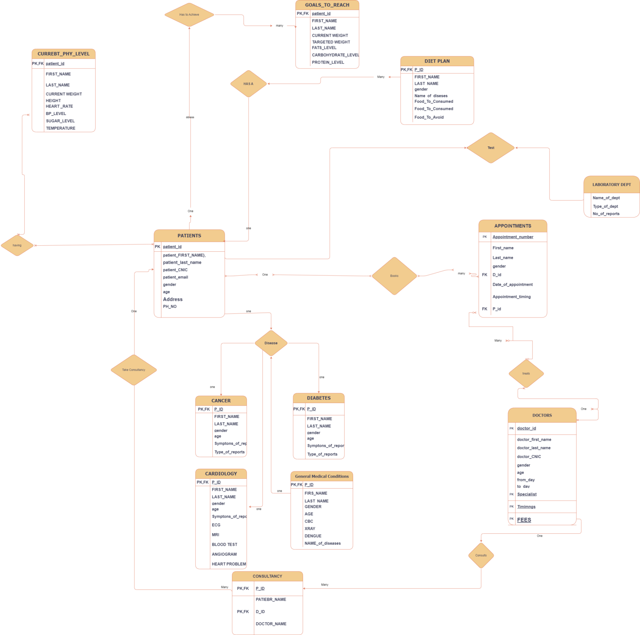
  Er-Model

Slide 3
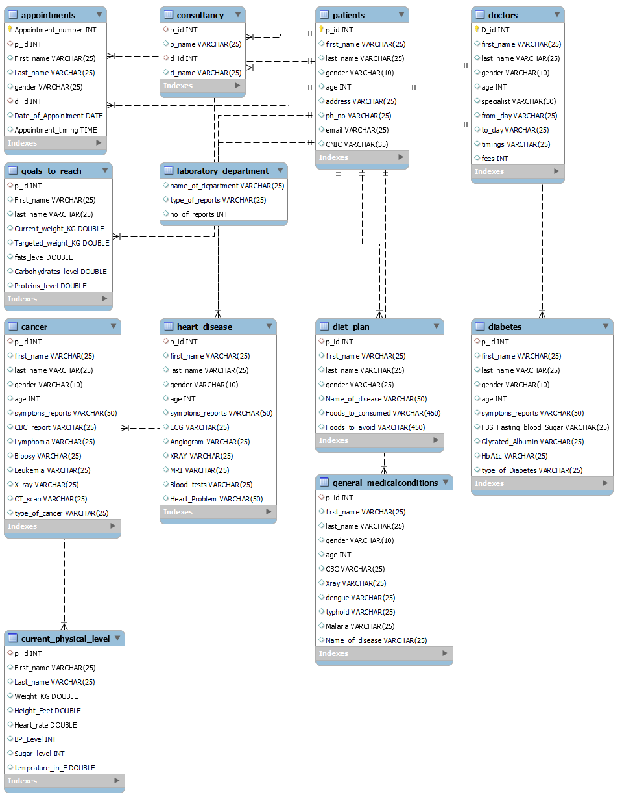
  Er-Diagram

Slide 4
Relationships of Each Table
One-to-One Relationships:
1.Patients Table (patients) - Goals to Reach Table (goals_to_reach):
  Patients (p_id) <--> Goals to Reach (p_id)
Patients Table (patients) - Current Physical Level Table (current_physical_level):
  Patients (p_id) <--> Current Physical Level (p_id)

Slide 5
Relationships of Each Table
Many-to-Many Relationships:
Patients Table (patients) - Doctors Table (doctors) through Appointments (appointments):
  Patients (p_id) <--> Appointments (p_id)
  Doctors (d_id) <--> Appointments (d_id)
Patients Table (patients) - Doctors Table (doctors) through Consultancy (consultancy):
  Patients (p_id) <--> Consultancy (p_id)
  Doctors (d_id) <--> Consultancy (d_id)

Slide 6
Relationships of Each Table
One-to- Many Relationships:
Patients Table (patients) - Heart Disease Table (heart_disease):
  Patients (p_id) <--> Heart Disease (p_id)
Patients Table (patients) - General Medical Conditions Table (general_medicalconditions):
  Patients (p_id) <--> General Medical Conditions (p_id)
Patients Table (patients) - Diet Plan Table (diet_plan):
  Patients (p_id) <--> Diet Plan (p_id)
Patients Table (patients) - Goals to Reach Table (goals_to_reach):
  Patients (p_id) <--> Goals to Reach (p_id)
Patients Table (patients) - Current Physical Level Table (current_physical_level):
  Patients (p_id) <--> Current Physical Level (p_id)

