Slide 1
BC-Z: Zero-Shot Task Generalization with Robotic Imitation Learning
Authors: Eric Jang, Alex Irpan, Mohi Khansari, Daniel Kappler, Frederik Ebert, Corey Lynch, Sergey Levine, Chelsea Finn

Slide 2
Presenters
Saran Koundinya Tummalagunta
Uma Maheswar Reddy

Slide 3
Contents
Abstract
Introduction
Interactive Imitation Learning
Related Work
Problem Setup and Method Overview
Data Collection and Workflow
Learning Algorithm
Language and Video Encoders
Policy Training
Network Architecture
Experiment Results
Evaluating Zero-Shot and Few-Shot Task Generalization
Ablation Studies and Comparison
Conclusion and Future Work

Slide 4
Abstract
The primary objective of this paper is to develop vision-based robotic manipulation techniques that allow robots to generalize and perform new tasks beyond their initial training.
In this paper, the researchers primarily focus on an imitation learning algorithm.
This approach uses machine learning and requires the robot to observe and replicate activities from an expert to perform new tasks.
The researchers have developed a flexible and interactive learning system capable of learning through both interventions where the robot is corrected when it makes errors and demonstrations, where it observes an expert performing a task.

Slide 5
Introduction
The task at hand for researchers is to create a general-purpose robot that can follow user instructions to carry out a variety of tasks in unpredictable circumstances.
To accomplish this, the robot must generalize its abilities, which include navigating novel settings, recognizing and interacting with unfamiliar items, and comprehending commands it has never encountered before. The main objective is to achieve a high degree of usefulness and flexibility in a variety of uncertain circumstances.
The robot makes a few assumptions about the representation of the world state, and it employs end-to-end learning from pixels. This approach is noted as a flexible option for modeling the behavior of such robots.
It builds on prior research that successfully applied one-shot or zero-shot techniques to new objects and new object-goal combinations, yet zero-shot generalization to new tasks remains challenging, especially for vision-based manipulation tasks that require diverse skills and interactions with a wide range of objects.

Slide 6
Interactive Imitation Learning
Researchers have developed the Interactive Imitation learning with two key features that make easier way to gather the high dimension quality data and allow the system to generalize to whole new tasks .
The shared autonomy policy is an policy that the robot policy can be verify and corrected by the humans and the raw dimensional data can be collected by the system when it integrates shared autonomy with teleoperation.
The policy is subject to several forms of task specification, such as linguistic instruction or a video of an individual completing the work, as determined by the system.
By delivering a spoken or video command of the new task at test time, these continuous types of task definition in contrast to discrete one-hot task identifiers, may allow the robot to generalize zero-shot or few-shot to new tasks.

Slide 7
Related work
By conditioning on videos or linguistic instructions, researchers have achieved many types of generalization in imitation learning, such as zero-shot and few-shot generalization to new objects, settings, and activities.
Our approach concentrates on few-shot and zero-shot generalization for novel 7-DoF manipulation tasks where training data does not contain task-relevant objects or target images.
Experts streamline the procedure and address distribution shift by intervening only when errors are likely to occur, drawing inspiration from HG-DAgger and EIL for their data collection strategy.
Our goal is to apply to new tasks in 100 difficult scenarios that call for fine control and several choices in each episode.

Slide 8
Problem setup and Method overview
The main goal is to implement conditional policy that can interpret the RGB image denoted s belongs S, together with a task command w belongs W this might corresponds to the language string or video of the person .
The policy is trained via a combination of human-in-the-loop shared autonomy and direct demonstration on a large-scale dataset obtained via a VR-based teleoperation setup
In the latter case, the robot is equipped with trained policies, and when the robot errs, the human operator steps in to rectify it. Similar to the human-gated DAgger (HG-DAgger) algorithm , this process offers a continuous signal that may be used to monitor the policy's performance in addition to iteratively improving the learned policy.

Slide 9
Cont’d..
In the latter case, the robot is equipped with trained policies, and when the robot errs, the human operator steps in to rectify it.
The policy architecture is composed of a control layer (𝜋) that uses the state (s) and embedding (z) to produce actions (a) and an encoder q(z∣w) that translates the command w into an embedding (z).
Because of its structure, additional supervision like pretrained language embedding can be added to improve the latent task
space and make generalization easier.
Trials show that this method allows for generalization to new tasks that are not yet known such as new verb-object combinations.

Slide 10
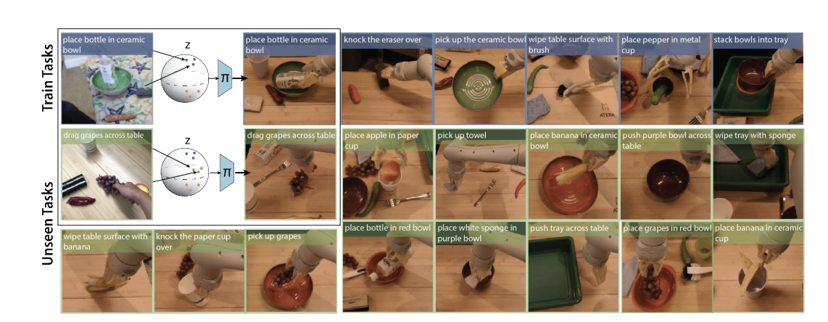
Fig :A subset of training tasks (top row), and a subset of held-out tasks (bottom two rows) used for evaluating zero shot task generalization.

Slide 11
Data Collection and Workflow
Additionally, the system can be trained on various kinds of task-specific data. Videos of people carrying out the task or pre-trained embeddings of natural language numerical representations of words or phrase may be examples of this.
Data Collection and Results : researchers has collect the data on real robot that doing over more than 100 unique jobs while performing the tasks they have achieved an average succession rate of 44% and the model performing the 24 new jobs which they don’t have the prior experience using the data.
The teleoperation system provides quick, closed-loop control at 10 Hz and enables an operator to operate the robot from a third-person perspective using an Oculus VR headset and handheld controls.
This configuration facilitates rapid intervention and simple task demonstration.
Robots are positioned in random positions in front of a table containing six to fifteen everyday things. Videos and demonstrations for one hundred jobs that cover skills like push and pick-and-place are gathered.

Slide 12
Cont’d..
After that, the model is put to the test on 29 more tasks that need precise task interpretation and reliable action output, either through fresh verbal descriptions or videos
Shared Autonomy Data Collection: To train an initial multi-task strategy, expert-only demos are the first step in the data collection process. The robot then attempts tasks under human supervision in a shared autonomy mode, allowing the human to intervene and correct the robot as needed. To re-train the policy, this method—dubbed HG-DAgger—combines intervention data with pre-existing data. 25,877 demonstrations in all were gathered, greatly enhancing performance.
Shared Autonomy Evaluation: Gathering more information to improve the policy and assessing it to find problems with workflow are mutually exclusive. The intervention rate, which has a negative correlation with policy effectiveness and suggests that fewer interventions equate to greater policy performance, is an extra evaluation indicator that shared autonomy offers.

Slide 13
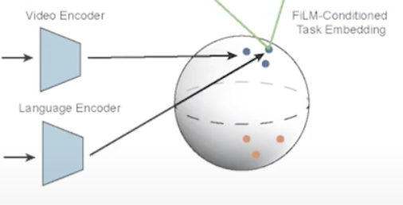
Learning Algorithm
Components of the Dataset for Each Task i
Expert Data (s,a) ∈ De^i
s: States
a: Actions
Human Video Data vh^i ∈ Dh^i​:
vh​: Video sequences of human performing the task
Language Command w^i_l:
w : Natural language instruction associated with the task

Slide 14
Language and Video Encoders
Overview
Purpose of Encoders q(z|w) :Convert inputs (language command or video) to task embeddings z.
Language Encoder
Input: Language command w^i_l.
Method: Use pre-trained multilingual sentence encoder.
Output: 512-dimensional language vector for each task.
Video Encoder
Input: Human video w^i_h.​
Method: Convolutional neural network (ResNet-18 based).
Dataset: 18,726 videos of humans performing tasks in various settings
.

Slide 15
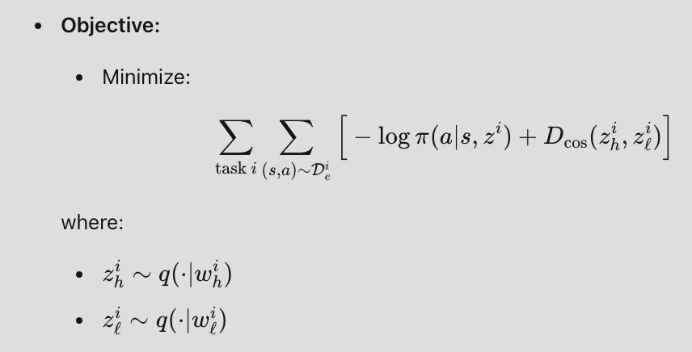
Cont’d…
Training Procedure
Paired Examples:
Human video w^i_h​ and corresponding demonstration {(s, a)}^i.
Embedding Process:
Encode w^i_h​ to z^i_h​ using q(⋅ | w^i_h).
Pass z to control layer π(a∣s,z^i).
Backpropagate gradient from behavior cloning loss
Auxiliary Language Regression Loss
Purpose: Improve semantic alignment of video embeddings
Method: Train video encoder to predict language command embedding with cosine loss
behavior cloning
Language regression
video encoder
language encoder

Slide 16
Policy Training
Training Objective
we train Action Policy π(a∣s,z) via:
Huber Loss: XYZ and axis-angle predictions
Log Loss: Gripper angle
Data Augmentation Techniques: Random cropping, Downsampling, Standard photometric augmentations.
Open-Loop Auxiliary Predictions
Objective: Predict action sequence for next 10 steps in an open-loop
Training Benefit: Provides auxiliary training objective
Inference Mode: Closed-loop, executing only the first action based on the current image
Visualization: Allows offline inspection of closed-loop plan quality
State Differences as Actions
Problem Addressed: Small actions and dithering behavior from cloning actions at 10Hz
Solution: Define actions as state differences to target poses N steps in the future and use adaptive algorithm to choose N based on arm and gripper movements.
Benefits: Improved action learning

Slide 17
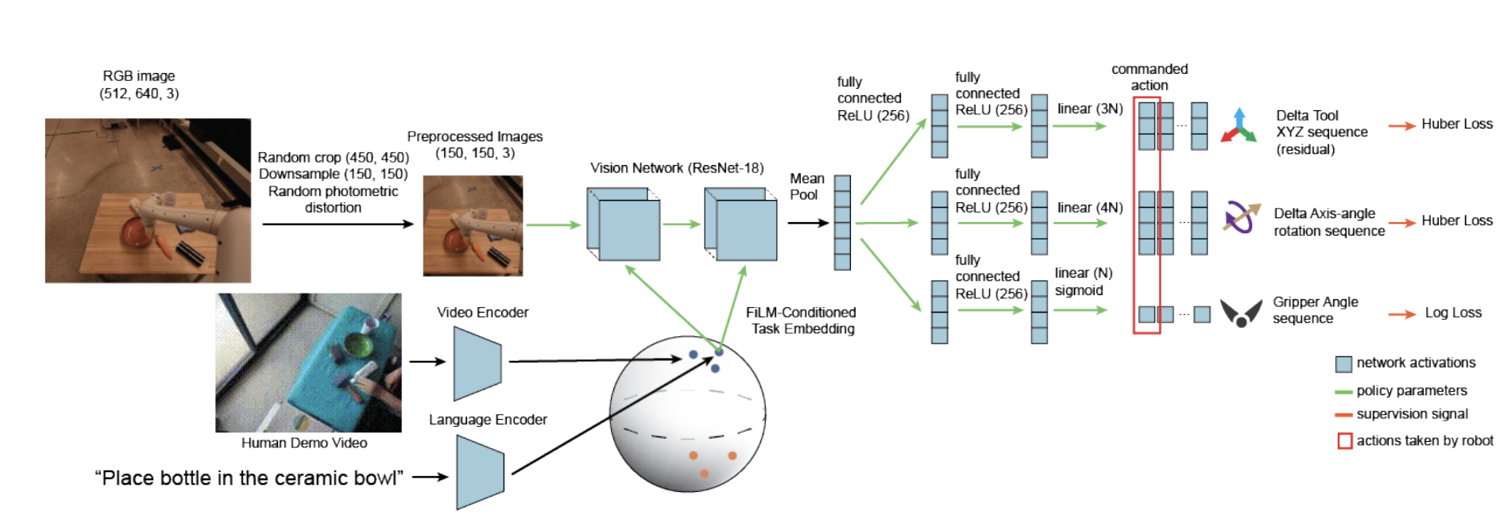
Network Architecture
Policy Network Architecture:
Utilizes ResNet-18 for image processing, branching into "action heads" (MLPs with two hidden layers of 256 units each).
Action heads predict delta XYZ, delta axis-angle, and normalized gripper angle for end-effector actions.
Task Conditioning:
512-dimensional task embedding z is incorporated using FiLM layers, applying channel-wise scales and shifts to the four ResNet blocks for task-specific feature modulation. Architecture Figure

Slide 18
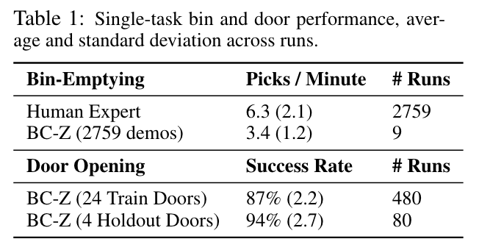
Experimental Results
The initial validation focuses on single-task visual imitation learning, aiming to answer several research questions. These questions include whether BC-Z can achieve zero-shot and few-shot generalization to new tasks from language or video commands, identifying performance bottlenecks and whether they are limited by the task embedding or the policy, and analyzing the importance of HG-DAgger data collection and adaptive state differences.
To evaluate BC-Z's performance on individual vision-based tasks before moving to multi-task settings, two specific tasks were chosen: bin-emptying and door opening. In the bin-emptying task, the robot is required to grasp and drop objects into an adjacent bin. For the door opening task, the robot must push a door open while avoiding collisions.
Validation results show that BC-Z demonstrates significant performance improvements on both training and held-out scenes. Notably, the bin-emptying task's performance is over half the speed of a human teleoperator, highlighting the effectiveness of the approach.

Slide 19
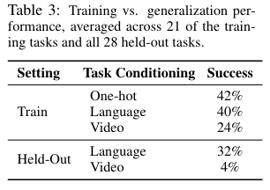
Evaluating Zero-Shot and Few-Shot Task Generalization
The dataset consists of 100 different manipulation tasks, divided into two disjoint object sets. The first set includes 21 tasks requiring a variety of skills, such as pick-and-place and positioning objects. The second set comprises 79 tasks that involve simpler behaviors but more clutter. For evaluation, 29 held-out tasks were used: 4 tasks from the 79-task family (without cross-object set generalization) and 25 tasks mixing objects from both sets. Analysis suggests that BC-Z's performance in generalization is more bottlenecked by the control layer π(a∣s,z) than by the task embedding q(z∣w). Language embeddings proved sufficient for task representation, while video embeddings posed greater difficulty, especially for novel tasks.The hypothesis is that the wide range of locations, objects, and distractors contributes to this task difficulty.

Slide 20
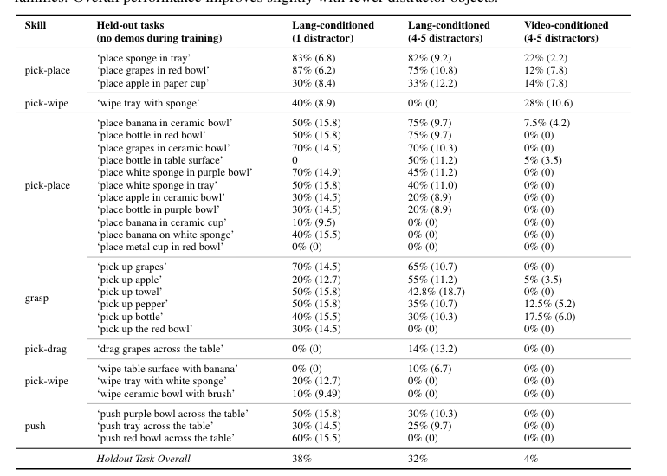
Table 2: Success rates for zero-shot (language) and few-shot (video) generalization.

Slide 21
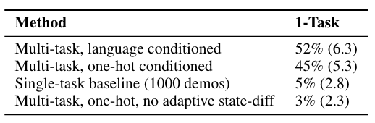
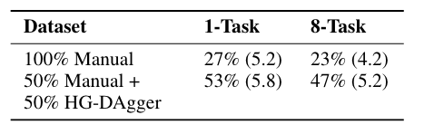
Ablation Studies and Comparisons
Evaluating Training Strategies
Validating the importance of BC-Z design decisions using the 21-task family, focusing on the task "Place the bottle in ceramic bowl" with 1000 demos. By comparing multi-task training, which used 25,877 demos, to single-task training with only 1000 demos, we found that the single-task baseline achieved just 5% success. In contrast, multi-task training significantly improved performance. Notably, the multi-task, language-conditioned model achieved a success rate of 52%.
HG-DAgger vs 100% Expert Demos:
Comparison of policies trained using 50% expert demos and 50% HG-DAgger interventions vs. 100% expert demos.

Slide 22
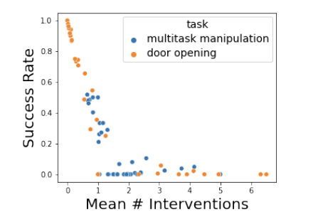
Mean Number of Interventions vs task success rate
Clear correlation between fewer interventions and higher success rates, suggesting interventions as a proxy for policy performance.
This result suggests that we can indeed use this metric with HG-DAgger for development purposes.

Slide 23
Conclusion and Future Work
The paper has introduced a multi-task imitation learning system using flexible task embeddings and training on a 100-task dataset, enabling generalization to new tasks via user-provided commands. Evaluation on 29 vision-based manipulation tasks revealed that simple imitation learning can achieve task-level generalization without additional robot data. Key findings include the effectiveness of HG-DAgger for performance and pre-trained language embeddings for task conditioning without extra training. Despite varied performance on novel tasks, the robot often demonstrates partial task understanding by correctly interacting with objects or performing related actions. Future directions include using current policies to initialize fine tuning for improved performance and addressing the "verb-noun" language structure limitation through diverse dataset annotations. Further research is needed to enhance video-based task representations and mitigate low-level control errors in imitation learning algorithms.

Slide 24
THANK YOU!!

