Slide 1
Dell case study- Kit Cycle Time Prediction Model
MAHESWARI bOLLIMUNTHA

Slide 2
Problem Statement and objective
In Dell’s manufacturing process, the kit phase requires gathering all components before production, but its completion time varies due to product complexity, order size, and factory conditions. This variability makes it difficult to accurately predict completion timelines and plan production efficiently
The objective is to develop a machine learning model to predict kit cycle time and estimate the expected completion date using historical order data, product processing times, and factory calendar and capacity information.

Slide 3
METHODOLOGY
Data Preparation and cleaning
Feature Engineering
Model Development
Model Improvement
Insights and Recommendations
Predictions

Slide 4
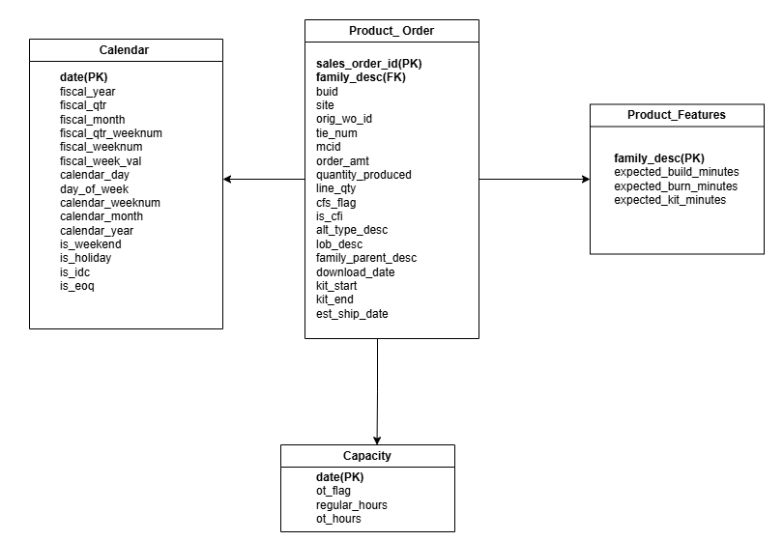
Data Sources
DATASETS USED:
Product Order Data- Forms the base dataset defines what we are predicting .[179,853 rows,19col]
Product Features Data-Captures product complexity ,helps estimate how long an order should take.[260 rows,4 col]
Calendar Data-Captures factory working conditions Explains delays due to non-working or special periods[370 rows,16 col]
Capacity Data-Represents factory workload and availability Helps model impact of capacity constraints on delays[191,934 rows,4col]

Slide 5
Data Exploration and cleaning
Data Quality Issues & Fixes, NaN Handling Strategy, Cleaning Results
Issue | Rows Affected | Fix Applied (Reason)
Missing download_date | 5 rows | Removed rows due to insufficient information to compute lead time features
kit_end < kit_start | 734 rows | Removed invalid records where the end time occurs before the start time
quantity_produced ≤ 0 | 4 rows | Removed unrealistic records with zero or negative production values
NaN after expected_minutes join | ~24% of rows | Imputed using median values to maintain consistency without skewing distribution
NaN after calendar join | minimal | Replaced missing flags with 0 and numeric values with median to preserve logical defaults
NaN after capacity join | minimal | Treated missing capacity as zero, assuming no recorded capacity for that day
Feature Type | Handling Strategy
Binary flags (is_weekend, is_holiday, is_idc, is_eoq) | Fill with 0
Numeric calendar fields (weeknum, month, year) | Fill with training median
Expected minutes (kit, build, burn) | Fill with training median
Capacity hours (regular_hours, ot_hours) | Fill with 0
Label-encoded categoricals | Fit on train + inference combined
Metric | Value
Raw Training Rows | 179,853
Rows Removed | 743 (0.41%)
Rows After Cleaning | 179,110

Slide 6
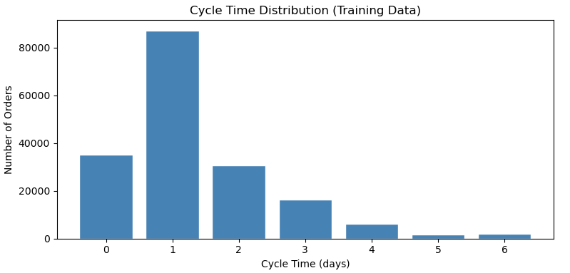
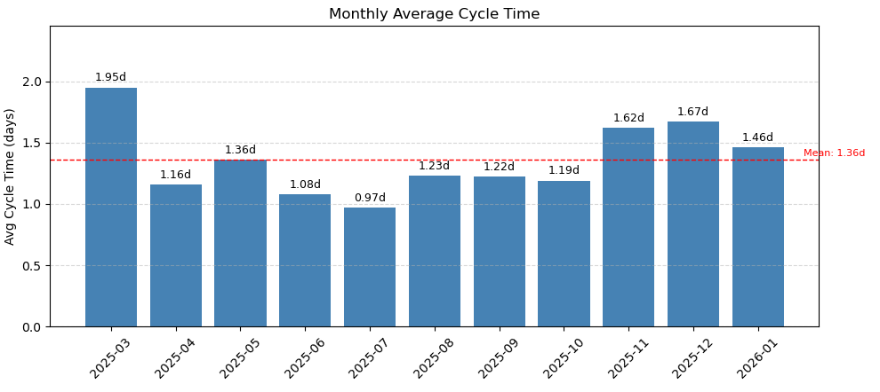
Exploratory data analysis
68% of orders completed within 0–1 days - reflects high overall factory efficiency and quick turnaround
1 day is the most common outcome (48.6%) - serves as a strong and reliable baseline for prediction
Only 1.8% of orders exceed 6 days - rare outliers, capped to prevent model skew
Mar 2025 (~1.95d) - Slowest, driven by fiscal year start, ramp-up, and product introductions
Jul 2025 (~0.97d) - Fastest, reflecting stable operations with minimal external pressures
Nov–Dec 2025 (~1.7d) peak due to EOQ & holidays, followed by Jan 2026 (~1.5d) recovery, which serves as the model validation phase

Slide 7
Setting target variable and FEATURE engineering
Category | Number of features | Features
Product Complexity | 4 | expected_kit_minutes, expected_build_minutes, expected_burn_minutes, total_expected_minutes
Calendar | 6 | day_of_week, is_working_day, is_eoq, is_idc, is_weekend, is_holiday
Capacity | 2 | total_capacity_hours, ot_flag
Order Details | 3 | quantity_produced, line_qty, order_amt
Engineered | 3 | workload, capacity_utilization, download_to_kitstart_days
Order Flags | 2 | is_cfi, cfs_flag
Hierarchy (Encoded) | 4 | family_desc_enc, family_parent_desc_enc, lob_desc_enc, buid_enc
Target variable
cycle_time_days = (kit_end − kit_start).dt.days (capped at 6 days)
Feature | Description
total_expected_minutes | Kit + build + burn minutes for the product family
workload | Quantity_produced × total_expected_minutes
capacity_utilization | Workload ÷ total_capacity_hours (0 if no capacity)
is_working_day | 1 if not weekend AND not holiday
total_capacity_hours | Regular_hours + OT_hours for kit_start date
download_to_kitstart_days | (kit_start − download_date).dt.days, clipped ≥ 0

Slide 8
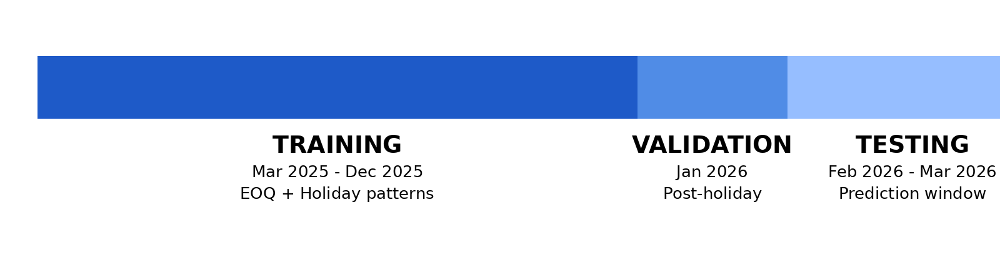
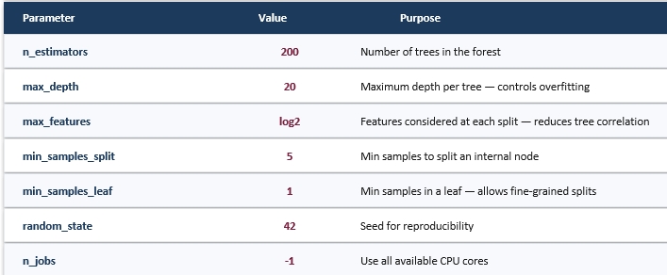
Random Forest -Implementation
Time based dataset split preserves temporal order and avoids data leak compared to random split
Why Random Forest? ​
Handles mixed feature types without scaling ​
Robust to outliers ​
Captures non-linear relationships ​
Provides feature importance
Random Forest parameters used after hyperparameter tuning

Slide 9
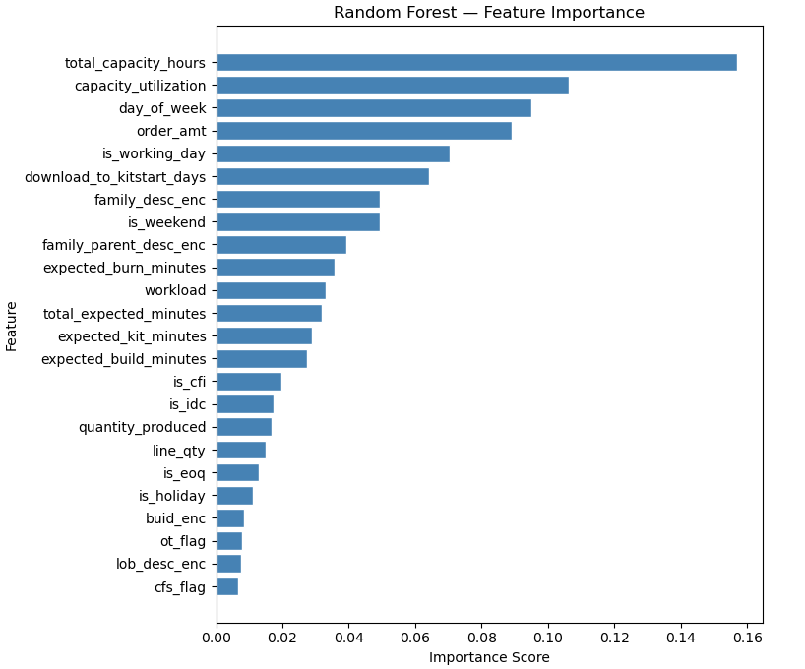
Random Forest –Evaluation and Feature importance
Mean Absolute Error (MAE)
0.7512 days
On average, the model’s predictions deviate by approximately 18 hours, indicating solid accuracy for daily cycle time forecasting.
Root Mean Squared Error (RMSE)
1.1947 days
The gap between RMSE and MAE (0.44) suggests that a small subset of orders experiences relatively higher prediction errors.

Slide 10
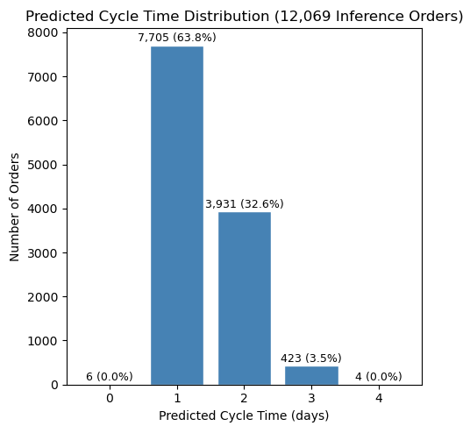
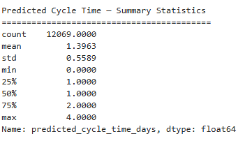
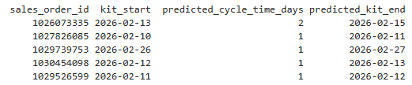
Random Forest – Prediction
Final model retrained on full dataset. Predictions are output as a NumPy array.
Sample prediction on the first 5 orders

Slide 11
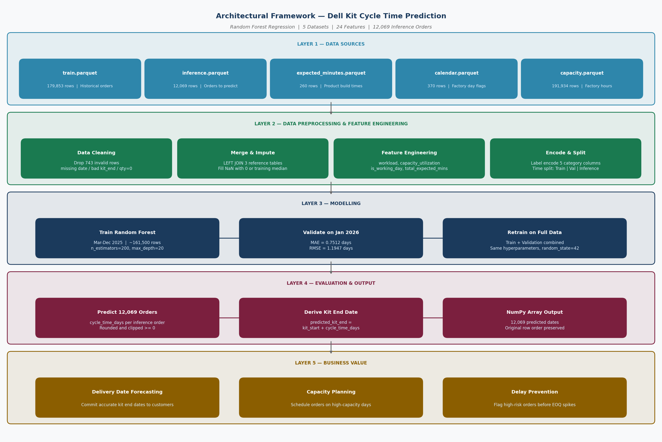

Slide 12

KEY Insights
Capacity (total_capacity_hours and capacity_utilization) is the most significant driver of cycle time, as days with lower available capacity consistently result in longer delays.
Order timing (day_of_week and is_working_day) has a greater impact than product type, with orders initiated near weekends or holidays taking longer due to reduced operational capacity.
End-of-quarter (EOQ) periods (is_eoq) lead to predictable increases in cycle time because of higher production demand and resource constraints.
Start delay (download_to_kitstart_days) plays a critical role in efficiency. Orders downloaded earlier are better planned and completed faster.
Order complexity, measured through workload, has a stronger influence on delays than order value (order_amt), indicating that effort required affects cycle time more than cost.

Slide 13

Strategic Recommendations
Schedule high-workload and complex orders on high-capacity days, avoiding Fridays, holidays, and low-capacity periods to minimize cycle time delays.
Allocate additional overtime capacity during the final two weeks of each quarter to proactively handle predictable end-of-quarter (EOQ) demand spikes.
Retrain the model every quarter using recent data to adapt to changes in product mix and factory conditions and maintain prediction accuracy.
Improve data completeness by filling missing product-level time estimates (approximately 24% of orders) to enhance prediction performance, especially for complex products.

Slide 14
THANK YOU

