Slide 1
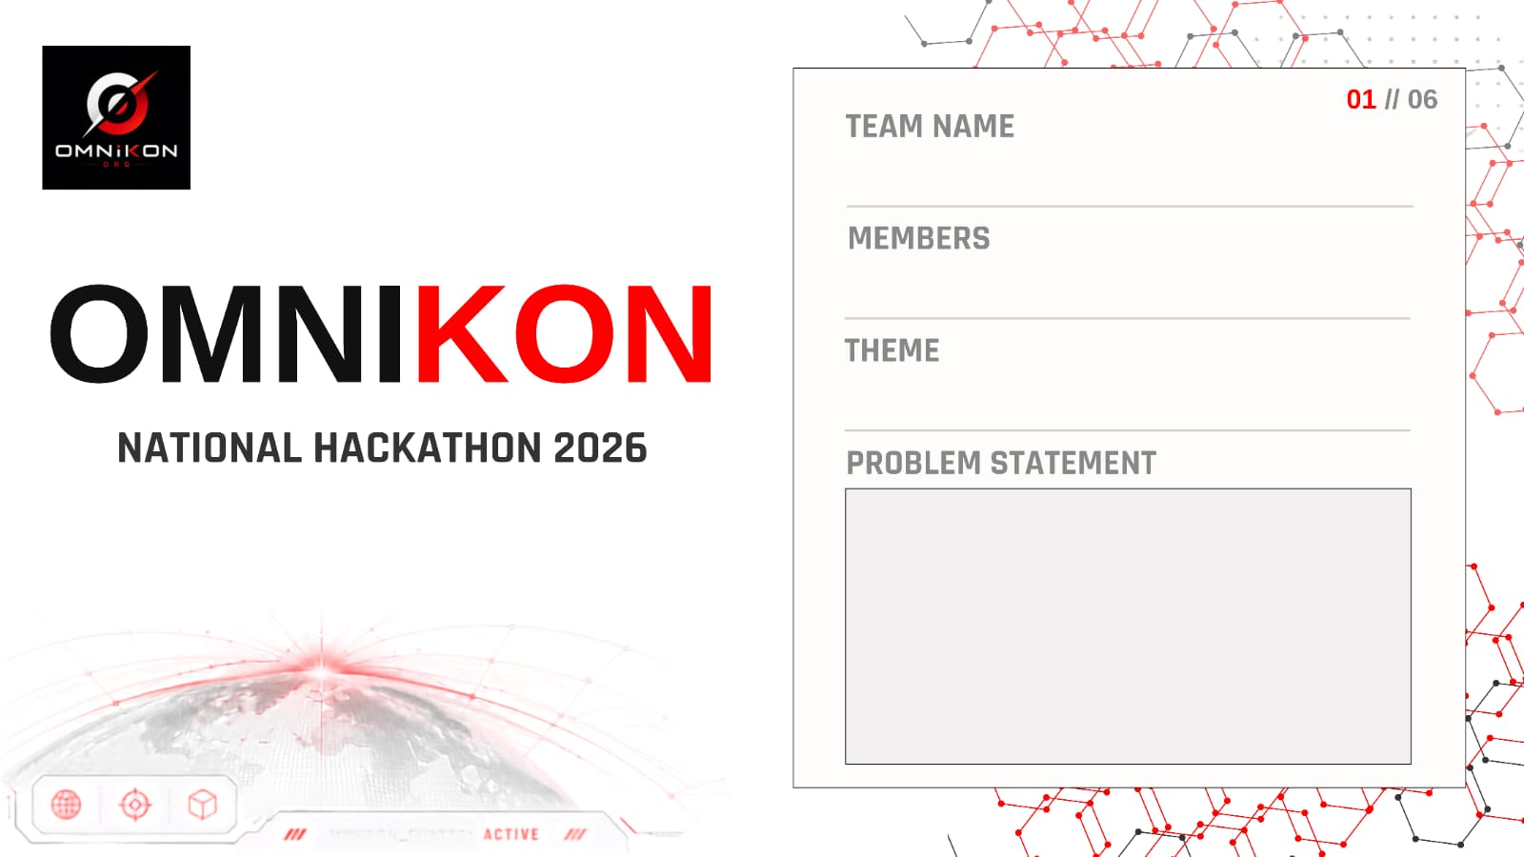
SPARKLE
K. Maheswari | T. Sahasra
Reliable Distress Alerts for Women's Safety
Existing safety apps depend on continuous internet and multiple
deliberate taps. In a real emergency — panic, poor network, or
a locked phone — alerts are delayed or never sent, especially in
rural and low-connectivity areas.

Slide 2
IDEA TITLE
02 // 06
Proposed Solution (Idea Overview)
•
Multi-trigger SOS — 5x power-button press, a BLE wearable button, or the voice keyword “Help” — works even with the screen locked
•
3-tier fallback delivery: live alert over internet → auto-SMS over 2G if data fails → Bluetooth mesh relay via nearby SPARKLE users if there's no signal at all
•
Silent, disguised mode — shows a fake incoming-call screen so an aggressor never suspects an alert was sent
•
Breadcrumb safe-journey trail — shares live location with trusted contacts on timed journeys, auto-escalating if a check-in is missed
ONE MISSION. BUILD THE IMPOSSIBLE.

Slide 3
SYSTEM ARCHITECTURE
03 // 06
Technologies to be used
Android (Kotlin) app • ESP32 / nRF52 BLE wearable band • Node.js + Firebase backend • Twilio / telecom SMS gateway • BLE mesh relay layer • Maps API • 112 India / Dial-100 API bridge
Methodology and process for implementation
1.
Trigger detected (button / BLE / voice)
2.
Internet available → live app alert + audio sent to contacts & police dashboard
3.
No internet → automatic SMS with GPS coordinates (2G fallback)
4.
No signal → Bluetooth mesh relay through nearby SPARKLE phones
5.
Alert confirmed → contacts & control room notified
ONE MISSION. BUILD THE IMPOSSIBLE.

Slide 4
FEASIBILITY AND VIABILITY
04 // 06
Analysis of the feasibility of the idea
•
Runs on any existing smartphone — no new device required for the core app
•
SMS fallback works on basic 2G, reaching rural / low-connectivity users
•
Wearable BOM under ₹500; reuses existing 112 India / Dial-100 infrastructure
Potential challenges and risks
•
False alarms, battery drain on the wearable, sparse mesh coverage in low-density areas
•
Data privacy concerns and cost of wearable adoption at scale
Strategies for overcoming these challenges
•
10-second cancel window + adaptive duty-cycling for battery (5+ days standby)
•
Phased pilot in dense zones first (campuses, transit); SMS remains guaranteed fallback
•
End-to-end encrypted, opt-in location data with auto-delete; subsidized wearables via NGO/police partners
ONE MISSION. BUILD THE IMPOSSIBLE.

Slide 5
IMPACT AND BENEFITS
05 // 06
Potential impact on the target audience
Gives women in both urban high-density and rural low-connectivity areas a genuinely reliable way to call for help — restoring confidence to commute, work late, and travel independently, without depending on always-on data.
Benefits of the solution
•
Social: Faster response reduces harm and builds trust in public spaces.
•
Economic: Low BOM cost + reuse of existing 112 infrastructure keeps city-wide rollout cheap.
•
Environmental / Governance: Structured alert data helps police & NGOs identify unsafe hotspots and target resources.
ONE MISSION. BUILD THE IMPOSSIBLE.

Slide 6
RESEARCH AND REFERENCES
06 // 06
Government of India — 112 India / Dial-100 Emergency Response Support System (ERSS), used as the escalation endpoint for verified alerts
Comparative review of existing personal-safety apps (bSafe, Raksha, Himmat Plus) — core gap identified: all rely on continuous internet, motivating the 3-tier fallback design
Bluetooth mesh relay networking for offline communication — basis for the peer-to-peer alert propagation layer in signal-dead zones
Ministry of Women & Child Development — Nirbhaya Fund safety-technology guidelines, referenced for scalable public-safety integration
Studies on SMS-based emergency alerting over 2G networks in low-connectivity regions — informing the guaranteed-delivery fallback tier
ONE MISSION. BUILD THE IMPOSSIBLE.

