Slide 1
E-Commerce Sales & Profit Analysis
Prepared by: Maheswari

Slide 2
Project Overview & Problem Statement
Project Overview
This project analyzes e-commerce sales and profit data.
The objective is to identify important sales and profit patterns.
Data analysis and visualization are used to support business decisions.
Problem Statement
Identify high-performing categories and regions.
Analyze sales and profit trends.
Find important patterns in the dataset.
Provide data-driven business recommendations.

Slide 3
Dataset & Data Preparation
Dataset
Dataset: Sample Superstore
Records: 9,994
Columns: 22
Contains information about orders, customers, products, sales, discounts and profit.
Data Preparation
Checked column names and data types.
Checked missing values.
Checked duplicate records.
No missing values were found.
No duplicate rows were found.
Created the cleaned dataset: Superstore_Cleaned.csv

Slide 4
EDA & Data Visualizations
Exploratory Data Analysis
Descriptive statistics were calculated.
Correlation between Sales, Quantity, Discount and Profit was analyzed.
Outliers were checked using the IQR method.
Sales and profit were analyzed by category, region and sub-category.
Monthly sales trends were analyzed.
Visualizations Created
Sales by Category
Profit by Category
Sales by Region
Sales by Sub-Category
Monthly Sales Trend
Tool: Python & Matplotlib

Slide 5
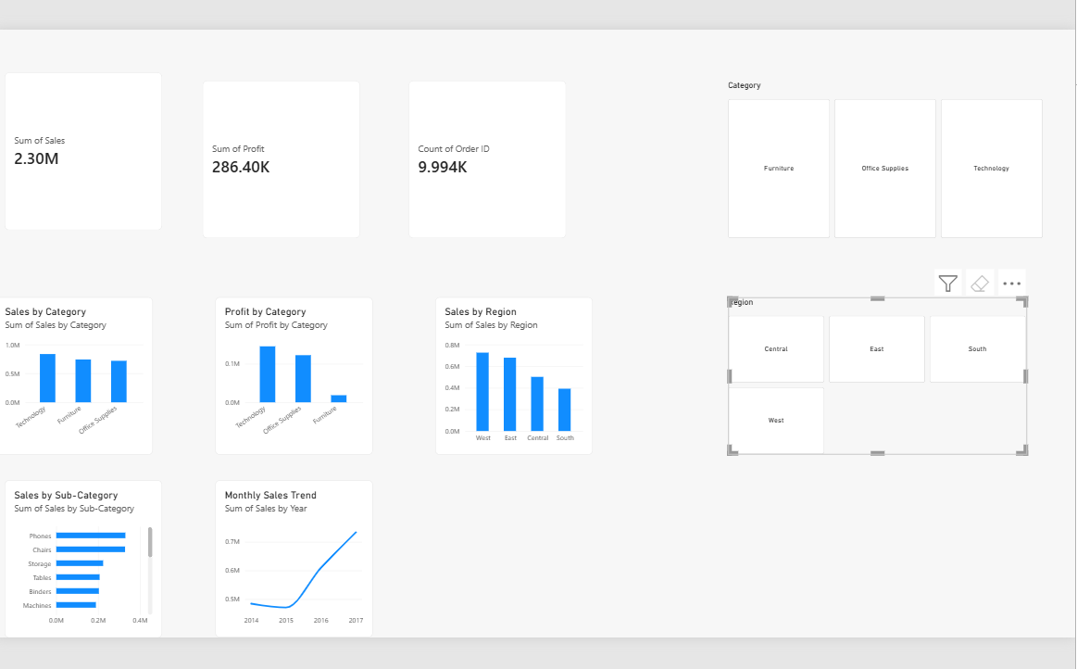

Slide 6
Key Insights & Recommendations
Key Business Insights
Technology is the highest-performing category in terms of sales and profit.
Furniture generates good sales, but its profit performance is comparatively lower.
The West region has the highest sales, while the South region has relatively lower sales.
Phones and Chairs are among the major sales-generating sub-categories.
Overall sales show an increasing trend over time, with stronger sales in the later years.
Recommendations
Focus marketing and inventory planning on high-performing categories such as Technology and sub-categories such as Phones.
Investigate lower-performing regions and product areas, especially the South region and lower-profit categories, and improve pricing, promotions and inventory planning.
Conclusion
Data analytics and Power BI help identify business performance patterns and support better decision-making.

