Slide 2
Snowflake Resource Monitors
To help control costs and avoid unexpected credit usage caused by running warehouses,
Snowflake provides resource monitors.
A virtual warehouse consumes Snowflake credits while it runs.
The number of credits consumed depends on the size of the warehouse and how long it runs.
Limits can be set for a specified interval or date range. When these limits are reached and/or are approaching, the resource monitor can trigger various actions, such as sending alert notifications and/or suspending the warehouses.

Slide 3
Data loading
Credit Quota
Credit quota specifies the number of Snowflake credits allocated to the monitor for the specified frequency interval. Any number can be specified.
In addition, Snowflake tracks the used credits/quota within the specified frequency interval by all warehouses assigned to the monitor. At the specified interval, this number resets back to 0.

Slide 4
Data loading
Assignment of Resource Monitors
A single monitor can be set at the account level to control credit usage for all warehouses in your account.
In addition, a monitor can be assigned to one or more warehouses, thereby controlling the credit usage for each assigned warehouse. Note, however, that a warehouse can be assigned to only a single resource monitor below the account level.

Slide 5
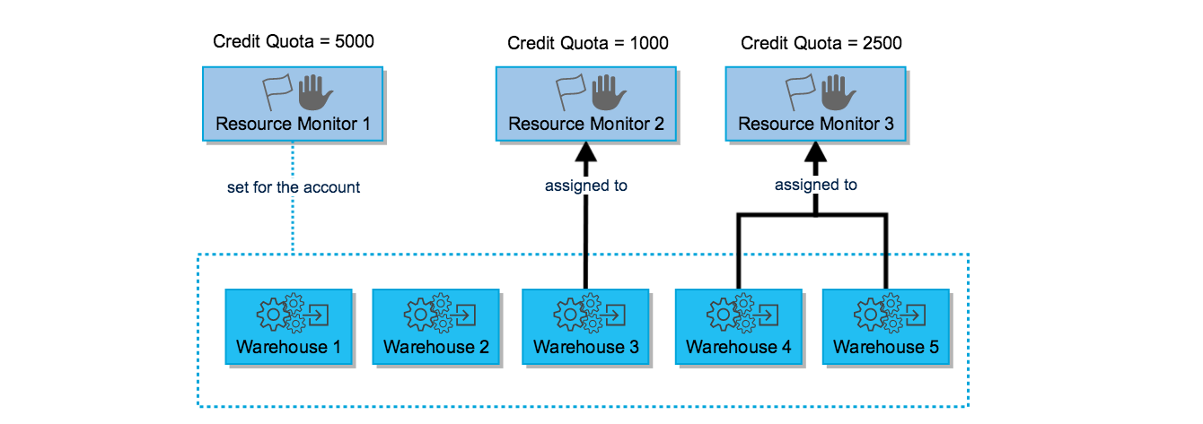
Data loading
Based on this diagram:
The credit quota for the entire account is 5000 for the interval (month, week, etc.), as controlled by Resource Monitor 1; if this quota is reached within the interval, the actions defined for the resource monitor (Suspend, Suspend Immediate, etc. ) are enforced for all five warehouses.
Warehouse 3 can consume a maximum of 1000 credits within the interval.
Warehouse 4 and 5 can consume a maximum combined total of 2500 credits within the interval.

