Slide 2
SnowPipe
Intro
Snowpipe enables loading data from files as soon as they’re available in a stage.
This means you can load data from files in micro-batches, making it available to users within minutes
How Does Snowpipe Work?
Snowpipe loads data from files as soon as they are available in a stage. The data is loaded according to the COPY statement defined in a referenced pipe.

Slide 3
SnowPipe
Snowpipe Compute
Compute Resources :
Serverless Compute Model
With Snowpipe’s serverless compute model, users can initiate any size load without managing a virtual warehouse. Instead, Snowflake provides and manages the compute resources, automatically for growing or shrinking capacity based on the current Snowpipe load

Slide 4
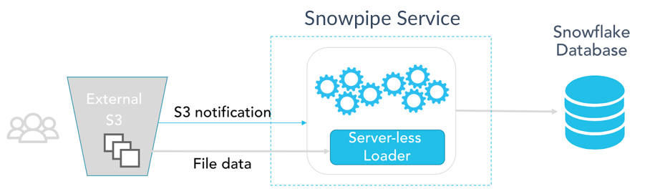
SnowPipe

Slide 5
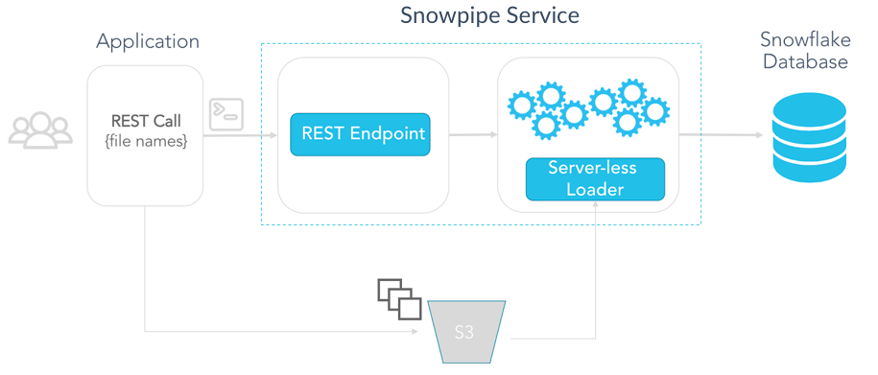
SnowPipe

Slide 6
SnowPipe
Common problems
Common problems that affect data loading include:
Legacy architecture – Tightly coupled storage and compute necessitate contention with queries as data is loading.
Stale data – Batch loading prevents organizations from acquiring instant, data-driven insight.
Limited data – Lack of support for semi-structured data requires transforming newer data types and defining a schema before loading, which introduces delays.
Manageability – Dedicated clusters or warehouses are required to handle the loading of data.
High-maintenance – Traditional data warehouse tools result in unnecessary overhead in the form of constant indexing, tuning, sorting and vacuuming.

Slide 7
SnowPipe
Benefits
The direct benefits of Snowpipe’s continuous data loading include:
Instant insights – Immediately provide fresh data to all your business users without contention.
Cost-effectiveness – Pay only for the per-second compute utilized to load data rather than running a warehouse continuously or by the hour.
Ease-of-use – Point Snowpipe at an S3 bucket from within the Snowflake UI and data will automatically load asynchronously as it arrives.
Flexibility – Technical resources can interface directly with the programmatic REST API, using Java and Python SDKs to enable highly customized loading use cases.
Zero management – Snowpipe automatically provisions the correct capacity for the data being loaded. No servers or management to worry about.

