Slide 2
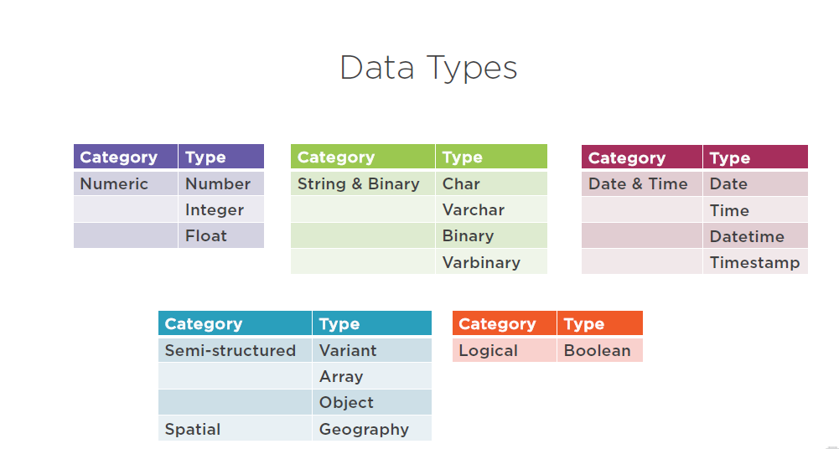
Snowflake

Slide 3
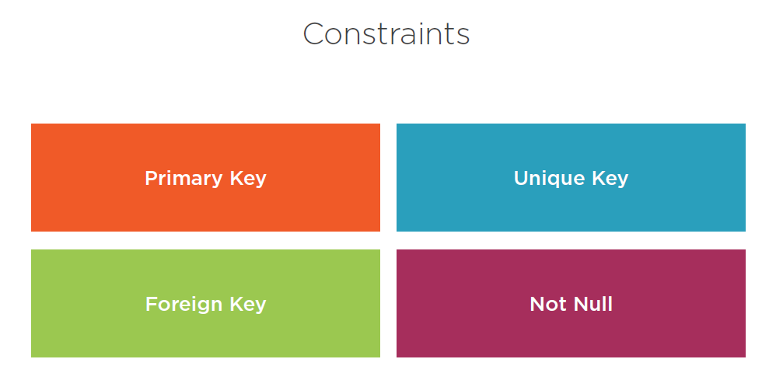
Snowflake

Slide 4
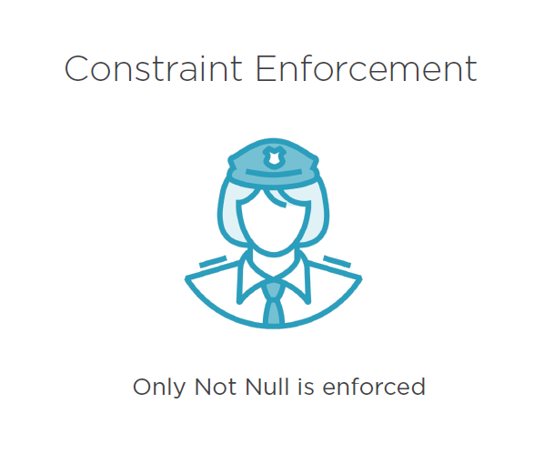
Snowflake

Slide 5
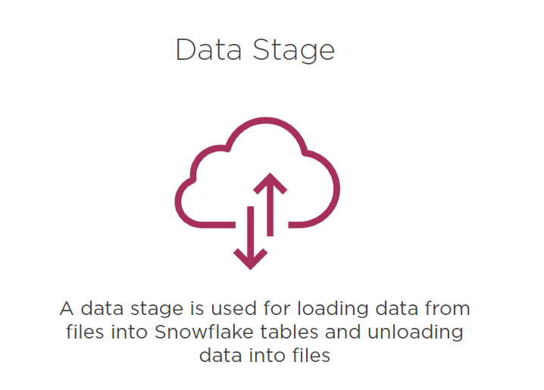
Snowflake Stages

Slide 6
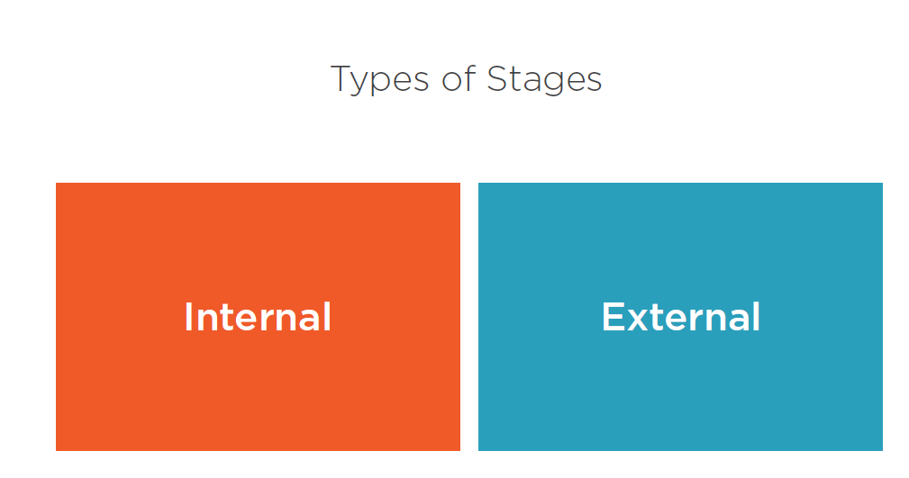
Snowflake DataStage

Slide 7
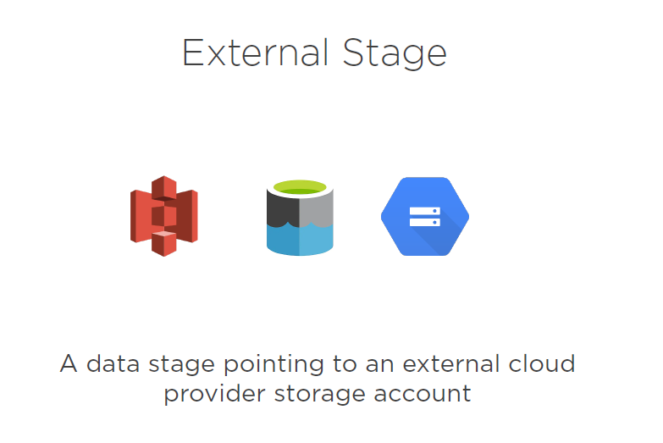
Data loading

Slide 8
Data loading
AWS GCP AZURE
Raw data
Stage Object
Snow flake
File Format
Copy Command
Integration Object

Slide 9
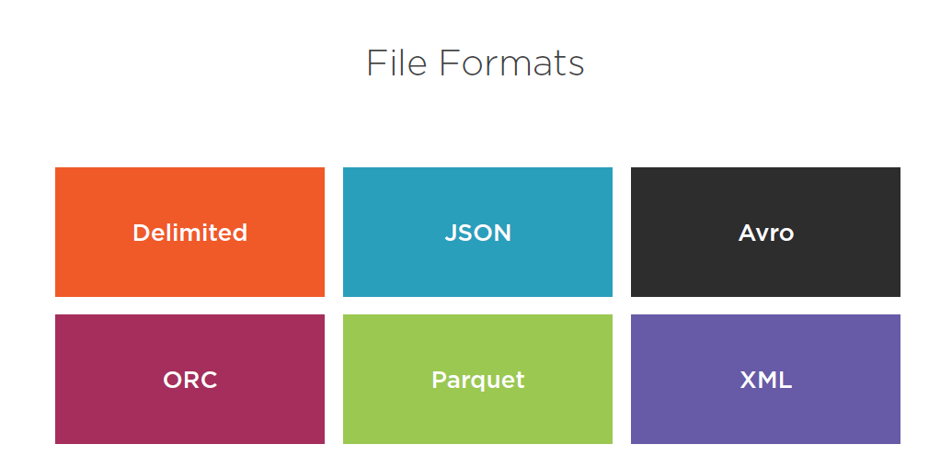
Data loading

Slide 10
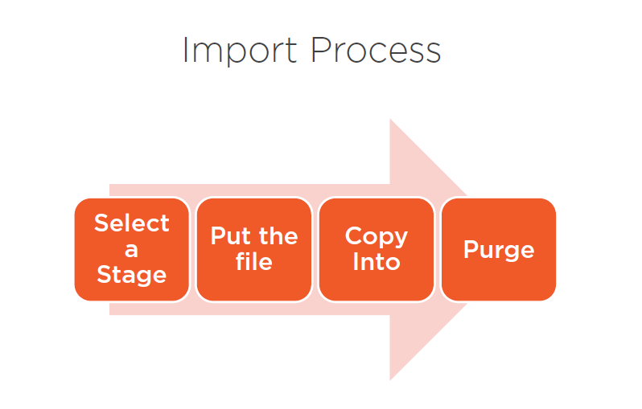
Data loading

Slide 11
INTERNAL STAGING SNOWFLAKE
Types of internal stages
User stage
@~
Table Stage
@%
Named Stage
@

Slide 12
USER STAGES IN SNOWFLAKE
Each user has a Snowflake stage allocated to them by default for storing files. This stage is a convenient option if your files will only be accessed by a single user but need to be copied into multiple tables.
Constraints :
Multiple users require access to the files.
User stages are referenced using @~; e.g. use LIST @~ to list the files in a user stage
The current user does not have INSERT privileges on the tables the data will be loaded into.

Slide 13
TABLE STAGES IN SNOWFLAKE
Each table has a Snowflake stage allocated to it by default for storing files.
This stage is a convenient option if your files need to be accessible to multiple users and only need to be copied into a single table.
Constraints :
Unlike named stages, table stages cannot be altered or dropped.
Table stages do not support setting file format options. Instead, you must specify file format and copy options as part of the COPY INTO <table> command.

Slide 14
NAMED STAGES IN SNOWFLAKE
Internal stages are named database objects that provide the greatest degree of flexibility for data loading. Because they are database objects, the security/access rules that apply to all
objects apply
Users with the appropriate privileges on the stage can load data into any table.
Ownership of the stage can be transferred to another role, and privileges granted to use the stage can be modified to add or remove roles.
Named stage is an object.
You can desc it and provide access control and revoke access for named stage
You can share data stored in named stage across tables.

Slide 15
Validate Data
Validating Your Data
Before loading your data, you can validate that the data in the uploaded files will load correctly.
To validate data in an uploaded file, execute COPY INTO <table> in validation mode using the VALIDATION_MODE parameter. The VALIDATION_MODE parameter returns errors that it encounters in the file. You can then modify the data in the file to ensure it loads without error.
In addition, COPY INTO <table> provides the ON_ERROR copy option to specify an action to perform if errors are encountered in a file during loading.
Validation_mode = RETRUNS_N_ROWS, RETURN_ERRORS, RETURNS_ALL_ERRORS
* Copy Command tests the files for errors but does not load the data into the table

Slide 16
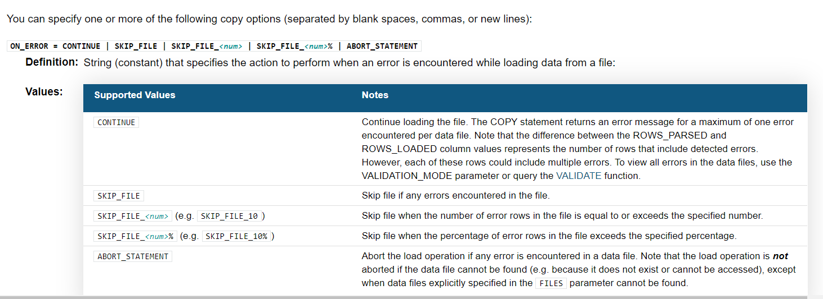
Error Handling

Slide 17
Validate Data
Table functions return a set of rows instead of a single scalar value. Table functions appear in the FROM clause of a SQL statement and cannot be used as scalar functions. Table functions take scalar expressions as input.

Slide 18
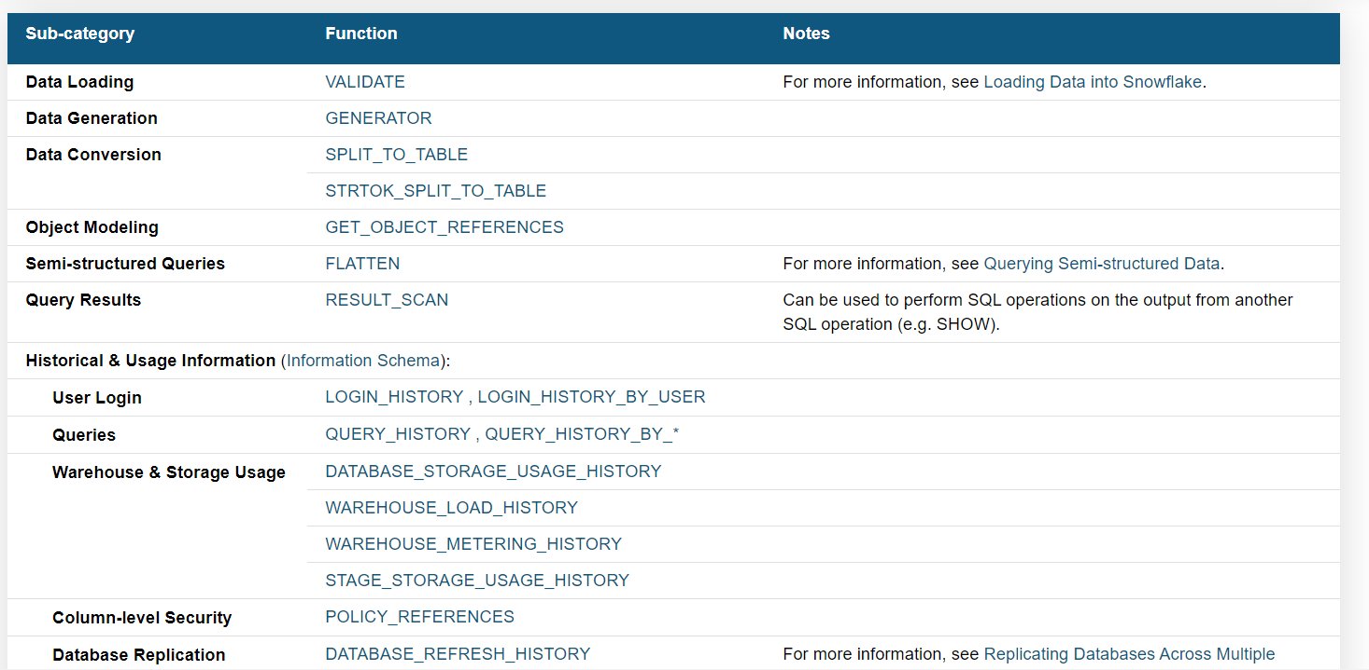
Validate Data

