Slide 1
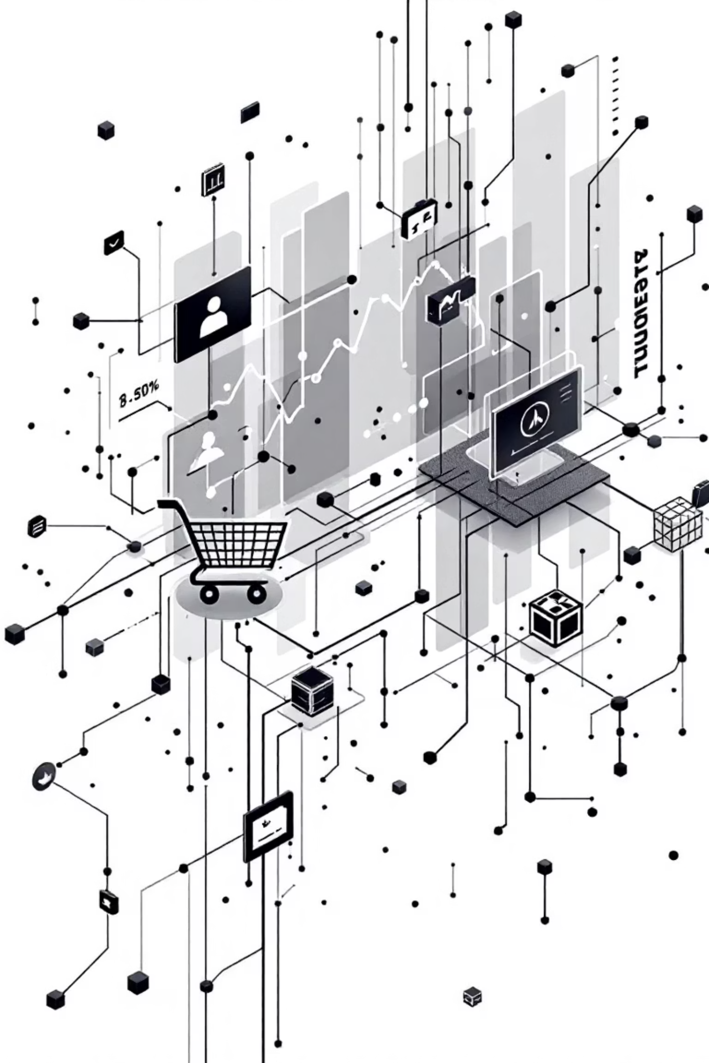
Customer Shopping Behavior Analysis
Uncovering insights from 3,900 purchases to guide strategic decisions.

Slide 2

Project Overview
Goal
Data Source
Analyze spending, segments, preferences, and subscription behavior.
Transactional data from 3,900 purchases.
Outcome
Actionable insights for business strategy.

Slide 3
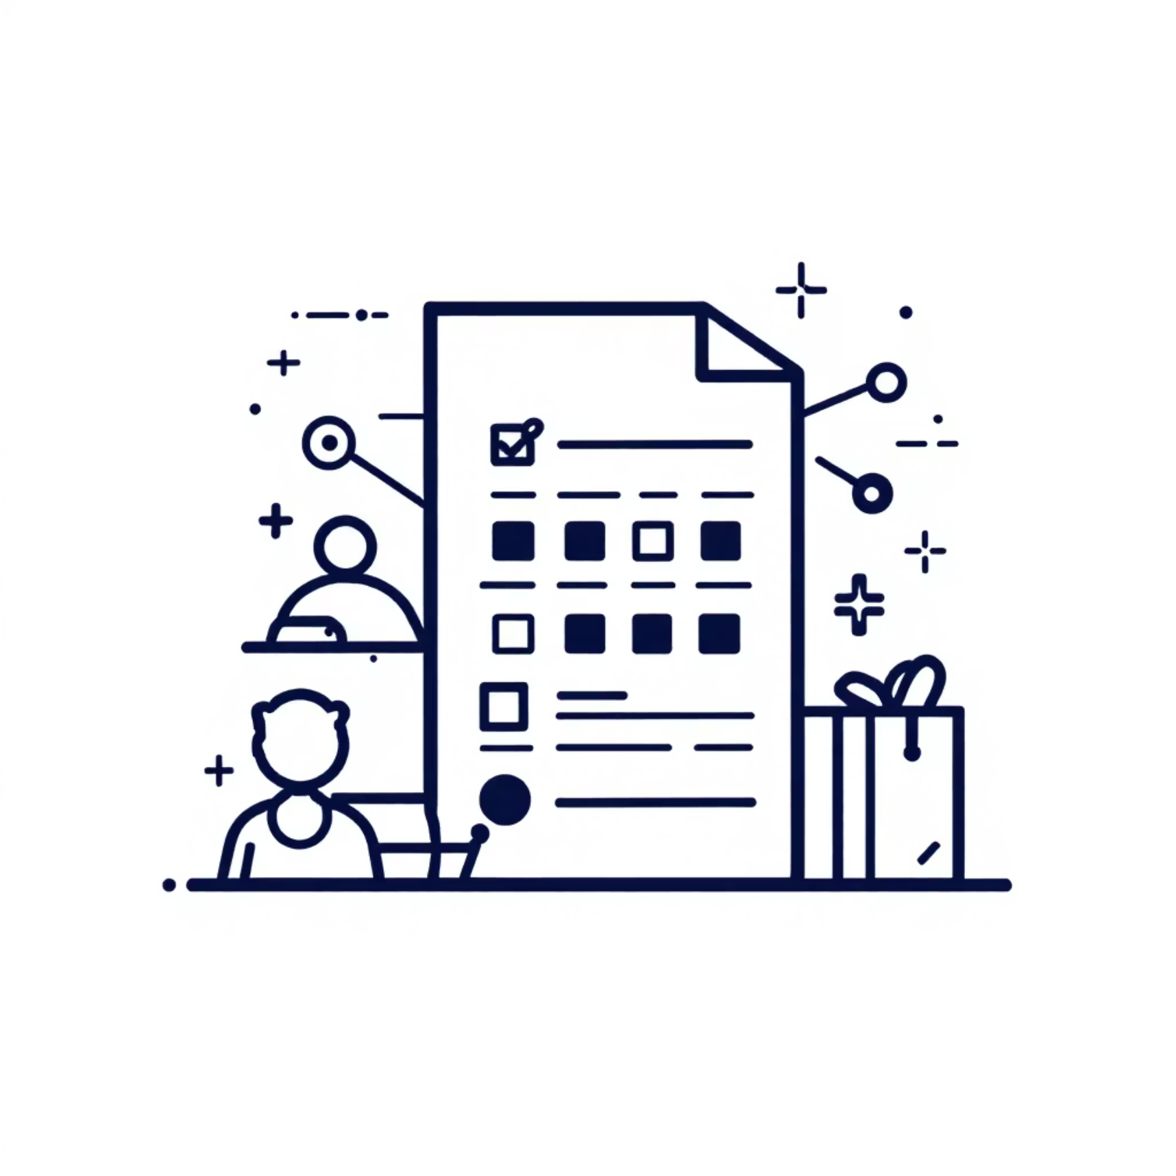
Dataset Summary
Key Features
Customer demographics
Purchase details
Shopping behavior
Data Volume
3,900 Rows
18 Columns
Missing Data
37 values in Review Rating column.

Slide 4

Exploratory Data Analysis (Python)
01
Data Preparation
Loading, initial exploration, missing data handling.
02
Column Standardization
Renamed to snake case for readability.
03
Feature Engineering
Created age groups, purchase frequency.
04
Database Integration
Loaded cleaned data to PostgreSQL for SQL analysis.

Slide 5
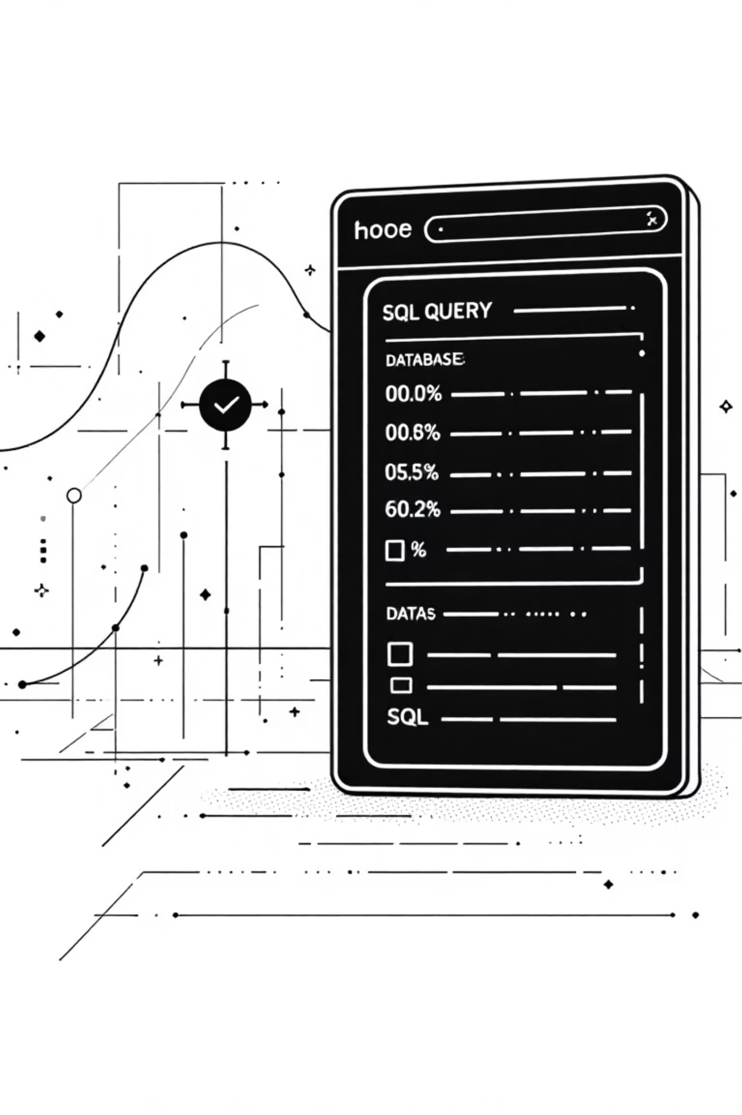
Data Analysis (SQL)
1
Revenue by Gender
Female: $75,191, Male: $157,890
2
High-Spending Discount Users
Identified 839 customers.
3
Top 5 Products by Rating
Gloves, Sandals, Boots, Hat, Skirt.
4
Shipping Type Comparison
Standard: $58.46, Express: $60.48.

Slide 6
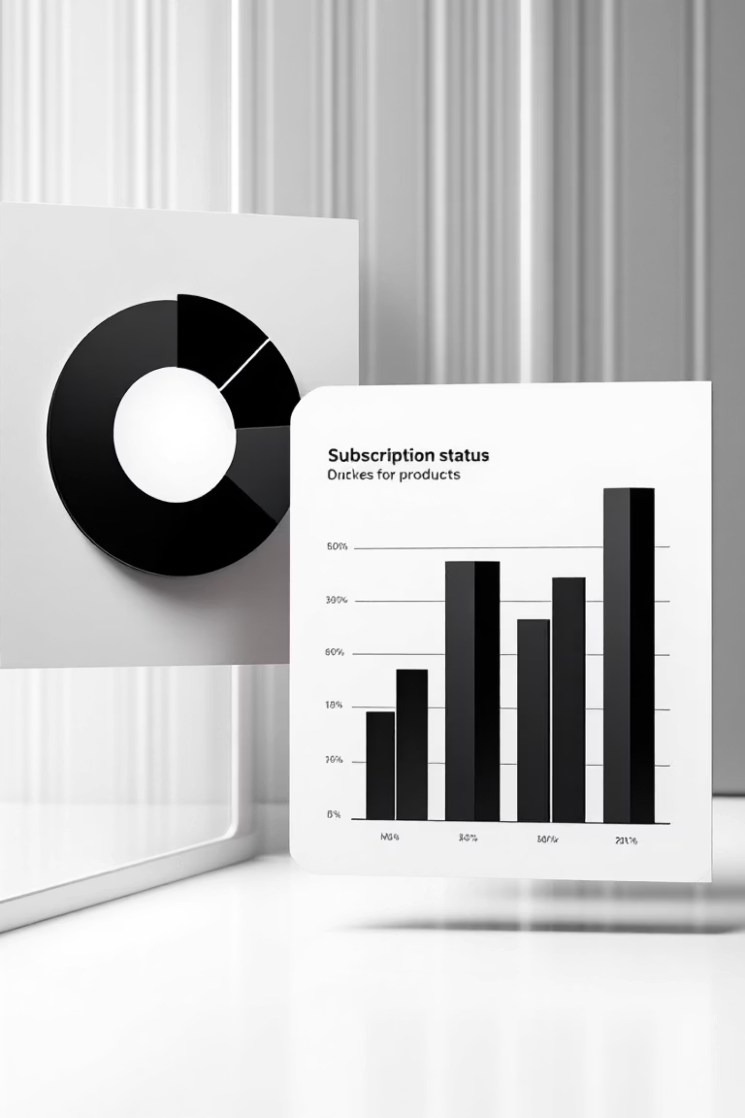
Subscription & Discount Insights
Subscribers vs. Non-Subscribers
Discount-Dependent Products
Subscribers: 1053, Avg Spend: $59.49, Total Revenue: $62,645.
Hat (50%), Sneakers (49.66%), Coat (49.07%), Sweater (48.17%), Pants (47.37%).
Non-Subscribers: 2847, Avg Spend: $59.87, Total Revenue: $170,436.

Slide 7


Customer Segmentation
Loyal
New
Returning
3116 Customers
83 Customers
701 Customers

Slide 8
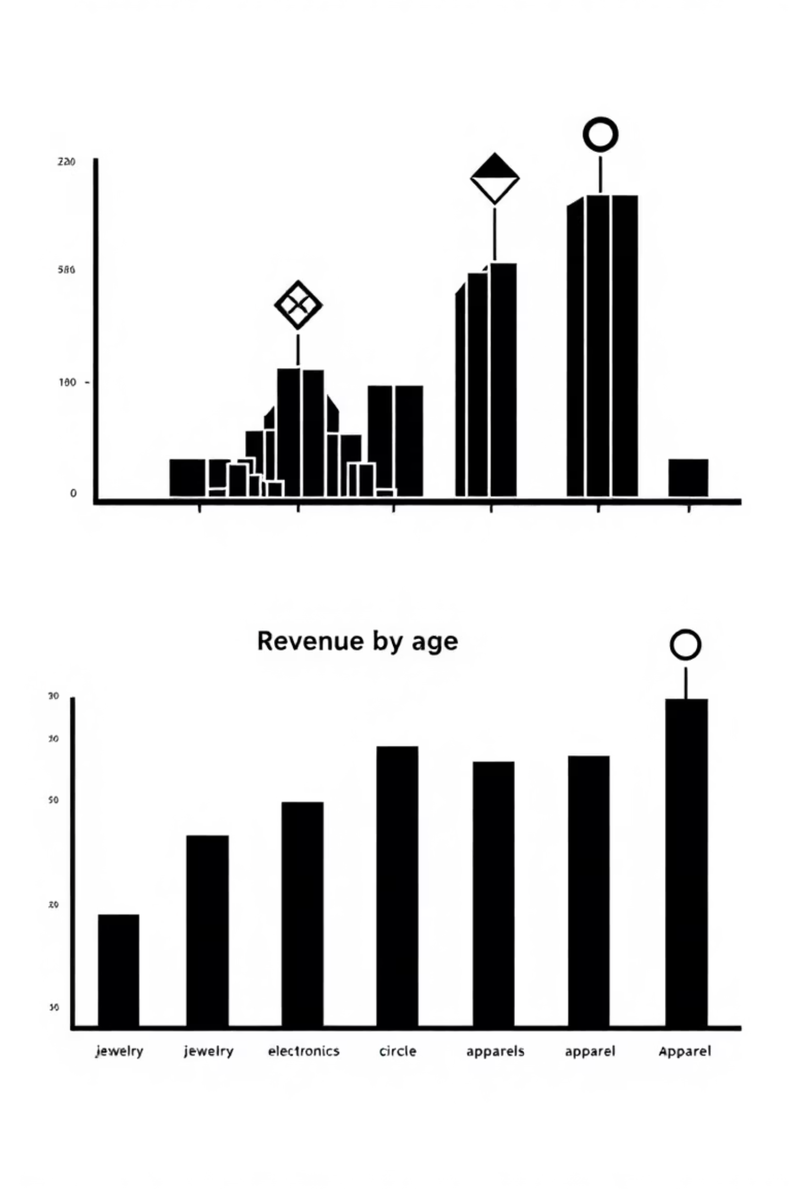
Product Performance & Age Group Revenue
Top Products per Category
Revenue by Age Group
Young Adult: $62,143
Accessories: Jewelry, Sunglasses, Belt
Middle-aged: $59,197
Adult: $55,978
Clothing: Blouse, Pants, Shirt
Senior: $55,763
Footwear: Sandals, Shoes, Sneakers
Outerwear: Jacket, Coat

Slide 9
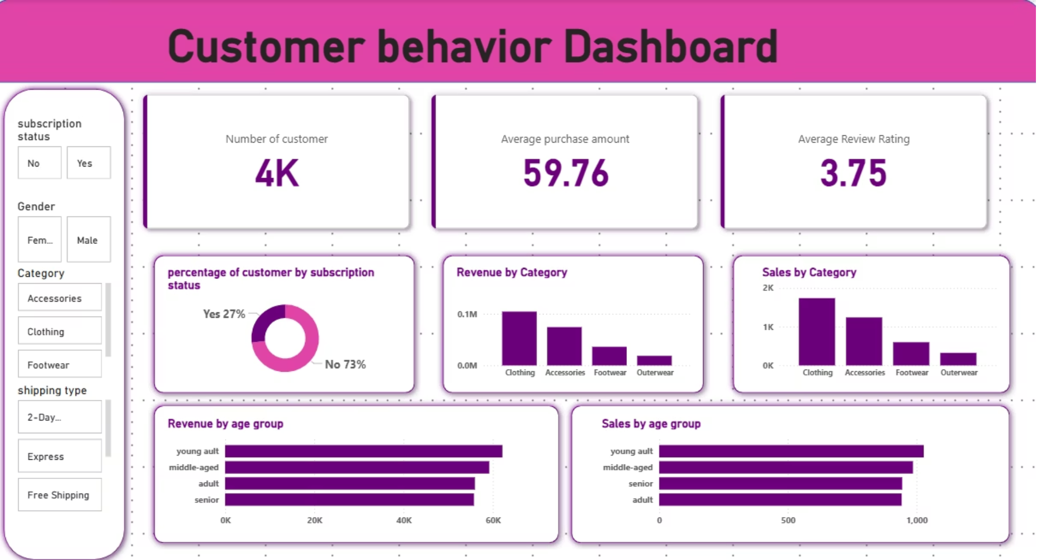

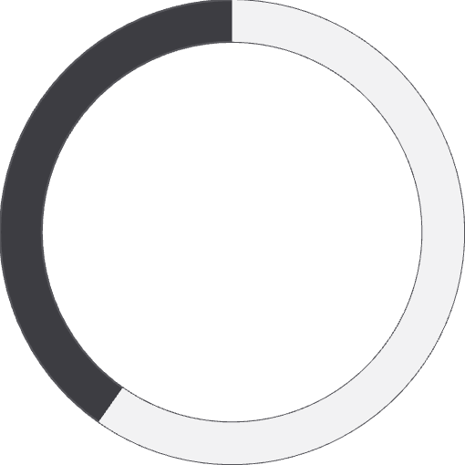

Power BI Dashboard
Interactive visualizations for key insights.
3.9K
$59.76
3.75
Customers
Avg. Purchase
Avg. Review

Slide 10

Business Recommendations
Boost Subscriptions
Promote exclusive benefits.
Customer Loyalty
Reward repeat buyers.
Review Discount Policy
Balance sales with margin.
Targeted Marketing
Focus on high-revenue groups.

