Slide 1




NEIGHBOURNOSH
NOURISHING CONNECTIONS BETWEEN STUDENTS AND HOME CHEFS"
Insight Explorer
Team Members :-
Mahfooz Alam (12203001)
Nikita Kumari (12202879)
Muskan Pandey(12204867)
Anand Mailapalli (12209056)

Slide 2
TABLE OF CONTENT
Introduction
Objective
Problems
Data preprocessing
Data visualization
Conclusion

Slide 3
PROJECT INTRODUCTION
Experience the comforting embrace of home-cooked meals crafted by nearby moms, catering to empowered students within a 3-4 km radius. This initiative not only satisfies hunger but also fosters community bonds, providing a taste of home that nourishes both body and soul in an increasingly fast-paced world."

Slide 4
OBJECTIVE
Empowerment of Housewives.
Showcasing cooking skills
Facilitating to Students' Needs
Promoting Community Connection

Slide 5
PROBLEMS
Low Response Rate
Unified Data Collection Challenges
Incomplete and Incorrect Submissions
Challenges in Data Segmentation
User Error and Misinterpretation

Slide 6




DATA PREPROCESSING
Data Exploration
Data Cleanning
Explore large dataset to find meaning ful insights.
Dealing with missing data, and duplicate data.
Data collection
Data Transformation
collection of data from LPU students of different departments and Housewife’s through google from
transform raw data into CSV file and split data set into two data frame on the basis of Housewifes and student

Slide 7
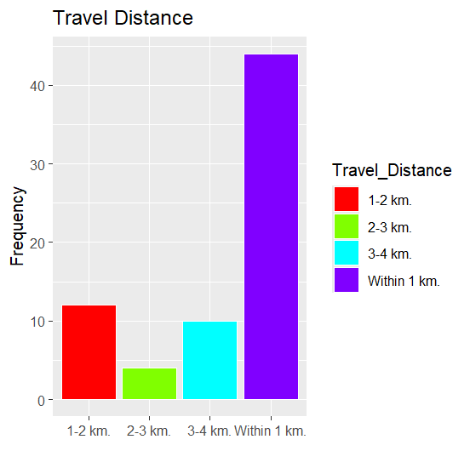
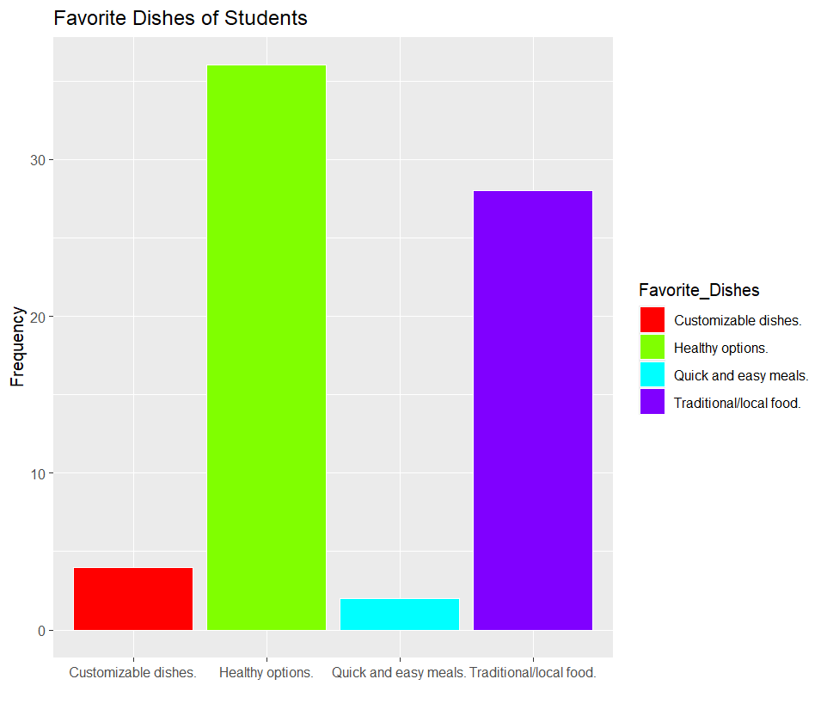
DATA VISUALIZATION

Slide 8
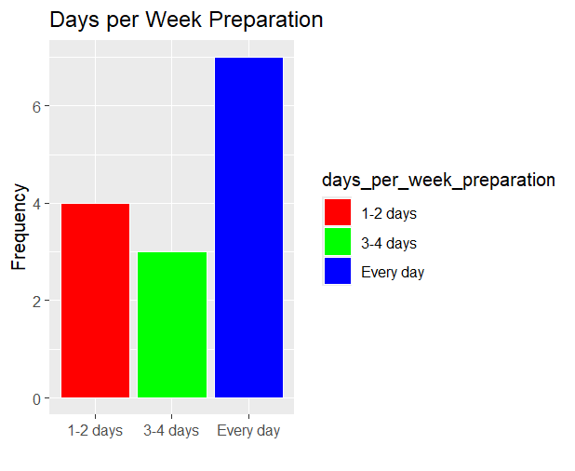
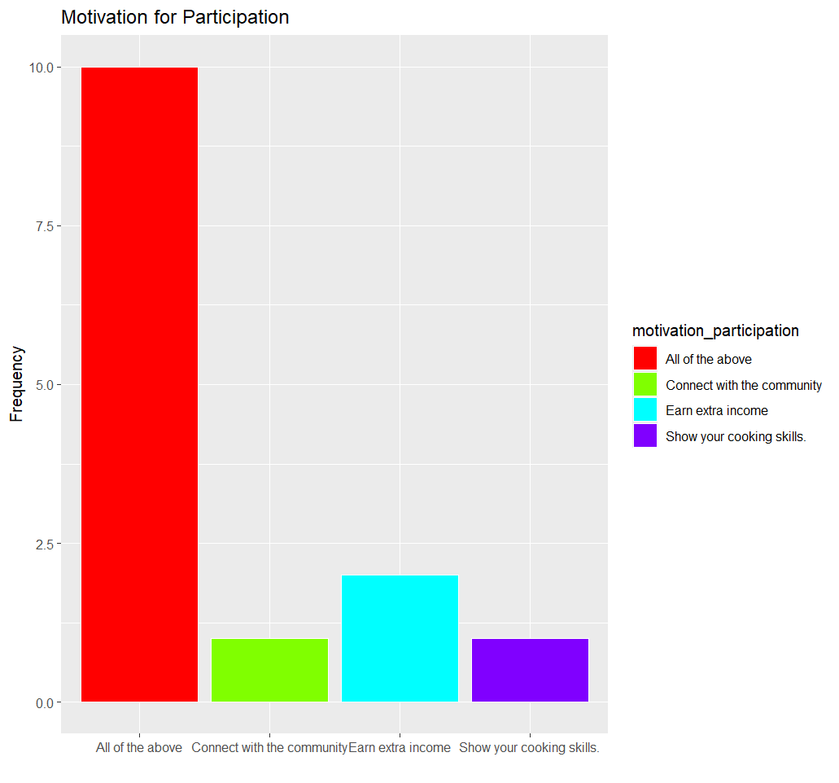
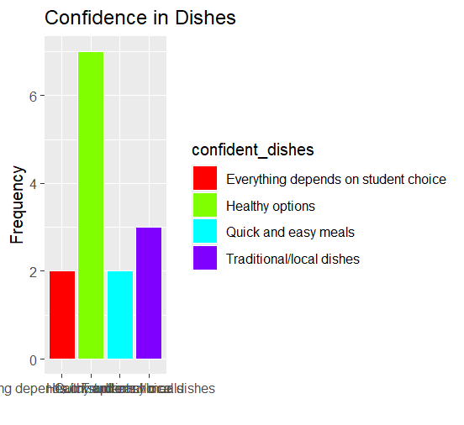

Slide 9
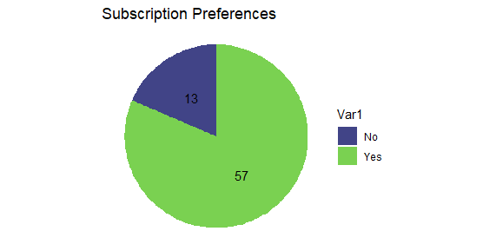
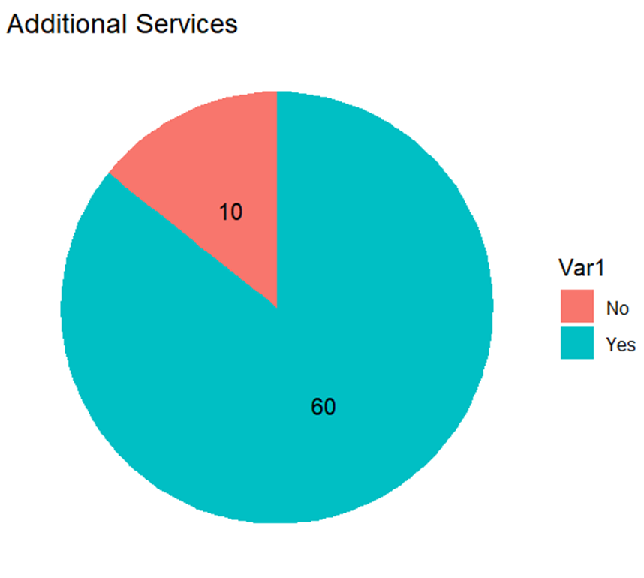

Slide 10
CONCLUSION
The analysis reveals NeighborNosh's unique position to satisfy student demands for homemade meals while providing housewives a valuable income source. Key to success are quality, convenience, sustainability, and dietary variety, with potential growth through subscription models and improved operations. NeighborNosh is poised to strengthen community ties and support local economies effectively.

Slide 11
THANK YOU

