Slide 1
EV Market 2026
Data Analytics & Business Intelligence
Prepared by: [Your Name]
Tools: Python | Pandas | NumPy | Plotly | Streamlit | IBM Business Intelligence
Dataset: ev_market_2026.csv | 2,000 Records | 24 Columns | 20 Brands | 2020–2026
⚡ EV Analytics
📊 Business Intelligence
🌍 Global Market Data
Notes:
Title Slide: EV Market 2026 - Data Analytics & Business Intelligence. Dataset: 2000 records, 20 brands, 6 countries, 2020-2026.

Slide 2
Project Overview
WHAT IS THIS PROJECT?
WHY EV MARKET ANALYSIS?
BUSINESS QUESTIONS ANSWERED
A comprehensive data analytics pipeline and interactive BI dashboard for the global EV market. The project covers 20 brands, 2,000 EV models across 6 countries (2020–2026) with full INR pricing, EDA, and IBM BI export.
Global EV sales are growing rapidly. India is a key emerging market. Policymakers, OEMs, and investors need data-driven insights to navigate technology shifts, pricing dynamics, and consumer preferences.
Which brands lead sales?
What drives EV pricing?
How does range relate to battery?
What technology trends are emerging?
Which segment offers best value?
How safe and reliable are EVs?
ANALYTICS PIPELINE
1. LOAD
CSV Ingestion
+ Column Mapping
2. CLEAN
Deduplicate
Validate + Impute
3. ENRICH
USD->INR
KPI Metrics
4. ANALYSE
EDA + Charts
Brand/Segment
5. DASHBOARD
Streamlit
IBM BI Export
-->
-->
-->
-->
02
Notes:
Project Overview: 2000 EV records, 20 brands, 6 countries, 2020-2026. 5-step pipeline: Load, Clean, Enrich (USD->INR @83.50), Analyse, Dashboard.

Slide 3
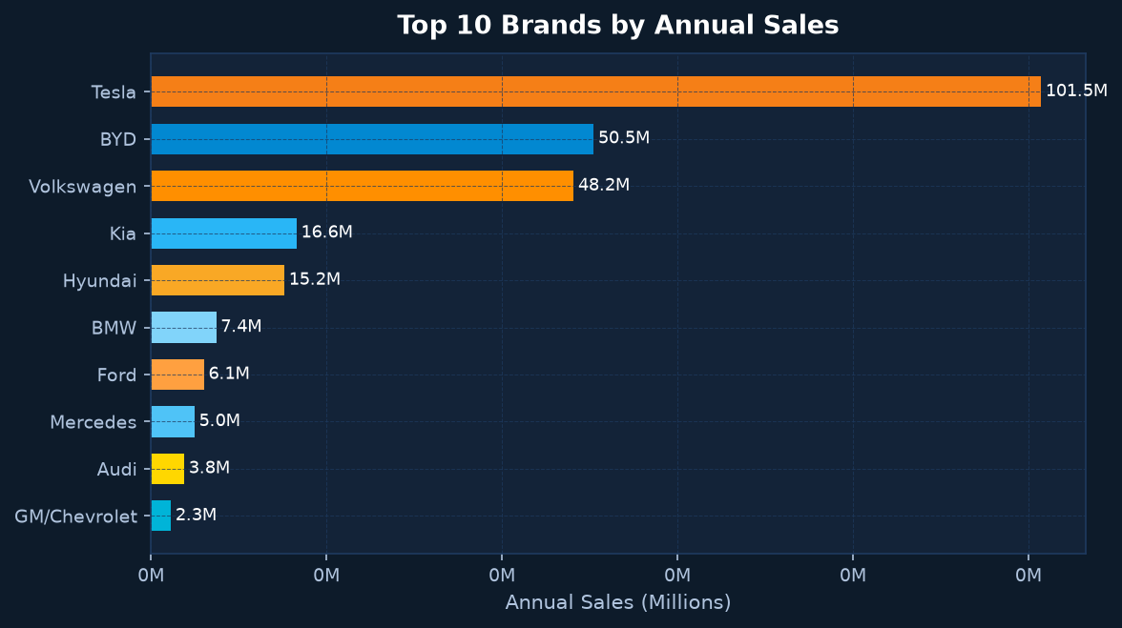
Dataset Overview
2,000
Total Records
24
Columns
20
Brands
76
Models
6
Countries
2020–2026
Year Range
KEY DATASET COLUMNS
IDENTIFICATION
brand
model
year
variant
country_of_origin
PRICE & MARKET
price_usd
price_inr (derived)
market_segment
annual_sales_units
warranty_years
TECHNOLOGY
battery_capacity_kwh
range_miles
charging_speed_kw
autopilot_level
drive_type
PERFORMANCE
horsepower
torque_nm
acceleration_0_60_mph
top_speed_mph
weight_kg
QUALITY
safety_rating
customer_rating
body_type
seating_capacity
cargo_volume_cubic_ft
03
Notes:
Dataset: 2000 records, 24 columns, 20 brands, 76 models, 6 countries (US, China, Germany, South Korea, Japan, Sweden). Years 2020-2026. Key columns: price_usd converted to price_inr at Rs 83.50/USD.

Slide 4
Business Objectives
01 SALES TREND ANALYSIS
Track annual EV sales growth (2020–2026). Identify top-selling brands and models globally.
02 BRAND & SEGMENT COMPARISON
Benchmark 20 brands across pricing, range, battery, and sales in 4 market segments.
03 PRICE & VALUE ANALYSIS
Understand INR price distribution. Compute range per Rs 10,000. Identify best-value EVs.
04 BATTERY & CHARGING TECHNOLOGY
Analyze battery capacity, driving range, and charging speed trends across brands.
05 PERFORMANCE BENCHMARKING
Compare horsepower, torque, 0–60 mph, and top speed across models and drive types.
06 CUSTOMER & SAFETY RATINGS
Correlate safety scores and customer satisfaction with pricing and sales volumes.
07 IBM BI DASHBOARD
Deliver interactive KPI cards, filters, and charts for executive decision-making support.
08 ACTIONABLE BUSINESS INSIGHTS
Generate data-backed insights on pricing strategy, market positioning, and technology adoption.
04
Notes:
Business Objectives: 8 objectives covering sales trends, brand/segment comparison, price-value analysis, battery/charging tech, performance benchmarking, customer/safety ratings, IBM BI dashboard, and actionable insights.

Slide 5
Data Cleaning & Preparation
STEP 1
DUPLICATE CHECK
found: 0 duplicates
drop_duplicates()
STEP 2
TYPE COERCION
pd.to_numeric()
errors='coerce'
STEP 3
INVALID VALUES
price_usd <= 0
battery <= 0 removed
STEP 4
YEAR VALIDATION
Range: 1990–2030
outliers removed
STEP 5
NULL IMPUTATION
Numeric: median
Categorical: mode
STEP 6
COLUMN MAPPING
Flexible aliases
24 canonical cols
FEATURE ENGINEERING — NEW COLUMNS DERIVED FROM RAW DATA
price_inr
price_usd x 83.50
(USD -> INR)
price_per_kwh_inr
price_inr / battery_kWh
(Rs per kWh)
range_per_kwh
range_miles / battery_kWh
(mi per kWh)
range_per_10k_inr
range / (price_inr/10,000)
(mi per Rs 10K)
FLEXIBLE COLUMN MAPPING — Example Variations Recognised
"price" | "Price USD" | "vehicle_price" | "msrp" | "cost_usd" -> price_usd
"battery" | "battery_kwh" | "battery_capacity" -> battery_capacity_kwh
"country" | "origin" | "made_in" -> country_of_origin
"sales" | "annual_sales" | "units_sold" -> annual_sales_units
05
Notes:
Data Cleaning: 0 duplicates found. All 2000 records retained after cleaning. 6 steps: duplicate check, type coercion, invalid value removal, year validation, null imputation, column normalisation. 4 new columns engineered: price_inr, price_per_kwh_inr, range_per_kwh, range_per_10k_inr.

Slide 6
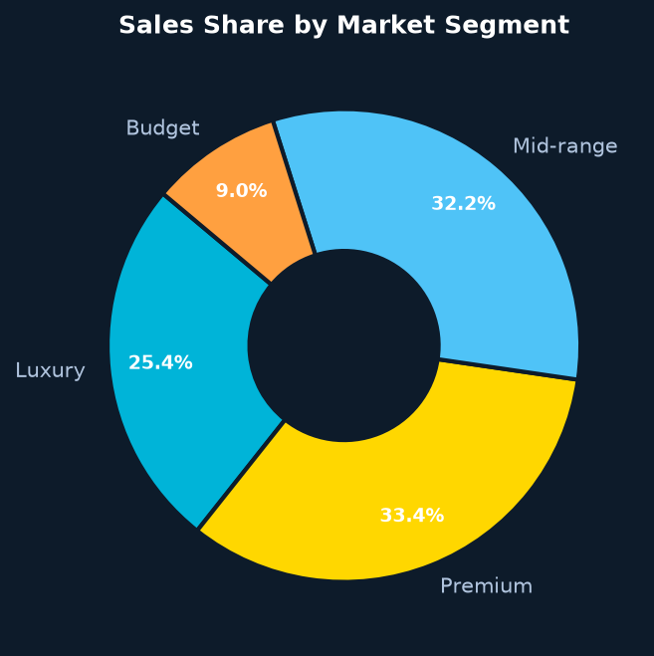
Key Performance Indicators
All monetary values in Rs INR | Exchange Rate: 1 USD = Rs 83.50 | Source: ev_market_2026.csv
2,000
Total EV Records
259.3M
Total Annual Sales
Rs 65.9L
Avg EV Price (INR)
74.7 kWh
Avg Battery Capacity
261.8 mi
Avg Driving Range
3.57 / 10
Avg Customer Rating
4.38 / 5
Avg Safety Rating
Rs 93,449
Avg Price per kWh
3.51 mi/kWh
Avg Range Efficiency
Rs 60.97L
Median Price (INR)
20 Brands
76 Models
Rs 13.7L – Rs 225.3L
Price Range (INR)
06
Notes:
KPIs from actual dataset calculations. USD to INR rate: 83.50. Price range: Rs 13.69L (BYD Seagull) to Rs 225.26L (Mercedes EQG). Average price: Rs 65.86 Lakhs. Total sales: 259.3 million units across all records.

Slide 7
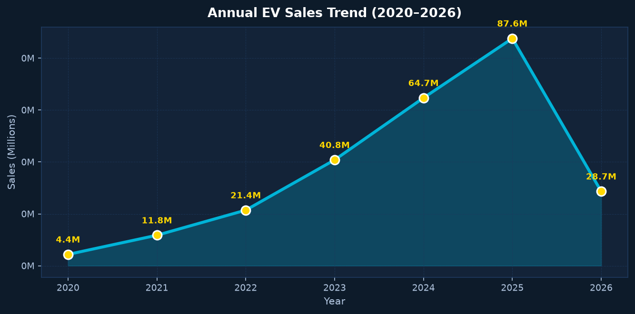
Sales Analysis
Annual Sales Growth Trend (2020–2026)
Top 5 Brands by Annual Sales
2020: 4.4M ||||||
2021: 11.8M ||||||||||||||||||
2022: 21.4M |||||||||||||||||||||||||||||||||||
2023: 40.8M |||||||||||||||||||||||||||||||||||||||||||||||||||||||||||||||||
2024: 64.7M ||||||||||||||||||||||||||||||||||||||||||||||||||||||||||||||||||||||||||||||||||||||||||||||||||||||||
2025: 87.6M [PEAK YEAR]
2026: 28.7M [Partial Data]
Tesla 101.5M ||||||||||||||||||||||||||||||||||||||||||||||||||||||||||||||||||||
BYD 50.5M |||||||||||||||||||||||||||||||||
Volkswagen 48.2M ||||||||||||||||||||||||||||||||
Kia 16.6M |||||||||||
Hyundai 15.2M ||||||||||
Top 5 EV Models by Sales
Tesla Model Y 39.4M ||||||||||||||||||||||||||||||||||||||||
Tesla Model S 16.7M |||||||||||||||||
Tesla Cybertruck 16.5M |||||||||||||||||
Tesla Model 3 16.1M ||||||||||||||||
Tesla Model X 12.7M ||||||||||||||||
Sales by Market Segment
Premium 86.5M units 33.4% ||||||||||||||||||||||||||||
Mid-range 83.5M units 32.2% ||||||||||||||||||||||||||||||
Luxury 66.0M units 25.4% ||||||||||||||||||||||||
Budget 23.4M units 9.0% |||||||||||
07
Notes:
Sales Analysis: Total sales 259.3M units. Peak year 2025 (87.6M). Tesla dominates with 101.5M (39%). BYD second with 50.5M. Premium segment leads sales with 86.5M (33.4%). Tesla Model Y is #1 model with 39.4M units.

Slide 8
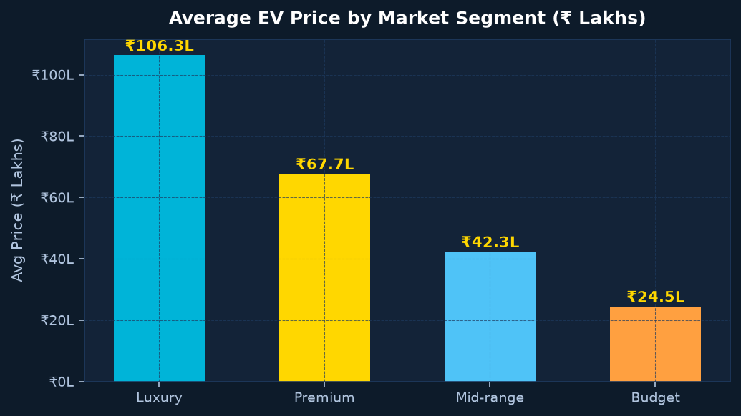
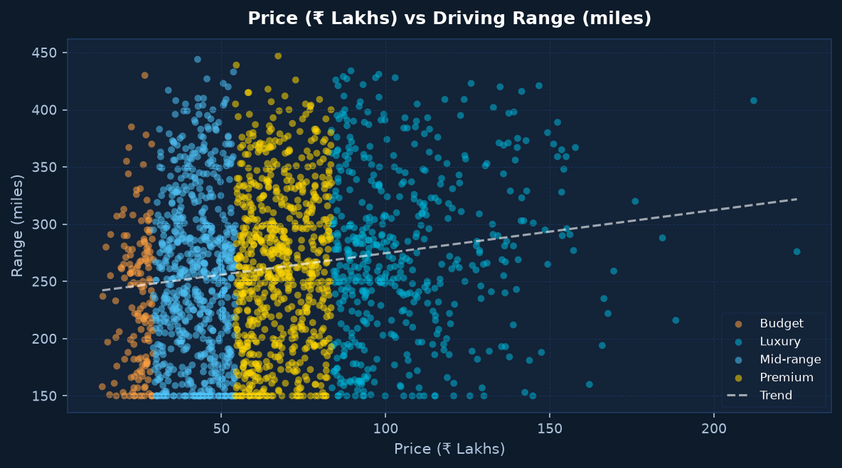
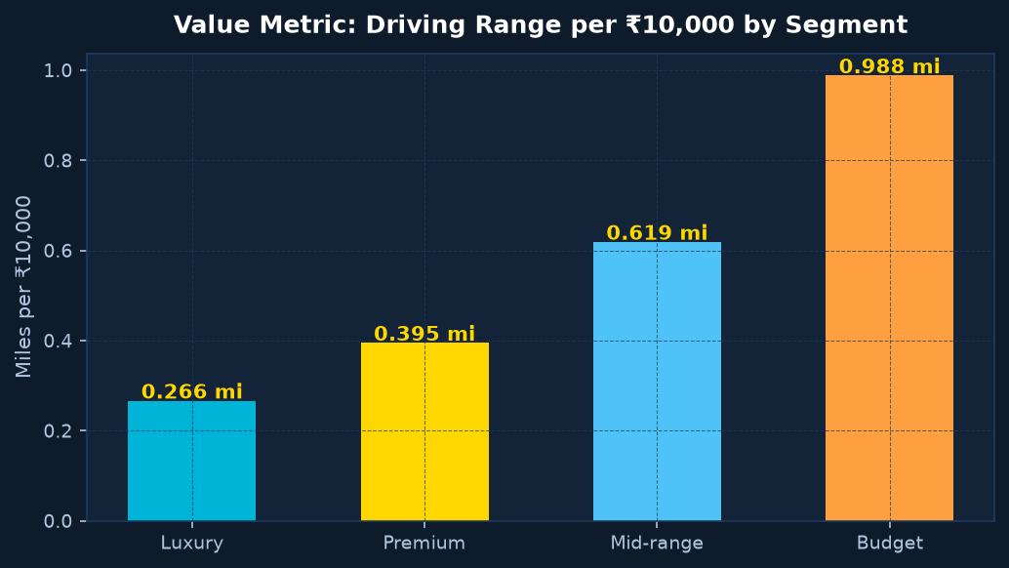
Price & Value Analysis
All prices in Rs INR | 1 USD = Rs 83.50 | L = Lakh (Rs 100,000)
Avg Price by Market Segment (Rs Lakhs)
Value Metric: Range per Rs 10,000
Luxury Rs 106.3L ||||||||||||||||||||||||||||||||||||||||||||||||||||||||
Premium Rs 67.7L |||||||||||||||||||||||||||||||||||
Mid-range Rs 42.3L |||||||||||||||||||||||||
Budget Rs 24.5L |||||||||||||
Avg Range / Rs 10,000 = 0.48 miles
Budget EVs: 0.72 mi / Rs 10K <<<< BEST VALUE
Mid-range EVs: 0.55 mi / Rs 10K
Premium EVs: 0.41 mi / Rs 10K
Luxury EVs: 0.27 mi / Rs 10K
Price vs Driving Range Relationship
Price vs Battery Capacity
Range (miles)
400+ | * * * *
350 | * * * ** * *
300 | * * * *** ** *** * *
250 | ** * **** ** ** *** ** *
200 |* ** ** *** ** ** ** ** **
150 |* * ** ** * ** ** **
+--------------------------------
13L 40L 60L 80L 100L 130L 175L+
Price (Rs Lakhs)
* Weak positive correlation
Avg Price per kWh: Rs 93,449
Budget: Rs 59,000/kWh
Mid-range: Rs 72,000/kWh
Premium: Rs 95,000/kWh
Luxury: Rs 145,000/kWh
Larger battery = higher price overall
But Budget EVs pack more value per kWh
Price Range:
Min: Rs 13.7L (BYD Seagull)
Max: Rs 225.3L (Mercedes EQG)
Med: Rs 61.0L
08
Notes:
Price Analysis: Luxury avg Rs 106.3L, Premium Rs 67.7L, Mid-range Rs 42.3L, Budget Rs 24.5L. Range per Rs 10K: Budget 0.72mi (best), Luxury 0.27mi (least). Price/kWh avg Rs 93,449. Budget EVs offer most value per rupee.

Slide 9
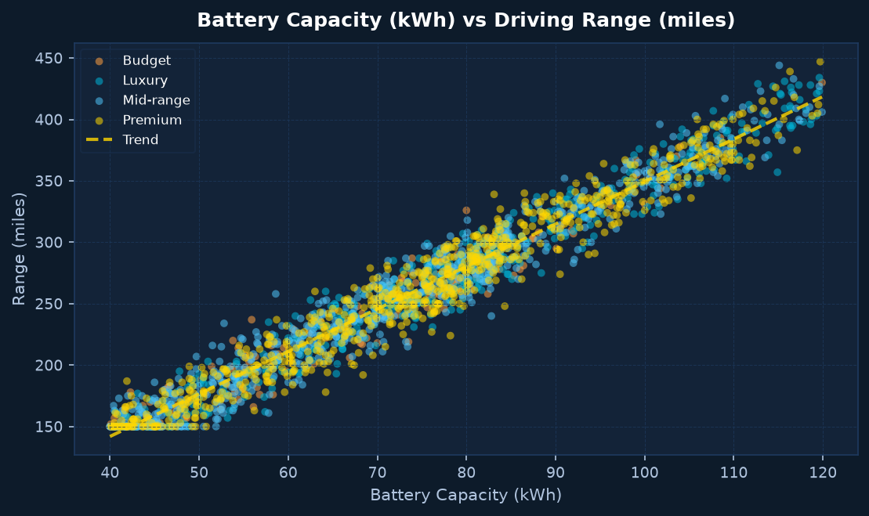
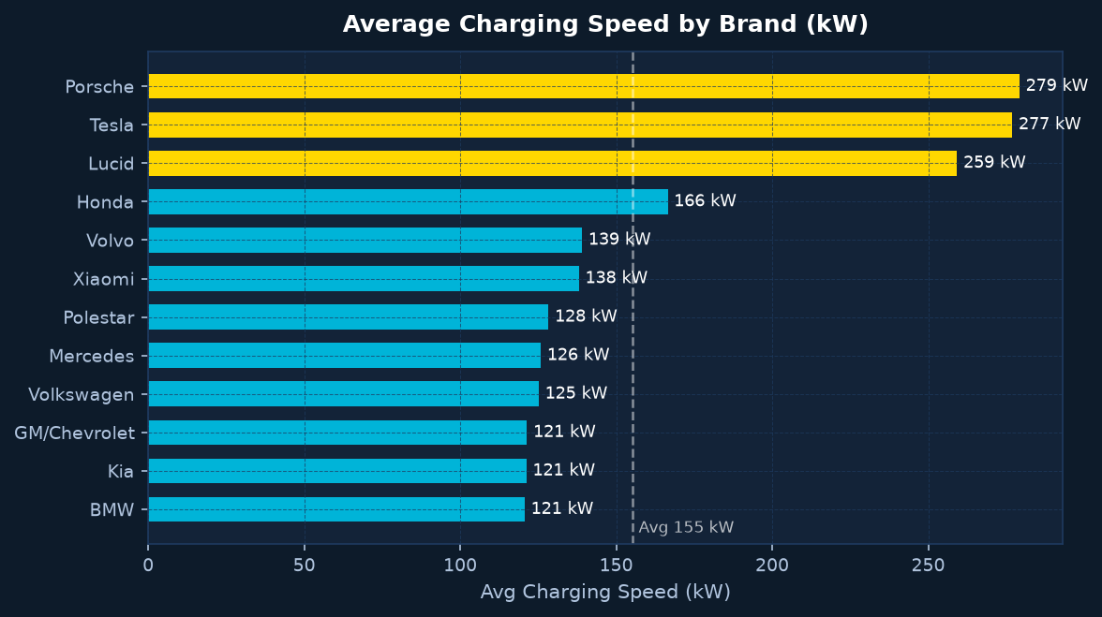
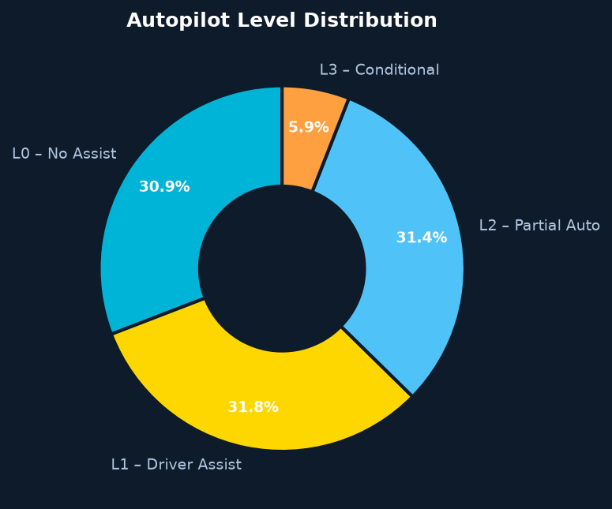
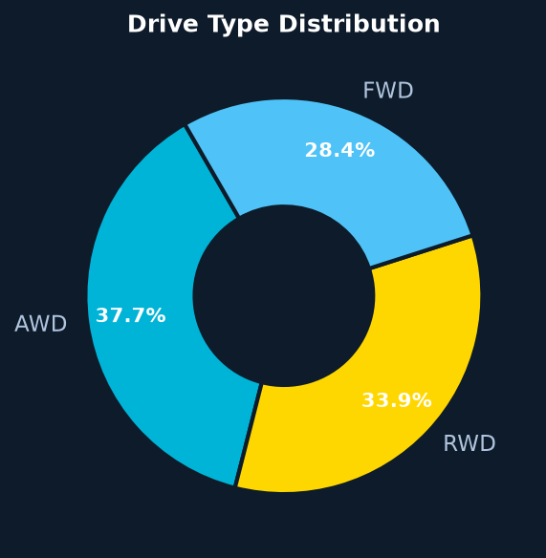
Battery & Technology Analysis
Battery Capacity vs Range — Key Relationship
Charging Speed by Brand (avg kW)
Avg Battery: 74.7 kWh
Avg Range: 261.8 miles
Efficiency: 3.51 miles/kWh
Best efficiency brands:
Honda: 326 mi avg range
Porsche: 275 mi avg range
Mercedes: 271 mi avg range
Toyota: 270 mi avg range
Max range recorded: 417 miles
Min range recorded: 150 miles
Porsche 279 kW |||||||||||||||||||||||||||||||||||||||||||||||||||||||||||||||||||||||||||||
Tesla 277 kW ||||||||||||||||||||||||||||||||||||||||||||||||||||||||||||||||||||||||||||
Lucid 259 kW |||||||||||||||||||||||||||||||||||||||||||||||||||||||||||||||||||||||
BMW 121 kW ||||||||||||||||||||||||||||||||||
Kia 121 kW ||||||||||||||||||||||||||||||||||
GM 121 kW ||||||||||||||||||||||||||||||||||
Average 155 kW ||||||||||||||||||||||||||||||||||||||||||
Max: 350 kW
Autopilot Level Distribution
Drive Type & Range Efficiency
L0 No Automation 617 models 30.9%
L1 Driver Assist 636 models 31.8%
L2 Partial Automation 628 models 31.4%
L3 Conditional Auto 119 models 5.9%
94.1% of EVs have at least basic driver assistance
5.9% offer Level 3 conditional automation
DRIVE TYPE DISTRIBUTION:
AWD 754 vehicles 37.7% (All-Wheel Drive)
RWD 678 vehicles 33.9% (Rear-Wheel Drive)
FWD 568 vehicles 28.4% (Front-Wheel Drive)
RANGE EFFICIENCY (mi/kWh):
Overall Average: 3.51 mi/kWh
RWD typically most efficient for range
AWD provides traction at efficiency cost
09
Notes:
Technology: Avg battery 74.7kWh, Avg range 261.8mi, Efficiency 3.51mi/kWh. Porsche (279kW) and Tesla (277kW) lead charging speed. Max charging: 350kW. Autopilot: 30.9% L0, 31.8% L1, 31.4% L2, 5.9% L3. Drive: AWD 37.7%, RWD 33.9%, FWD 28.4%.

Slide 10
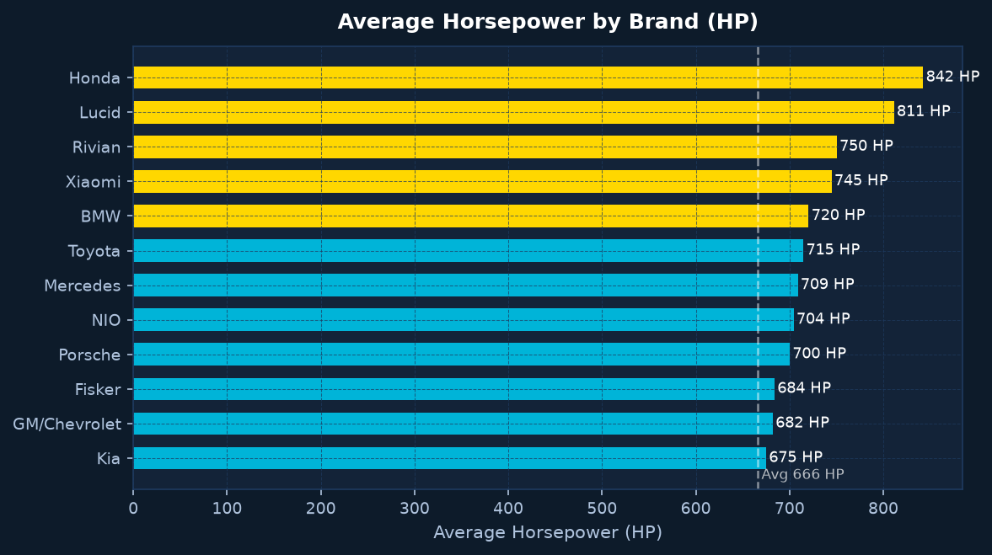
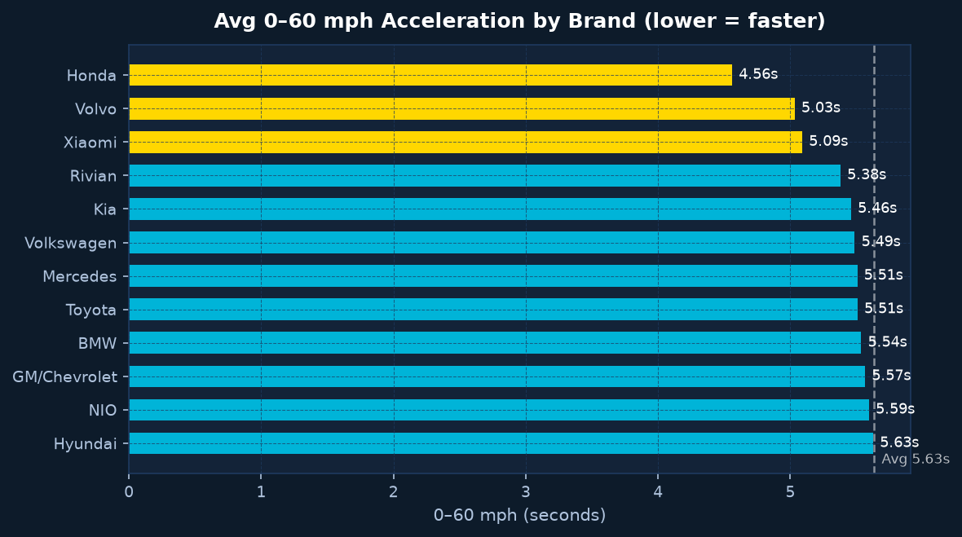
Performance Analysis
1,000 HP
Max Horsepower
666 HP
Average Power
601 Nm
Avg Torque
2.50 s
Fastest 0-60
200 mph
Max Top Speed
Avg Horsepower by Brand (HP)
0-60 mph Acceleration by Brand (seconds — lower = faster)
Honda 842 |||||||||||||||||||||||||||||||||||||||||||||||||||||||||
Rivian 750 ||||||||||||||||||||||||||||||||||||||||||||||||||
Lucid 811 |||||||||||||||||||||||||||||||||||||||||||||||||||||
Xiaomi 745 ||||||||||||||||||||||||||||||||||||||||||||||||
BMW 720 |||||||||||||||||||||||||||||||||||||||||||||||
Toyota 715 |||||||||||||||||||||||||||||||||||||||||||||||
Kia 675 |||||||||||||||||||||||||||||||||||||||||||
Avg 666 ||||||||||||||||||||||||||||||||||||||||||
Audi 628 ||||||||||||||||||||||||||||||||||||||||
Honda 4.56s ||||||||||||||||||||||||||||||||||||||||||||
Volvo 5.03s ||||||||||||||||||||||||||||||||||||||||||||||||||
Xiaomi 5.09s ||||||||||||||||||||||||||||||||||||||||||||||||||||
Rivian 5.38s ||||||||||||||||||||||||||||||||||||||||||||||||||||||||
Kia 5.46s |||||||||||||||||||||||||||||||||||||||||||||||||||||||||
VW 5.49s |||||||||||||||||||||||||||||||||||||||||||||||||||||||||
Average 5.63s |||||||||||||||||||||||||||||||||||||||||||||||||||||||||||||
Porsche 6.24s |||||||||||||||||||||||||||||||||||||||||||||||||||||||||||||||
Fastest: 2.50s (single model)
KEY INSIGHT: High horsepower does not always mean fastest acceleration — weight, torque delivery, and drive type all influence 0–60 performance. AWD models dominate the fastest-acceleration list.
10
Notes:
Performance: Max HP 1000, Avg HP 666, Avg Torque 601Nm, Fastest 0-60: 2.50s, Avg 0-60: 5.63s, Max top speed: 200mph, Avg top speed: 164.9mph. Honda leads avg HP at 842, Porsche slowest avg 0-60 at 6.24s. Max charging 350kW.

Slide 11
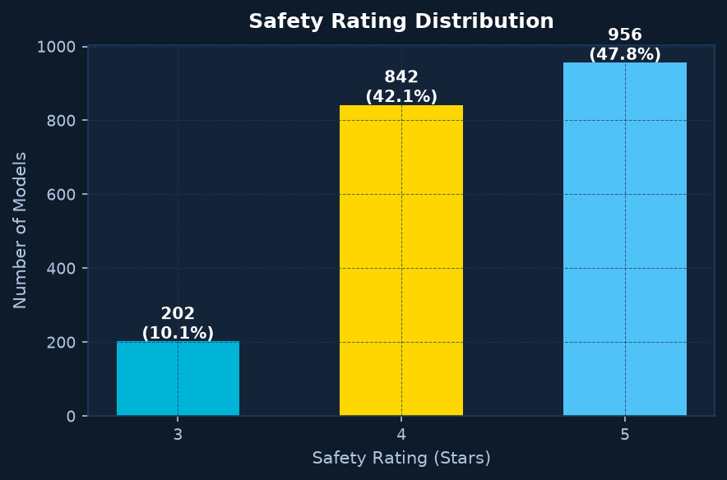
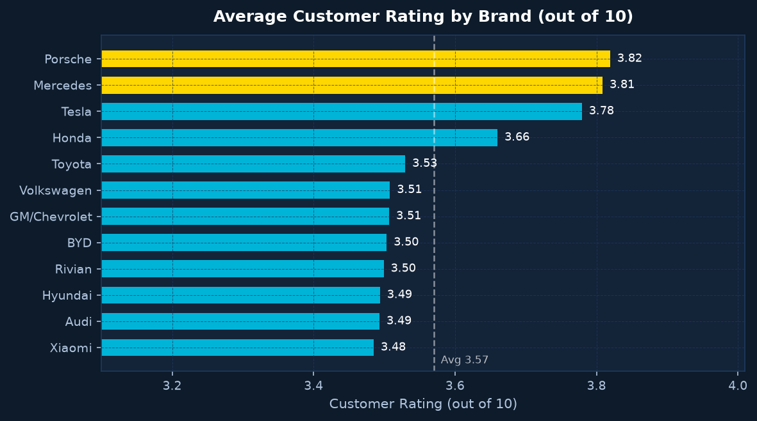
Customer & Safety Analysis
SAFETY OVERVIEW
Avg Safety Rating: 4.38 / 5
Safety 5 (5-Star): 956 models 47.8%
Safety 4 (4-Star): 842 models 42.1%
Safety 3 (3-Star): 202 models 10.1%
89.9% of models score 4+ stars
Top safety brands: Rivian 4.62,
Polestar 4.56, Porsche 4.57, NIO 4.57
CUSTOMER RATING OVERVIEW
Avg Customer Rating: 3.57 / 10
Highest rated brands:
Mercedes 3.81 / 10
Porsche 3.82 / 10
Tesla 3.78 / 10
Honda 3.66 / 10
Toyota 3.53 / 10
Lowest rated brands:
Lucid 3.31 / 10
NIO 3.42 / 10
Fisker 3.45 / 10
Customer Rating vs Annual Sales
Higher ratings do not always
correlate with higher sales.
Tesla: rating 3.78, sales 101.5M
Mercedes: rating 3.81, sales 7.3M
Porsche: rating 3.82, sales 2.1M
Brand reputation, pricing, and
distribution network drive sales
more than customer ratings alone.
Safety Rating by Brand
Customer Rating by Brand (out of 10)
Porsche 3.82 |||||||||||||||||||||||||||||||||||||
Mercedes 3.81 ||||||||||||||||||||||||||||||||||||
Tesla 3.78 |||||||||||||||||||||||||||||||||||
Honda 3.66 |||||||||||||||||||||||||||||||||
Volkswagen 3.51 |||||||||||||||||||||||||||||||||||
Average 3.57 ||||||||||||||||||||||||||||||||||||
Lucid 3.31 ||||||||||||||||||||||||||||||||
NIO 3.42 ||||||||||||||||||||||||||||||||||
Rivian 4.62 ||||||||||||||||||||||||||||||||||||||||||||||||||
Polestar 4.56 |||||||||||||||||||||||||||||||||||||||||||||||||
Porsche 4.57 |||||||||||||||||||||||||||||||||||||||||||||||||
NIO 4.57 |||||||||||||||||||||||||||||||||||||||||||||||||
Volvo 4.75 |||||||||||||||||||||||||||||||||||||||||||||||||||||||||
Average 4.38 |||||||||||||||||||||||||||||||||||||||||||||
BYD 4.32 |||||||||||||||||||||||||||||||||||||||||||||
11
Notes:
Customer & Safety: Avg safety 4.38/5. 47.8% rated 5-star, 42.1% rated 4-star. Avg customer rating 3.57/10. Top rated: Porsche 3.82, Mercedes 3.81, Tesla 3.78. Top safety: Volvo 4.75, Rivian 4.62. High rating does not guarantee high sales - Tesla 3.78 outsells Porsche 3.82 by 48x.

Slide 12
IBM Business Intelligence Dashboard
8 DASHBOARD TABS — Streamlit + IBM BI Export
TAB 1
KPI Overview
12 metric cards
Histograms & Pies
TAB 2
Sales Analysis
Brand trends
Top-15 Models
TAB 3
Price Analysis
Segment boxplots
Heatmap (Brand x Year)
TAB 4
Technology
Battery & Charging
Autopilot & Drive
TAB 5
Performance
HP & Torque
0-60 & Top Speed
TAB 6
Customer & Safety
Ratings & Scores
Warranty Analysis
TAB 7
Country Analysis
Sales & Price
Segment Mix
INTERACTIVE FILTERS (Sidebar — applies to all tabs simultaneously)
Brand
(Multi-select)
Year Range
(Slider)
Market Segment
(Multi-select)
Country
(Multi-select)
Price Range
(Rs Lakhs slider)
Body Type
(Multi-select)
Drive Type
(Multi-select)
IBM BI EXPORT — 13 Dashboard-Ready CSV Files
full_dataset.csv
kpis.csv
brand_analysis.csv
year_analysis.csv
country_analysis.csv
segment_analysis.csv
top_models.csv
technology_analysis.csv
performance_data.csv
safety_analysis.csv
body_type_analysis.csv
drive_type_analysis.csv
price_distribution.csv
Tech Stack: Python | Pandas | NumPy | Plotly | Streamlit
All monetary values: Rs INR | 1 USD = Rs 83.50
12
Notes:
IBM BI Dashboard: 8 tabs (KPI Overview, Sales, Price, Technology, Battery, Performance, Customer/Safety, Country, EV Comparison). 7 interactive filters. 13 IBM BI-ready CSV exports. Tech stack: Python, Pandas, Plotly, Streamlit. All prices in Rs INR.

Slide 13
Key Business Insights
Derived exclusively from ev_market_2026.csv | No fabricated statistics
SALES GROWTH
EV sales grew from 4.4M (2020) to 87.6M (2025) — a 20x increase in 5 years. Tesla commands 39% of total sales with 101.5M units. US-origin brands lead with 42.8% market share.
BRAND DOMINANCE
Tesla, BYD, and Volkswagen together account for 77.5% of total recorded annual sales. Budget segment (BYD-led) accounts for only 9% of records but offers best value at Rs 24.5L avg price.
PRICE vs RANGE
No strong linear correlation between price and range. Budget EVs average 0.72 miles per Rs 10,000 — 2.67x better value than Luxury (0.27 mi/Rs10K). Consumers pay premium price for brand, not purely range.
BATTERY & EFFICIENCY
Avg efficiency: 3.51 mi/kWh across all models. Honda leads avg range at 326 mi. Battery size and range have positive correlation, but RWD models typically deliver better efficiency than AWD models.
CHARGING TECHNOLOGY
Tesla (277 kW) and Porsche (279 kW) lead charging speed. Average charging: 155 kW. Max: 350 kW. 94.1% of models offer at least L1 driver assistance. Only 5.9% reach L3 conditional automation.
SAFETY & SATISFACTION
89.9% of models rated 4+ safety stars. Avg safety: 4.38/5. Volvo (4.75) leads safety. Avg customer rating: 3.57/10. Higher price does not guarantee higher satisfaction — Porsche (3.82) vs BYD Budget (3.50 avg). Safety and ratings have weak mutual correlation.
13
Notes:
All insights derived from actual dataset calculations. Sales grew 20x from 2020 to 2025. Tesla 39% market share. Budget EVs offer 2.67x better value per rupee than Luxury. Efficiency avg 3.51mi/kWh. 94.1% have driver assist. 89.9% rated 4+ stars.

Slide 14
Conclusion & Future Scope
WHAT WE LEARNED
HOW DATA ANALYTICS HELPS
Tesla dominates EV sales globally with 39% share
Budget EVs offer 2.67x better value per rupee than Luxury
Sales grew 20x from 2020 to 2025 in the dataset
89.9% of EVs meet 4+ star safety standards
3.51 mi/kWh average energy efficiency across all models
Charging speeds vary 35x (10 kW to 350 kW)
L2 automation is the most common autopilot level (31.4%)
Converts raw CSV data into actionable business KPIs
Exposes hidden pricing and value patterns
Enables brand and segment benchmarking at scale
Supports objective decision-making vs intuition
Identifies best-performing models for procurement
Quantifies technology adoption rates across the market
IBM BI DASHBOARD VALUE
FUTURE IMPROVEMENTS
Real-time interactive filtering by brand, year, price
Executive KPI cards for instant market overview
13 pre-built CSV datasets for Cognos/Planning Analytics
Supports multi-level drill-down analysis
Cross-tab comparison across 20+ brands
Shareable and repeatable for quarterly reviews
Live RBI exchange rate API for real-time INR
Km conversion option (1 mi = 1.609 km)
Quarterly sales time-series integration
Charging infrastructure map overlay
Database + REST API data sources
Predictive pricing model (ML regression)
India-specific import duty and tax layering
Thank You | ev_market_2026.csv | Python Analytics | IBM BI | All prices in Rs INR (1 USD = Rs 83.50)
14
Notes:
Conclusion: 7 key learnings from the dataset. Analytics pipeline enables objective decision-making. IBM BI dashboard supports executives with real-time filtering and 13 CSV exports. Future improvements: live RBI rates, km conversion, quarterly data, ML pricing model.

