Slide 1
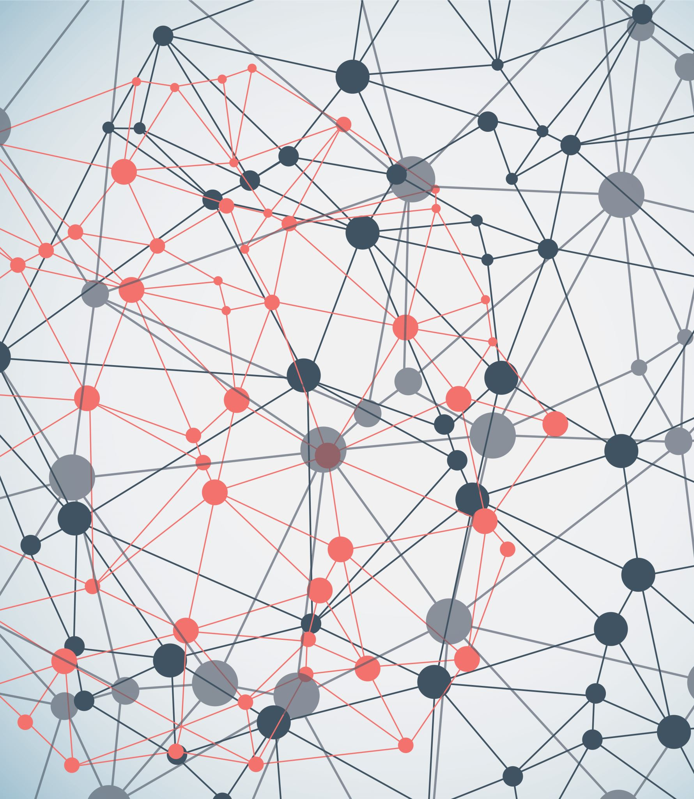
Effectivity comparison of machine learning algorithms to detect covid-19

Slide 2
Thesis Supervisor Mahamudul Hasan senior lecturer (Department of Computer Science & Engineering)
Students
Mehatub Uddin (2015-3-60-050)
Md. Roky Ahmed (2017-1-60-150)
Mahfuzur Rahman (2017-3-60-056)
Mir Mumit-Ul-Islam (2016-2-60-108)

Slide 3
Introduction
Covid-19 has spread over the world, causing a worldwide pandemic. It has brought the entire globe to a halt. New instances are being reported on a daily basis. Almost 16 core individuals have been affected by it thus far. As a result, taking the Covid-19 test for a whole country's population is extremely difficult for any government or country. Sometimes even a country is capable of taking the Covid-19 test, but still it takes too much time.

Slide 4
DATA PROCESSING
Preprocessed dataset
Trained and tested by Symptoms and COVID Presence dataset
Data processing and data cleaning both have done in this project
Creating data that is suited for machine learning categorization

Slide 5
Machine learning Models:
Classification:
Given a collection of records (training set)
Each record contains a set of attributes, one of the attributes is the class.
Each record contains a set of attributes, one of the attributes is the class.
Goal: previously unseen records should be assigned a class as accurately as possible.

Slide 6
Some Detection Systems
EXAMPLES OF CLASSIFICATION TASK:
Predicting tumor cells as benign or malignant
Classifying credit card transactions as legitimate
Classifying secondary structures of protein as alpha-helix, beta-sheet, or random coil
Categorizing news stories as finance, weather, entertainment, sports, etc.

Slide 7
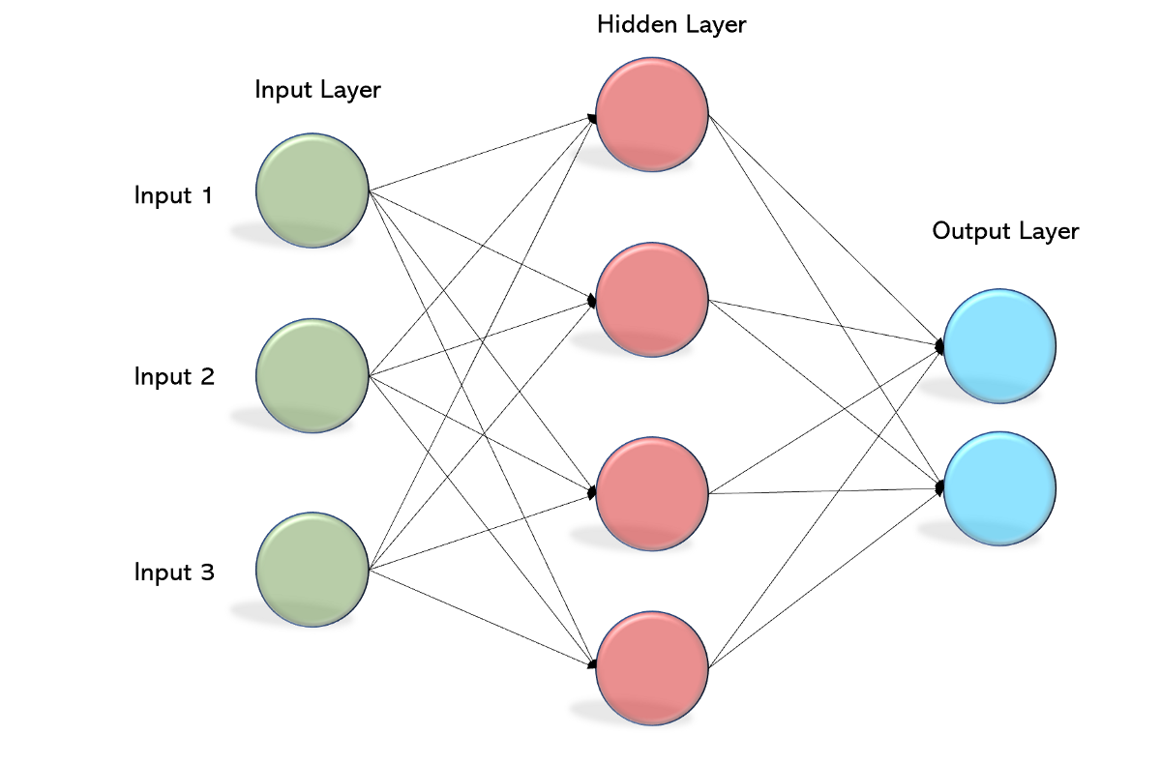

Algorithms that have been used:
Decision Tree:
MLP Classifier:
7

Slide 8

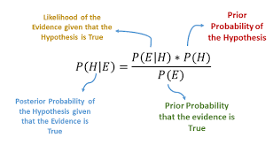
Random Forest
Naïve Bayes

Slide 9
Description of Models and Associated Parameters:
Dataset divided into training and testing portion.
We measure and print the accuracy score, f1 score, precision score and recall score of our ML classification models.
Python library like pandas, numpy, sklearn, scipy, matplotlib, graphviz, pydotplus and so on.
Sklearn library contains features like classification, regression, clustering and various algorithm. We have used sklearn classification library.

Slide 10
Performance Evaluation:
True -Positive (TP): The amount of positive samples predicted to be positive.
False- Positive (FP): The amount of negative samples predicted to be positive.
True -Negative (TN): The amount of negative samples predicted to be negative.
False- Negative (FN): The amount of positive samples predicted to be negative.

Slide 11
Method | Different Metrics
 | Accuracy | Precision | Recall | F1-score | Roc Score
Neural Network | 98% | 99% | 98% | 98% | 97%
Decision Tree | 96% | 97% | 98% | 97% | 92%
Random Forest | 88% | 87% | 100% | 93% | 73%
Naïve Bayes | 75% | 100% | 69% | 82% | 85%

Slide 12
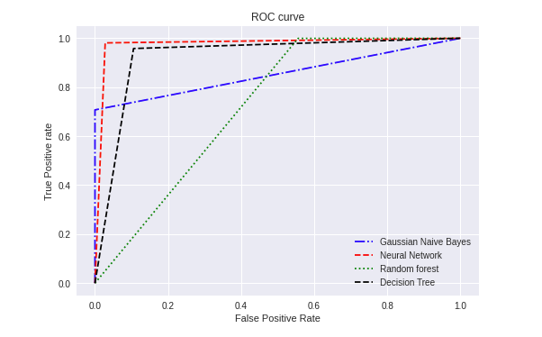

Slide 13
Discussion:
We used four distinct machine learning methods to build our datasets. We've seen fantastic results with certain algorithms, with near-perfect accuracy.
Neural network has the best precision rate with 99.0%
Decision tree has the second best with a precision rate of 97.0%
Naïve Byes precision was 100% but as its accuracy level is low with only 75%

Slide 14
Challenges:
Dataset: Getting the perfect dataset is a challenge.
Cleaning Process: Dataset processing is a difficult task. Many datasets lack the expected value we desire. Numeric values are required by some algorithms. As a result, datasets must be cleaned.
Deciding Factors: Choosing one of the various machine learning algorithms is difficult. Prior to execution, it's difficult to predict which one will produce reliable results.

Slide 15
Motivation:
To reduce testing time
To determine the affected rate and give medical support quickly.
To minimize the testing total time, spend on collecting data one by one.
To give faster and accurate results.

Slide 16
Future Work
Work with large portion of data provided by user.
Application and web based system.

Slide 17

