Slide 1
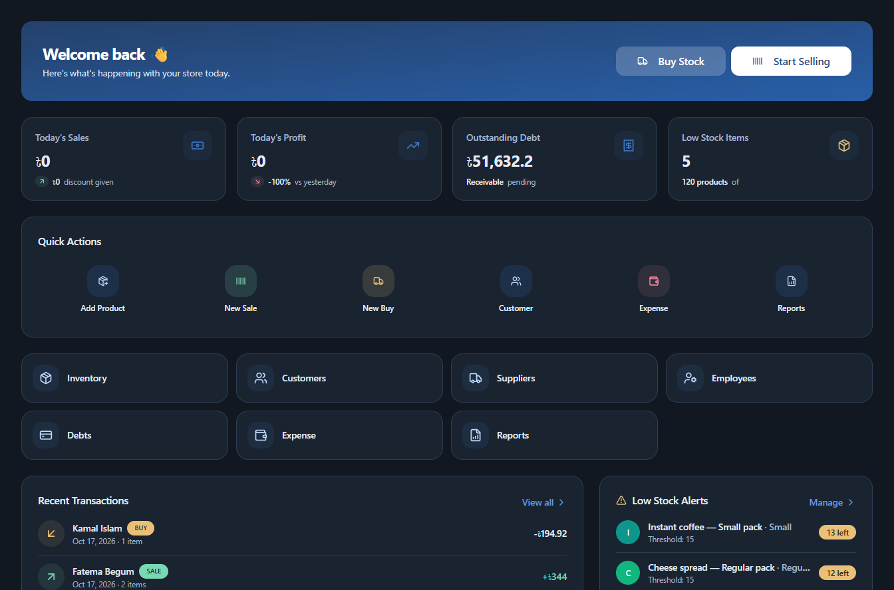
BizWizard
01
BUSINESS MANAGEMENT + FINANCE
BizWizard
Business management
with financial guidance
Run the shop. Use its records
to make financial decisions.
Current product UI with illustrative demo data
BongoForge
2026 FinTechathon International Track
Sadman Sakib / Mahfuz Saim / Sunan Rabbi
Rajshahi University of Engineering & Technology (RUET)
Bangladesh
Notes:
Suggested speaking time: 25 seconds.
We are BongoForge: Sadman Sakib, Mahfuz Saim and Sunan Rabbi from Rajshahi University of Engineering & Technology, RUET, Bangladesh. BizWizard combines daily business management with a finance copilot built on that existing platform. Owners manage inventory, sales, customers, debts, purchases, suppliers, expenses and employees. Finance services read those persisted shop records to calculate margins, cash forecasts and financing capacity. Our goal is to help owners run the business and make financial decisions in one connected workspace. The demonstration uses illustrative seeded data, not verified real-customer records or evidence of customer adoption.
Sources
submission/technical/main.tex
README.md
client/src/app/(dashboard)
server/src/app/modules
submission/presentation/assets/provenance.json
Team names and academic affiliation supplied by the team.

Slide 2
BizWizard
02
A busy shop can still run short of cash
An illustrative owner scenario
The owner’s question
Stock on the shelf
Sales on credit
Bills approaching
“Can I pay
and restock?”
Cash has already
paid for inventory
Customers still
owe the shop
Rent and suppliers
need payment
Sales, stock and cash answer different questions.
The decision needs payment timing, financing terms and product economics together.
Notes:
Suggested speaking time: 30 seconds.
This is an example of the decision problem, not a measured market statistic. Stock can consume cash before a sale. A credit sale creates revenue before collection. Bills can arrive in between. An owner needs to know whether to collect, reduce spending, change stock or seek financing.
This slide describes an illustrative scenario. It makes no market-size or customer-adoption claim.
Sources
submission/technical/main.tex
PLAN.md

Slide 3
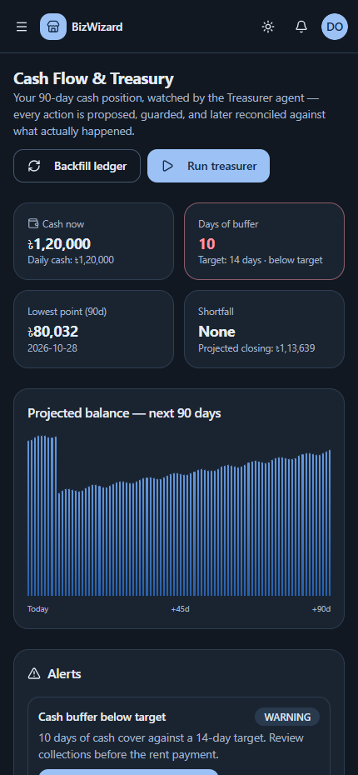
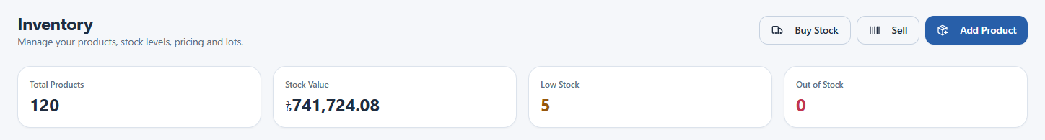
BizWizard
03
Three finance questions, one set of records
Which financing fits?
Will cash run short?
Where is cash tied up?
Compare eligibility, cost
and repayment capacity.
Project dated balances
and review alerts.
Inspect product margins
and working capital.
Inventory: live app with seeded demo records. Mobile view: illustrative demo data.
Notes:
Suggested speaking time: 25 seconds.
These are the three capabilities in Topic E. BizWizard uses sales, inventory, debt and expense records already present in the application. The same shop scope carries into financing, treasury and analysis. The responsive interface supports smaller screens as well.
Sources
submission/technical/main.tex
client/src/app/(dashboard)/finance
submission/presentation/assets/provenance.json

Slide 4
BizWizard
04
A decision stays connected to its records
Shop records
Finance engines
AI choice
Owner review
Outcome record
Sales, debt,
stock and expenses
Cash forecast,
metrics and eligibility
Select or explain
allowed options
Approve or reject
a proposed plan
Link recorded events
and inspect results
Example: overdue customer payment
A cash alert leads to a proposed collection plan. The owner reviews it.
A recorded payment can later supply evidence of collection.
Approval records a decision. The application does not execute a bank transfer.
Notes:
Suggested speaking time: 30 seconds.
Follow a collection decision through the system. The cash engine raises an alert from scoped records. A treasury recommendation comes from a prepared menu and passes financial guards. The owner can approve a plan. Collection evidence must link an existing recorded debt payment. Approval alone cannot claim that cash arrived. Financing acceptance follows a separate application workflow.
Sources
submission/technical/main.tex
submission/security/main.tex
server/src/app/modules/finance/cashflow/cashflow.service.ts

Slide 5
BizWizard
05
Daily work inside BizWizard
The finance copilot reads the platform’s saved business records.
Daily activity | Saved business records | Connection to finance
Buy and manage stock | Purchases, suppliers, lots and unit costs | Inventory value and cost of goods
Sell to customers | Sales, customer accounts and unpaid balances | Revenue, margins and receivables
Collect money owed | Debt payments and customer payment history | Cash inflow and remaining debt
Record expenses and bills | Operating expenses and dated commitments | Cash outflow and forecasts
Manage employees | Staff profiles, attendance and shop assignments | Controlled access to shop records
A credit sale reduces stock and records money owed.
A later collection adds a payment record to the same shop.
Implemented application workflows. Presentation screenshots use illustrative seeded data.
Notes:
Suggested speaking time: 30 seconds.
This is the business-management foundation beneath the finance copilot. The platform supports inventory and lot-level stock, purchasing and suppliers, checkout and sales, customer records, outstanding debts and collections, expenses, reporting, employee profiles, attendance and shop assignments. These are implemented application workflows with persisted records, rather than numbers typed only into a finance demonstration. Finance services read scoped sales, costs, debt, stock, expense and cash records from the same backend. Employee administration supplies access controls and business context; the finance engine does not use every employee field directly.
Example: a credit checkout records the sale and its items, reduces stock and creates a customer debt in a transaction. A recorded debt payment later supplies collection history and, for a non-simulated source shop, the database cash trigger synchronizes the cash ledger. The finance layer uses that connected history for revenue, receivables, margins and cash projections. A forecast remains a model rather than a transaction. The existing integration is distinct from claiming that the sample records came from real customers. The screenshots use intercepted synthetic responses and seeded demonstrations, as documented in asset provenance. No production adoption, externally audited data quality or complete enterprise accounting capability is claimed.
Sources
README.md
client/src/app/(dashboard)
server/src/app/modules/checkout/checkout.service.ts
server/src/app/modules/debt
server/src/app/modules/inventory
server/src/app/modules/expense
server/src/app/modules/supplier
server/src/app/modules/employee/employee.service.ts
server/src/app/modules/finance/shared/shopData.ts
server/prisma/migrations/20261018190000_cash_event_sync/migration.sql
submission/presentation/assets/provenance.json

Slide 6
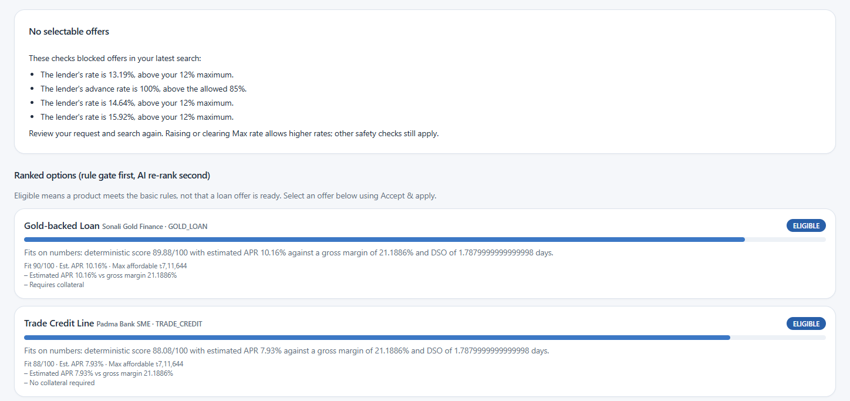
BizWizard
06
Financing that starts with affordability
1 Check eligibility
7 simulated lenders / 12 seeded products
90 days of sales history.
At least 60% sales-day coverage.
2 Compare feasible options
AI can enrich the ranking.
Code prices the offer.
3 Review the terms
Deterministic policies negotiate
for up to three rounds.
Live app with seeded demo records. Eligible matches do not guarantee an offer. No loan disbursement.
Notes:
Suggested speaking time: 35 seconds.
Matching needs at least 60 percent sales-day completeness across a 90-day window. Deterministic weights are affordability 30 percent, cost 25, liquidity 20, collateral 15 and flexibility 10. AI score changes stay within 15 points before a 60/40 blend. Pricing and negotiation use deterministic policies, not LLM-to-LLM bargaining. Initial offers pass guards. Acceptance checks scope, offer state and expiry but does not re-underwrite current affordability. The displayed APR is an annualized cost approximation. The screenshot illustrates the UI, not a live lender quote.
Sources
submission/technical/main.tex
server/src/app/modules/finance/matching/matching.service.ts
server/src/app/modules/finance/agents/agentCore.ts
submission/presentation/assets/provenance.json

Slide 7
BizWizard
07
Financing rules and negotiation
Ten eligibility rules run before AI sees the eligible products.
Affordability | Cost | Liquidity | Collateral | Flexibility
30% | 25% | 20% | 15% | 10%
Final score = 60% rules + 40% AI
The AI score stays within ±15 points of the rules score.
Repayment capacity
Negotiation limits
Monthly installment ≤50% of free cash flow.
Secured principal also respects 85% of collateral.
Up to 3 rounds. Borrower acceptance tests
a 35% installment burden and owner rate limits.
Code prices offers from risk and product limits. A guard breach produces no offer.
Notes:
Suggested speaking time: 45 seconds.
A 90-day profile combines sales, lot-level cost of goods sold, operating expenses, debts, inventory and existing installments. It includes margin, days sales outstanding, debt/revenue, monthly free cash flow and sales-day coverage. The seeded catalog contains seven simulated providers and twelve products. Ten eligibility rules check minimum/maximum amount, minimum/maximum tenor, business age, revenue, debt/revenue, sector, GSTIN and bank statements. All passing rules give ELIGIBLE. Exactly one soft miss within 20% gives NEAR_MISS. Other failures give INELIGIBLE. Below 60% sales-day completeness, matching stops. Only eligible products enter AI reranking. Weighted rules scores use affordability 30%, cost 25%, liquidity 20%, collateral 15% and flexibility 10%. Clamp the AI score to ±15 points of the deterministic score, within 0–100, then blend 60% deterministic and 40% AI.
Affordability converts 50% of monthly free cash flow into a serviceable principal using rate and tenor. A positive finite collateral limit can further cap principal at 85% of collateral value. These are distinct units, not a comparison of monthly cash flow directly with principal. Borrower acceptance uses a 35% installment/free-cash-flow test, APR versus gross margin and owner rate preferences. Lender pricing estimates probability of default and loss given default, applies a heuristic risk premium and clamps the rate to the product band. The guard checks positive amount, affordability, rate, tenor and advance rate. The 85% advance-rate guard can reject unsecured offers whose core proposes 100%; therefore an eligible match need not become an offer. A decline is a valid recorded result.
Negotiation runs deterministic lender/borrower policies for at most three rounds. Each stored step includes party, proposed amount/rate/tenor, decision, message and reasoning. The owner sees score bars, failed rules and trade-offs, then full-term cost, thread and schedule. Records include financing_matches, financing_offers with APR/conditions/expiry, financing_negotiations, loan_schedules and ai_decisions including ISSUE_OFFER or DECLINE_OFFER. Acceptance creates an application and installment schedule, never a disbursement. It checks scope, state and expiry but does not re-underwrite current affordability. APR is an annualized cost approximation, not regulatory IRR APR.
Sources
Team-supplied financing reference: photo_6249019189544817642_y.jpg
server/src/app/modules/finance/shared/eligibility.ts
server/src/app/modules/finance/shared/affordability.ts
server/src/app/modules/finance/shared/guard.ts
server/src/app/modules/finance/agents/agentCore.ts
server/src/app/modules/finance/matching/matching.service.ts

Slide 8
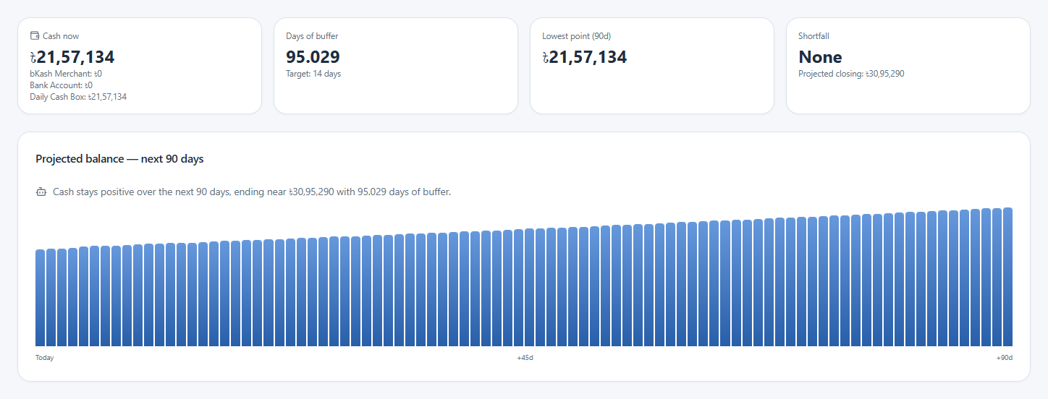
BizWizard
08
Cash flow before the next bill
90-day projection
History, dated commitments
and weighted receivables.
Nine alert conditions
Shortfalls, cash buffers,
aging debt and unusual costs.
A reviewable next step
The owner can inspect a plan
before approving it.
Live app with seeded demo records. Projected cash and proposed actions are forecasts, not measured gains.
Notes:
Suggested speaking time: 35 seconds.
The projection uses recent inflow and outflow levels, weekday patterns and a clipped trend. Dated commitments and probability-weighted receivables change future balances. Nine conditions span eight alert families, with separate 30-day and 60-day debt-aging conditions. Non-simulated sales, debt payments and expenses synchronize through PostgreSQL triggers. Isolated simulation workspaces use their own ledger. This screenshot comes from the live source demo shop using seeded records. It shows positive projected balances and a buffer above target, not a fabricated shortfall. No Run treasurer, backfill or approval action was clicked for the capture.
Sources
submission/technical/main.tex
server/src/app/modules/finance/shared/cashEngine.ts
server/src/app/modules/finance/shared/alerts.ts
submission/presentation/assets/provenance.json

Slide 9
BizWizard
09
Cash forecast and action rules
History | Forecast | Alert conditions
180 days | 90 days | 9
Daily balance calculation
Weekday patterns and a trend clipped to ±30%.
Dated bills and weighted receivables change cash.
Collection assumptions
Cash buffer
70% weight for receivables aged 0–7 days.
12% for balances aged 61 days or more.
Cash ÷ average daily outflow
from the last 28 days.
Guarded proposals. Critical alerts notify the owner. A daily 06:00 server-time job repeats the run.
The owner reviews a proposed action. A linked payment record supplies collection evidence.
Notes:
Suggested speaking time: 45 seconds.
Input: 180 days of shop-scoped cash-ledger history, dated commitments and open receivables. PostgreSQL triggers synchronize non-simulated sales, debt payments and expenses atomically with the cash ledger. Simulation shops maintain a separate ledger. TypeScript computes the money values. The projection combines day-of-week factors, a recent 28-day level and a trend clipped to ±30% of level. Receivables use age-bucket collection weights, from 70% at 0–7 days to 12% at 61+ days, with estimated collection dates. Buffer days equal current cash divided by average daily outflow over up to 28 history days. The forecast saves 90 daily buckets, closing cash, trough date, first shortfall date and amount. These are modeled assumptions, not promised collection rates.
Nine conditions cover projected shortfall, buffer, debt aging, idle cash and decline/cost signals. Debt-aging conditions are separate. Alerts persist as OPEN with severity and metric snapshots. CRITICAL alerts create an owner-scoped notification in the same shop and tenant. The deterministic treasury path builds a menu, ranks positive-impact actions and checks mandate exposure and projected balances. Guard violations record REJECTED_BY_GUARD and do not create proposed actions. The current run passes a zero balance floor to the final treasury guard; the menu uses the target buffer. Do not claim that this call enforces a 14-day target floor on every proposal. The owner sees the balance curve, buffer versus the configured target (default 14 days), trough date, next action, estimated impact and manual completion step. A shortfall inside fourteen days allows earlier planning, without guaranteeing a business outcome.
Approval records intent and moves no money. Collection evidence links a unique existing debt payment, not an arbitrary gain. Database records include cash_flow_projections, cash_alerts with rule and metricSnapshot, treasury_action_evidence and ai_decisions with guardResult/status. A daily 06:00 server-time cron repeats treasury work and reconciles EXECUTED actions older than seven days only when linked evidence exists. A linked collection can also reconcile immediately through the service. The routine treasury choice is currently deterministic-core, while optional AI policy selection exists in the matched sandbox evaluation.
Sources
Team-supplied cash flow reference: photo_6249019189544817640_y.jpg
server/src/app/modules/finance/shared/cashEngine.ts
server/src/app/modules/finance/shared/alerts.ts
server/src/app/modules/finance/cashflow/cashflow.service.ts
server/src/app/modules/finance/cron/financeCron.service.ts
server/src/app.ts

Slide 10
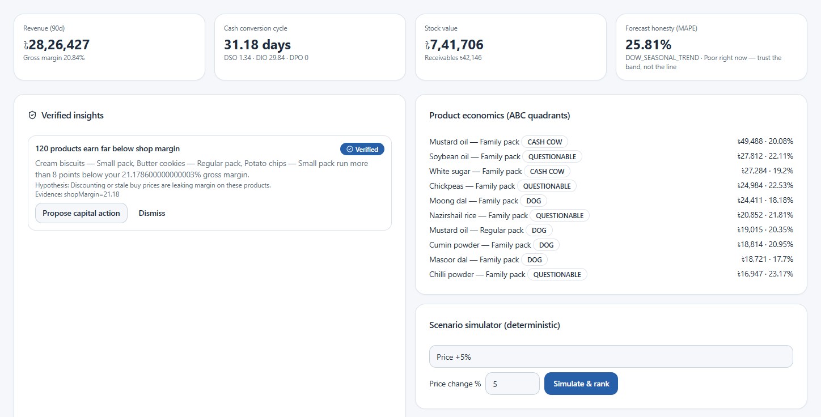
BizWizard
10
An explanation has to match the numbers
Candidate explanation
Check the contribution
to the observed gap
Residual gap ≤10%
Accounting attribution
supports the “verified” label.
Scenarios explore changes
before the owner commits.
Live app with seeded demo records. Saved insights may predate current metrics. Verification does not prove causation.
Notes:
Suggested speaking time: 35 seconds.
The analyst can propose a candidate explanation. Code checks how much of a nonzero gap the candidate accounts for. A residual of at most ten percent allows the verified label. This is accounting attribution, not proof that changing the product caused profit to rise. Product economics and working-capital measures give context. Price, collection, cost and mix scenarios use simplified models. Observed capital outcomes compare 30-day windows and remain non-causal.
Sources
submission/technical/main.tex
server/src/app/modules/finance/shared/verifier.ts
server/src/app/modules/finance/analysis/analysis.service.ts
submission/presentation/assets/provenance.json

Slide 11
BizWizard
11
Analysis checks and outcome measurement
Metric history | Forecast / anomaly history | Forecast holdout
90 days | 120 days | 14 days
Unusual changes
Verification threshold
Weekday-adjusted robust z-score: |z| >3.5.
AI ranks the supplied candidate explanations.
Residual gap ≤10%.
Keep refuted explanations in the record.
Stock and customer risk
Capital decisions
Dead stock: >45 days without sale and >5%
of stock value. Top customer >25% or HHI >0.25.
Freeze a baseline, then observe 30 days.
Before/after results remain non-causal.
Missing lot costs use a 70% sales-value estimate. Forecast accuracy reports held-out MAPE when available.
Notes:
Suggested speaking time: 45 seconds.
Input: sales, lot-level cost of goods sold, expenses, receivables, inventory and customer mix. Metrics use a 90-day profile; forecasting and anomaly detection load 120 days of daily sales. The reference image describes thirty metrics. The implementation returns families of profit/loss, product unit economics, working capital, breakeven/profitability, customer concentration and risk, plus metadata rather than a fixed thirty-row report. Working-capital cash conversion cycle equals days sales outstanding + days inventory outstanding − days payable outstanding. Product economics include margins, stock value and ABC-style quadrants. Missing or unavailable lot buy prices fall back to an estimated 70% of discounted line value. The source does not guarantee a separate per-line warning for every estimated cost, so do not present all costs as observed.
Forecasting holds out the last fourteen days when sufficient history exists, predicts those dates and reports actual MAPE. Unavailable validation remains unavailable rather than invented accuracy. A day-of-week-adjusted median-absolute-deviation z-score flags absolute z >3.5. AI only ranks candidate IDs supplied by code. For anomaly hypotheses, the verifier subtracts a candidate contribution from the nonzero original gap; residual within 10% allows VERIFIED. This is accounting attribution, not a causal experiment. Deterministic stock/margin/risk detectors also create verified facts directly. The default insight feed filters to VERIFIED; REFUTED entries remain accessible in stored records and unfiltered queries.
Dead stock requires more than 45 days since last sale and over 5% of total inventory value. Concentration triggers at top-customer share over 25% or HHI over 0.25. Scenarios vary price, collections, costs or mix and rank modeled expected value. Capital approval freezes a baseline before the thirty-day observation window. Owner outputs include the hypothesis, evidence, product quadrants, headline report, forecast and ranked scenarios. Evidence includes insights.verificationStatus and residual metrics, forecasts.method/backtest MAPE, and capital_decisions with frozen baseline/measurement. Thirty-day before/after observations do not prove causal profit or AI alpha.
Sources
Team-supplied analysis reference: photo_6249019189544817643_y.jpg
server/src/app/modules/finance/analysis/analysis.service.ts
server/src/app/modules/finance/shared/metricEngine.ts
server/src/app/modules/finance/shared/verifier.ts
server/src/app/modules/finance/shared/scenario.ts
server/src/app/modules/finance/shared/shopData.ts

Slide 12
BizWizard
12
System architecture
Next.js frontend
Express API
PostgreSQL
React / Tailwind
Vercel deployment
JWT, roles and scope
Request validation
Prisma migrations
Scoped business records
Same-origin API proxy
Backend authorization
Finance engines
AI runtime
Optional OpenAI
Calculations, forecasts
and financial guards
Structured JSON
Budget and fallback
Select or explain
constrained options
Browser, application, database and external AI form separate trust boundaries.
Notes:
Suggested speaking time: 35 seconds.
The browser uses a same-origin Next.js API rewrite. Express verifies the token, explicit role, tenant membership and employee shop assignment, then validates requests. Services use PostgreSQL through Prisma. The finance engines calculate money and constraints in TypeScript. The optional provider receives minimized structured inputs through a shared runtime. Upload and push providers exist outside this finance diagram. One production database serves the app; the local disposable test database is evidence infrastructure.
Sources
submission/technical/main.tex
submission/security/main.tex
client/next.config.ts
server/src/app.ts
server/src/app/middlewares/verifyTenant.ts

Slide 13
BizWizard
13
Where AI participates
Four agent roles
Code keeps the financial contract
Lender, borrower, treasurer and analyst.
Optional AI supports ranking, explanations
and matched evaluation choices.
Eligibility, pricing, negotiation policies,
repayment math and outcome calculations.
$2 / tenant / month default budget 6s fast / 12s reasoning deadline
Scoped inputs
JSON choice
Guards
Decision or fallback
Only the relevant shop
Schema and allowed IDs
Independent code checks
Label the model used
No key: zero provider calls. A fallback after an invalid response or timeout can still incur cost.
Notes:
Suggested speaking time: 45 seconds.
Four roles: lender, borrower, treasurer and analyst. Code supplies precomputed options and shop aggregates. One active mandate per shop/role controls objectives and limits. Editing inserts version +1 and deactivates the previous version. Routine pricing, negotiation and treasury picks use deterministic policies. Optional model calls enrich eligible ranking, generate constrained hypotheses, or select policies for the matched evaluation. Do not present all agent activity as a paid AI call.
For configured provider calls: check enablement, redact structured inputs, reserve a conservative estimated budget, request JSON-only output and validate with Zod plus allowed IDs. The default deadlines are six seconds for fast and twelve seconds for reasoning, shared with at most one repair retry. Redaction targets identifying keys and selected email/phone strings but is incomplete. A PostgreSQL advisory transaction lock serializes reservations per tenant and calendar month. The configurable default monthly budget is USD 2 per tenant. Financial guards run after generation. A violation voids the output and records the guard rejection. Owner/admin approval gates consequential actions, and no external bank transfer occurs.
No API key means zero provider calls and a labeled deterministic path. Budget denial also skips the provider request. Invalid output or a timeout can fall back after an attempted call and can still incur cost. Provider billing is authoritative. Runs record model/prompt version, tokens, estimated cost, latency, status and retries. Decisions record input hashes, output, guard result and status. Persistence is best-effort in some paths, so this is traceability rather than an independently witnessed immutable audit ledger. Evidence tables include ai_runs, ai_decisions, ai_budget_months and finance_evaluations. The owner sees versioned mandates, guard badges, budget, scorecards and audit export. Unknown alpha remains null without matched evidence. Audit JSON exports policies, decisions, runs, performance and evaluation summaries; individual evaluation exports carry replay inputs and outcomes.
Sources
Team-supplied agent system reference: photo_6249019189544817641_y.jpg
submission/technical/main.tex
submission/security/main.tex
server/src/lib/ai/client.ts
server/src/lib/ai/budget.ts
server/src/app/modules/finance/agents/agents.service.ts
server/src/app/modules/finance/agents/agentCore.ts

Slide 14
BizWizard
14
Decision ledger and matched evaluation
Versioned mandates and recorded choices keep decisions inspectable.
Saved live policy run: eight paired paths on one frozen shop snapshot
Role / metric | Rules baseline (BDT) | AI policy (BDT) | AI-favouring delta
Lender / net credit return | 665.94 | 265.22 | −400.72
Borrower / borrowing cost | 705.82 | 423.28 | +282.54
Treasurer / closing cash | 1,484,037.23 | 1,484,037.23 | 0.00
Analyst / modeled margin | 46,761.23 | 46,761.23 | 0.00
Same inputs and outcome draws. Offline replay matched the saved outcome hash.
Loan roles use full terms. Cash and margin use 30 days. These outcomes are simulated and cannot be added as profit.
Notes:
Suggested speaking time: 40 seconds.
The saved shop-specific evaluation is separate from the standalone three-risk benchmark on the evidence slide. Its successful gpt-4o-mini call used no fallback and estimated USD 0.000155. Before the call, the service freezes shop inputs, mandate versions and the available policy universe; it persists choices before outcome replay. Eight paired outcome paths share the same draws. The displayed means come directly from the saved scorecards, with no new paid call during presentation generation. Borrower benefit is baseline cost minus participant cost. Other roles use participant minus baseline. Treasurer and analyst cover thirty days; lender and borrower use full loan terms with independent assumptions. Never combine these metrics into one return.
Without matched counterfactual evidence, alpha remains null. Saved zero or negative differences stay visible. Mandates retain versions, decisions retain input hashes and guard results, and audit JSON exports policies, decisions, runs and evaluations. Download an individual evaluation to replay its frozen inputs, policy choices, seed, assumptions and both ledgers. From server/, after dependency installation, run npm run evidence:finance -- --replay FILE.json. Replay needs no database and no API key. It recomputes outcomes and checks a canonical hash. A matching hash supports reproducibility, not cryptographic authorship or real-world causality. Refuted explanations and unknown results are retained rather than converted into success claims.
Sources
Team-supplied agent system reference: photo_6249019189544817641_y.jpg
evidence/submission/matched-evaluation-live.json
evidence/submission/matched-replay-verification.json
server/src/app/modules/finance/agents/matchedEvaluation.service.ts
server/src/app/modules/finance/agents/agents.service.ts
server/scripts/evidence-scenarios.ts

Slide 15
BizWizard
15
The owner keeps approval authority
Finance capability | Employee | Owner / admin
Read assigned-shop finance | Allowed | Allowed
Acknowledge or dismiss alerts | Allowed | Allowed
Change mandates and run agents | Denied | Allowed
Accept offers or approve plans | Denied | Allowed
Backend checks
Token, role, tenant membership
and employee shop assignment.
Financial safeguards
Scoped references, allowed IDs
and transactional state changes.
Remaining risks
Browser token storage, incomplete redaction, audit gaps and unverified restore capability need further work.
Notes:
Suggested speaking time: 35 seconds.
This table summarizes finance routes. Owners operate within their tenant. Admins are trusted and can bypass tenant membership checks. Employees can read assigned-shop finance, including sensitive exports, and acknowledge alerts. Owner/admin roles control finance mutations. Public users have no finance access. Approval does not initiate a real bank transfer. We have not performed an independent penetration test or a restore drill. Browser localStorage tokens, incomplete redaction, mutable best-effort logs and recovery verification remain in the risk register.
Sources
submission/security/main.tex
server/src/app/modules/finance/matching/matching.routes.ts
server/src/app/modules/finance/cashflow/cashflow.routes.ts
server/src/app/middlewares/verifyFinanceShopAccess.ts

Slide 16
BizWizard
16
What the evidence shows
Live AI versus pinned rules
11
Three synthetic risk cases across four roles
integration tests passed
5 suites
Zero failed or skipped
Migrations applied
Cash integrity, permissions,
concurrency and isolation
4 AI wins, 5 rules wins, 3 ties. Synthetic outcomes do not establish real-world financial improvement.
Notes:
Suggested speaking time: 40 seconds.
The standalone live benchmark made three successful gpt-4o-mini calls without fallback at synthetic default-risk inputs of 5, 20 and 50 percent. Across four roles that gives 12 comparisons: four AI wins, five rules wins and three ties. Borrower modeled cost improved in all three cases. The analyst lost in all three, the treasurer tied, and lender results depended on risk. These are different financial metrics and cannot be summed as profit. Separately, the saved PostgreSQL execution report records 11 passing tests across five suites and successful migrations. These are saved reports, not new tests or paid calls during the presentation build. The preceding slide covers the independent paired shop-specific result.
Reviewer commands run from server/ after npm ci. npm run benchmark:finance uses deterministic synthetic fixtures and needs no database or API key. npm run benchmark:finance -- --live needs the reviewer’s own API key and network, with a configured spend limit. npm run evidence:finance applies migrations and runs integration suites against EVIDENCE_DATABASE_URL pointing to disposable local PostgreSQL at 127.0.0.1/simulator_test; it needs no AI key. npm run evidence:finance -- --replay FILE.json checks an exported evaluation offline without PostgreSQL or an API key. Keep live keys in the environment or ignored .env.benchmark. Reports record tested revision, inputs and outcomes. Private source repositories require reviewer access.
Benchmark total estimated API cost: USD 0.000273. Scope: standalone synthetic policy benchmark, not the entire application negotiation pipeline.
Sources
evidence/submission/benchmark-live-results.json
evidence/submission/sandbox-operation-logs.json
submission/technical/main.tex
README.md
server/scripts/benchmark-finance.ts
server/scripts/evidence-scenarios.ts

Slide 17
BizWizard
17
BizWizard in practice
Daily operations and financial decisions,
connected in one shop workspace.
Manage the business, then use its records
to review financing, cash flow and margins.
bizwizard-lake.vercel.app
Working sandbox. No external lender contact or bank transfer.
Notes:
Suggested speaking time: 15 seconds.
Our broader idea is connected business management and financial guidance for small-business owners. The implemented foundation covers daily operational workflows. The finance copilot builds on their saved shop records to compare simulated financing, project cash and explain product economics. The intended benefit is less manual transfer between operational records and financial decisions; we do not claim a measured customer outcome. Demonstration records remain seeded or synthetic. If moving to a demonstration, use an isolated demo workspace and saved evidence, without a new paid call during the talk. Included screenshots support an offline explanation. Current financing is simulated, with no external lender contact or money execution. Before sensitive production use, strengthen browser sessions, provider-data handling and audit guarantees, and verify backup restoration. Real lending would require revalidating final affordability and terms, assessing legal obligations and implementing external execution controls. Heuristic risk/cost models, Float money, trusted administrators and non-causal observations remain limitations.
Sources
submission/technical/main.tex
submission/security/main.tex
README.md
https://bizwizard-lake.vercel.app/

