Slide 1
Chapter 3: Processes

Slide 2
Process
a process is basically a program that’s currently being executed — not just sitting on disk, but alive and running
Program → a passive file (like chrome.exe stored on your disk)
Process → an active instance of that program in memory (chrome actually running)
You can even have multiple processes of the same program running at once.

Slide 3
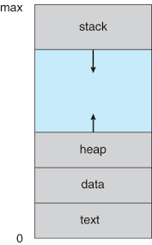
Sections of process and Their memory location
Text section: the executable code
Data section: global variables
Heap: memory that is dynamically allocated during program run time
Stack: containing temporary data, Function parameters, return addresses, local variables, Data section containing global

Slide 4
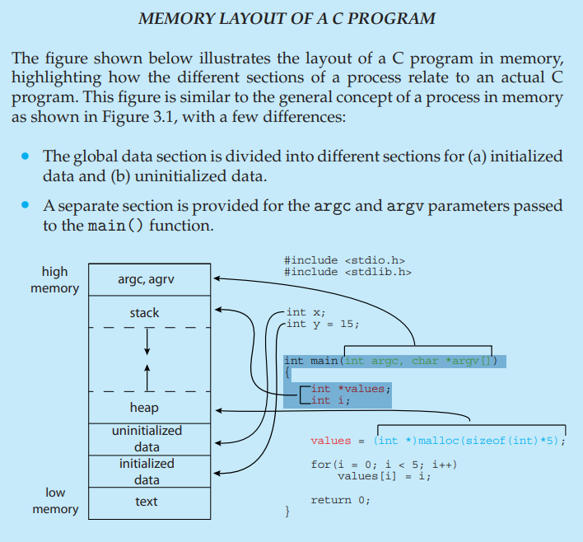

Slide 5
Process state
As a process executes, it changes state
new: The process is being created
running: Instructions are being executed
waiting: The process is waiting for some event to occur
ready: The process is waiting to be assigned to a processor
terminated: The process has finished execution

Slide 6

Diagram of process state

Slide 7
Process control block(cont’d)
Each process is represented in the operating system by a process control block (PCB)—also called a task control block. It contains many pieces of information associated with a specific process, including these:
Process state. The state may be new, ready, running, waiting, halted, and so on.
Program counter. The counter indicates the address of the next instruction to be executed for this process.
CPU registers. The registers vary in number and type, depending on the computer architecture. They include accumulators, index registers, stack pointers, and general-purpose registers, plus any condition-code information. Along with the program counter, this state information must be saved when an interrupt occurs, to allow the process to be continued correctly afterward when it is rescheduled to run.

Slide 8
Process control block(cont’d)
CPU-scheduling information. This information includes a process priority, pointers to scheduling queues, and any other scheduling parameters. (Chapter 5 describes process scheduling.)
• Memory-management information. This information may include such items as the value of the base and limit registers and the page tables, or the segment tables, depending on the memory system used by the operating system (Chapter 9).
• Accounting information. This information includes the amount of CPU and real time used, time limits, account numbers, job or process numbers, and so on.
• I/O status information. This information includes the list of I/O devices allocated to the process, a list of open files, and so on.

Slide 9
Process and thread
A process is an independent program in execution
A thread is a lightweight unit of execution inside a process( a process may have multiple threads.)
Easy Analogy
Process → A house
Thread → Rooms inside the house (share electricity, water)

Slide 10
Process and thread
Basis | Process | Thread
Definition | A process is an independent program in execution | A thread is a lightweight unit of execution inside a process
Memory | Has separate memory space | Shares memory with other threads of the same process
Creation | Heavyweight (takes more time/resources) | Lightweight (faster to create)
Communication | Uses IPC (pipes, sockets, etc.) | Direct communication via shared memory
Overhead | High overhead | Low overhead
Isolation | Strongly isolated (safe from other processes) | Not isolated (one thread can affect others)
Context Switching | Slower | Faster
Failure Impact | Crash affects only that process | Crash can terminate the whole process
Example | Running Chrome, Word, VLC | Multiple tabs in Chrome

Slide 11
Process Scheduling (Cont’d)
Process scheduling is the method an operating system uses to decide which process (program in execution) gets to run when multiple processes are ready. The process scheduler selects a process from the ready queue and allocates CPU time to it.
It Maintains scheduling queues of processes
Job queue – set of all processes in the system
  Stored in secondary storage (disk)
  Managed by the long-term scheduler
  Not all processes in this queue are ready to run
Device Queue
Each I/O device may have its own queue. Example: Printer queue, disk queue

Slide 12
Process Scheduling (Cont’d)
Ready Queue
The ready queue contains processes that are in main memory and ready to execute, waiting for CPU time.
  stored in main memory (RAM)
  processes are in ready state
  managed by the short-term scheduler
  CPU selects processes from here
Waiting Queue
Contains processes that are waiting for I/O operations (like keyboard input, file read, printer).

Slide 13
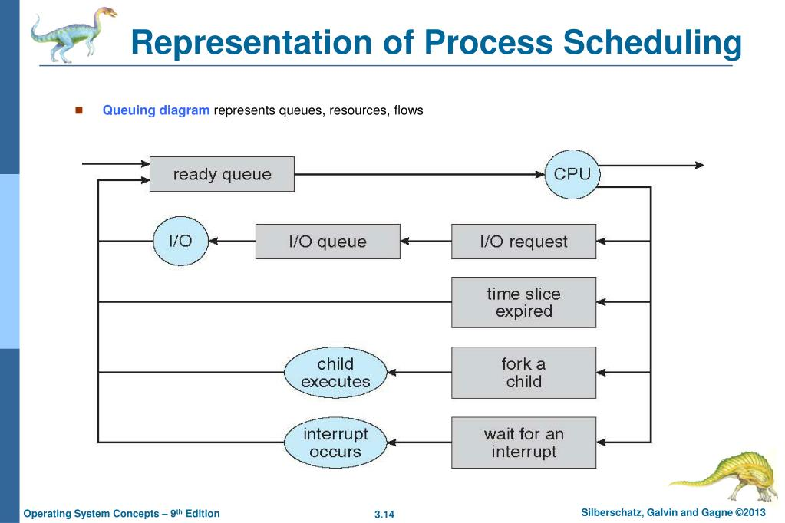
Process Scheduling (Cont’d)
Queueing-diagram representation of process scheduling.

Slide 14
Schedulers
Short-term scheduler (or CPU scheduler) – selects which process should be executed next and allocates CPU
  Sometimes the only scheduler in a system
  Short-term scheduler is invoked frequently (milliseconds) (must be fast)
Long-term scheduler (or job scheduler) – selects which processes should be brought into the ready queue
  Long-term scheduler is invoked infrequently (seconds, minutes) (may be slow)
  The long-term scheduler controls the degree of multiprogramming
Processes can be described as either: I/O-bound process– spends more time doing I/O than computations, many short CPU bursts .CPU-bound process – spends more time doing computations; few very long CPU bursts

Slide 15
Context switching
Context switching is the operation by which an operating system saves the execution state (context) of a currently running process or thread and restores the saved state of another process or thread so that the CPU can switch execution between them.
When CPU switches to another process, the system must save the state of the old process and load the saved state for the new process via a context switch

Slide 16
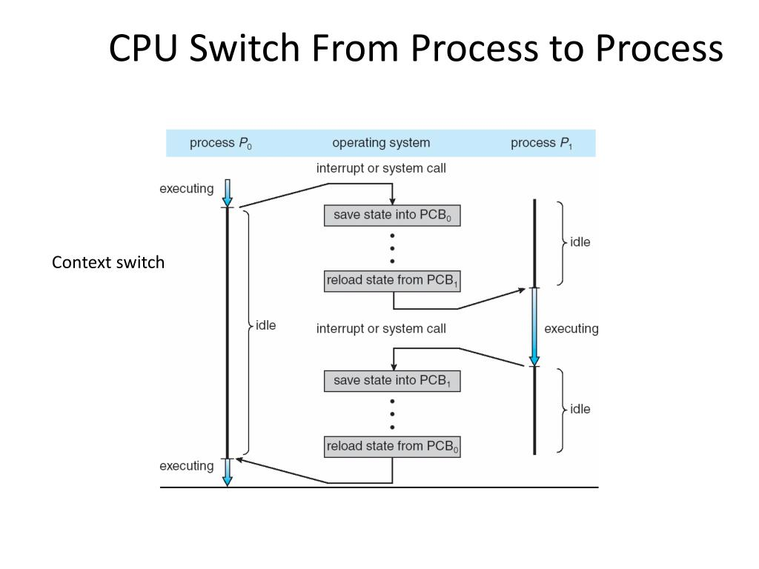
Context switching

Slide 17
Operations on Processes
System must provide mechanisms for:
process creation,
process termination,
and so on as detailed next

Slide 18
Process Creation
Parent process create children processes, which, in turn create other processes, forming a tree of processes
Generally, process identified and managed via a process identifier (pid)
Resource sharing options
  Parent and children share all resources
  Children share subset of parent’s resources
  Parent and child share no resources
Execution options
  Parent and children execute concurrently
  Parent waits until children terminate

Slide 19
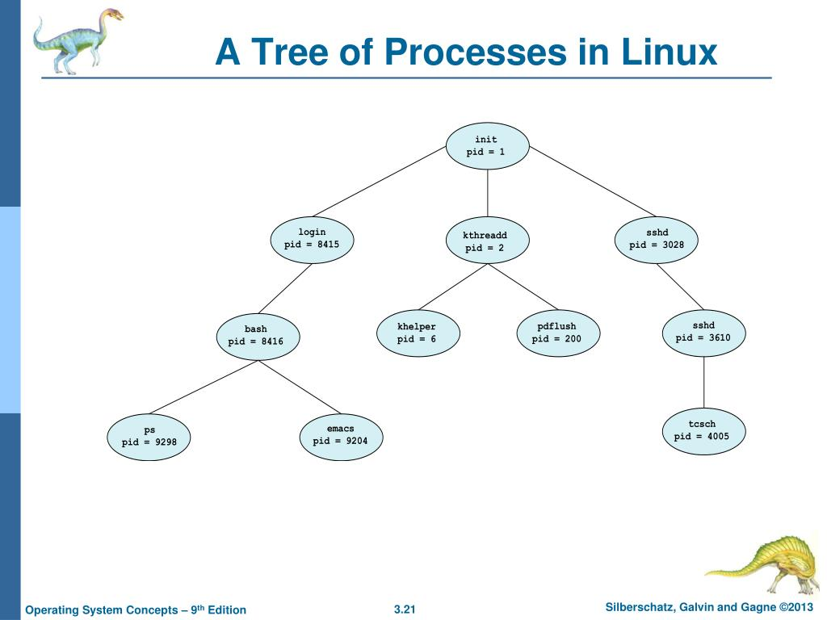
A Tree of Processes in Linux

Slide 20
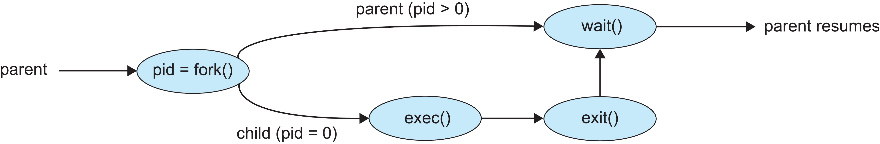
Process Creation (Cont.)
Address space options
  Child duplicate of parent
  Child has a program loaded into it
UNIX examples
  fork()system call creates new process
  exec()system call used after a fork() to replace the process’ memory space with a new program

Slide 21
Process Termination
Process executes last statement and then asks the operating system to delete it using the exit() system call.
  Returns status data from child to parent (via wait())
  Process’ resources are deallocated by operating system
Parent may terminate the execution of children processes using the abort() system call. Some reasons for doing so:
  Child has exceeded allocated resources
  Task assigned to child is no longer required
  The parent is exiting and the operating systems does not allow a child to continue if its parent terminates

Slide 22
Process Termination
Some operating systems do not allow child to exists if its parent has terminated. If a process terminates, then all its children must also be terminated.
  cascading termination. All children, grandchildren, etc. are terminated.
  The termination is initiated by the operating system.
The parent process may wait for termination of a child process by using the wait()system call. The call returns status information and the pid of the terminated process
pid = wait(&status);
If no parent waiting (did not invoke wait()) process is a zombie
If parent terminated without invoking wait , process is an orphan

Slide 23
Interprocess Communication
Processes within a system may be independent or cooperating
Cooperating process can affect or be affected by other processes, including sharing data
Independentprocess cannot affect or be affected by the execution of another process
Reasons for cooperating processes:
  Information sharing
  Computation speedup
  Modularity
Cooperating processes need interprocess communication (IPC)
Two models of IPC
  Shared memory
  Message passing

Slide 24
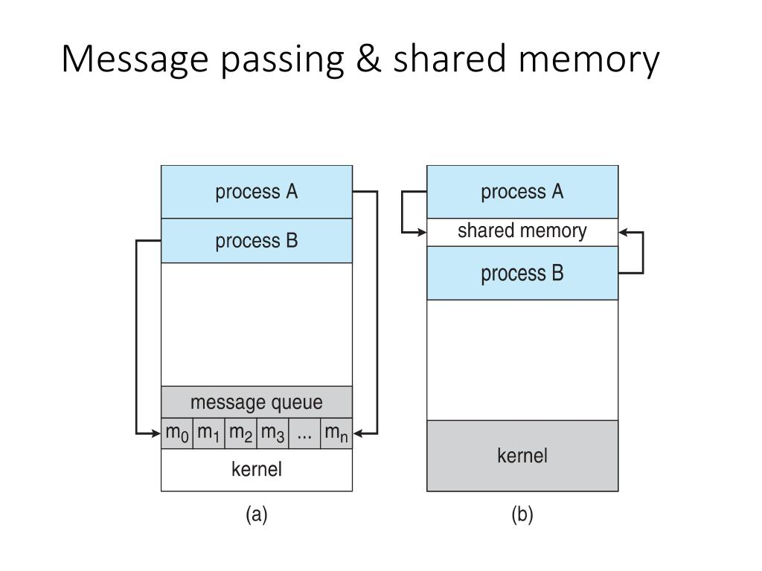
Interprocess Communication
(a) Message passing. (b) shared memory.

