Slide 1
JavaScript - a Brief Introduction

Slide 2
What is JavaScript
Object based (not object oriented) programming language
  very limited object creation
  a set of pre-defined objects associated with
    HTML document structure
      many HTML tags constitute JS Objects
    Browser functionality
      provides a limited API to Browser functionality

Slide 3
JavaScript…Java ?
Java - Programming Language (PL)
  Interactive Web Graphics
  Creating web browser applications
  Writing stand-alone applications
JavaScript - Scripting Language
  Runs within the context of the Web browser
  Customizing pages based on browser version
  Visual Feedback to user actions
  Validating data entered on HTML Forms

Slide 4
What can it be used for
Some pretty amazing things….
  Text animation
  graphic animation
  simple browser based application
  HTML forms submission
  client-side forms data validation (relieving the server of this task)
  web site navigation

Slide 5
What do I need to get started
A web browser
  Netscape Navigator 4.x or later
  MS Internet Explorer 3.x or later
A text Editor
  Wordpad/Notepad
  Vi, Emacs

Slide 6
“Three Legged Stool”
-- JavaScript works with HTML & CSS (Cascading Style Sheets)
-- Content is separated from Presentation & Behavior
HTML
Content
CSS
(Cascading Style Sheets)
Presentation
JavaScript
Behavior

Slide 7
How to specify JavaScript code
Inline Code
  Add dynamic functionality to an individual element
    <img onMouseOver=“doThisFunction(this)”>
    Write JavaScript code directly in appropriate event attributes
Embedded scripts
  Embed JavaScript code in an XHTML document—either in the head or in the body
    <script type=“text/javascript”> x=3; y=9; document.writeln( x + y );
    </script>
Inserting external scripts
  Insert a file with “.js” extension that contains JavaScript code
    <script type=“text/javascript” src=“external.js” />
    JavaScript libraries can be shared by multiple XHTML documents

Slide 8
<SCRIPT>…</SCRIPT>
<SCRIPT language=…. src=……></SCRIPT>
  <script> tag
    Indicate that the text is part of a script
    type attribute
      Specifies the type of file and the scripting language use
    writeln method
      Write a line in the document
    Escape character ( \ )
      Indicates “special” character is used in the string
    alert method
      Dialog box

Slide 9
<SCRIPT>
<SCRIPT LANGUAGE=“JavaScript”>
<!-- start hiding code from old browsers>
Script
Code
Goes
Here
// Stop Hiding code -->
</SCRIPT>

Slide 10
Embedding Javascript
External JavaScript File
<body>
...
<script type="text/javascript" src=“myCode.js" />
<script type="text/javascript">
//<![CDATA[
alert("Page is loading");
//]]>
</script>
<p onclick="alert('I told you not to click on me!');">
Please do not click on this text.</p>
...
</body>
Inline Code
Event Handler

Slide 11
JavaScript Statements
<html>
<head><title>My Page</title></head>
<body>
<script language=“JavaScript">
document.write('<h1>This is my first →
JavaScript Page</h1>');
</script>
</body>
</html>
HTML written
inside JavaScript
Notes:
This example demonstrates that anything included within the quotes in the document.write statement is printed to the screen, and this includes HTML tags. The <h1> tag is delivered to the browser along with the text, and the browser would interpret it as a normal HTML file, displaying the text in the Heading 1 style.
IMPORTANT NOTE:
This example shows a JavaScript statement in the <body> of the web page.
It is possible to include JavaScript statements in the <head> section of a web page but care must be taken that they do not try to access items that don't exist until the page has loaded (e.g. form elements, links, images). The web browser parses (reads through and executes) any script commands as it displays the page.
In most cases it is common sense that dictates where a statement should be placed.
If, in the above example, document.write was placed in the <head> of the page, the text "This is my first JavaScript Page" would appear in the <head> of the finished page – this would be incorrect – although modern browsers will let you get away with it!
In some circumstances you may wish to use document.write in the <head> - for example to dynamically generate <meta> or <title> tags. Such uses are not considered here.
JavaScript functions are typically defined in the <head> section of a web page as they do not normally execute until they have been triggered elsewhere. The use of functions in JavaScript is covered in the Netskills Training Module: "Further JavaScript (Enhancing JavaScript with Functions and Events)"

Slide 12
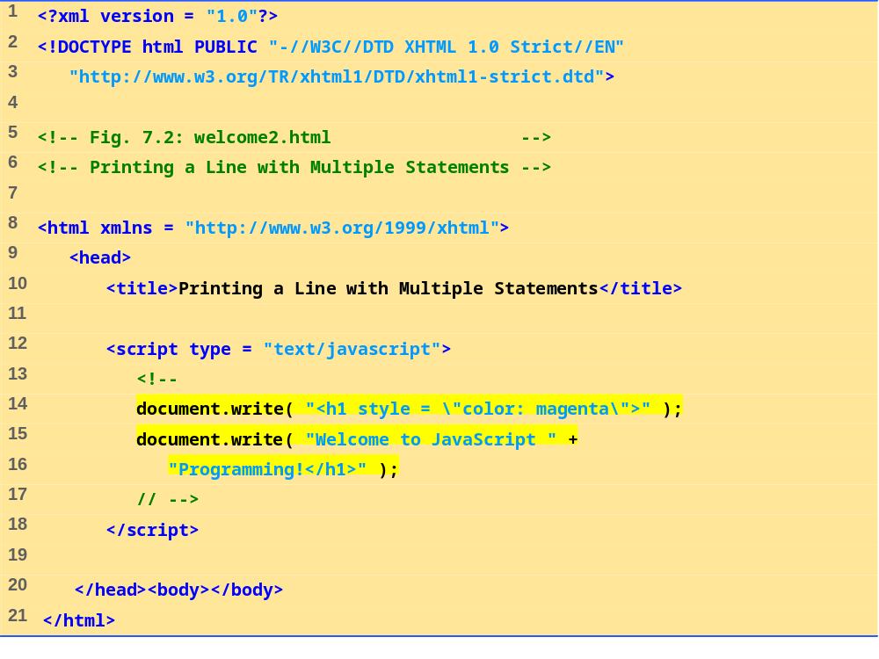
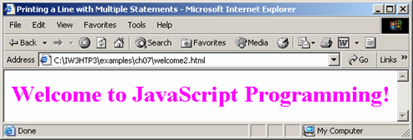
welcome2.html

Slide 13
Using the alert() Method
<head>
<script language=“JavaScript”>
alert(“An alert triggered by JavaScript”);
</script>
</head>
Alert Box
  An alert box is often used if you want to make sure information comes through to the user.
  When an alert box pops up, the user will have to click "OK" to proceed.

Slide 14
Using the confirm() Method
<head>
<script language=“JavaScript”>
confirm(“Are you happy with the class?”);
</script>
</head>
Confirm Box
  A confirm box is often used if you want the user to verify or accept something.
  When a confirm box pops up, the user will have to click either "OK" or "Cancel" to proceed.
  If the user clicks "OK", the box returns true. If the user clicks "Cancel", the box returns false.

Slide 15
Using the prompt() Method
<head>
<script language=“JavaScript”>
prompt(“What is your student id number?”);
prompt(“What is your name?”,”No name”);
</script>
</head>
This is the only one that allows the user to type in his own response to the specific question.
You can give a default value to avoid displaying “undefined”.

Slide 16
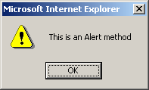

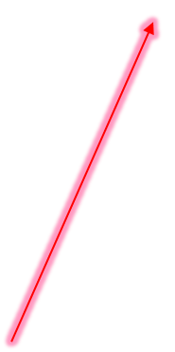
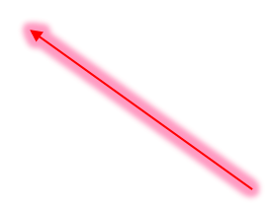
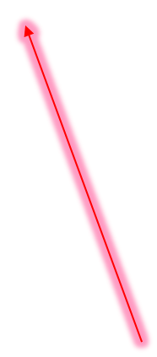
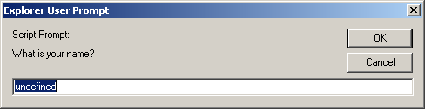
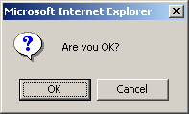
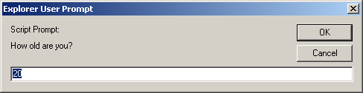
Three methods
<script language="JavaScript">
alert("This is an Alert method");
confirm("Are you OK?");
prompt("What is your name?");
prompt("How old are you?","20");
</script>

Slide 17
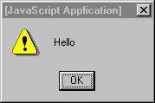

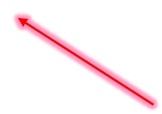

JavaScript Statements
<html>
<head><title>My Page</title></head>
<body>
<p>
<a href="myfile.html">My Page</a>
<br />
<a href="myfile.html"
onMouseover="window.alert('Hello');">
My Page</A>
</p>
</body>
</html>
JavaScript written
inside HTML
An Event

Slide 18
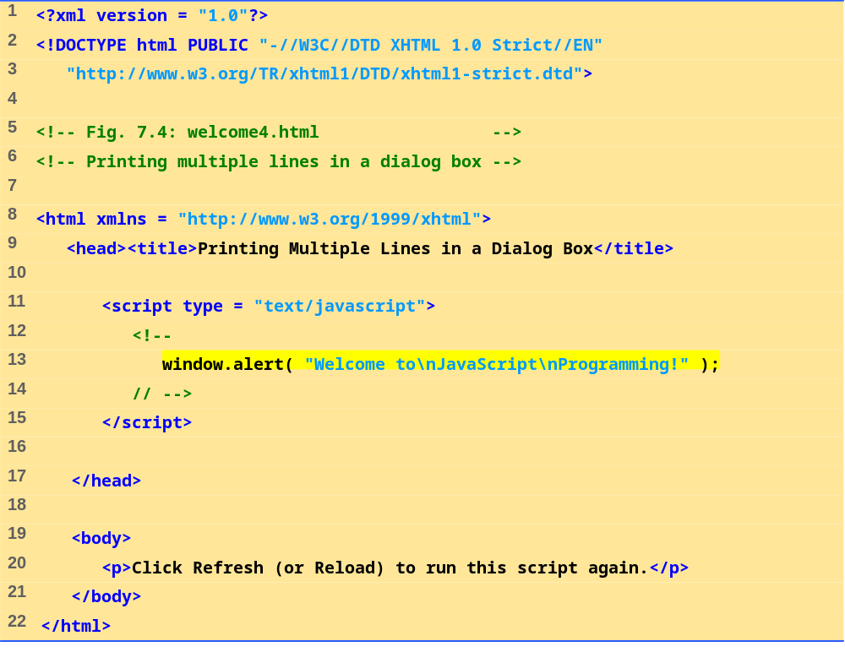
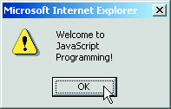
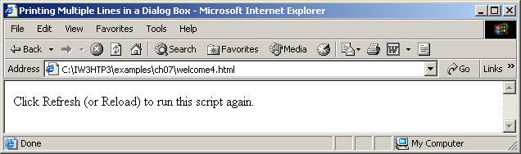
welcome4.html

Slide 19
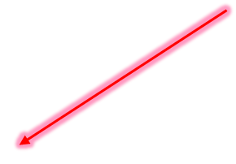
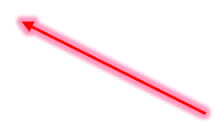

Example Statements
<script language="JavaScript">
window.prompt('Enter your name:','');
</script>
<form>
<input type="button" Value="Press" onClick="window.alert('Hello');">
</form>
Another event
Note quotes: " and '

Slide 20

Naming Form Elements in HTML
  <form name="addressform">
  Name: <input name="yourname"><br />
  Phone: <input name="phone"><br />
  Email: <input name="email"><br />
  </form>
Notes:
This example shows a simple form. Notice the name attribute is used at all points - to name the form, and to name each element within the form.
How JavaScript uses the name attribute is described next.

Slide 21
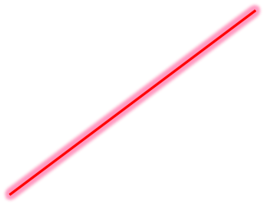
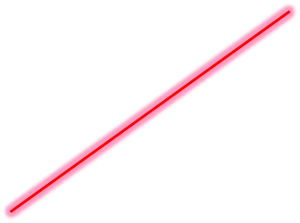
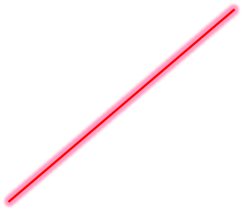
Forms and JavaScript
document.formname.elementname.value
Thus:
document.addressform.yourname.value
document.addressform.phone.value
document.addressform.email.value
Notes:
To refer to the value that a user has typed in a text box, you use the following naming system:
document.formname.elementname.value
This is a naming convention derived from the JavaScript object model:
document refers to the page displayed in the browser.
formname is supplied by the page author as the name attribute of the <form> tag - in the example it is addressform and refers to the whole form.
elementname is supplied by the page author using the name attribute of the <input> tag.
value is a predefined term which refers to the text typed in by the user.

Slide 22
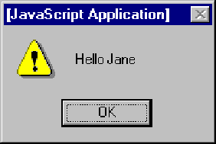

Using Form Data
Personalising an alert box
<form name="alertform">
Enter your name:
<input type="text" name="yourname">
<input type="button" value= "Go" onClick="window.alert('Hello ' + → document.alertform.yourname.value);">
</form>
Notes:
This simple code creates a form called alertform.
The JavaScript is activated when 'Go' button is pressed (an onClick event - see separate Netskills Training Module for more details on Functions and Events in JavaScript). The current value of the element yourname would be displayed in a an alert box.

Slide 23
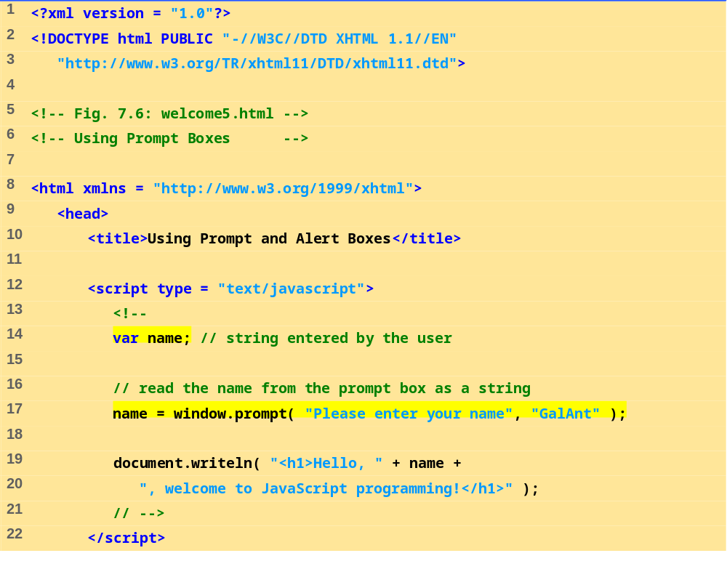
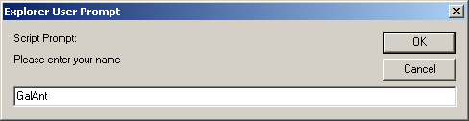
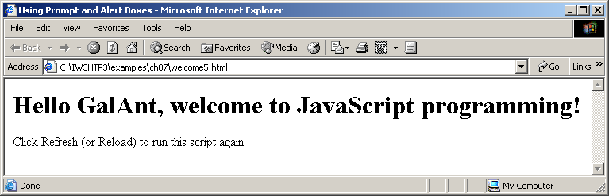
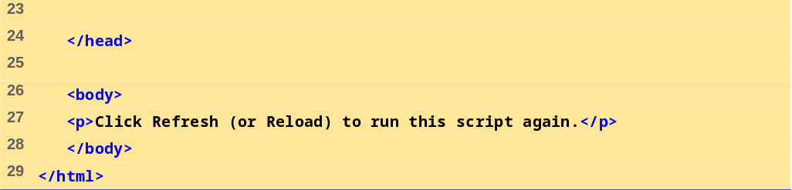
welcome5.html

Slide 24

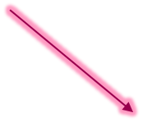


Dynamic Welcome Page
When the user clicks OK, the value typed by the user is returned to the program as a string.
This is the prompt
to the user.
This is the default value that appears when the dialog opens.
This is the text field in which the user types the value.
Fig.:Prompt dialog displayed by the window object’s prompt method.

Slide 25
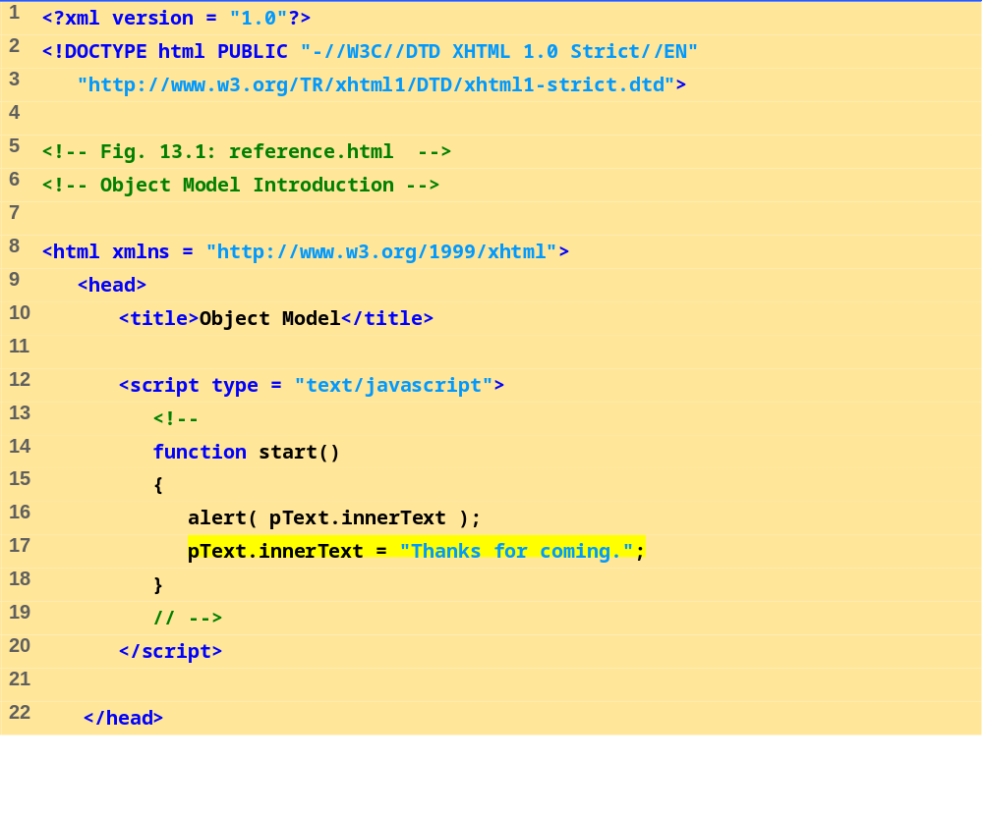
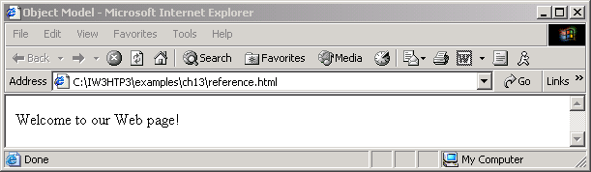
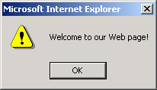
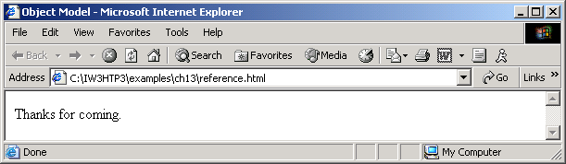
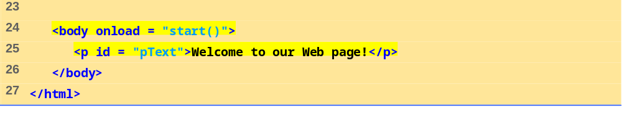

Slide 26
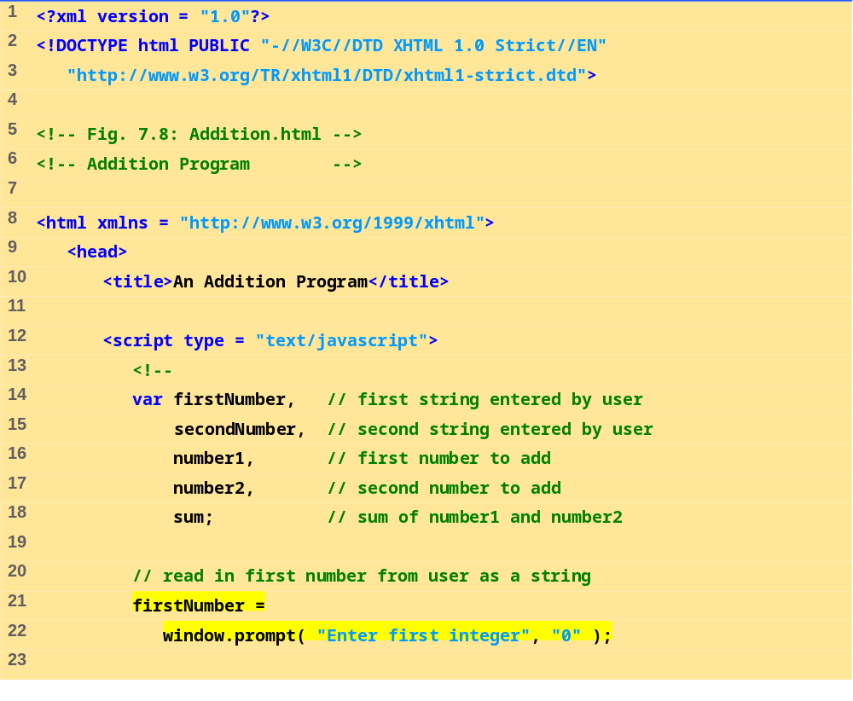
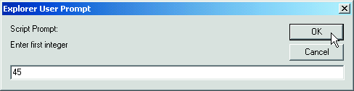
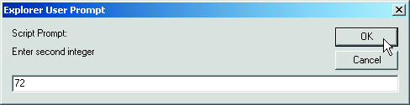
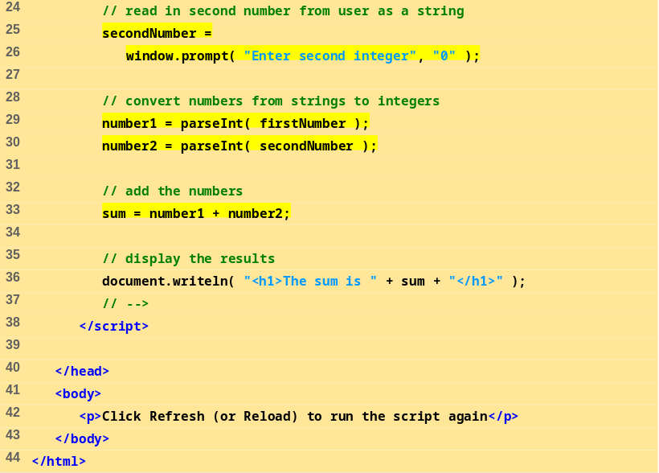
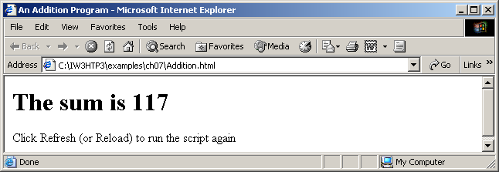
Addition.html

Slide 27
JavaScript native functions
parseInt()
  Converts a string into an integer, if possible
parseFloat ()
  Converts a string into a floating-point number, if possible
string ()
  Converts any object into a string
number ()
  Converts any object into a number, if possible
isNAN ()
  true if the object is Not A Number
escape() and unescape()
  Converts and deconverts strings to “safe” characters

Slide 28
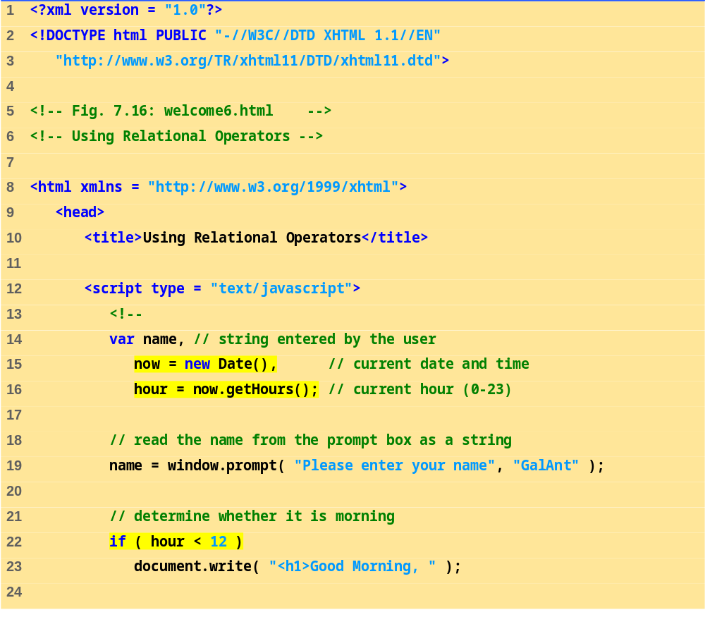
welcome6.html

Slide 29
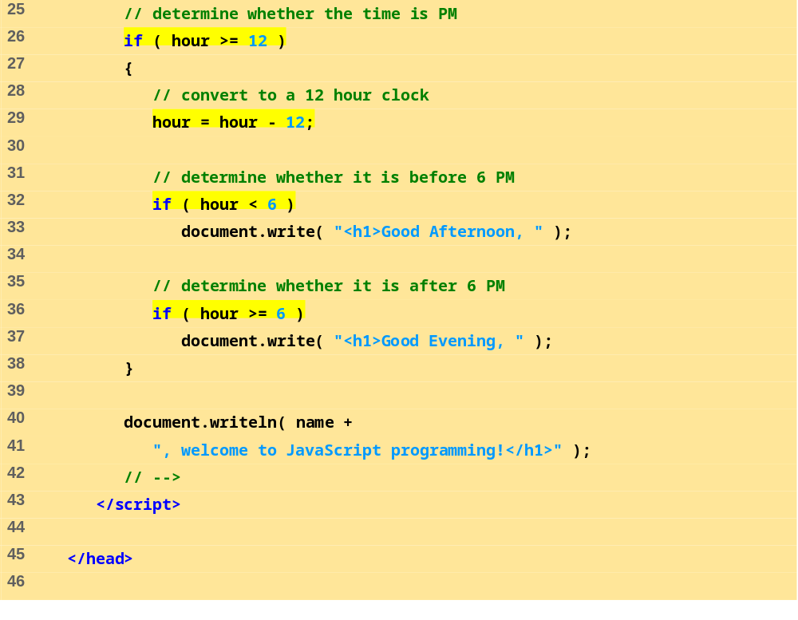
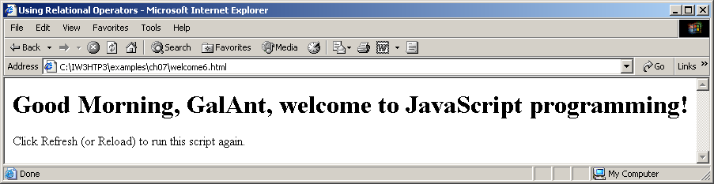
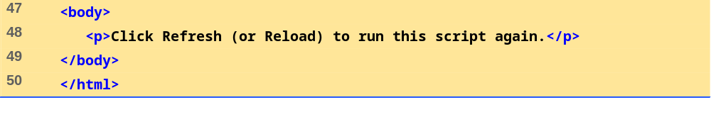
welcome6.html

Slide 30
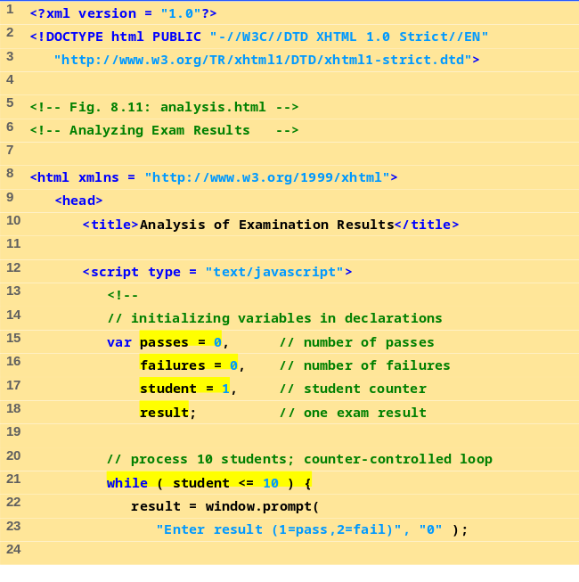
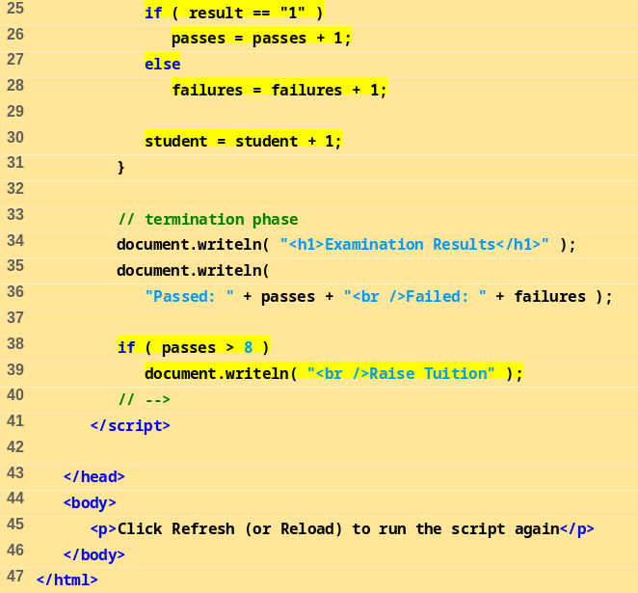
analysis.html

Slide 31
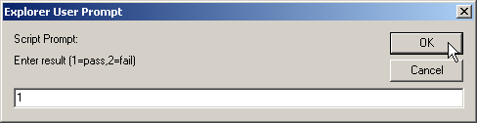
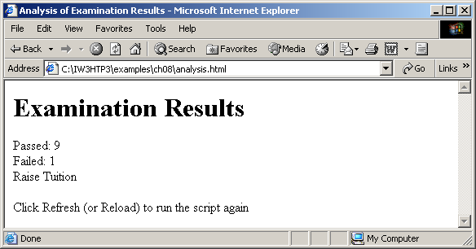
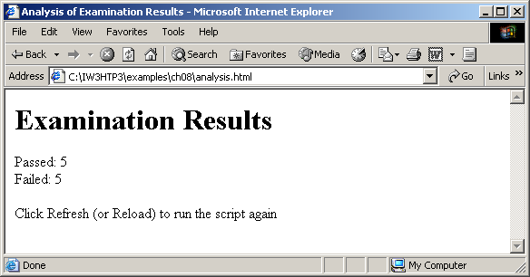

Slide 32
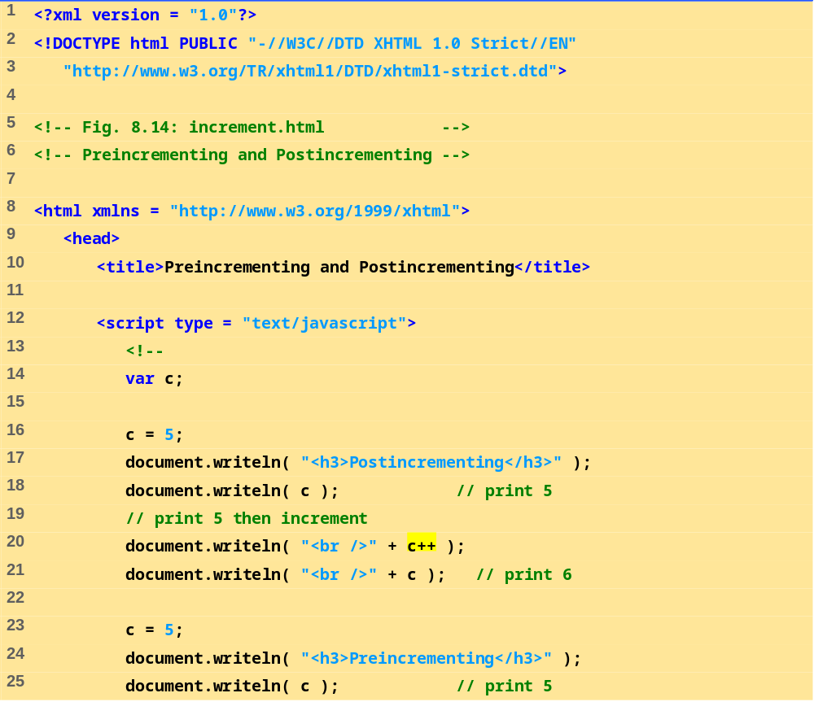
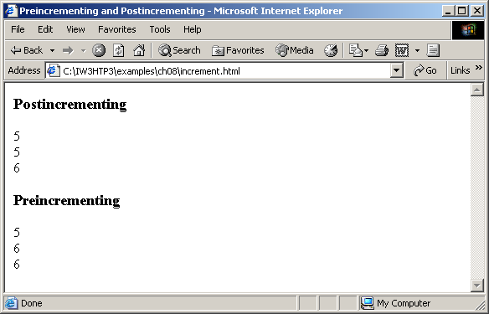
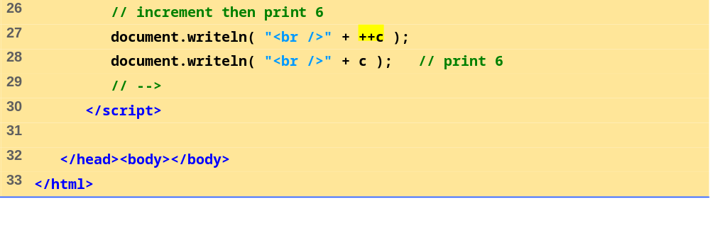
increment.html

Slide 33
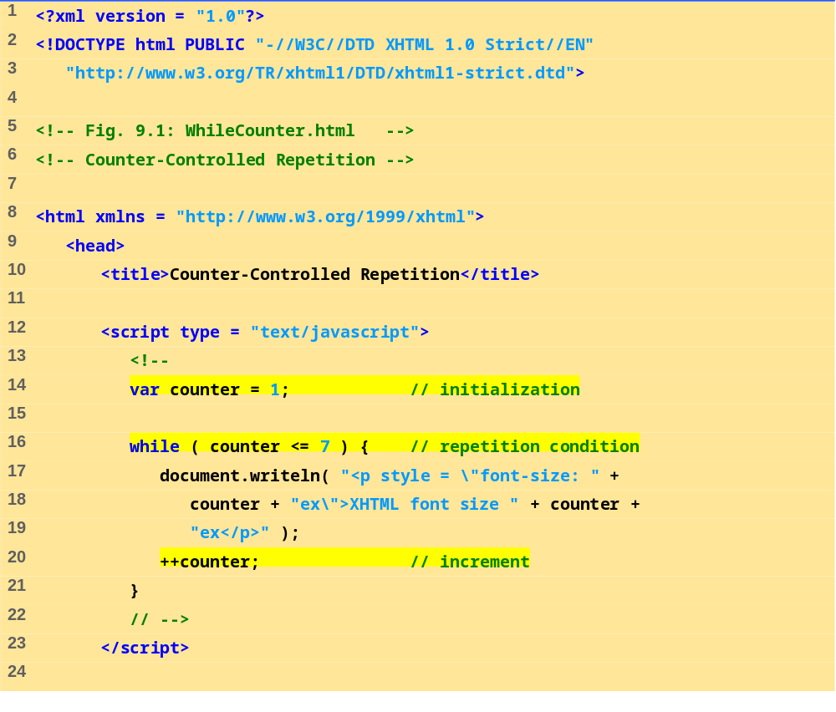
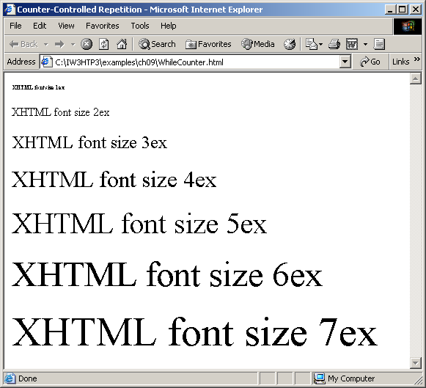
WhileCounter.html
(1 of 2)

Slide 34
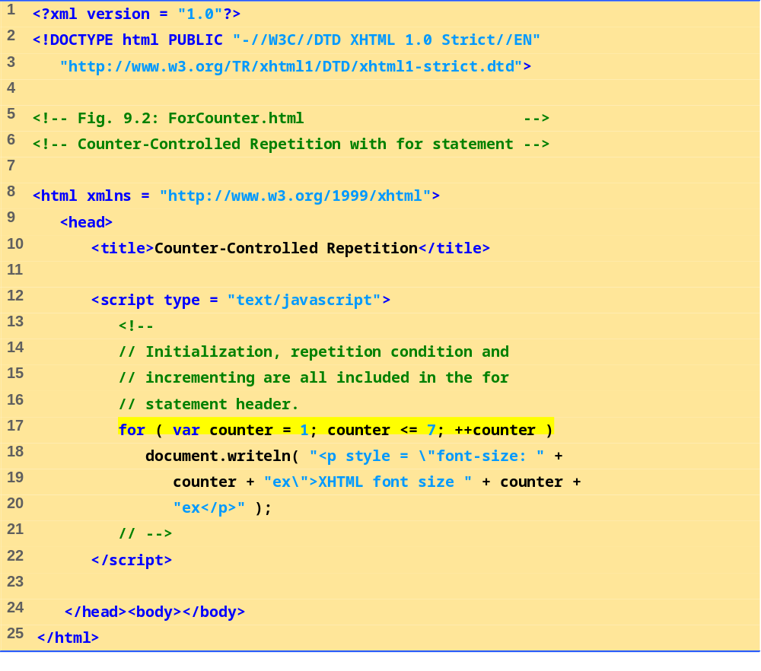

ForCounter.html
(1 of 1)

Slide 35


Sum.html

Slide 36



Interest.html

Slide 37

SwitchTest.html
(

Slide 38








SwitchTest.html
(2 of 3)

Slide 39



BreakLabelTest.html

Slide 40



ContinueLabelTest.html

Slide 41



LogicalOperators.html
(1 of 2)

Slide 42
Object Hierarchy
window
history
document
location
link
link
anchor
layer
form
applet
image
area
text
radio
button
fileUpload
select
textarea
checkbox
reset
option
password
submit

Slide 43
Objects in JavaScript
An object is a complex type of variable that contains its own variables (properties), and has its own functions (methods)
  Properties
    The variables of an object
    Can also be other objects
  Methods
    The functions that belong to an object
      e.g. document.bgColor, window.location
You can also define your own objects

Slide 44
Objects
window - the current browser window
window.history - the Netscape history list
window.document - the html document currently in the browser client area
window.location - the browser location field
window.toolbar - the browser toolbar
window.document.link - an array containing all of the links in the document
window.document.anchor - an array of all the anchor points in the document

Slide 45
Objects (more…)
Window.document.layer - a named document layer
window.document.applet - a named java applet area
window.document.image- a named image tag
window.document.area - a named area
window.document.form - a named form or the default form
ect, ect

Slide 46
A few examples...
window.location = “http://www.yahoo.com”
  will take you to the specified URL (like a goto)
window.history.back()
  back() is a method on history
  will be like clicking the back button in Nav 3
  in Nav 4 will take you back to prev window
window.history.goto(1)
  takes you back to first URL in history array

Slide 47
The Object Model
It is very important to understand the object model
each object has its own properties, some of which are read only some of which you can set directly by assignment (as location)
each object also has a set of behaviors called methods

Slide 48
Object Model
Text Object
HTML text tag
=
B l u r ()
defaultValue
form
name
type
value
Select()
focus()
Red - gettable and settable
handleEvent

Slide 49
Object Event Handlers
Most objects respond to asynchronous, user generated events through predefined event handlers that handle the event and transfer control to a user written event handling function
Each object has particular events that they will respond to
the way you specify an event handler is by adding an additional attribute to the HTML tag that specifies the particular handler
<input name=bt1 type=button value=ok onClick=“acb();”>

Slide 50
Events
onAbort
onBlur
onChange
onClick
onError
onFocus
onLoad
onMouseOut
onMouseOver
onReset
onSelect
onSubmit
onUnload

Slide 51
onAbort
Activated when a user aborts the loading of an image
<img name=ball src=images/ball.gif onAbort=“alert(‘You missed a nice picture’)”>

Slide 52
onBlur
Used with frame, select, text, textarea and window objects
invoked when an object loses the focus
use with select, text and textarea for data validation

Slide 53
onChange
Used with select, text and textarea objects
use instead of onBlur to validate only if a value has changed
<form>
Color: <select onChange=“processSelection()”>
<option value=“R”>Red
<option value=“G”>Green
<option value=“B”>Blue
</select>
</form>

Slide 54
onClick
Used with button, checkbox,link, radio, reset, and submit objects.
<input type=button name=btn1 value=“Click Me” onClick=“alert(‘button was clicked’;” >

Slide 55
onError
Used with image and window objects to invoke a handler if an error occurs while an image or window is loading.
Setting window.onerror = null will prevent users from seeing JavaScript generated errors

Slide 56
onFocus
Used with frame, select, text, textarea and window objects.
Just the opposite of onBlur; i.e. invoked when the object gets focus.
<body bgcolor=“lightgrey” onBlur=“document.bgColor=‘black’ onFocus=“document.bgColor=‘white’” >

Slide 57
onLoad
Used with window, frame and image objects (use with <body ….><frameset ….> and <img ...>)
<img name=spinball src=images/spinball.gig onLoad=“startAnimation(this)”>

Slide 58
onMouseOut and onMouseOver
Used with area and link objects
user moves mouse off of an area or link
<map name=flower>
<area name=top coords=“0,0,200,300 href=“javascript:displayMessage()”
onMouseOver=“self.status=‘when you see this message click your left mouse button’ ;
return true”
onMouseOut=“self.status = ‘’ ; return true”>

Slide 59
onReset
Used with form objects
<form onReset=“alert(‘the form has been reset’)” >

Slide 60
onSelect
Used with text and textarea objects
run some JavaScript whenever a user selects a piece of text in a text or textarea object
<input type=text name=line onSelect=“showHelp()” >

Slide 61
onSubmit
Use with form objects to run a handler whenever a form has been submitted.
Useful to validate all fields prior to actual submission

Slide 62
onUnload
Just like onLoad but the handler is run when the window/frame is exited
<body onUnload=“cleanup()” >

Slide 63



Outline
all.html
(1 of 2)

Slide 64




Outline

Slide 65
Dynamic Styles
Element’s style can be changed dynamically
Dynamic HTML Object Model also allows you to change the class attribute

Slide 66





Outline
dynamicstyle.html
(1 of 2)

Slide 67





Outline
dynamicstyle2.html
(1 of 2)

Slide 68
Dynamic Positioning
XHTML elements can be positioned with scripting
  Declare an element’s CSS position property to be either absolute or relative
  Move the element by manipulating any of the top, left, right or bottom CSS properties

Slide 69






Outline

Slide 70
Using the frames Collection
Referencing elements and objects in different frames by using the frames collection

Slide 71



Outline

Slide 72




Slide 73
13.7 navigator Object
Netscape, Mozilla, Microsoft’s Internet Explorer
  Others as well
Contains information about the Web browser
Allows Web authors to determine what browser the user is using

Slide 74




Outline
navigator.html
(1 of 2)

Slide 75

window.html

Slide 76

window.html

Slide 77

window.html

Slide 78

window.html

Slide 79

window.html

Slide 80

window.html

Slide 81

window.html

Slide 82



Slide 83



Slide 84
Variables
  <script language="JavaScript">
  <!-- html comment
  var x = 15;
  var _y = x * 10;
  var name = prompt("What is your name?");
  // -->
  </script>

Slide 85
Modifying a document
http://docs.sun.com/source/816-6408-10/document.htm
<script language="JavaScript">
<!-- html comment
document.write("<a href=\"");
document.write(document.referrer);
document.write("\">Return to the last page</a>");
// -->
</script>

Slide 86
Formatting Strings
Strings have methods that modify the way they are printed.
http://docs.sun.com/source/816-6408-10/string.htm
  <script language="JavaScript">
  <!-- html comment
  var name = prompt("What is your name? ");
  document.writeln(name.fontcolor("red"));
  document.writeln(name.italics());
  document.writeln(name.toUpperCase());
  // -->
  </script>

Slide 87
Functions
  <script language="JavaScript">
  <!-- html comment
  function foo(name)
  {
  document.writeln(name.bold());
  }
  // -->
  </script>

Slide 88
More Programming Constructs
if
  if(var1==var2) {/* do stuff */ }
for loops
  for(i=0; i < count; i++) {/* do stuff */ }
while loops
  while(var1==var2) {/* do stuff */ }
arrays
  var a = new Array(1, 2, 3);
  document.writeln (a[0]);

Slide 89
Interaction
Link and image elements have special properties that use the definitions set up in the main block.
http://docs.sun.com/source/816-6408-10/handlers.htm
  <a href="#" onClick="foo(name)">Click me</a>
  <img src="img1.png" name="the_image">
  <a href="#” onMouseOver="document.the_image.src=img2.gif';">change</a>

Slide 90
Learning from Others
Client-side Javascript can be viewed by looking at the source code for a page.
Consider this function from the Google homepage.
<!--
function qs(el) {
if (window.RegExp && window.encodeURIComponent) {
var ue=el.href;
var qe=encodeURIComponent(document.f.q.value);
if(ue.indexOf("q=")!=-1) {
el.href=ue.replace(new RegExp("q=[^&$]*"),"q="+qe);
} else {
el.href=ue+"&q="+qe;
} }
return 1;
}
// -->

Slide 91
Example
<script>
x=“Hello World!”
document.write(x)
</script>
<script>
x=“İsminizi Yazın….”
document.write(“Merhaba” +x)
</script> ⇒ use line break html code

Slide 92
JS Examples -1
Y=20x+12 ve x=3 ise, sonucu açılan pencerede gösteren kod nasıl yazılmalıdır?
<script>
x=3
y=20*x+12
alert(y)
</script>

Slide 93
Examples -2
<script>
s1=12
s2=28
toplam=s1+s2
document.write("Sayıların toplamı: "+toplam)
</script>

Slide 94
Examples -3
s1=12, s2=28
Bu değişkenlere ait sayıların toplamlarını, farklarını, çarpımlarını ve bölümlerini ayrı satırlarda gösteren ve son olarak ekrana “Hesaplamalar sona erdi” yazısını çıkaran js kodunu oluşturunuz.
<script>
s1=12
s2=28
toplam=s1+s2
fark=s1-s2
carp=s1*s2
bol=s1/s2
document.write("<br>Değişkenlerdeki sayılarla ilgili aritmetik işlemler...<br>")
document.write("<br>Sayıların toplamı: "+toplam)
document.write("<br>Sayıların farkı: "+fark)
document.write("<br>Sayıların çarpımı: "+carp)
document.write("<br>1.sayının 2.sayıya bölümü: "+bol)
alert("Hesaplamalar sona erdi!")
</script >

Slide 95
Conditional Statements
Very often when you write code, you want to perform different actions for different decisions. You can use conditional statements in your code to do this.
In JavaScript we have the following conditional statements:
if statement - use this statement if you want to execute some code only if a specified condition is true
if...else statement - use this statement if you want to execute some code if the condition is true and another code if the condition is false
if...else if....else statement - use this statement if you want to select one of many blocks of code to be executed
switch statement - use this statement if you want to select one of many blocks of code to be executed

Slide 96
Conditional Statements - 2
if (condition)
{
code to be executed if condition is true
}
if (condition)
{
code to be executed if condition is true
}
else
{
code to be executed if condition is not true
}

Slide 97
Conditional Statements Examples
<script>
x=3
if(x<0)
{
alert (“negatif”)
}
else
{
alert (“pozitif”)
}
</script>

Slide 98
Conditional Statements Examples - 2
<script>
c=confirm(“Kitap Okuyor musunuz?”)
if(c)
{
alert (“tebrikler walla”)
}
else
{
alert (“ayıp ettiniz ama”)
}
</script>

Slide 99
Conditional Statements Examples - 3
<script>
p=prompt("Ankara'nın plaka numarası nedir?", " ")
if(p=="06")
{
alert("Doğru")
}
else
{
alert("Yanlış")
}
</script>

