Slide 1

The Dawn of a Maturing Industry
1-<number>

Slide 2
The focus of this chapter is on several learning objectives
Conceptual understanding of e-commerce, e-business and e-strategy
Advantages and Issues in E-Commerce
Value-chain and supply-chain management and how they relate to e-commerce and e-business
Business models of the e-environment
A trend toward integrating e-commerce
1-<number>

Slide 3
What Is E-commerce?
Communications Perspective : the ability to deliver products, services, information, or payments via networks.
Interface View : E-commerce means information and transaction exchanges between:
  Business-to-Business (B2B)
  Business-to-Consumer (B2C)
  Consumer-to-Consumer (C2C)
  Business-to-Government (B2G)
1-<number>

Slide 4
What Is E-commerce?
Business Process : E-commerce means activities that support commerce electronically by networked connections.
Online Perspective : E-commerce is an electronic environment that allows sellers to buy and sell products, services, and information on the Internet.
A Structure : E-commerce deals with various media: data, text, Web pages, Internet telephony, and Internet desktop video.
A Market : E-commerce is a worldwide networked Market.
1-<number>

Slide 5
E-business
Sometimes used interchangeably to refer to e-commerce
E-business covers online transactions, but also extends to all Internet based interactions with business partners, suppliers and customers such as:
  selling direct to consumers,
  manufacturers and suppliers;
  monitoring and exchanging information;
  auctioning surplus inventory;
  collaborative product design.
aimed at improving or transforming business processes and efficiency.
1-<number>

Slide 6
E-commerce Is Not E-business
E-business - the conduct of business on the Internet, in supply-chain planning, tracking, fulfillment, invoicement, and payment.
  Includes buying and selling as well as servicing customers and collaborating with business partners
  Electronic information is used to boost performance and create value by forming new relationships between and among businesses and customers.
  One example of e-business is SAP (www.sap.com)
1-<number>

Slide 7
E-commerce Versus E-business
E-commerce
  Selling goods and services on the retail level with anyone, anywhere, via the Internet
  Greater efficiency and effective exchange of goods and services
  Exchange based upon transaction
    A block of information exchange between the merchant and its customers via the corporate Web site
    www.amazon.com
E-business
  Connecting critical business systems and constituencies directly via the Internet
1-<number>

Slide 8
The Drivers for E-commerce
Digital Convergence - digital devices communicating with one another
Anytime, anywhere, anyone - e-commerce is available to anyone (24/7)
Changes in Organizations - today’s businesses empower frontline workers to do the kind of work once performed by junior management
Increasing pressure on operating costs and profit margins - global competition and the proliferation of products and services worldwide have added pressure on operating costs and profit margins
Demand for customized products and services - mass customization puts pressure on firms to handle customized requests on a mass-market scale
1-<number>

Slide 9
Myths about E-commerce
Setting up a Web site is easy.
E-commerce means no more mass marketing.
E-commerce means a new economy.
E-commerce is revolutionary.
E-commerce is a commercial fad that crashed in 2000.
All products can be sold online using identical business models.
Build it and they will come.
The middleman is out.
1-<number>

Slide 10
Advantages through E-commerce
Lower cost to the E-merchant
  Cost effective
  Reduces logistics problem
  Give small company equal exposer as the big companies
  Lower transaction processing charge
Economy
  No rental of physical storage space, insurance or infrastructural investment
  Only need a good idea, unique product and well designed storefront
Higher margins
  Businesses gain more control and flexibility when manual transaction is done electronically
  Low transaction processing charge
1-<number>

Slide 11
Advantages through E-commerce
Better customer service
  Web based customer service make user happy
  Let user serve him/herself save time and money
Quick comparison shopping
  E commerce allows comparison shopping using automated shopping assistant program called shopbot
  shopbots finds best deals from web storefronts
Productivity gains
  Weaving the web tech. throughout the organization means improved productivity
Teamwork
  Supports user collaboration in exchanging information and work on solution
  More interaction mean better overall result.
  improved communication with its suppliers, vendors and business partners
1-<number>

Slide 12
Advantages through E-commerce
Information sharing, convenience, and control
  Improves information sharing between merchants and customer and promote quick, just-in-time deliveries
  Open 24x7, no traffic jam, do not have to carry shopping bags
  Business can give more control to his customer managing his account
Customization
  Digital products are highly customizable
  Easy to recognize, reverse or edit
  With the information about the customer products can be customized and matched to individual needs
1-<number>

Slide 13
Issues and Constraints of E-commerce
The cost factor
Security
System and data integrity
System scalability
E-commerce is not free
Fulfillment and customer relations problems
Products people resist buying online
Cultural, language, and trust issues
Corporate vulnerability
Lack of a blueprint for handling E-commerce
High risk of Internet start-up
1-<number>

Slide 14
Benefits and Limitations of the Internet
The Internet is the enabler of the e-commerce
Marketing and selling products and services
Doing business fast
Gathering opinions and trying out new ideas
Leveling the playing field
Promoting a paper-free environment
Providing superior customer service and support resources
Efficiency and unequaled cost-effectiveness
Supporting managerial functions, spreading ideas, ease of technical support
Triggering new business
Providing Web services
1-<number>

Slide 15
Limitations of the Internet
Security and privacy
Fakes and forgeries
Cyber terrorism
Problems and stress
Abuses in the workplace
1-<number>

Slide 16
Value Chain in E-commerce
Value Chain: A way of organizing the activities of a business so that each activity adds value (value-added activity) or productivity to the total operation of the business.
A strategic tool for identifying how the critical components of a business tie together to deliver value for the business across the value-chain process.
Makes B2C interface operational
1-<number>

Slide 17
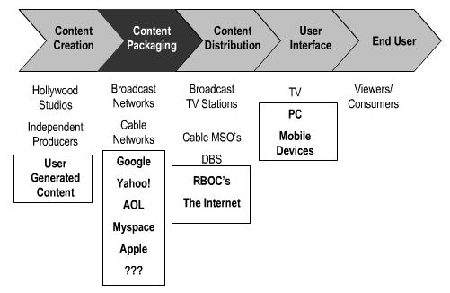
Value Chain
1-<number>

Slide 18
Value Chain in E-commerce - cont’d
Organizations are open systems
  They do not consist of isolated sets of functions
  They are a chain of value-creating activities that assure competitive advantages by delivering value to the customer
Depicts the series of interdependent activities of a business
A business evaluates its value to find opportunities for improving the value activities
1-<number>

Slide 19
Competitive Advantage
Competitive advantage is achieved when an organization links the activities in its value chain more cheaply and effectively than its competitors.
1-<number>

Slide 20
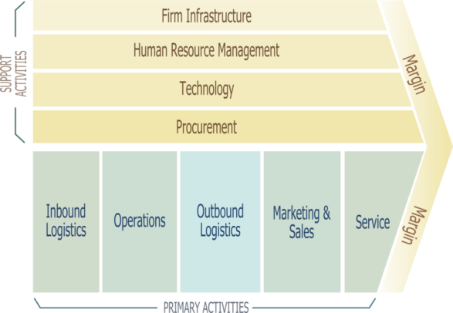
Value Chain Activities
1-<number>

Slide 21
Value Chain Primary Activities
Inbound logistics
  Procurement Activities: vendor selection, comparative shopping, negotiating supply contract
  Represents supply side of the business
Operations
  Conversion of raw material into finished product
  Machining, packaging, assembly, equipment maintenance, testing etc.
  Provides added value for the marketing function.
  Operational activities are the point in the value chain where value is added
1-<number>

Slide 22
Value Chain Primary Activities
Outbound logistics
  Storing, distributing and shipping the final product.
  Involves warehousing, material handling, shipping and timely delivery to the retailer
  Output of this activity is ties in directly to marketing and sales
Marketing and sales
  Deals with ultimate customers
  Includes advertising, product promotion, sales management, identifying customer base and distribution channel
  Output of this activity triggers
    increased production,
    more advertising
1-<number>

Slide 23
Value Chain Primary Activities
Service
  Focus is on after sales service
  Includes testing, maintenance, repair, warranty works and replacement parts
  Output of this activity means
    satisfied customer,
    improved image of the product and the business and
    potential for increased production
1-<number>

Slide 24
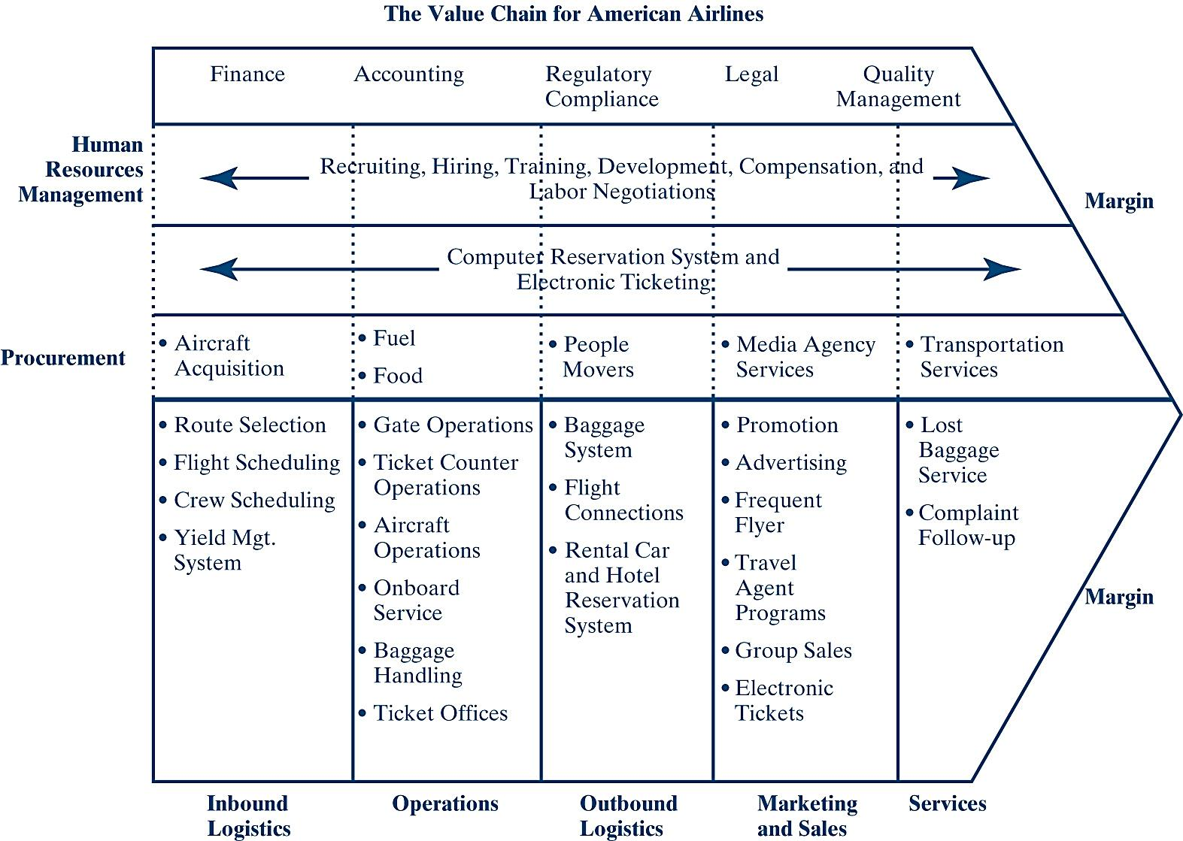
Value Chain for American Airlines
1-<number>

Slide 25
Value Chain Support Activities
Corporate infrastructure
  General management, accounting, finance, planning and legal service, quality management
Human resources
  Activity to matching right people to the job
  Involves recruitment, retention, career path development, compensation, training and development etc.
Technology development
  Improves the products and business processes
  Output: product quality, integrity and reliability
Procurement
  Purchasing, ensuring availability of quality raw materials
1-<number>

Slide 26
Analyzing Value Chain Activities
What type of activity is being performed? Does it add value? Does it ensure the quality of other activities?
How does the activity add value to the customer?
Could the same activity be reconfigured or performed in a different way?
What inputs are used? Is the expected output being produced?
Is the activity vital? Could it be outsourced, deleted completely, or combined with another activity?
How does information flow into and out of the activity?
Is the activity a source of competitive advantage?
Does the activity fit the overall goals of the organization?
1-<number>

Slide 27
E-commerce Value Chain
The E-commerce Value Chain means identifying:
  The competitive forces within the company’s e-commerce environment
  The business model it will use
  Identifying the value activities that help the e-commerce value chain do its homework
E-commerce views information technology as part of a company’s value chain
1-<number>

Slide 28
Roles for E-commerce
Reducing costs
Improving product quality and integrity
Promoting a loyal customer base
Creating a quick and efficient way of selling products and services
Incorporate information technology and telecommunications to improve overall productivity
Web sites are used to provide and collect information between the e-merchant and the customer
  Competitive pricing information
  Invoicing facilitates online payment flows
  Customized products or orders can be shipped and delivered by independent shippers directly to the customer
1-<number>

Slide 29
E-commerce Application
Business-to-Consumer (Internet)
Business-to-Business (Internet and Extranet)
  Supply-Chain Management
Business-within-Business (Intranet)
Business-to-Government (B2G)
1-<number>

Slide 30
Business-to-Consumer (Internet)
The consumer’s use of a merchant’s Web storefront or Web site
Modeled on the traditional shopping experience
Shopping cart is used to hold goods until the customer is ready to check out
  Online order form supported by the appropriate software
Checkout is order and payment processing
1-<number>

Slide 31
Business-to-Business
(Internet and Extranet)
Business-to-Business e-commerce is industrial marketing. among the processes it handles are fulfillment and procurement
Companies can conveniently and quickly check their suppliers’ inventories or make instant purchases
B2B often use an extranet: a shared intranet vendors, contractors, suppliers, and key customers
1-<number>

Slide 32
Supply-Chain Management
Integrating the networking and communication infrastructure between businesses and suppliers
Having the right product in the right place, at the right time, at the right price, and in the right condition
Delivery of customer and economic value through integrated management of the flow of physical goods and related information
Designed to improve organizational processes by optimizing the flow of goods, information, and services between buyers and suppliers in the value chain
1-<number>

Slide 33
Supply-Chain Management – cont’d
SCM is:
  Collaboration among business partners
  Coordination of logistics for timely delivery of goods or products
  Cooperation among businesses and suppliers to make sure orders and inquiries are filled correctly
  Connectivity through networking infrastructure to ensure speed and good response time at all times
1-<number>

Slide 34
Business-within-Business (Intranet)
Strictly a “within company” type of information exchange
  Restricted to internal employees and customers
  Firewalls to keep out non employees
  E-mail replaces paper for the communication of messages, order acknowledgement and approvals, and other forms of correspondence
  The intranet becomes a facilitator for the exchange of information and services among the departments or divisions of a company
  Different departments with different PCs or local area networks can interact on an intranet
1-<number>

Slide 35
Benefits of an Intranet
Low development and maintenance costs
Environmentally friendly because it is company-specific
Availability and sharing of information
Timely, current information
Quick and easy dissemination of information
1-<number>

Slide 36
Business-to-Government (B2G)
Online procurement
Ensuring transparency, reducing cost
The government market is similar to B2B.
difficulties
  Changing the status quo in government is not so easy
  Changes to employee tasks and job restructuring often create resistance
  Tax savings potential is not easily recognized
  Committing to technology means constant need for upgrades and additional costs
1-<number>

Slide 37
Chapter Summary
Electronic commerce (EC) is the ability to deliver products, services, information, or payments via networks such as the Internet and the World Wide Web.
Electronic business connects critical business systems directly to key constituents
The rise of specialized Web sites and Web logs (blogs) generated opportunities to read and write on a vast array of topics
Several drivers promote EC: digital convergence
Advantages of EC
1-<number>

Slide 38
Chapter Summary (continued)
Limitations of EC
A value chain is a way of organizing the activities of a business so that each activity provides added value or productivity to the total operation of the business.
The transaction life cycle includes three major e-commerce applications: Business-to-Consumer (B2C), Business-to-Business (B2B), and Business-within-Business.
An intranet wires the company for information exchange.
Success in the E-commerce field depends on attracting and keeping qualified technical people and managerial talent.
There are several types of specialized Web sites on the Internet. Each site is based on a business model as a way of doing business to sustain a business - generated revenue.
1-<number>

