Slide 1
Chapter 2: Operating-System Structures

Slide 2
Chapter 2: Operating-System Structures
Operating System Services
User Operating System Interface
System Calls
Types of System Calls
System Programs
Operating System Design and Implementation
Operating System Structure
Virtual Machines
Operating System Debugging
Operating System Generation
System Boot

Slide 3
Objectives
To describe the services an operating system provides to users, processes, and other systems
To discuss the various ways of structuring an operating system
To explain how operating systems are installed and customized and how they boot

Slide 4
Operating System Services
One set of operating-system services provides functions that are helpful to the user:
User interface - Almost all operating systems have a user interface (UI)
Varies between Command-Line (CLI), Graphics User Interface (GUI), Batch Interface.
Program execution - The system must be able to load a program into memory and to run that program, end execution, either normally or abnormally (indicating error)
I/O operations - A running program may require I/O, which may involve a file or an I/O device
File-system manipulation - The file system is of particular interest. Obviously, programs need to read and write files and directories, create and delete them, search them, list file Information, permission management.

Slide 5
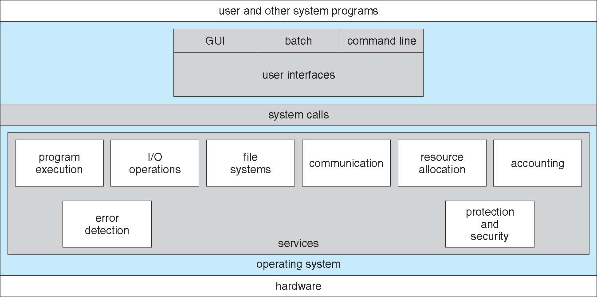
A View of Operating System Services

Slide 6
Operating System Services (Cont.)
One set of operating-system services provides functions that are helpful to the user (cont.):
Communications – Processes may exchange information, on the same computer or between computers over a network
Communications may be via shared memory or through message passing (packets moved by the OS)
Error detection – OS needs to be constantly aware of possible errors
May occur in the CPU and memory hardware, in I/O devices, in user program
For each type of error, OS should take the appropriate action to ensure correct and consistent computing
Debugging facilities can greatly enhance the user’s and programmer’s abilities to efficiently use the system

Slide 7
Operating System Services (Cont.)
Resource allocation - When multiple users or multiple jobs running concurrently, resources must be allocated to each of them
Many types of resources - Some (such as CPU cycles, main memory, and file storage) may have special allocation code, others (such as I/O devices) may have general request and release code
Accounting - To keep track of which users use how much and what kinds of computer resources
Protection and security - The owners of information stored in a multiuser or networked computer system may want to control use of that information, concurrent processes should not interfere with each other
Protection involves ensuring that all access to system resources is controlled
Security of the system from outsiders requires user authentication, extends to defending external I/O devices from invalid access attempts
If a system is to be protected and secure, precautions must be instituted throughout it. A chain is only as strong as its weakest link.

Slide 8
System Calls
System Calls provide programming interface for user processes to request the services from the system made available by the OS.
System calls allow user-level processes to request services of the operating system
Typically written in a high-level language (C or C++)
Mostly accessed by programs via a high-level Application Program Interface (API) rather than direct system call use
Three most common APIs are Win32 API for Windows, POSIX API for POSIX-based systems (including virtually all versions of UNIX, Linux, and Mac OS X), and Java API for the Java virtual machine (JVM)
Why use APIs rather than system calls?

Slide 9
System Calls and API (Def.)
A System Call is an explicit request to the kernel made via a software interrupt by OS from user processes.
Application Programming Interface (API) is a set of functions, objects, protocols or data structures for the support of application development for developers/programmers.

Slide 10
API (Def.)
Operating Systems provide a library (or high-level Application Program Interface or API) that sits between normal programs and the rest of the operating system.
This library handles the low-level details of passing information to the kernel and switching to supervisor mode,

Slide 11
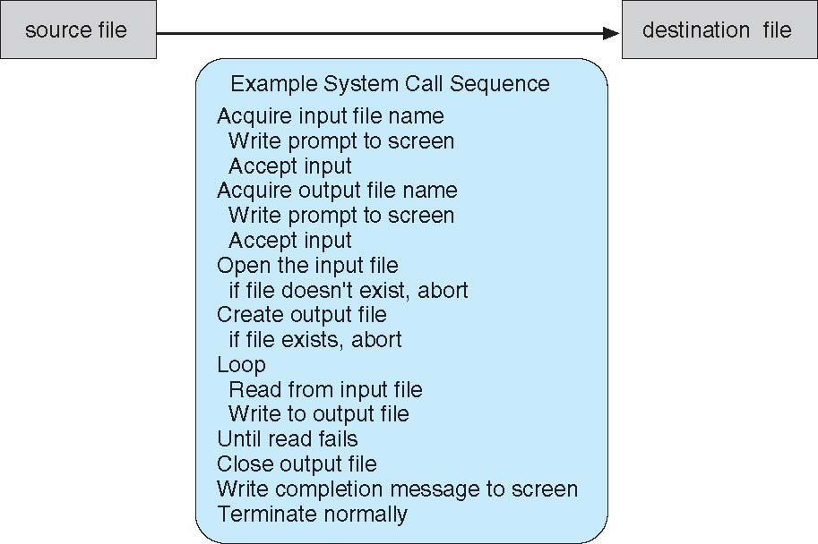
Example of System Calls
System call sequence to copy the contents of one file to another file

Slide 12
System Call Implementation
Typically, a number associated with each system call
System-call interface maintains a table indexed according to these numbers
The system call interface invokes intended system call in OS kernel and returns status of the system call and any return values
The caller need know nothing about how the system call is implemented
Just needs to obey API and understand what OS will do as a result call
Most details of OS interface hidden from programmer by API
Managed by run-time support library (set of functions built into libraries included with compiler)

Slide 13
Operating System Design and Implementation
Design and Implementation of OS not “solvable”, but some approaches have proven successful
Internal structure of different Operating Systems can vary widely
Start by defining goals and specifications
Affected by choice of hardware, type of system
User goals and System goals
User goals – operating system should be convenient to use, easy to learn, reliable, safe, and fast
System goals – operating system should be easy to design, implement, and maintain, as well as flexible, reliable, error-free, and efficient

Slide 14
Operating System Design and Implementation (Cont.)
Important principle to separate
Policy: What will be done? Mechanism: How to do it?
Mechanisms determine how to do something, policies decide what will be done.
The separation of policy from mechanism is a very important principle, it allows maximum flexibility if policy decisions are to be changed later.

Slide 15
Operating System Design and Implementation
Selecting language for coding
Assembly language was used before
Adv: faster/ run fast directly due to directly hard coding
Disadv: More no of lines with large program
Now generally used C, C++ or Python.
Linux and windows OS are written mainly in C
Advantages of using higher-level language :
Code can be written faster
More compact
Easier to understand and debug
Improvements in compilation technology
Easier to port

Slide 16
Operating System Structure
An Operating System (OS) structure refers to the way the operating system is organized internally. Different structures are designed to achieve goals such as high performance, modularity, security, maintainability, and portability. There are several OS structure, such as:
Simple Structure
Monolithic Structure
Layered Structure
Microkernel Structure
Modular Structure
Hybrid Structure
Virtual Machine Structure
Exokernel Structure

Slide 17
1. Simple Structure
MS-DOS – written to provide the most functionality in the least space
Not divided into modules
This kernel is hard to extend.
If a user wants to add a new service then the entire operating system has to be modified.
No dual-mode and no hardware protection
Leave vulnerable to errant or malicious programs
Crashes entire program when user program fails

Slide 18
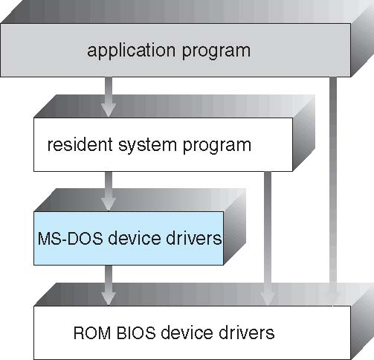
MS-DOS Layer Structure

Slide 19
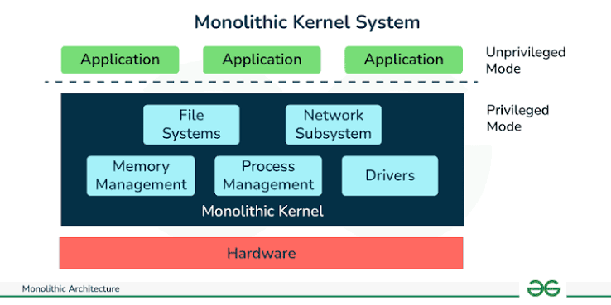
2. Monolithic Structure
In a monolithic kernel, all operating system services run in kernel mode as one large program. Every module can directly communicate with every other module.

Slide 20
2. Monolithic Structure
Advantages
High performance.
Fast communication among kernel modules.
Efficient system call execution.
Disadvantages
Large kernel size.
Difficult debugging.
A faulty driver may crash the entire OS.
Examples
Linux
Traditional UNIX

Slide 21
3. Layered Approach
OS can be broken into smaller and more appropriate pieces creating modular operating system
With modularity, layers are selected such that each uses functions (operations) and services of only lower-level layers
More freedom in changing inner workings of the system

Slide 22
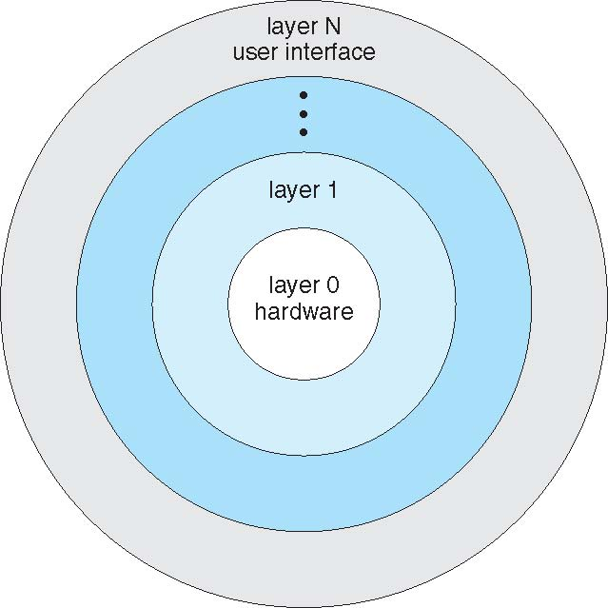
Layered Operating System

Slide 23
Layered Approach
Advantages:
Simplicity of construction and debugging
Design and implementation of the system is simplified
Each layer is implemented only those operation provided by its lower layer
Disadvantages:
Major difficulty involves appropriately defining each layer
Less efficient than others
An I/O request of user program adds overhead at each layer

Slide 24
4. Microkernel System Structure
A microkernel-based system puts only the bare minimum system components in the kernel and runs the rest of them as user mode processes.
Moves all non-essential components as much from the kernel into “user” space
Implementing as system and user level
Communication takes place between user modules using message passing

Slide 25
Microkernel System Structure
new protocol stacks, file systems, device drivers and other low-level systems located in the monolithic kernel which results to a lot of work and careful code management.
operating system functions, such as device drivers, protocol stacks and file systems, are typically removed from the microkernel itself and are instead run in user space.
Examples
Mach
Minix 3
QNX

Slide 26
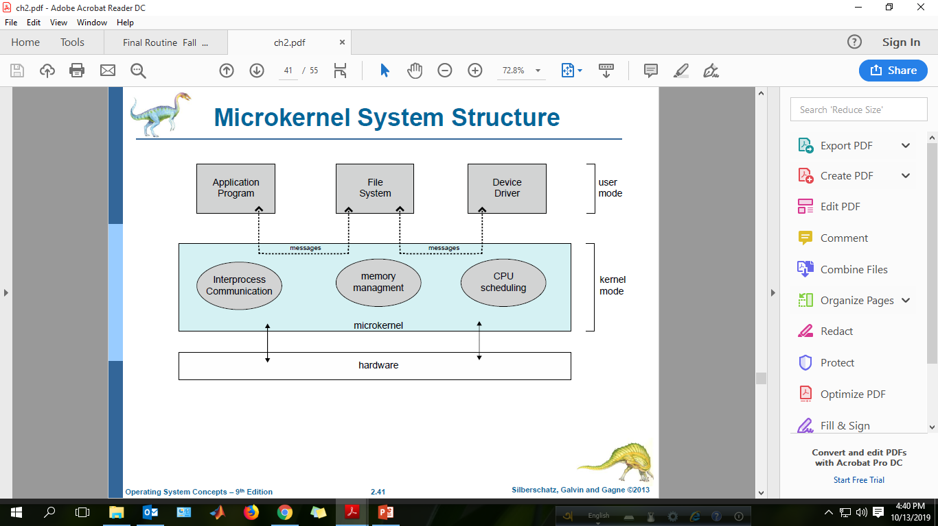

Slide 27
Microkernel System Structure
Benefits:
Easier to extend a microkernel
Easier to port the operating system to new architectures
More reliable (less code is running in kernel mode)
More secure
Demerits:
Performance overhead of user space to kernel space communication

Slide 28
5. Modular Structure
The best current methodology for OS design is loadable kernel modules where the kernel has a set of core components and links in additional services via modules either boot time or during run time.
Kernel is provided to design core services
And other services dynamically is adding new features directly to the kernel (required kernel compilation every time)
Example: Solaris, Linux and Mac OS X.

Slide 29
Modules Architecture

Slide 30
Modules Architecture
Advantages
More flexible than a layered approach as one module can call another module.
More efficient than microkernel because modules do not need to invoke message passing to communicate
Disadvantages
the fragmentation penalty is a major disadvantage of loadable modules in the kernel. This means that every time a new kernel module code is inserted, the kernel becomes fragmented.[TLB (Transaction Lookaside Buffer)]

Slide 31
Hybrid Architecture
Most modern operating systems are actually not one pure model
Hybrid combines multiple approaches to address performance, security, usability needs
Linux and Solaris kernels in kernel address space, so monolithic(Simple), plus modular for dynamic loading of functionality
Windows mostly monolithic, plus microkernel for different subsystem personalities

Slide 32
Hybrid Architecture
Apple Mac OS X
iOS and Android (most prominent mobile OS)

Slide 33
7. Virtual Machines
A virtual machine takes the layered approach to its logical conclusion. It treats hardware and the operating system kernel as though they were all hardware.
A virtual machine provides an interface identical to the underlying bare hardware.
The operating system host creates the illusion that a process has its own processor and (virtual memory).
Each guest is provided with a (virtual) copy of underlying computer.

Slide 34
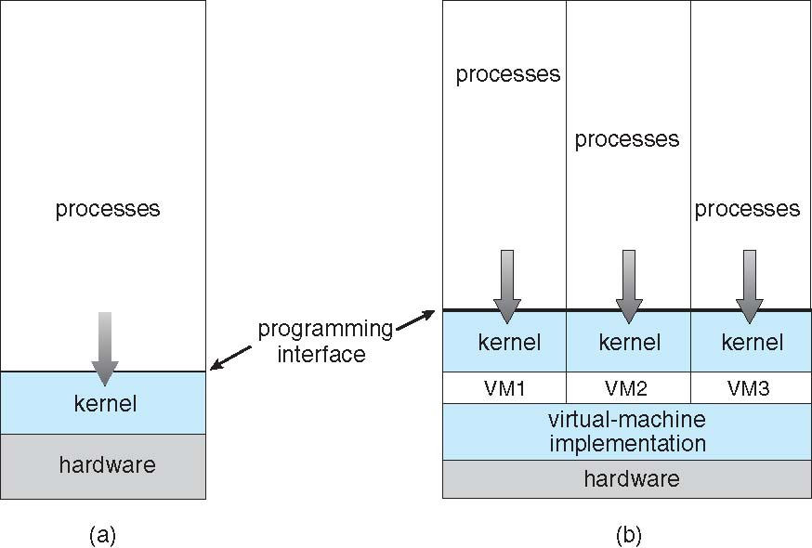
Virtual Machines (Cont.)
(a) Nonvirtual machine (b) virtual machine

Slide 35
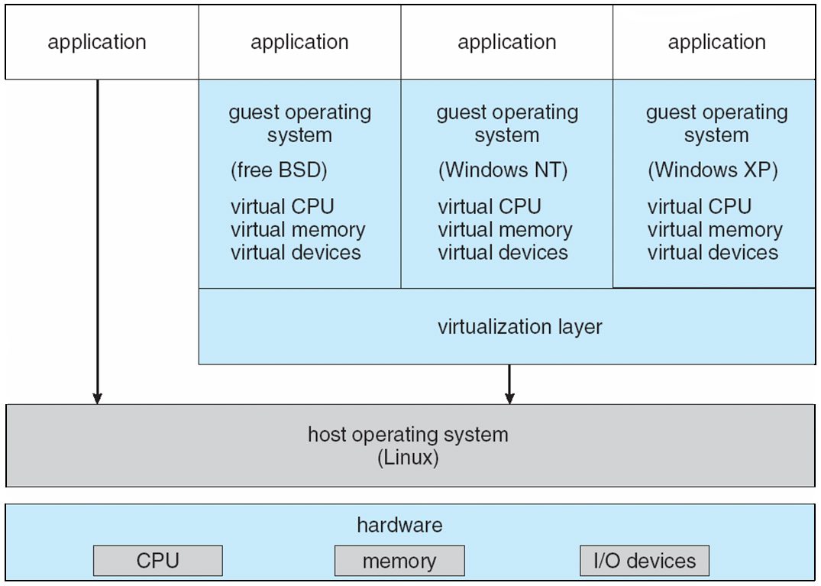
VMware Architecture

Slide 36
8. Exokernel Structure
Description
The exokernel provides only the minimum abstraction over hardware. Applications are given direct access to hardware resources, allowing them to manage resources and make decisions that the kernel previously made. Applications manage resources through library operating systems (LibOS).
Architecture
+----------------------+
| Applications |
+----------------------+
| Library OS (LibOS) |
+----------------------+
| Exokernel |
+----------------------+
| Hardware |
+----------------------+

Slide 37
8. Exokernel Structure
Advantages
Maximum performance.
Highly customizable.
Efficient resource utilization.
Disadvantages
Difficult to program.
Rarely used in commercial systems.
Examples
MIT Exokernel
Aegis

Slide 38
8. Comparison Table
Structure | Performance | Security | Maintainability | Complexity | Examples
Simple | High | Low | Poor | Low | MS-DOS
Monolithic | Very High | Medium | Difficult | Medium | Linux, UNIX
Layered | Medium | High | Excellent | Medium | THE OS
Microkernel | Medium | Very High | Excellent | High | Minix, QNX
Modular | High | High | Good | Medium | Linux, Solaris
Hybrid | High | High | Good | High | Windows, macOS
Virtual Machine | Medium | Very High | Good | High | VMware, Hyper-V
Exokernel | Very High | Medium | Difficult | Very High | MIT Exokernel

Slide 39
End of Chapter 2

