Slide 1

Ted Stories
An Event Planning Company
Submitted To :
Name : Dr. Md. Nawab Yousuf Ali
Designation : Professor Department of CSE
East West University
Submitted By :
Name : Jannat Milky
Id: 2023-1-60-042
Name : Jasmin Akter
Id: 2023-1-60-258
Name : Mahfuz Uddin Ahmed
Id: 2023-1-60-207

Slide 2


Introduction
The project "Ted's Stories" – An Event Planning Company is inspired by Ted Mosby, the romantic architect from How I Met Your Mother. It models an event planning company where multiple planners collaborate to organize weddings and proposals while managing limited resources and spontaneous brainstorming sessions.

Slide 3

Problem Statement:
Ted's Stories must handle:
Multiple Concurrent events
Limited planners
Shared resources
Spontaneous idea sharing

Slide 4

Objectives
Simulate concurrent event planning
Manage shared resources
Prevent deadlocks & race conditions
Log activities

Slide 5
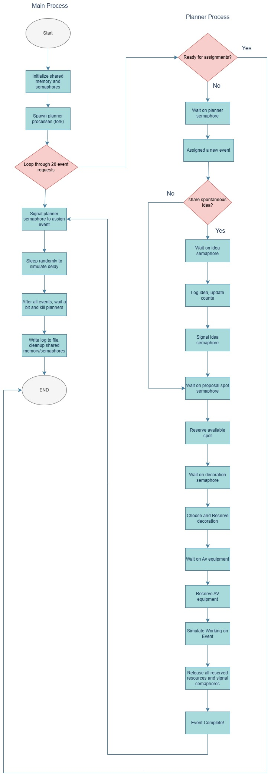

Slide 6
. Semaphore Operations
0: Planner slots
1–3: Resource types
4: Idea-sharing mutex
Use of sem_wait and sem_signal
union semun {
int val;
struct semid_ds *buf;
unsigned short *array;
};
void sem_wait(int semid, int sem_num) {
struct sembuf sb = {sem_num, -1, 0};
semop(semid, &sb, 1);
}
void sem_signal(int semid, int sem_num) {
struct sembuf sb = {sem_num, 1, 0};
semop(semid, &sb, 1);
}

Slide 7
Shared Data Structure
typedef struct {
char log_buffer[4096];
int used_proposal_spots[MAX_RESOURCES];
int used_decorations[MAX_RESOURCES];
int used_av_equipment[MAX_RESOURCES];
int idea_in_progress;
int idea_counter;
} SharedData;
Buffers
Resource usage arrays
Idea synchronization

Slide 8
Idea Sharing Mechanism
void share_idea(SharedData *shared, int semid, int planner_id) {
sem_wait(semid, 4);
shared->idea_in_progress = 1;
shared->idea_counter++;
sleep(1);
shared->idea_in_progress = 0;
sem_signal(semid, 4);
}
Protected section for creative idea
Uses sleep() and semaphore 4

Slide 9
Planner Process Workflow
Acquire planner slot
Lock 3 resources
(proposal, decoration, AV)
Plan event
50% chance of idea sharing
Release in reverse
void planner_process(SharedData *shared, int semid, int planner_id) {
while (1) {
sem_wait(semid, 0); // Acquire planner slot
sem_wait(semid, 1); // Proposal spots
sem_wait(semid, 2); // Decorations
sem_wait(semid, 3); // AV equipment
sleep(2 + rand() % 3);
sem_signal(semid, 1);
sem_signal(semid, 2);
sem_signal(semid, 3);
sem_signal(semid, 0); // Release planner slot
}
}

Slide 10
Logging System
void write_log(SharedData *shared, const char *msg) {
printf("%s", msg);
strcat(shared->log_buffer, msg);
}
Realtime log
Shared memory for persistent log

Slide 11
Simulation Termination
sleep(15);
for (int i = 0; i < MAX_PLANNERS; i++) {
kill(planners[i], SIGTERM);
}
Timeout & cleanup
kill() planners
Free memory, semaphores

Slide 12
Main Function
int main() {
int shmid = shmget(IPC_PRIVATE, sizeof(SharedData), IPC_CREAT | 0666);
SharedData *shared = (SharedData *)shmat(shmid, NULL, 0);
int semid = semget(IPC_PRIVATE, 5, IPC_CREAT | 0666);
for (int i = 0; i < MAX_PLANNERS; i++) {
planners[i] = fork();
if (planners[i] == 0) {
planner_process(shared, semid, i + 1);
exit(0);
}
}
for (int i = 1; i <= MAX_EVENTS; i++) {
sem_signal(semid, 0); // Release planner slot
sleep(1 + rand() % 2);
}
}

Slide 13
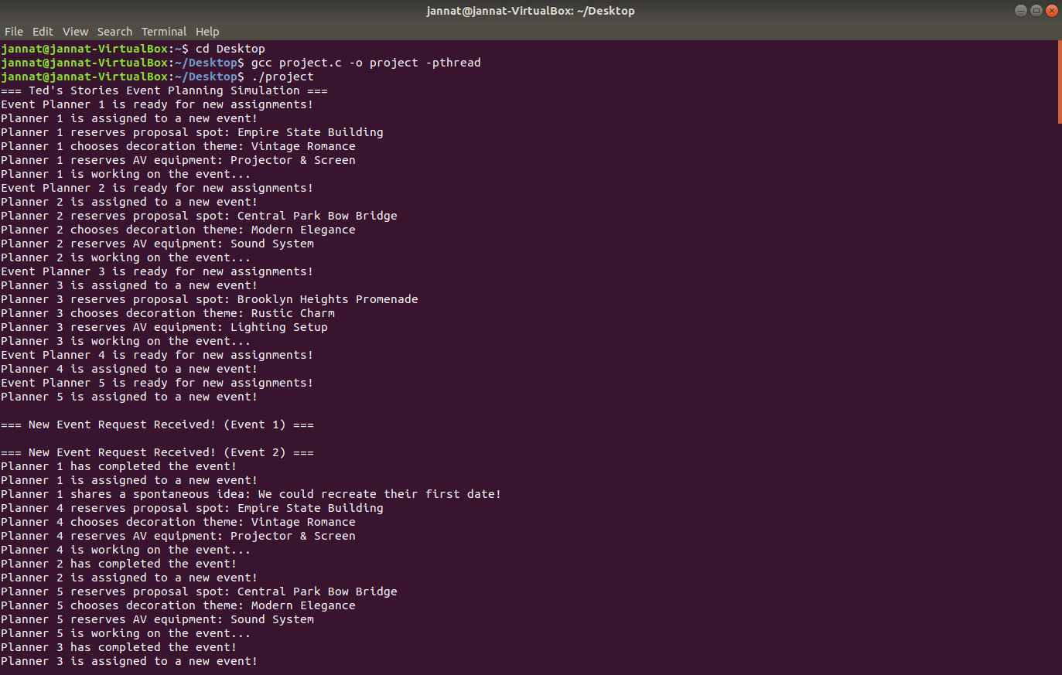
Output

Slide 14
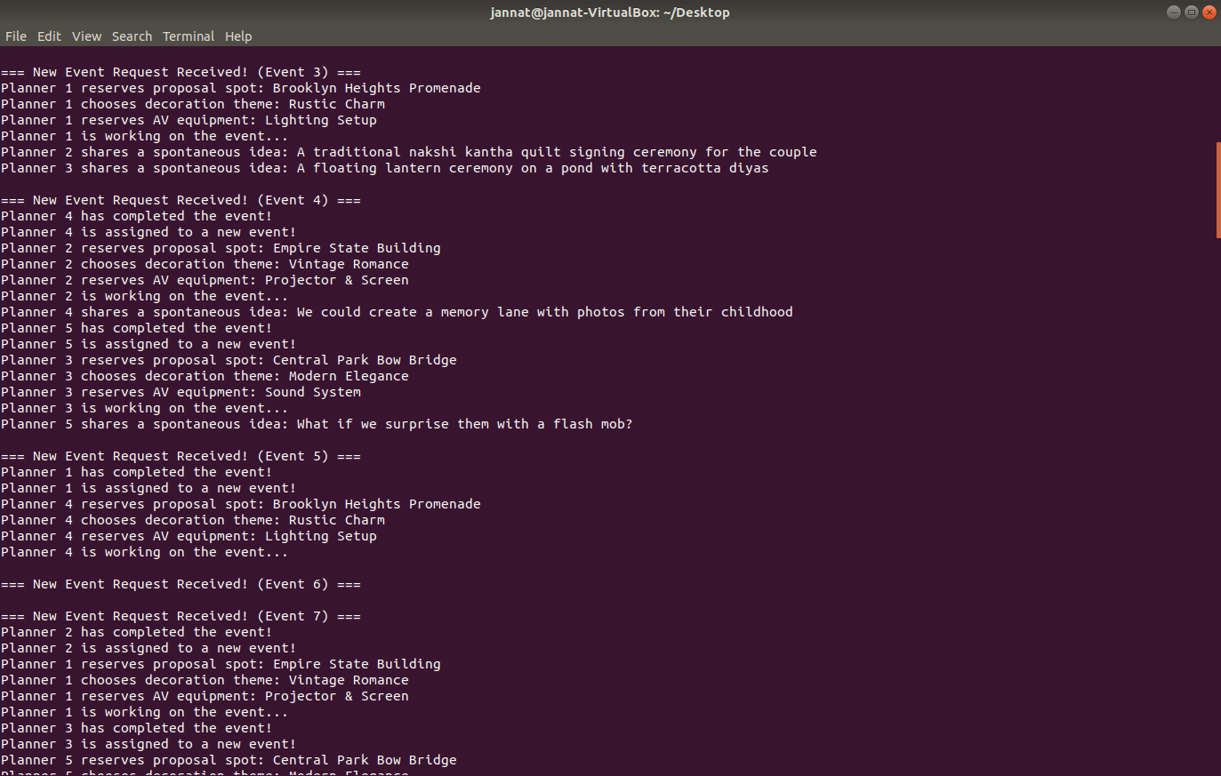
Output

Slide 15
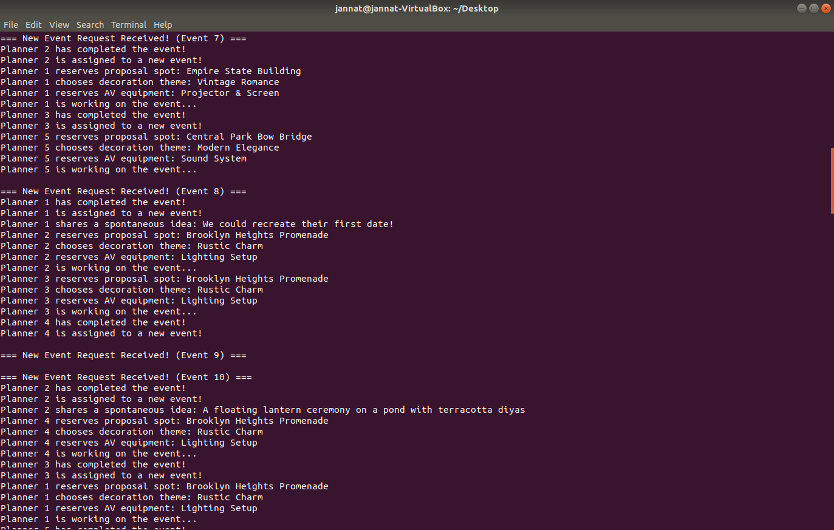
Output

Slide 16
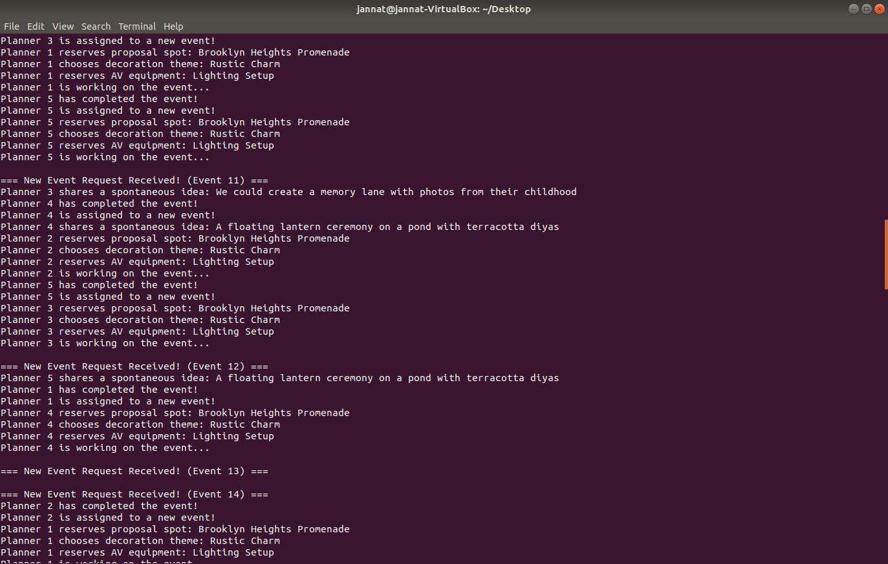
Output

Slide 17
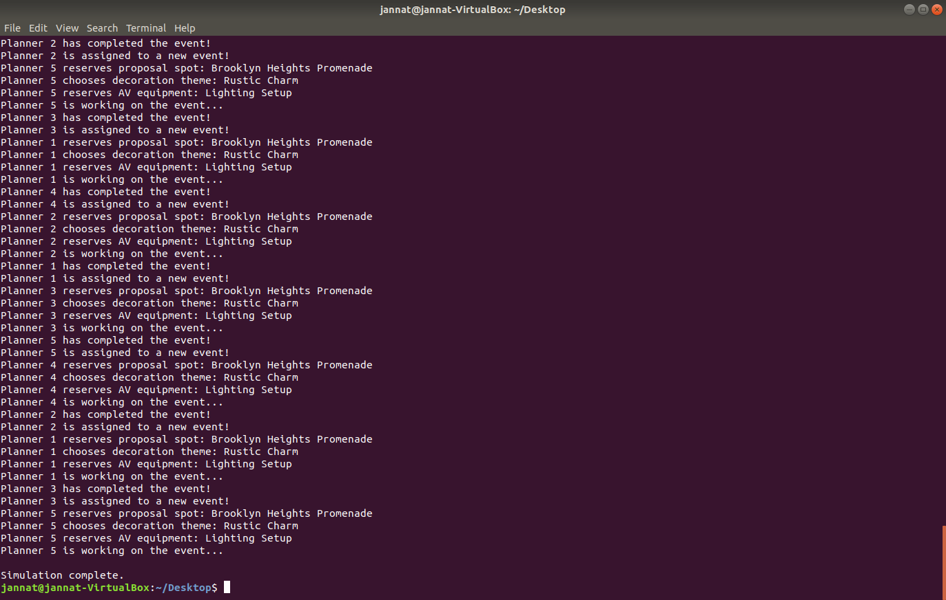
Output

Slide 18

Thank You

