Slide 1
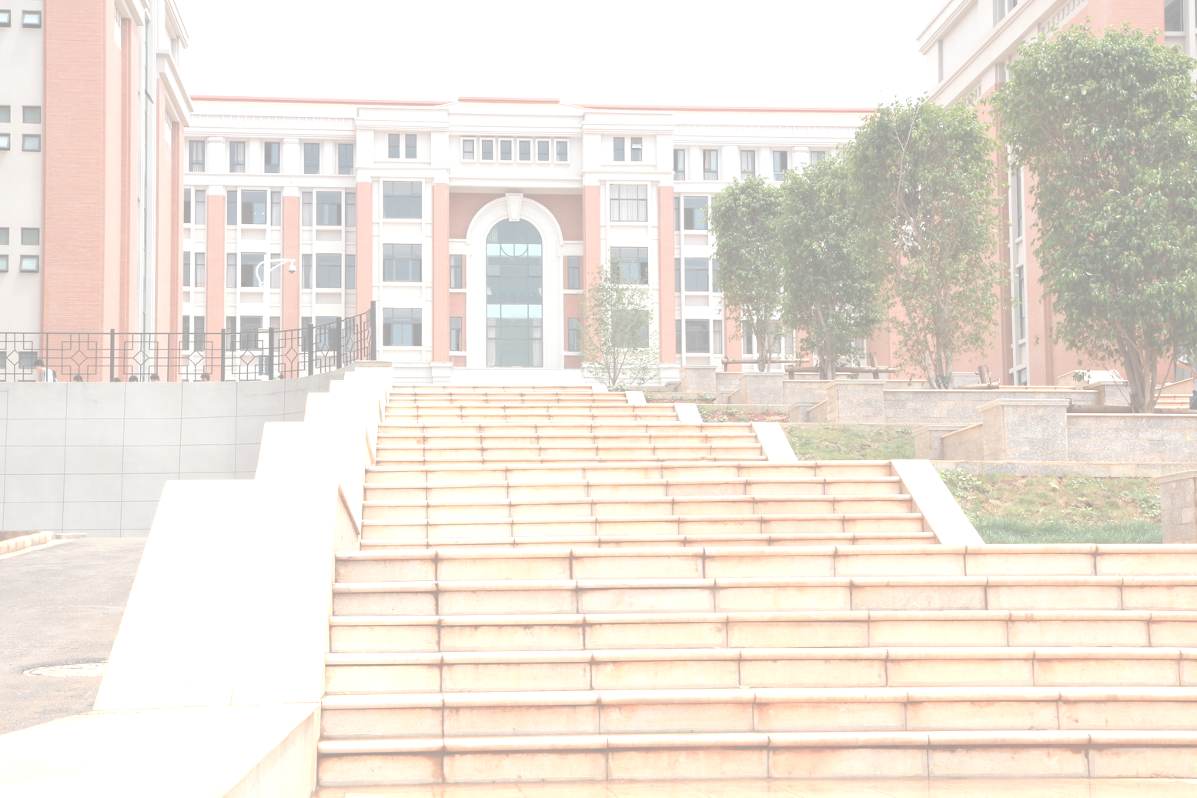

National Elaborate Course
Shared Course of Chinese Universities
Software Engineering
Cheng Xie
2020

Slide 2
Chapter 1
An Introduction to Software Engineering

Slide 3

Software engineering
The economies of ALL developed nations are
dependent on software.
More and more systems are software controlled
Software engineering is concerned with theories, methods and tools for professional software development.
Expenditure on software represents a
significant fraction of GDP in all developed countries.

Slide 4
Software costs
Software costs often dominate computer system costs. The costs of software on a PC are often greater than the hardware cost.
Software costs more to maintain than it does to develop. For systems with a long life, maintenance costs may be several times development costs.
Software engineering is concerned with cost-effective software development.

Slide 5

What is software?
Computer programs and associated documentation such as requirements, design models and implementations.
Software products may be developed for a particular customer or may be developed for a general market.
Software products may be
  Generic - developed to be sold to a range of different customers e.g. PC software such as Excel or Word.
  Bespoke (custom) - developed for a single customer according to their specification.
New software can be created by developing new programs, configuring generic software systems or reusing existing software.

Slide 6

What is software engineering?
Software engineering is an engineering discipline that is concerned with all aspects of software production.
Software engineers should adopt a systematic and organised approach to their work and use appropriate tools and techniques depending on the problem to be solved, the development constraints and the resources available.

Slide 7
What is the difference between software engineering and computer science?
Computer science is concerned with theory and fundamentals; But, software engineering is concerned with the practicalities of developing and delivering software product.
Computer science theories are still insufficient to act as a complete underpinning for software engineering .

Slide 8

What is a software process?
A set of activities whose goal is the development or evolution of software.
Generic activities in all software processes are:
  Requirement/Specification - what the system should do and its development constraints
  Design/Development - production of the software system
  Validation/Test - checking that the software is what the customer wants
  Evolution/Update - changing the software in response to changing demands.

Slide 9
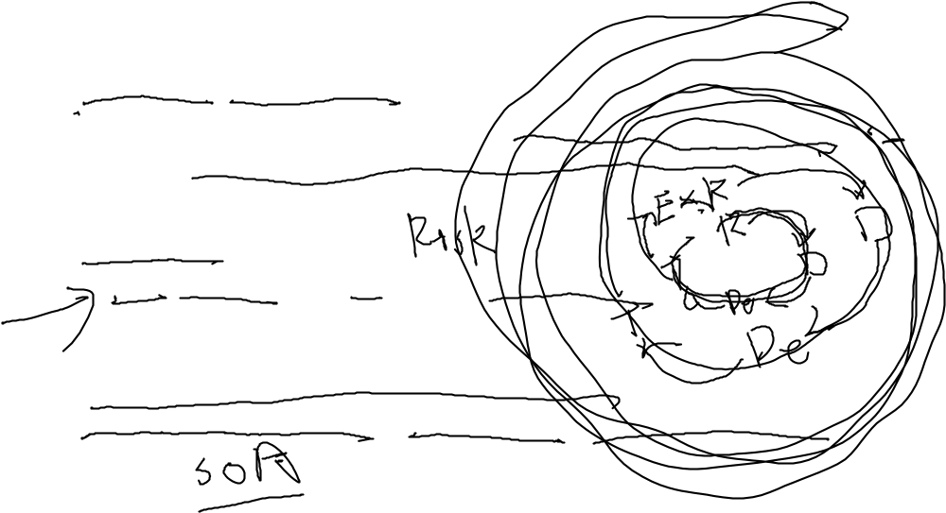
What is a software process model?
Generic process models
  Waterfall development;
  Waterfall methodology, also known as the linear sequential lifecycle model, is defined by its linear, structured approach to project management.
  Iterative development;
  RUP, Agile Process, XP process, Scrump process
  Component-based software engineering.
  Service-Orient Development，Micro Services, Service Middle Ground

Slide 10

What are the costs of software engineering?
Roughly 60% of costs are development costs, 40% are testing costs. For custom software, evolution costs often exceed development costs.
Costs vary depending on the type of system being developed and the requirements of system attributes such as performance, reliability and etc.
Distribution of costs depends on the process model that is used.

Slide 11

Activity cost distribution
Waterfall model
0
2
5
5
0
7
5
1
00
Specification
Design
Development
Integ
ration and testing
Iterative development
0
2
5
5
0
7
5
1
00
Specification
Iterative development
S
ystem testing
Component-based software engineering
0
2
5
5
0
7
5
1
00
Specification
Development
Integ
ration and testing
Development and evolution costs for long-lifetime systems
0
1
00
2
00
3
00
400
S
ystem development
S
ystem evolution

Slide 12
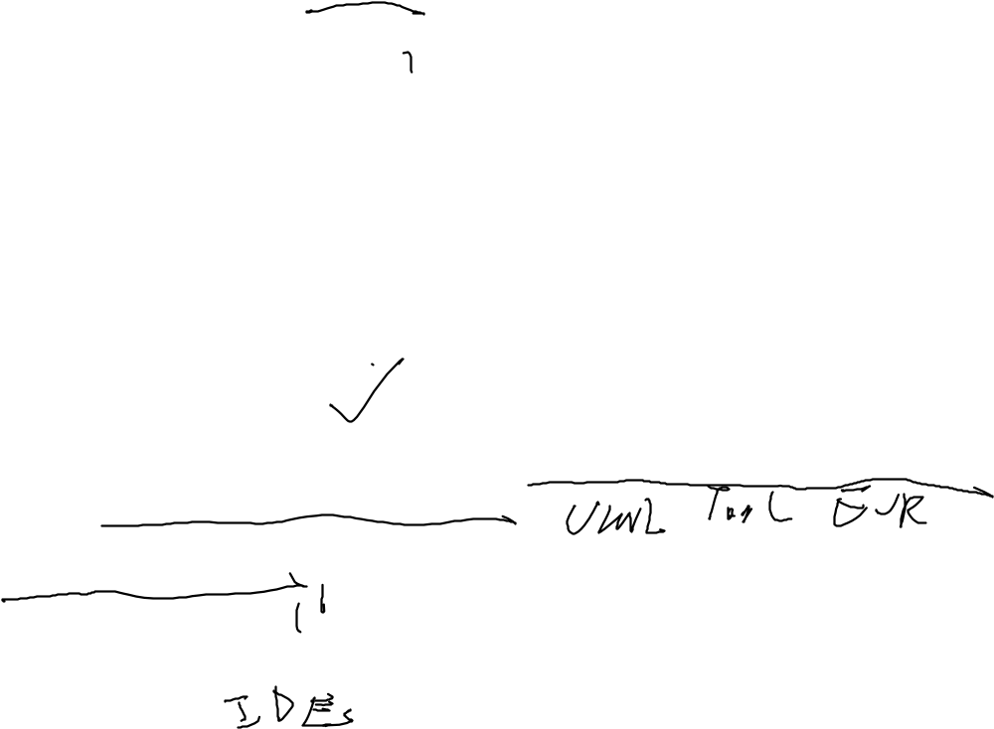
What is CASE (Computer-Aided Software Engineering)
Software systems that are intended to provide automated support for software process activities.
CASE systems are often used for method support.
Upper-CASE
  Tools to support the early process activities of requirements and design;
Lower-CASE
  Tools to support later activities such as programming, debugging and testing.

Slide 13

What are the attributes of good software?
The software should deliver the required functionality and performance to the user and should be maintainable, dependable and acceptable.
Maintainability
  Software must evolve to meet changing needs;
Dependability
  Software must be trustworthy;
Efficiency
  Software should not make wasteful use of system resources;
Acceptability
  Software must be accepted by the users for which it was designed. This means it must be understandable, usable and compatible with other systems.

Slide 14

1.2 Professional and ethical responsibility
Software engineering involves wider responsibilities than simply the application of technical skills.
Software engineers must behave in an honest and ethically responsible way if they are to be respected as professionals.
Ethical behaviour is more than simply upholding the law.

Slide 15
Issues of professional responsibility
Confidentiality
  Engineers should normally respect the confidentiality of their employers or clients irrespective of whether or not a formal confidentiality agreement has been signed.
Competence
  Engineers should not misrepresent their level of competence. They should not knowingly accept work which is outside their competence.

Slide 16

Issues of professional responsibility
Intellectual property rights
  Engineers should be aware of local laws governing the use of intellectual property such as patents, copyright, etc. They should be careful to ensure that the intellectual property of employers and clients is protected.
Computer misuse
  Software engineers should not use their technical skills to misuse other people’s computers. Computer misuse ranges from relatively trivial (game playing on an employer’s machine, say) to extremely serious (hacking, back-door,illegal control,destroy).

Slide 17

ACM/IEEE Code of Ethics
The professional societies in the US have cooperated to produce a code of ethical practice.
Members of these organisations sign up to the Code of Ethics when they join.
The Code of Ethics contains eight Principles related to the behaviour of and decisions made by professional software engineers, including practitioners, educators, managers, supervisors and policy makers, as well as trainees and students of the profession.

Slide 18
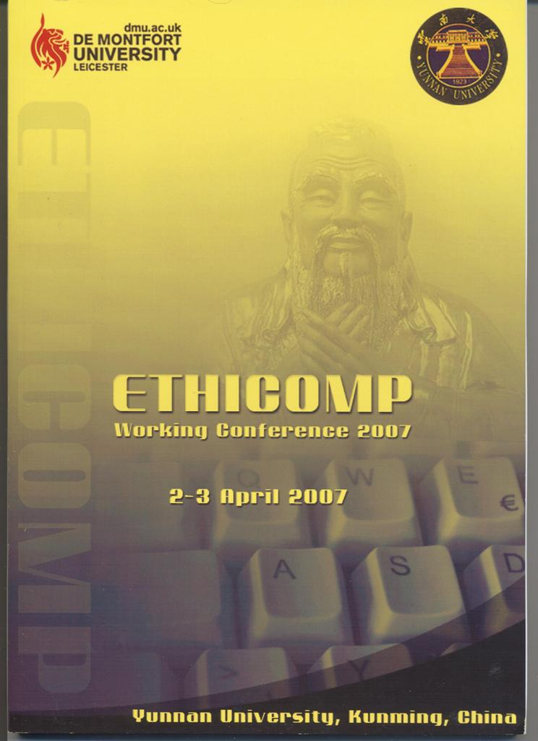
Proceedings of ETHICOMP Working Conference
2007, Held in 2-3 April 2007, Yunnan University, Kunming, China

Slide 19

Code of ethics - principles
PUBLIC
  Software engineers shall act consistently with the public interest.
CLIENT AND EMPLOYER
  Software engineers shall act in a manner that is in the best interests of their client and employer consistent with the public interest.
PRODUCT
  Software engineers shall ensure that their products and related modifications meet the highest professional standards possible.

Slide 20

Code of ethics - principles
JUDGMENT
  Software engineers shall maintain independence in their professional judgment.
MANAGEMENT
  Software engineering managers and leaders shall subscribe to and promote an ethical approach to the management of software development and maintenance.
PROFESSION
  Software engineers shall advance the integrity and reputation of the profession.

Slide 21
Code of ethics - principles
COLLEAGUES
  Software engineers shall be fair to and supportive of their colleagues.
SELF
  Software engineers shall participate in lifelong learning regarding the practice of their profession and shall promote an ethical approach to the practice of the profession.

Slide 22
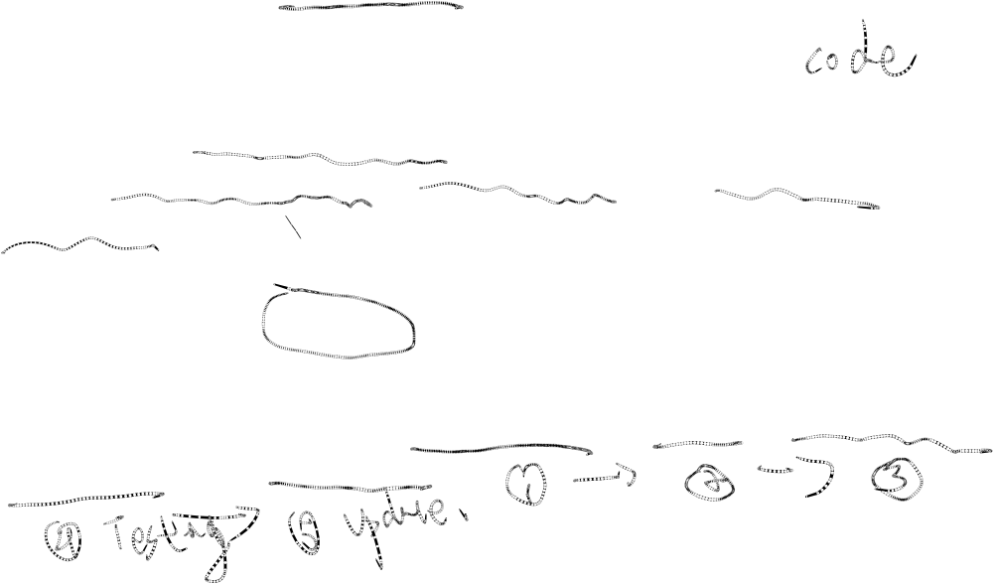
Key points
Software engineering is an engineering discipline that is concerned with all aspects of software production.
Software products consist of developed programs and associated documentations. Essential product attributes are maintainability, dependability, efficiency and usability.
The software process consists of activities that are involved in developing software products. Basic activities are software requirement, design, development, validation and evolution.

Slide 23

Key points
CASE tools are software systems which are designed to support routine activities in the software process such as UML tools, ER tools, IDEs, Testing tools .
Software engineers have responsibilities to the engineering profession and society. They should not simply be concerned with technical issues.
Professional societies publish codes of ethics which set out the standards of behaviour expected of their members.

