Slide 1

Food Trend Analysis: Customer Behavior and Market Insights
SUBMITTED TO : NITHYASRI S J
SUBMITTED BY: Iti Tiwari

Slide 2
Project Overview
Objective: To analyze customer purchasing patterns, regional performance, and seasonal trends in the food industry using data visualization and analytics.
Key Focus Areas:
Sales Overview Regional Insights
Seasonal Trends Customer Insights
Future Recommendations Product Insights

Slide 3

Data Source & Tools Used
Data Sources:
Collected sample transactional data (Orders, Customers, Regions, Food Items)
Time period: 2023-2024
Tools Used:
Power BI: Data visualization

Slide 4
Sales Overview Dashboard
Avg. Discount
15.56%
Total Orders
2000
Total Revenue
4M
26%
UPI
25%
Wallet
24%
Card
25%
Cash
Payment Preferences: UPI (26%), Wallet (25%), Cash (25%), Card (24%)
Peak Sales in July, drop in November.

Slide 5

Customer Behavior & Demographics
Customer Metrics
Total Customers: 787
Avg. Rating: 3.74
Gender Split: ~50% Male / Female
Revenue Drivers
Age Group 46–55 generated the highest revenue (1.03M)
Majority feedback: Good & Excellent

Slide 6

Product & Menu Insights
Top-selling items
Average Price Category
Demand Consistency
Brownie
Burger
Cheesecake
Biryani
Dessert
Beverage
Asian
Fast Food
Consistent demand across months; small dip at year-end.

Slide 7
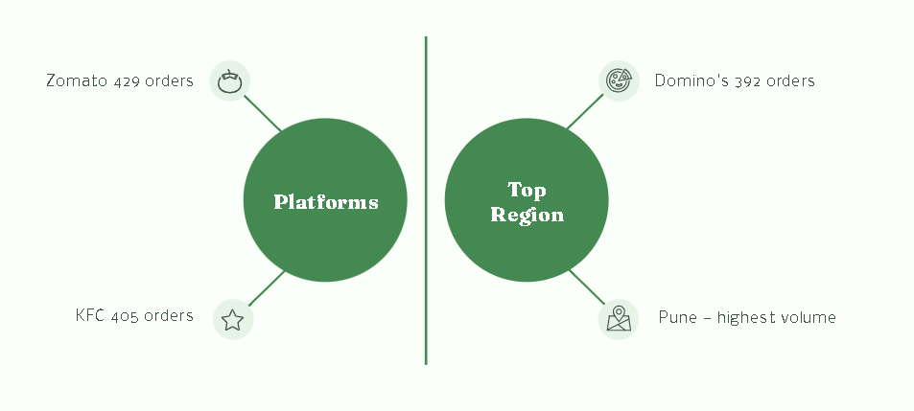
Regional & Platform Insights
Order Distribution:
Zomato (429), KFC (405), Domino’s (392)
Payment Mode Share: UPI dominates with ~26% usage.
Regional Performance
Top Region: Pune
Top Platform: Pizza Hut (Highest revenue)

Slide 8
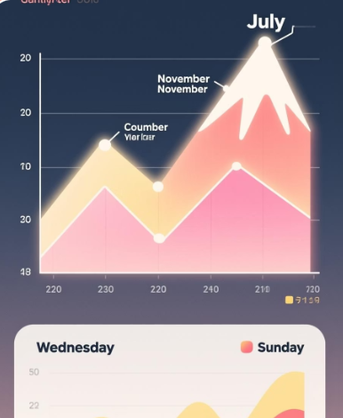
Seasonal & Time Trends
Peak Season
Summer (1.2M revenue)
Lowest Season
Autumn (0.7M revenue)
Peak&Off-Peak Month
July
November
Orders highest on Wednesday & Sunday.

Slide 9
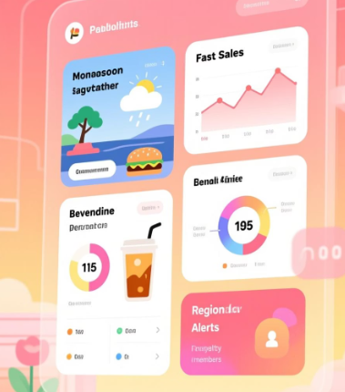
Future Insights Dashboard
Monsoon Season
Monsoon season drives fast-food sales.
Online Beverages
Beverages perform well online.
Loyalty Members
Loyalty members spend 25% more.
Underperforming Regions
Underperforming regions need localized offers.

Slide 10
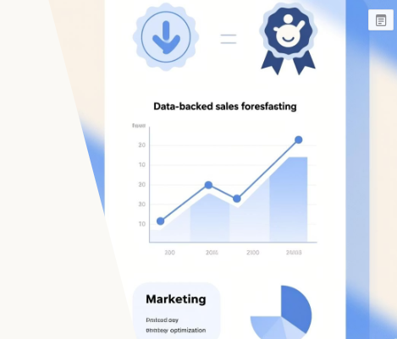
Impact & Outcomes
Improved customer satisfaction & loyalty.
Data-backed sales forecasting.
Optimized marketing and pricing strategy.
Better understanding of customer preferences.

Slide 11

Conclusion
This Food Trend Analysis provides valuable insights into customer behavior, product popularity, and market dynamics. It enables data-driven decision-making for improving business strategy.

Slide 12
Thank You !

