Slide 1


DYNAMIC PRICING FOR RIDE-SHARING SERVICES

Slide 2
TEAM MEMBERS
S RAVINDRA
T JASWANTH CHWODARY
AM.EN.U4CSE22151
AM.EN.U4CSE22156
S MAHIVARDHAN
AM.EN.U4CSE22147

Slide 3
CONTENT
MOTIVATION
PROBLEM STATEMENT
DATA ANALYSIS
ALGORITHMS USED
DATA VISUALIZATION
RESULTS

Slide 4
MOTIVATION
The motivation behind this Dynamic Pricing Prediction for Ride-Sharing Services project stems from the growing importance of efficient pricing strategies in the highly competitive ride-sharing industry. By accurately predicting ride prices, ride-sharing companies can:
• Enhance customer trust and satisfaction by providing transparent and predictable pricing.
• Effectively balance supply and demand during peak times or adverse weather conditions.
• Optimize driver earnings to ensure fair compensation and improve retention.
• Improve operational efficiency through better resource allocation, such as directing drivers to high-demand areas.
This project addresses a critical business need while leveraging machine learning techniques to deliver scalable and impactful solutions for dynamic pricing.

Slide 5
PROBLEM STATEMENT
This project aims to predict dynamic pricing for ride-sharing services using machine learning techniques, with the goal of providing accurate fare estimates based on various influencing factors. By analyzing a dataset containing ride details such as distance, time, weather conditions, and demand patterns, we will apply algorithms like Random Forest, XGBoost and Support Vector Regression to predict ride prices in real-time. The model's performance will be evaluated using metrics such as mean absolute error (MAE), root mean squared error (RMSE), and R-squared. The insights gained from this model will help ride-sharing platforms optimize pricing strategies, balance supply and demand, enhance customer satisfaction, and improve driver earnings.

Slide 6
DATA ANALYSIS

Slide 7
DATASET 1
Features (Columns):
['Trip_Distance_km', 'Time_of_Day', 'Day_of_Week', 'Passenger_Count', 'Traffic_Conditions', 'Weather', 'Base_Fare', 'Per_Km_Rate', 'Per_Minute_Rate', 'Trip_Duration_Minutes', 'Trip_Price']
Total Rows: 1000
Total Columns:11

Slide 8
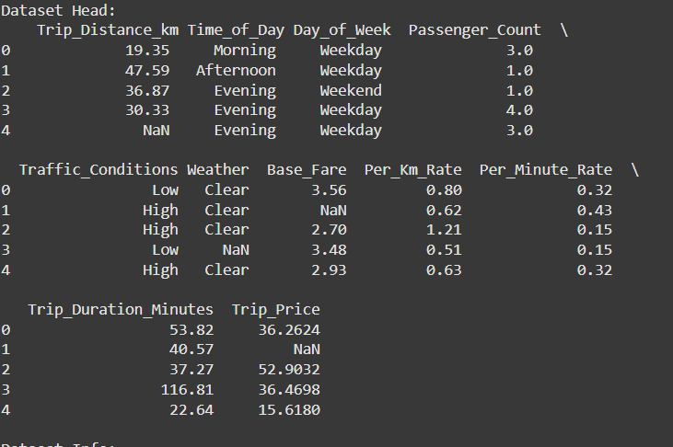
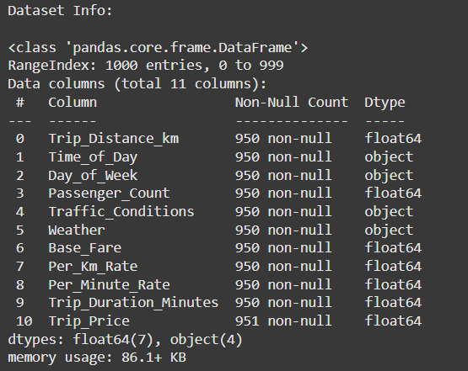

Slide 9
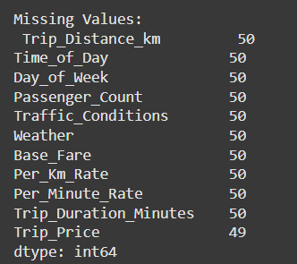
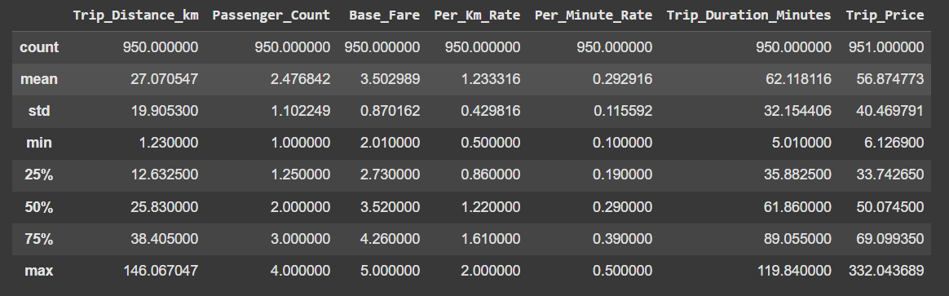
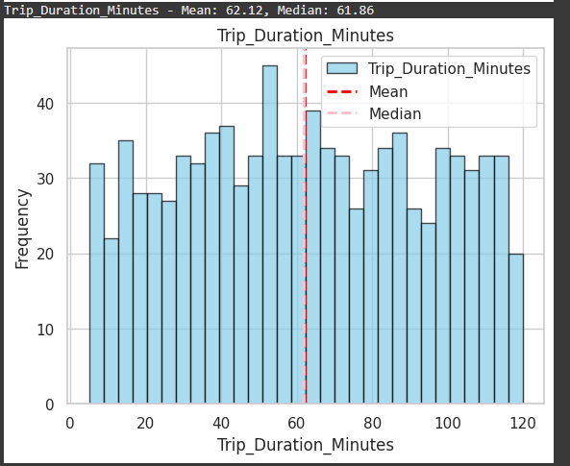
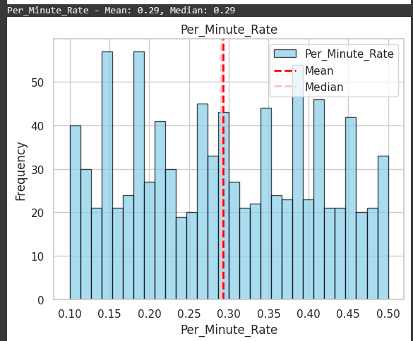

Slide 10
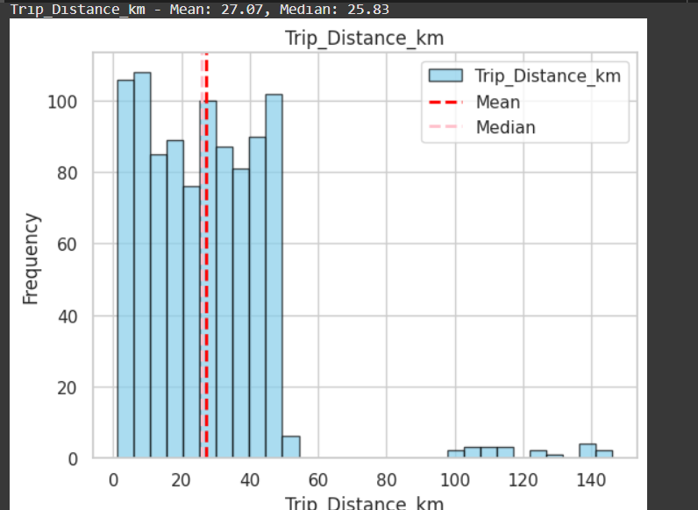
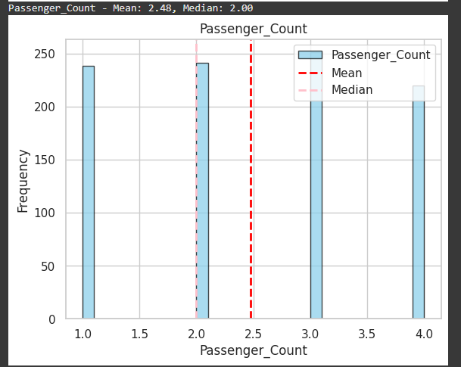

Slide 11
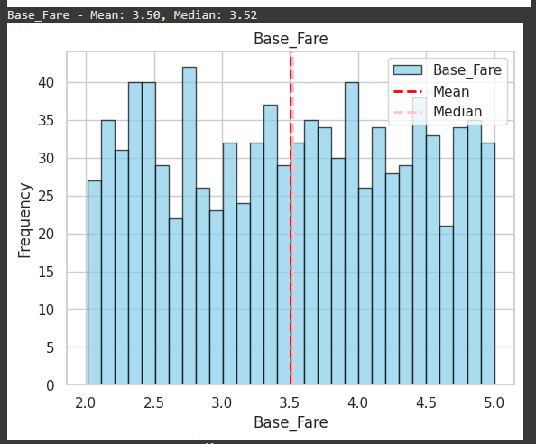
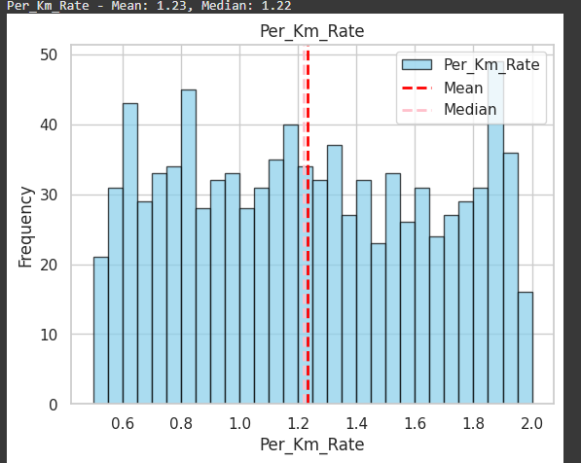
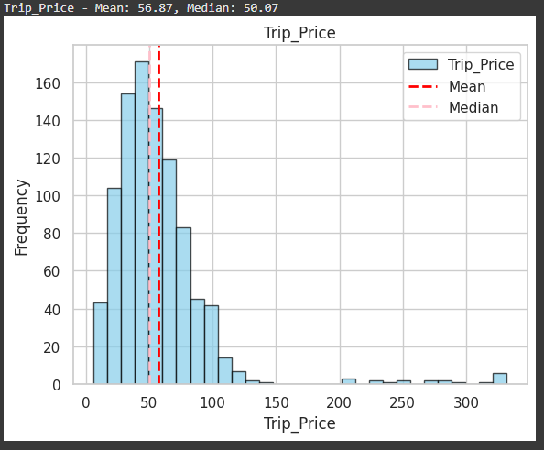

Slide 12
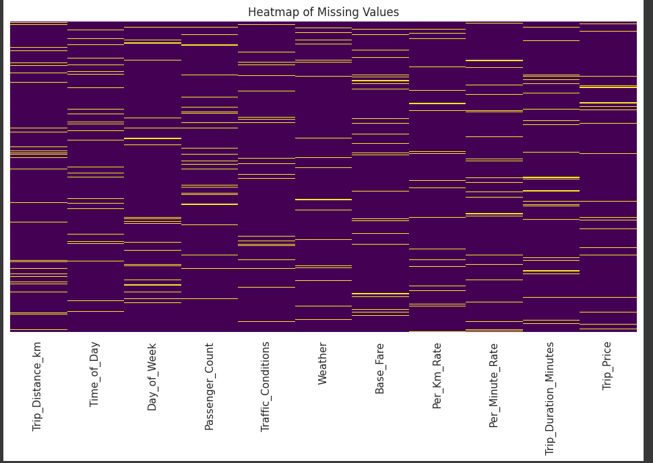
HeatMap Of Missing Values

Slide 13
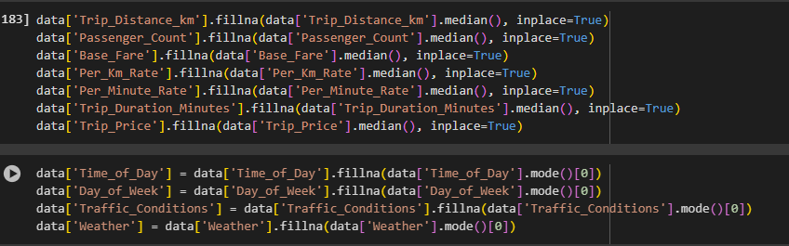
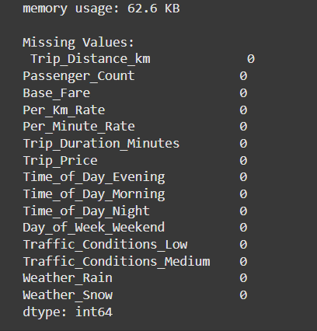
PREPROCESSING

Slide 14
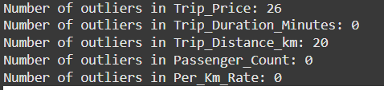
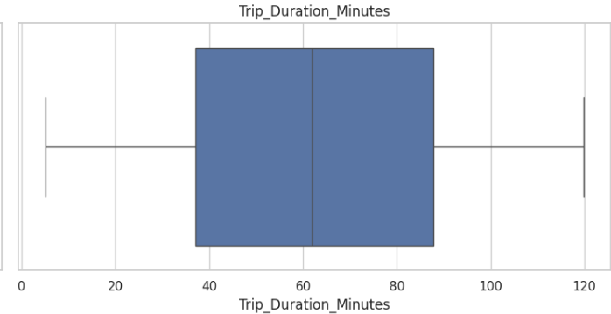
OUTLIERS DETECTION

Slide 15
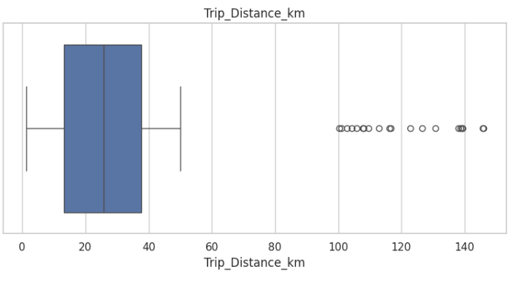
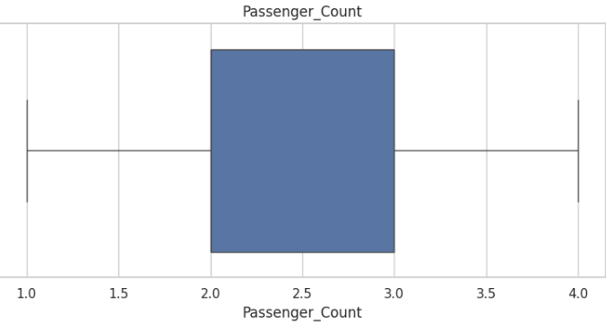

Slide 16
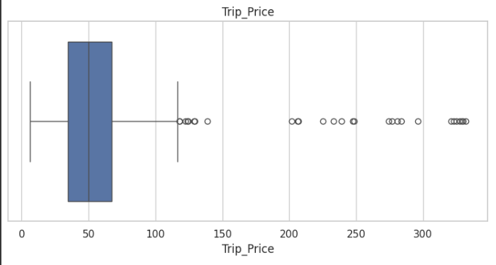
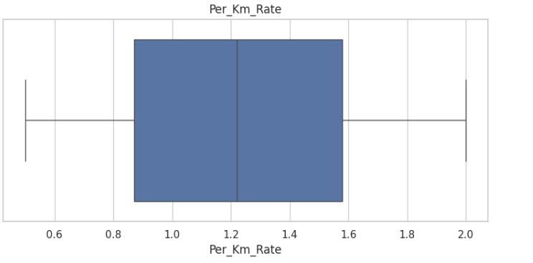

Slide 17
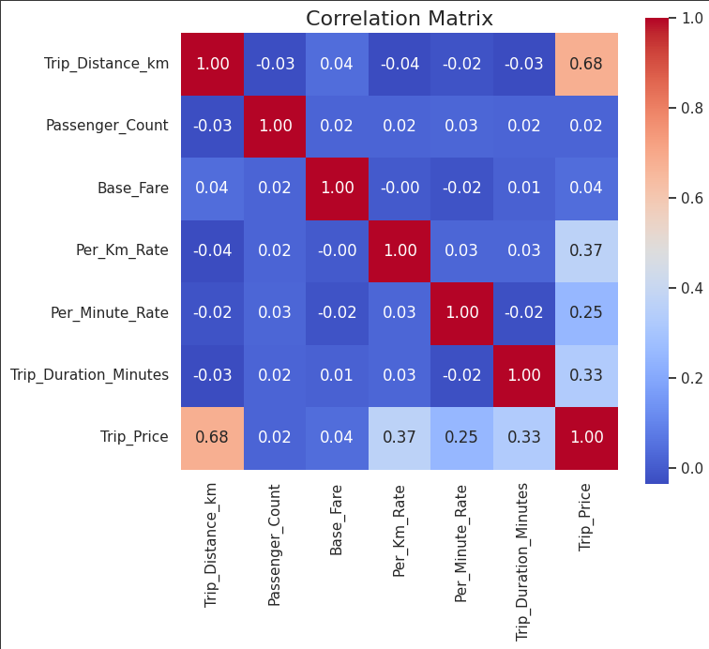
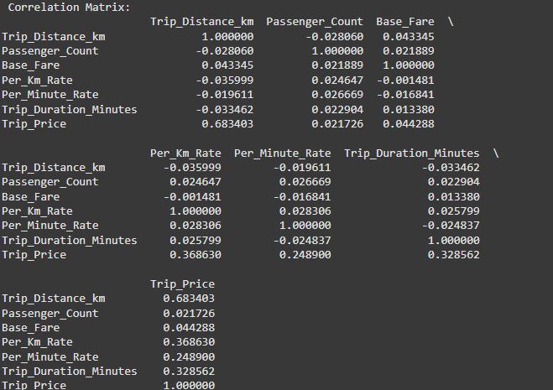
CORRELATION MATRIX

Slide 18
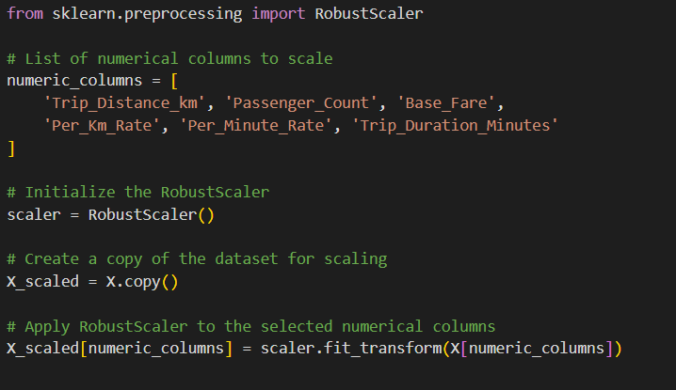
ONEHOTENCODING
data = pd.get_dummies(data, columns=['Time_of_Day', 'Day_of_Week', 'Traffic_Conditions', 'Weather'], drop_first=True)
SCALING

Slide 19
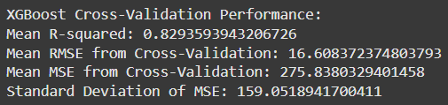
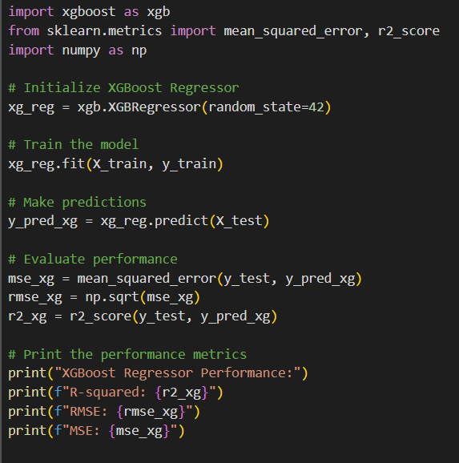

MODEL EVALUATION
XGBOOST

Slide 20
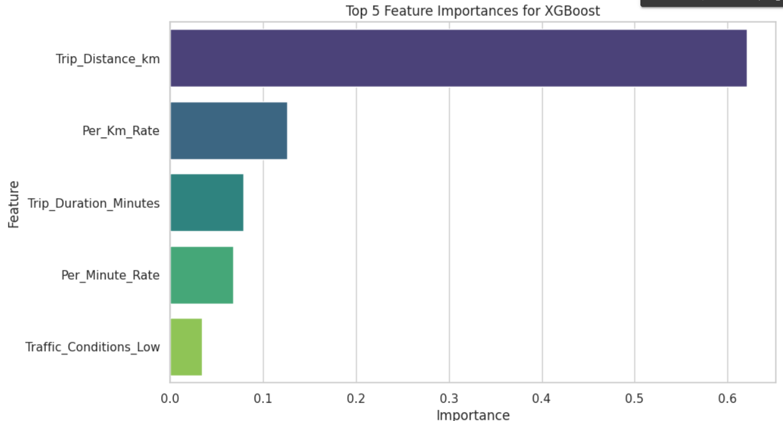

Slide 21
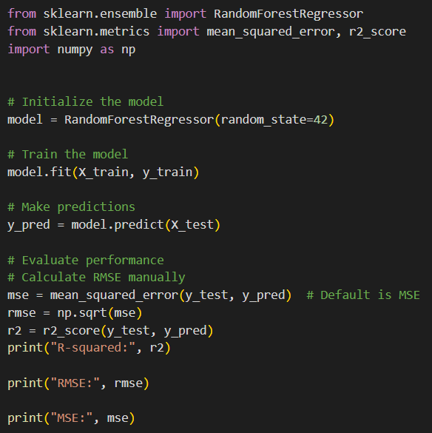

RANDOM FOREST

Slide 22
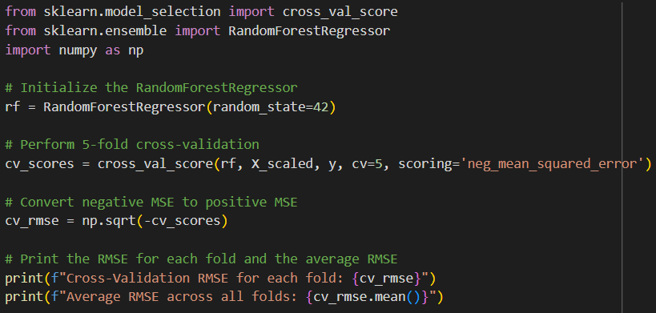

Slide 23
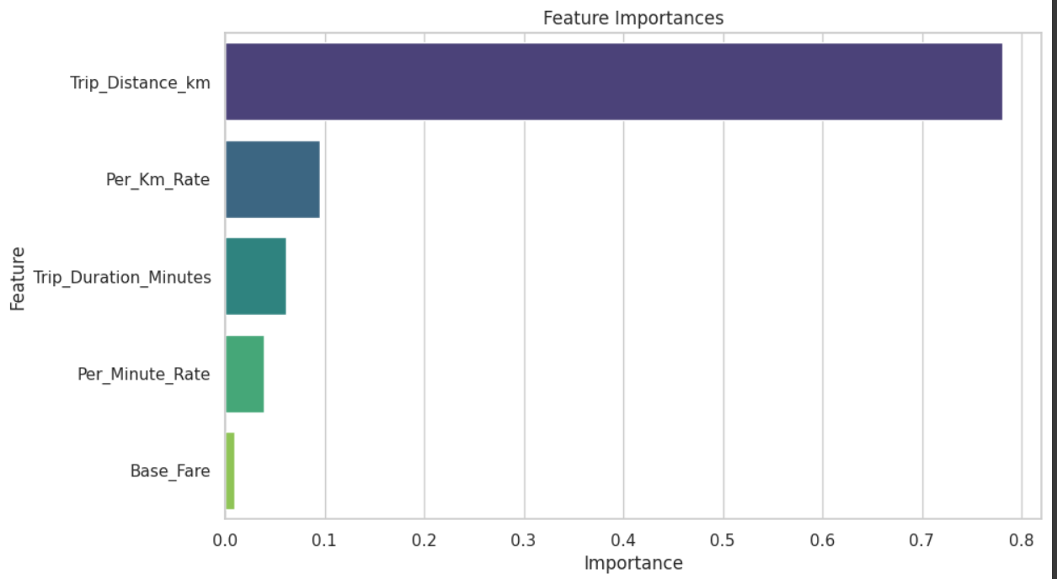

Slide 24
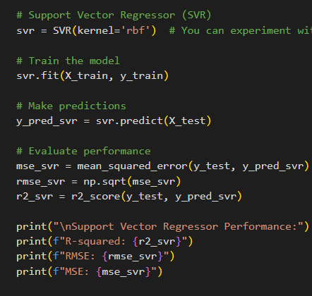
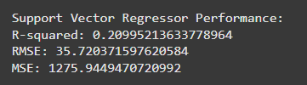
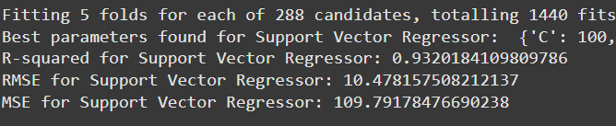
SUPPORT VECTOR REGRESSOR
AFTER HYPERPARAMETER TUNING

Slide 25
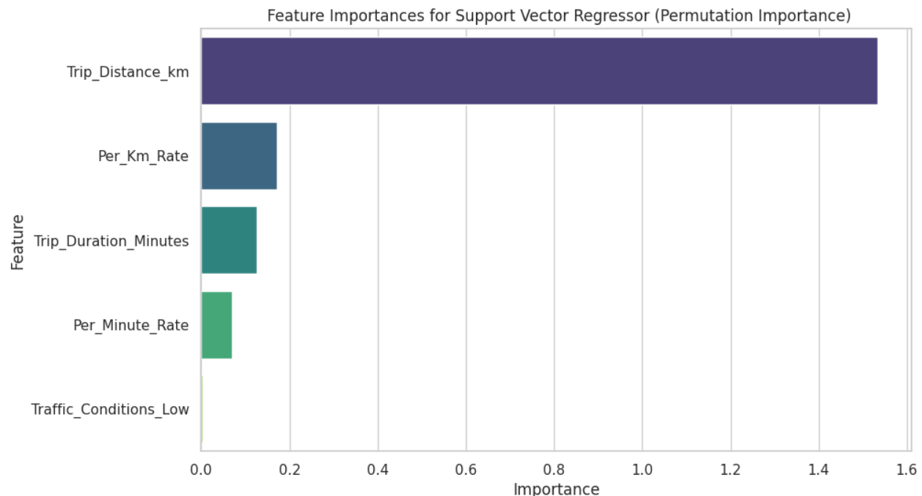

Slide 26
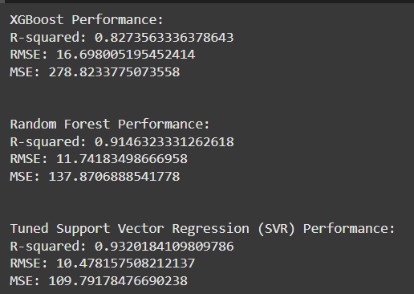
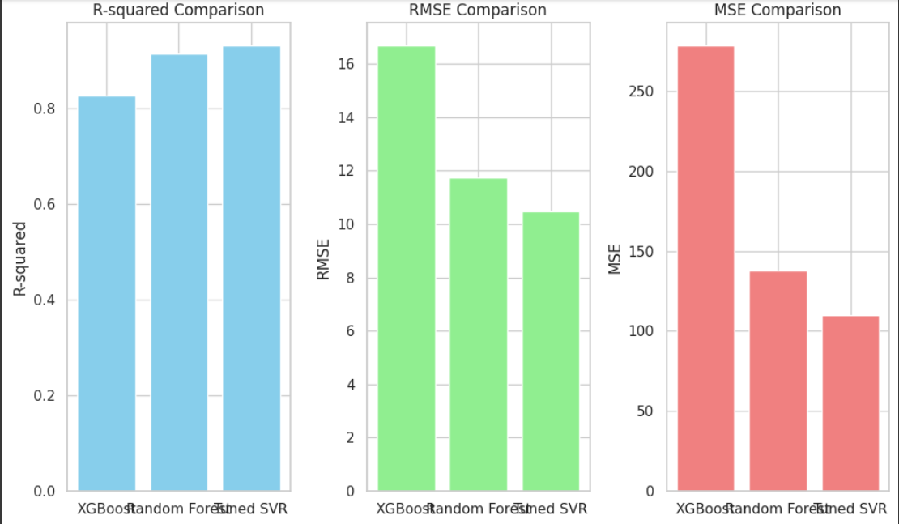
SVR IS BEST AMONG ALL FOR DATASET1

Slide 27
DATASET2

Slide 28
Features in Ride Dataset
['distance', 'cab_type', 'time_stamp', 'destination', 'source', 'price', 'surge_multiplier', 'id', 'product_id', 'name']
Number of columns: 10
Features in Weather Dataset
['temp', 'location', 'clouds', 'pressure', 'rain', 'time_stamp', 'humidity', 'wind']
Number of columns:8

Slide 29
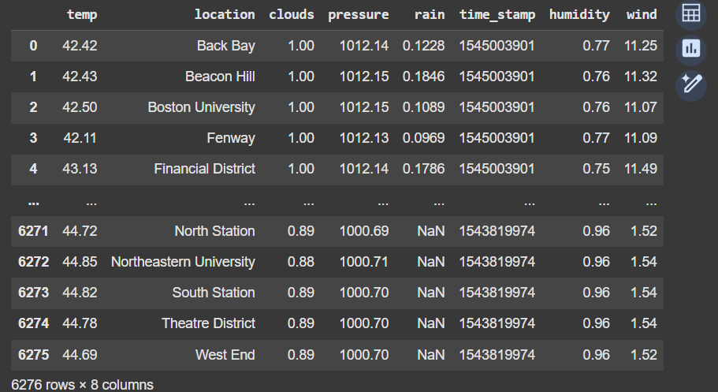
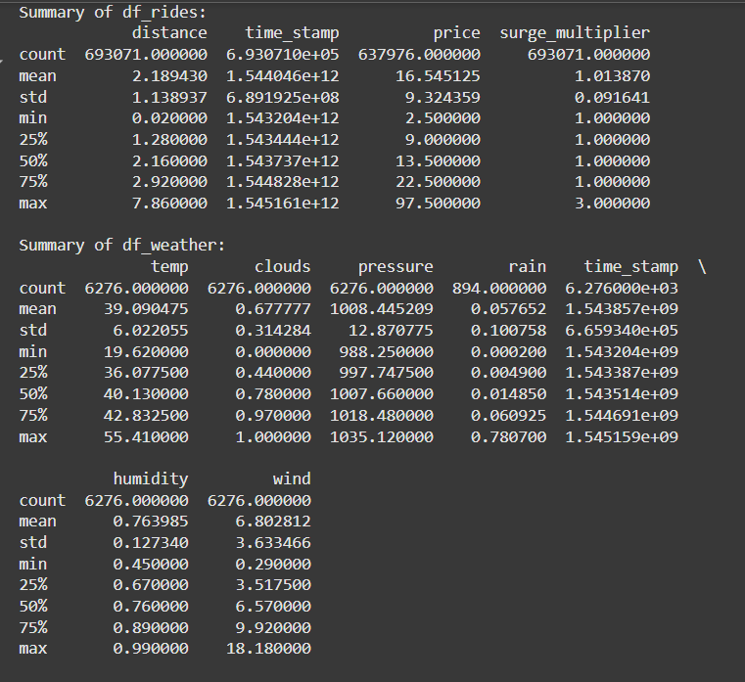

Slide 30
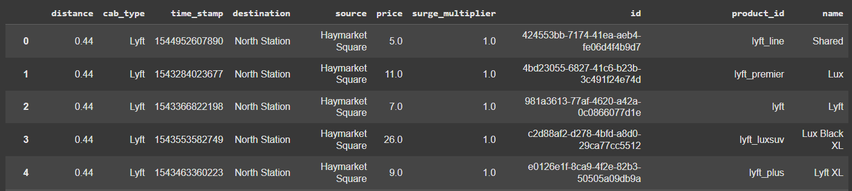
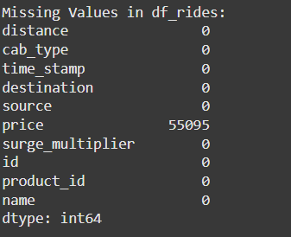
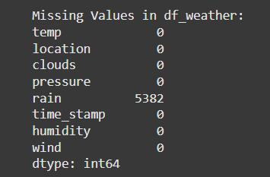

Slide 31
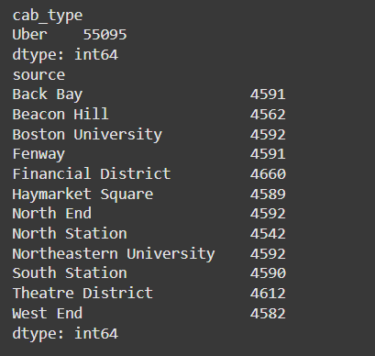
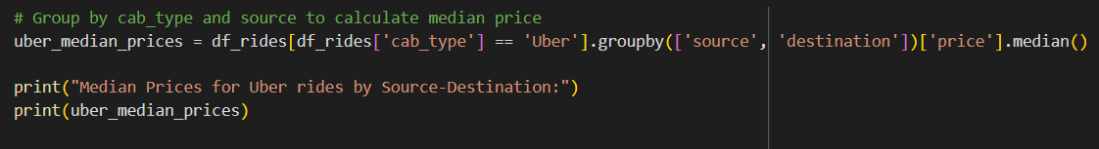
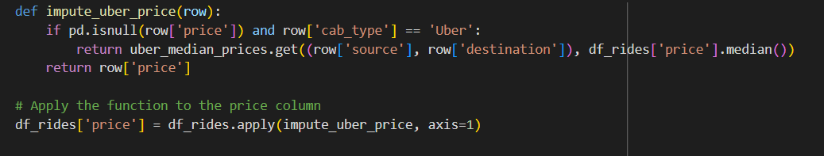

PREPROCESSING

Slide 32
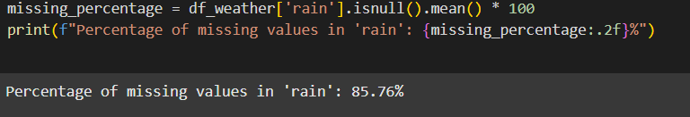
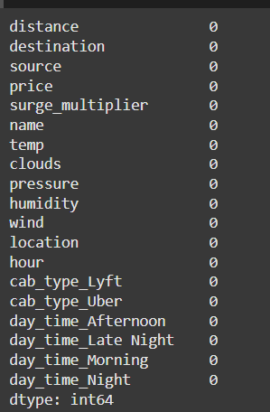

Slide 33
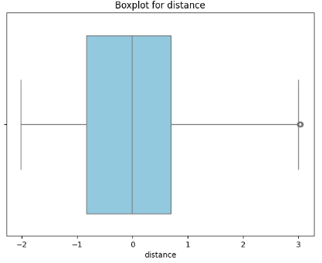
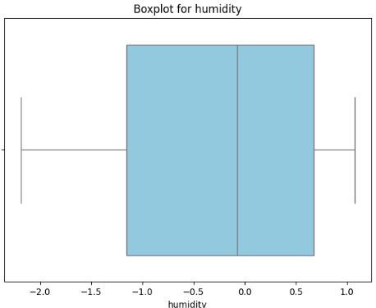
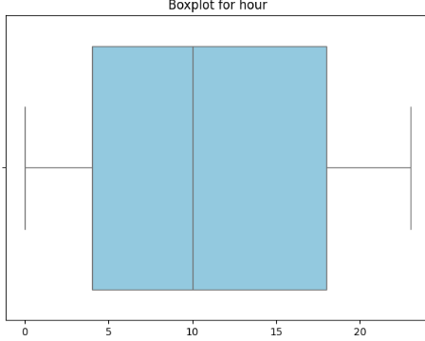
OUTLIER DETECTION

Slide 34
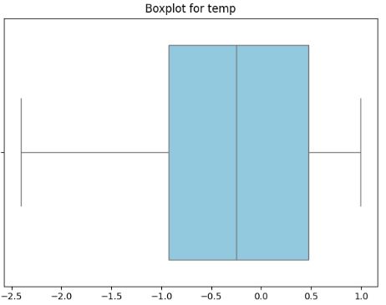
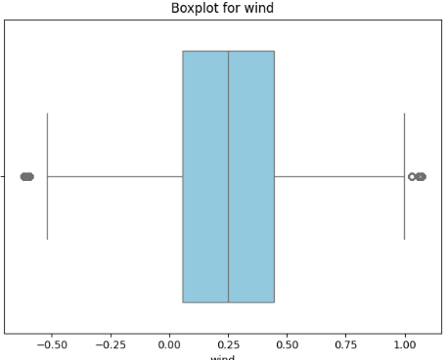



Slide 35


CORRELATION MATRIX

Slide 36



Slide 37


ONE HOT ENCODING
DROPPING IRRELEVANT COLUMNS

Slide 38


SUPPORT VECTOR REGRESSOR

Slide 39


Slide 40


RANDOMFORESTREGRESSOR

Slide 41



Slide 42


XGBOOST

Slide 43


Slide 44
DATASET 3

Slide 45




Slide 46





Slide 47


Slide 48



PREPROCESSING

Slide 49



Slide 50





Slide 51




Slide 52



Slide 53


CORRELATION MATRIX

Slide 54


Slide 55


Slide 56


Slide 57


Slide 58


RANDOM FOREST

Slide 59


XGBOOST

Slide 60

SVR MODEL

Slide 61
THANK YOU

