Slide 1






Seasonal Agriculture Performance Analysis
Student Name- MAHI VERMA
College Name- JSS Academy Of Technical Education,NOIDA
AICTE STU ID : STU6a6ca4c789ed91785504967
Annual Review
9/9/2026
‹#›

Slide 2

PROBLEM STATEMENT
Agricultural activities are influenced by seasonal variations in environmental conditions, farming practices, resource availability and market conditions. As a result, agricultural performance may differ from one season to another. However, raw agricultural data does not clearly explain how agricultural performance changes across seasons or what patterns can be observed in different seasonal conditions. The problem is to analyze the given agricultural dataset and investigate seasonal differences in agricultural performance by identifying meaningful patterns, trends, relationships and variations within the available data.
9/9/2026
Annual Review
‹#›

Slide 3
Project Description
The project analyses agricultural data from 4,000 farm records to understand how performance changes across Kharif, Rabi and Zaid seasons. The analysis covers weather conditions, soil characteristics, farming practices, crop yield, production, water usage and financial performance. Different charts and statistical comparisons are used to identify patterns and relationships in the data.
The important groups of variables are:
Farm details: Farm ID, State, District, Crop, Season
Weather: Rainfall, temperature, humidity, sunlight
Soil: pH, soil moisture, nitrogen, phosphorus, potassium
Farming practices: irrigation method, fertilizer, pesticide, seed quality
Production: yield and total production
Business: market price, total cost, revenue and profit
Water: water used and water efficiency
Risk: disease/pest risk
9/9/2026
Annual Review
‹#›

Slide 4

WHO ARE THE END USERS?
  Farmers
  Agricultural consultants
  Agriculture departments
  Farm managers
  Researchers
  Agribusiness/market planners
9/9/2026
Annual Review
‹#›

Slide 5

Technology Used
  Python
  Google Colab
  Pandas
  NumPy
  Matplotlib
  Seaborn
  Scikit-learn
  GitHub
9/9/2026
Annual Review
‹#›
Notes:
5

Slide 6
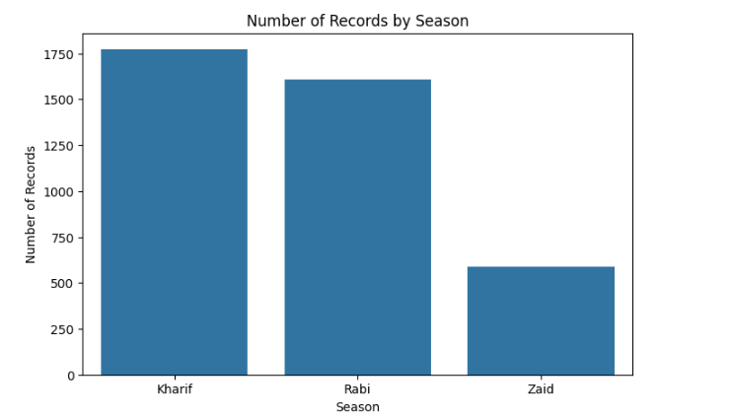
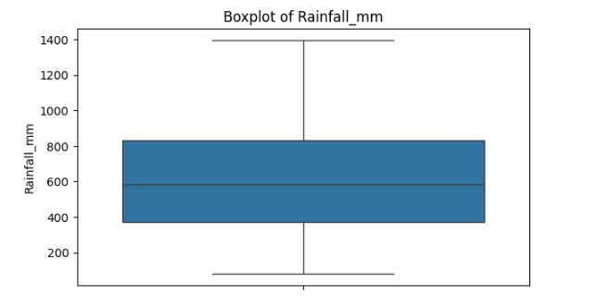
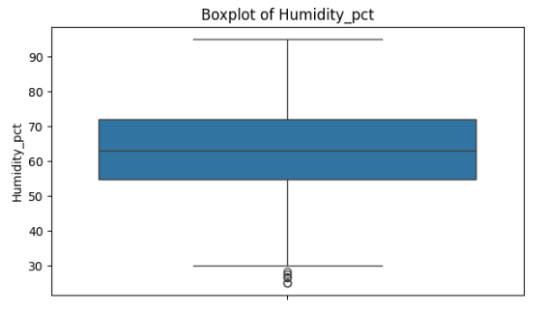
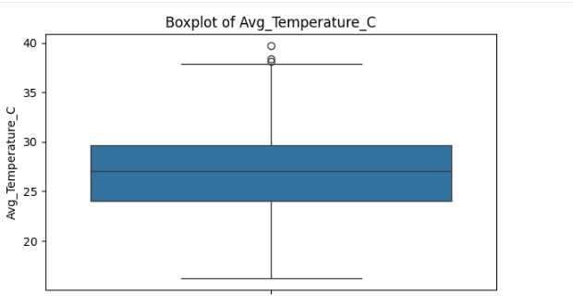
RESULTS
9/9/2026
Annual Review
‹#›

Slide 7
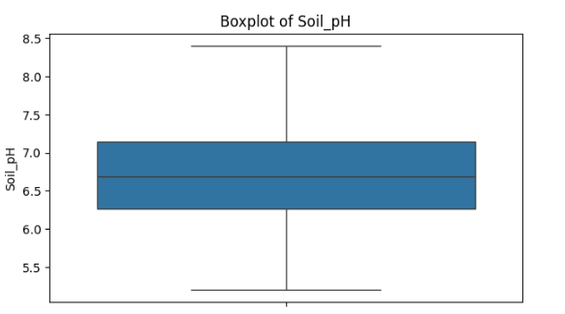
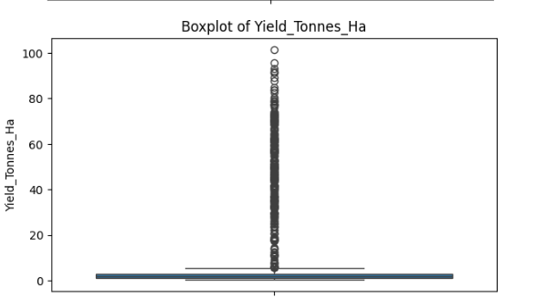
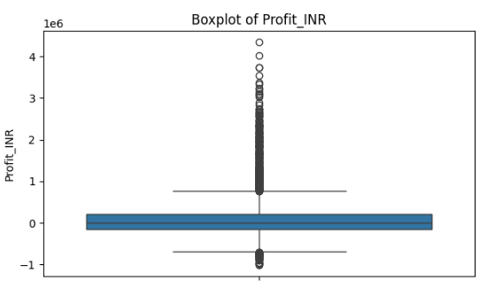
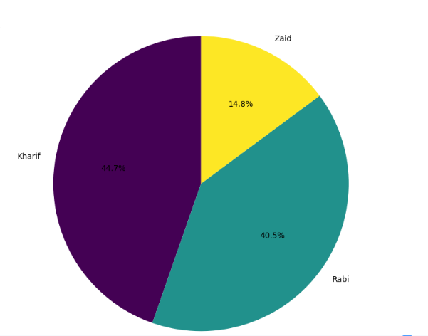
RESULTS
9/9/2026
Annual Review
‹#›

Slide 8
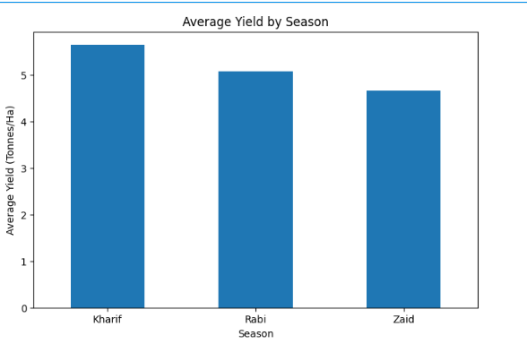
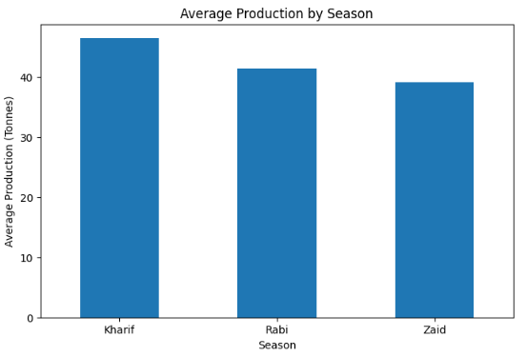
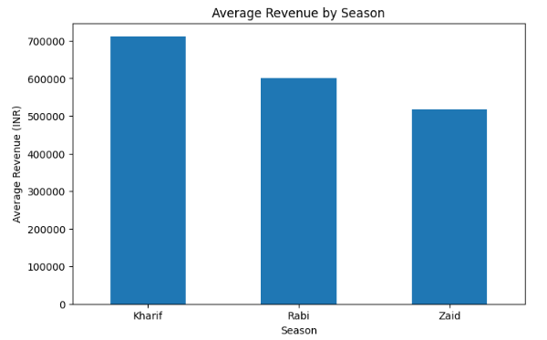
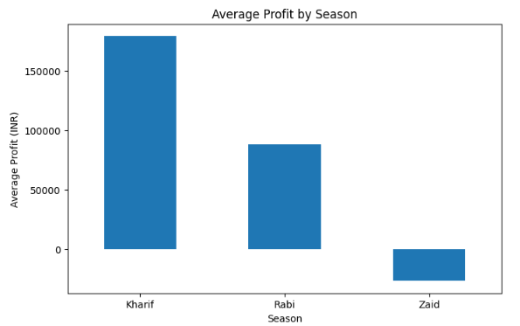
RESULTS
9/9/2026
Annual Review
‹#›

Slide 9
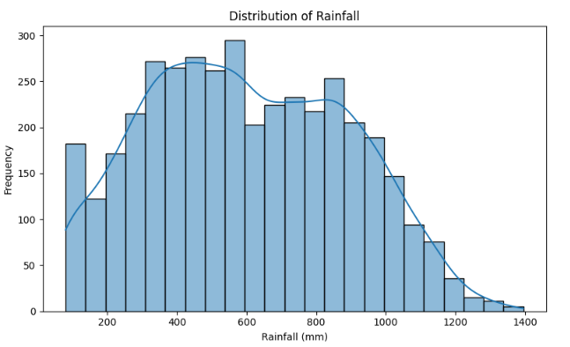
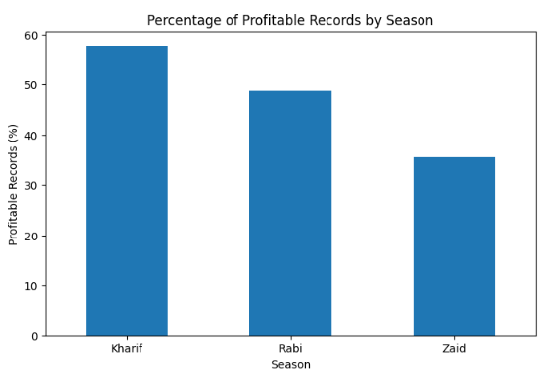
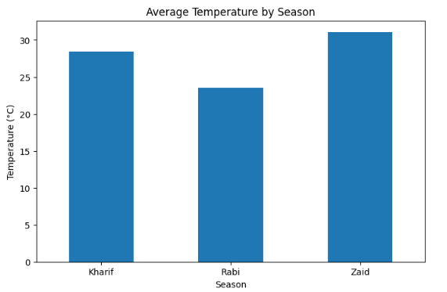
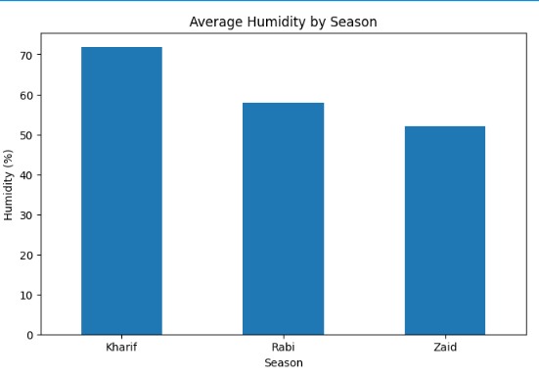
RESULTS
9/9/2026
Annual Review
‹#›

Slide 10
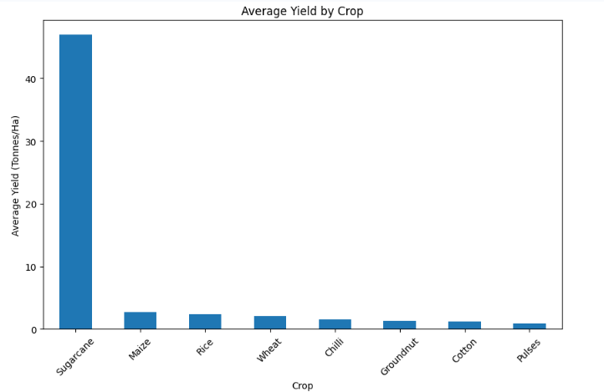
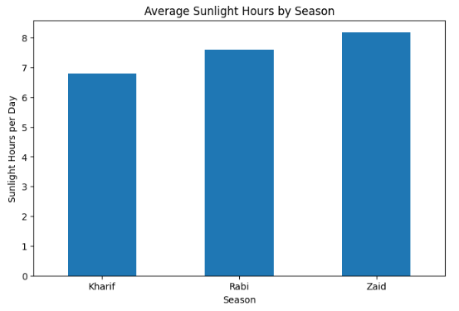
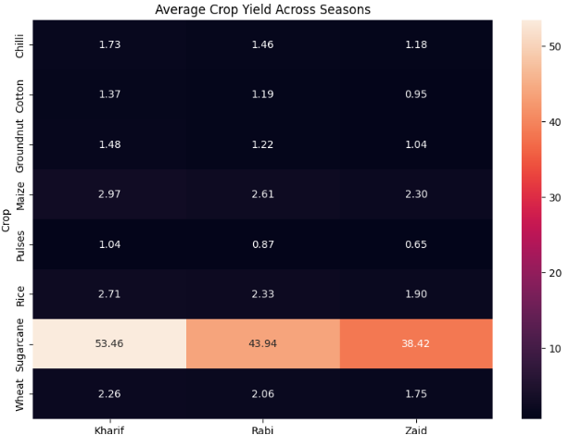
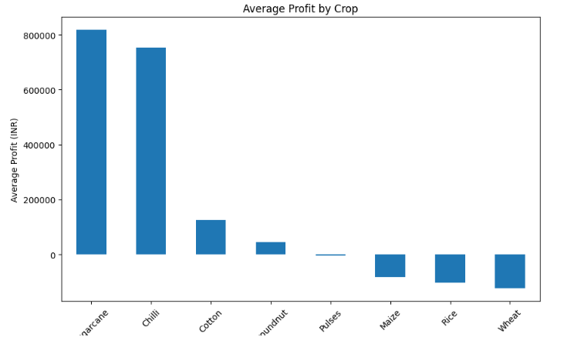
RESULTS
9/9/2026
Annual Review
‹#›

Slide 11
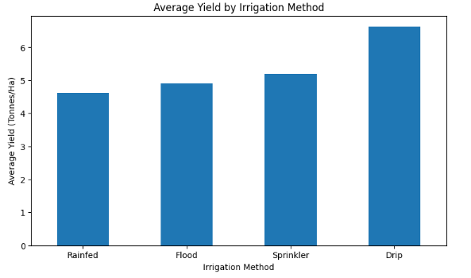
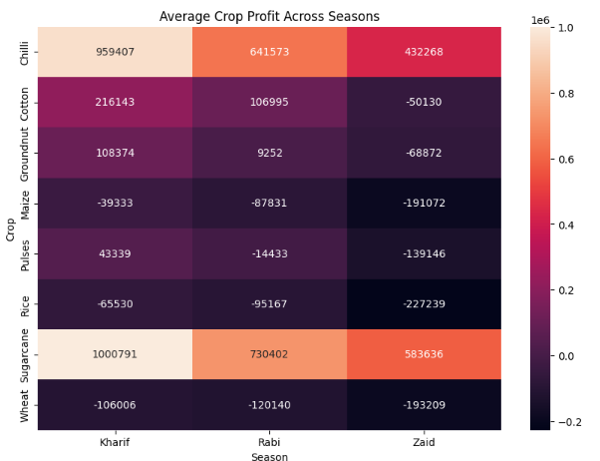
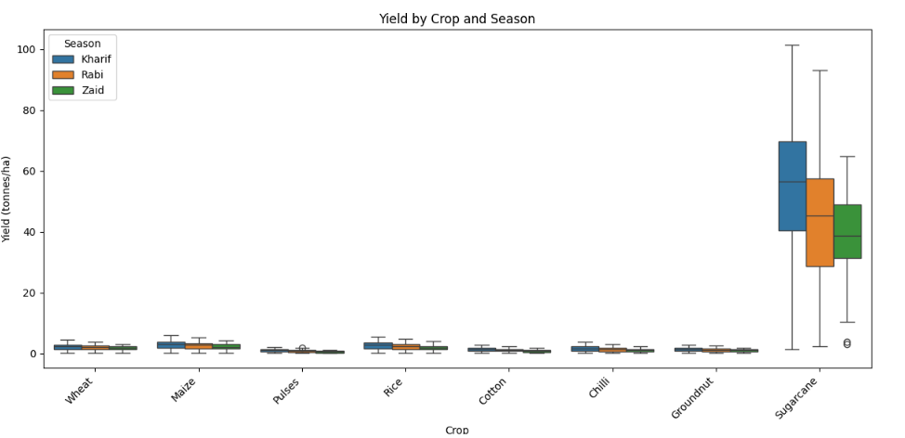
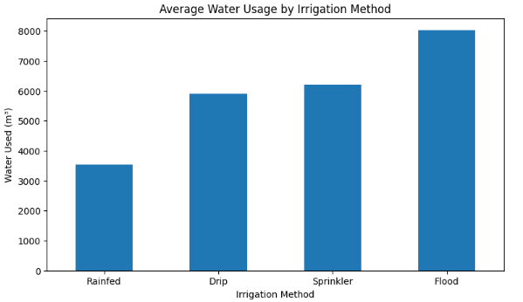
RESULTS
9/9/2026
Annual Review
‹#›

Slide 12
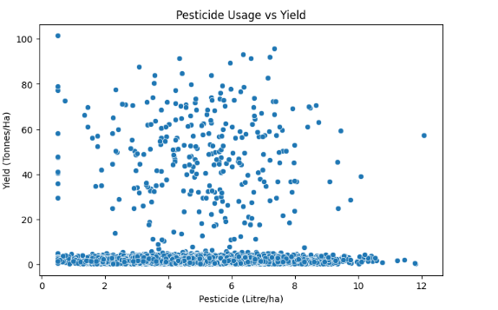
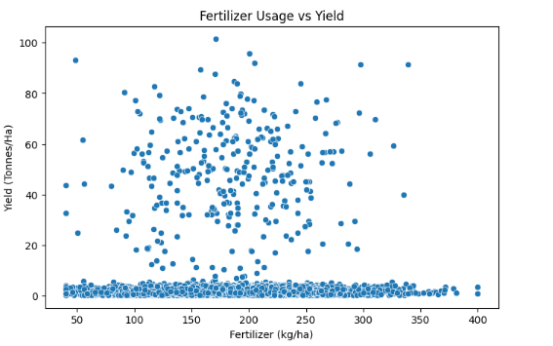
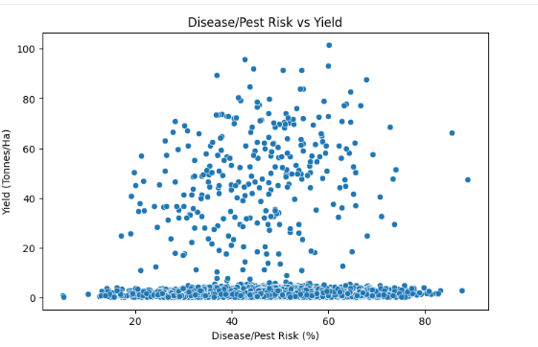
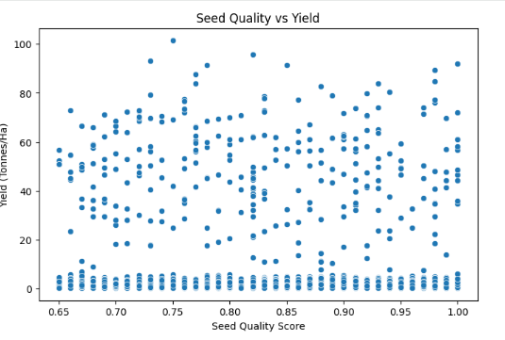
RESULTS
9/9/2026
Annual Review
‹#›

Slide 13
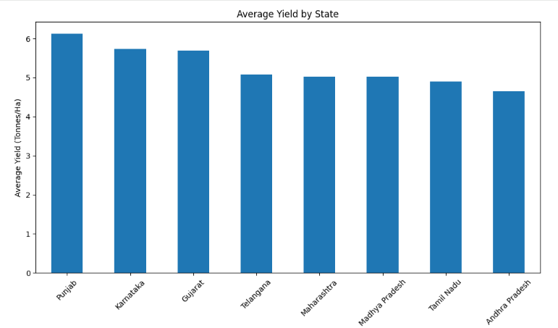
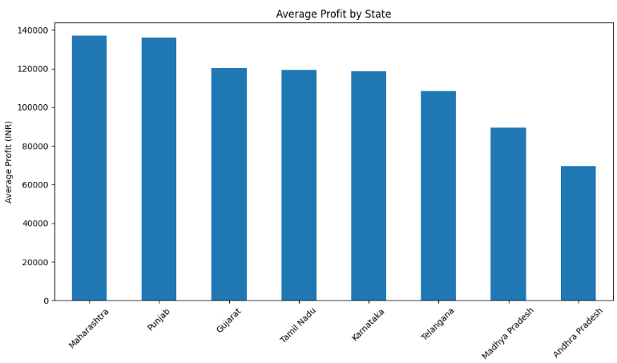
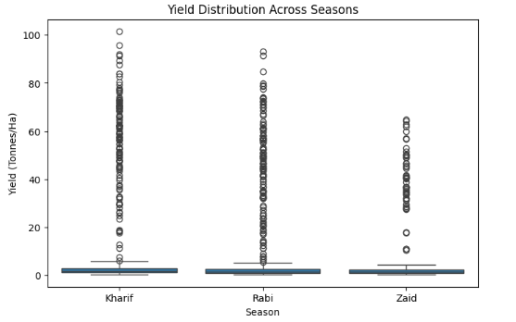
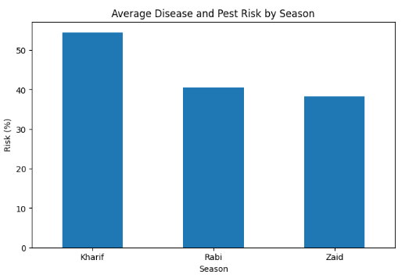
RESULTS
9/9/2026
Annual Review
‹#›

Slide 14
Future scope
The project can be extended by:
  - Adding agricultural data from more years.
  - Including more detailed weather information.
  - Adding real-time weather data.
  - Building crop yield prediction models.
  - Developing profit prediction models.
  - Creating an interactive dashboard.
  - Adding more detailed regional analysis.
  - Studying disease and pest risk in greater detail.
9/9/2026
Annual Review
‹#›

Slide 15
GitHub Link
https://github.com/mahi-verma23/Seasonal_Agriculture_Performance_Analysis_VOIS
9/9/2026
Annual Review
‹#›

Slide 16

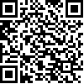
VOIS Course completion certificate -
Course name- Data Visualization
Mahi Verma
Data Visualization
September 4, 2026
VFLMS26_163619
9/9/2026
Annual Review
‹#›

Slide 17
Thank you
.
.
9/9/2026
Annual Review
‹#›

