Slide 1

BACHELOR'S THESIS · DATA ANALYTICS
Spatial Regression on
Environmental Data
Modelling the Summer Surface Urban Heat Island across the
Campania Region, Southern Italy
Candidate
Mahesh Pentu · B34000079
Supervisor · Co-supervisor
Prof. Rosanna Verde · Dr. Prof. Antonio Balzanella
Università degli Studi della Campania “Luigi Vanvitelli” · Dipartimento di Matematica e Fisica · A.Y. 2025/2026

Slide 2

THE PROBLEM
Southern Europe's Summers Are Getting Hotter — And Cities Hotter Still
Urban surfaces absorb & re-radiate heat
Asphalt and concrete store daytime heat and release it slowly, producing the Urban Heat Island (UHI) effect (Oke, 1973).
Mediterranean summers amplify the risk
Heat waves are growing more frequent and intense across southern Europe, compounding the urban warming signal.
Consequences are tangible
Higher cooling-energy demand, degraded air quality, and increased heat-related morbidity — falling hardest on the elderly and vulnerable.
A policy-relevant question
Where is the Surface UHI strongest, and which physical & human factors drive it — a prerequisite for evidence-based heat mitigation.
Spatial Regression on Environmental Data
2

Slide 3
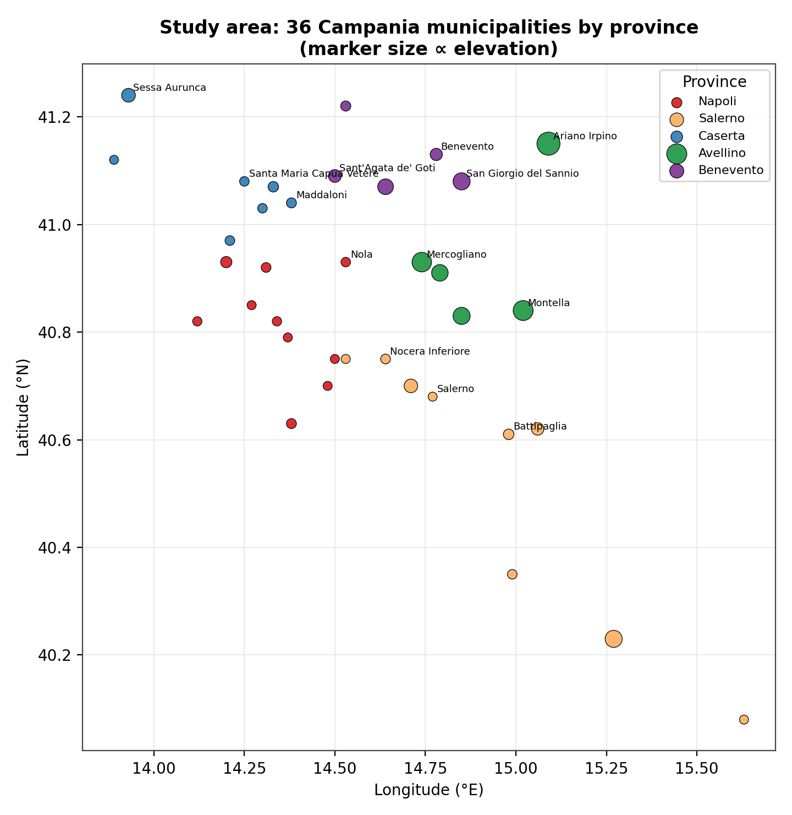




STUDY AREA
Campania: A Natural Laboratory for Surface Heat
36
Municipalities studied
5
Provinces spanned — Napoli, Salerno, Caserta, Avellino, Benevento
~13,600 km²
Total regional area — coast to Apennine interior
3 – 788 m
Elevation range across the sample
Figure — The 36 study municipalities, coloured by province
Spatial Regression on Environmental Data
3
The region couples an intensely urbanised Tyrrhenian coastal belt around Naples with a cooler, sparsely populated Apennine interior — spanning the full environmental gradient in one dataset.

Slide 4



RESEARCH QUESTION
How do environmental and demographic factors influence the
summer Surface Urban Heat Island in Campania — and do these
influences vary geographically across the region?
1. Assemble
2. Test
3. Compare
4. Map
A reproducible, municipality-level spatial dataset of summer LST and its candidate drivers — entirely from open sources.
For spatial autocorrelation in summer LST using global Moran's I, Local Moran (LISA), and Getis-Ord Gi*.
A non-spatial OLS baseline against spatial lag, spatial error, and spatial Durbin models via formal LM diagnostics.
Geographic variation in each driver's effect using Geographically Weighted Regression (GWR / MGWR).
Spatial Regression on Environmental Data
4

Slide 5


DATA & VARIABLES
One Dependent Variable, Four Families of Predictors
Dependent variable
Summer Land Surface Temperature (lst_summer_c, °C) — mean summer daytime LST per municipality, from Landsat Collection-2 Level-2 thermal composites.
Predictors
Topographic
Distance-based
Climatic
Demographic
Elevation (Copernicus DEM GLO-30)
Distance to coast, motorway, hospital (Natural Earth / OSM)
Precipitation, humidity, wind, temperature (ERA5 / ERA5-Land)
Resident population, log-transformed (ISTAT / Eurostat)
Every variable is drawn from openly licensed sources — Eurostat GISCO, Copernicus, Open-Meteo / ERA5-Land, and the USGS Landsat archive — so the workflow is fully reproducible.
Spatial Regression on Environmental Data
5

Slide 6
METHODOLOGY
From Global to Local: An Explicit Analytical Pipeline
01
02
03
Descriptive & correlation analysis
Spatial weights & autocorrelation
OLS baseline + LM diagnostics
Characterise variables; screen multicollinearity (VIF)
k-NN (k=6) weights matrix; global Moran's I
Test residuals for spatial dependence
04
05
06
Global spatial models
Local models (GWR / MGWR)
Unified model comparison
SAR, SEM, SDM estimated by maximum likelihood
Map geographic heterogeneity in each driver
R², AIC/BIC, residual Moran's I, RMSE/MAE
Spatial Regression on Environmental Data
6

Slide 7
WHY SPACE MATTERS
Tobler's First Law: Near Things Are More Related
“Everything is related to everything else, but near things are more related than distant things.”
Spatial Weights Matrix (W)
— Tobler (1970)
Structure
k-Nearest-Neighbour, k = 6
Standard OLS assumes observations are independent — geographic data routinely violate this.
Weighting
Row-standardised
Ignoring spatial dependence: biased/inconsistent estimates (lag) or understated standard errors (error), inflating significance.
Diagnostics
Global Moran's I; permutation p-value (999 draws)
Spatial regression models incorporate neighbourhood structure directly into the estimating equation.
Local tools
LISA (Local Moran) & Getis-Ord Gi*
Spatial Regression on Environmental Data
7

Slide 8
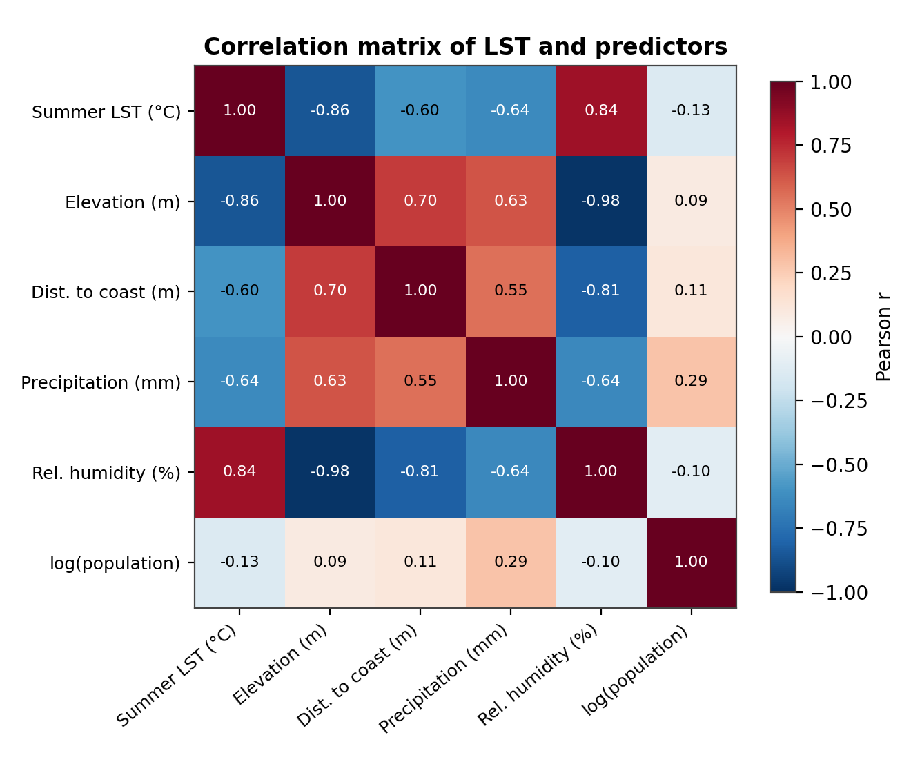
RESULTS · DATA STRUCTURE
Elevation Dominates — and Drives a Collinearity Problem
r = −0.86 LST vs. elevation — the strongest single relationship
r = −0.98 Elevation vs. relative humidity — near-perfect collinearity
Variance Inflation Factor (VIF)
Predictor | Full (5-var) | Screened (4-var)
Elevation | 605.5 | 2.34
Relative humidity | 919.8 | dropped
Distance to coast | 60.1 | 2.03
Precipitation | 1.9 | 1.87
log(Population) | 1.1 | 1.10
Threshold = 5. Relative humidity is dropped as the more redundant, near-linear image of elevation; the remaining four predictors are well-conditioned.
Figure — Correlation matrix of LST and predictors
Spatial Regression on Environmental Data
8

Slide 9
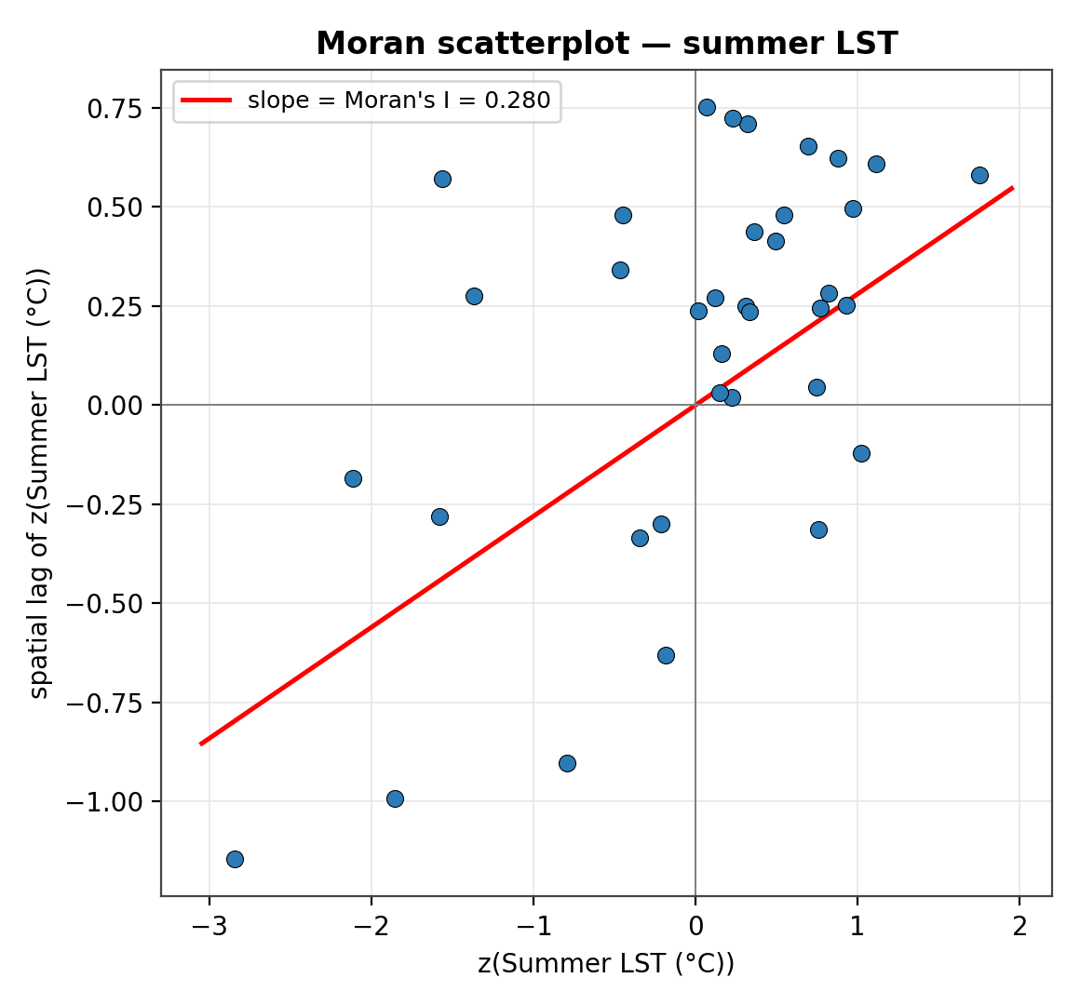
RESULTS · SPATIAL AUTOCORRELATION
Summer Heat Is Significantly Clustered in Space
0.2804
p = 0.004
Global Moran's I
Permutation pseudo p-value (999 draws)
Hot municipalities tend to adjoin other hot municipalities; cool ones adjoin cool ones.
Confirms, on formal statistical grounds, the spatial structure anticipated from physical reasoning.
This significant global clustering motivates the local cluster analysis and spatial-regression modelling that follow.
Figure — Moran scatterplot for summer LST
Spatial Regression on Environmental Data
9

Slide 10
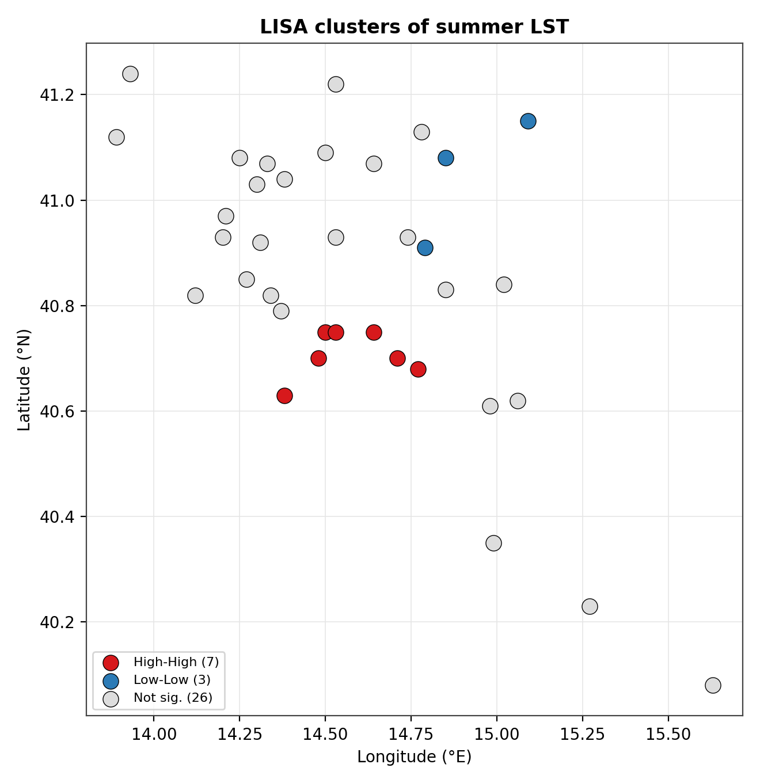
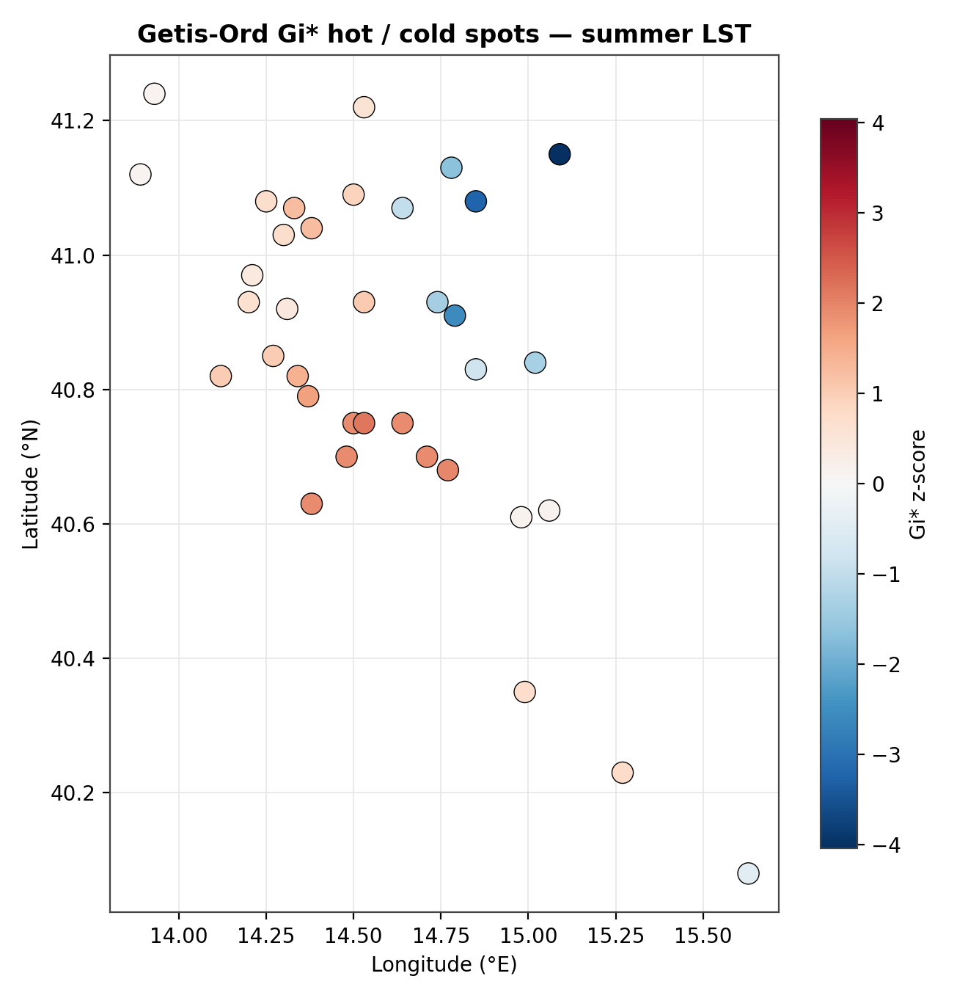
RESULTS · LOCAL CLUSTERS
A Warm Coastal Core Against a Cool Mountain Periphery
Warm cluster (High-High)
Castellammare di Stabia, Cava de' Tirreni, Nocera Inferiore, Pompei, Salerno, Scafati, Sorrento — the Naples–Salerno coastal corridor.
Cool cluster (Low-Low)
Ariano Irpino, Avellino, San Giorgio del Sannio — the elevated Avellino–Benevento interior.
Figure — LISA clusters (left) and Getis-Ord Gi* hot/cold spots (right)
LISA and Getis-Ord Gi* are mutually corroborating: strongest hot spots at Salerno & Scafati; strongest cold spots at Ariano Irpino, Avellino & San Giorgio del Sannio. The remaining 26 municipalities are not significant at the 5% level.
Spatial Regression on Environmental Data
10

Slide 11

RESULTS · GLOBAL REGRESSION
Elevation Alone Explains Three-Quarters of the Variation
R² = 0.752
−0.41 °C / 100 m
p < 0.001
Goodness of fit
Elevation effect
Elevation significance
Predictor | Coefficient | Std. Error | p-value
Elevation (m) | −0.0041 | 0.0007 | < 0.001
Distance to coast (m) | 0.000000 | 0.000000 | 0.747
Precipitation (mm) | −0.0016 | 0.0012 | 0.183
log(Population) | −0.0140 | 0.0704 | 0.844
Key takeaway
Elevation is the only statistically significant predictor. Once it is controlled for, distance to coast, precipitation and population add essentially nothing. OLS residuals show no significant spatial autocorrelation.
Screened four-predictor OLS specification (relative humidity removed for collinearity). Adjusted R² = 0.720.
Spatial Regression on Environmental Data
11

Slide 12
RESULTS · GLOBAL SPATIAL MODELS
SAR, SEM & SDM: No Improvement Over the OLS Baseline
Because the Lagrange-Multiplier diagnostics detect no residual spatial dependence in the OLS residuals, the spatial-econometric models are estimated for completeness — but are not expected to outperform OLS.
Spatial Lag (SAR)
Spatial Error (SEM)
Spatial Durbin (SDM)
ρ = 0.101
λ = 0.291
ρ = 0.095
pseudo-R² = 0.750
Elevation coef. −0.0042
Elevation coef. −0.0043
Direct + indirect (spillover) effects decomposed; elevation total effect −0.0045 °C/m.
Models spatially correlated errors rather than a lagged response.
Adds spatially lagged predictors (W·x); a large log-pop spillover appears but is unsupported by significance and treated as an artifact.
Spatial Regression on Environmental Data
12

Slide 13

RESULTS · LOCAL REGRESSION
GWR Finds No Meaningful Spatial Non-Stationarity
GWR
MGWR
bandwidth = 36 (whole sample)
bandwidths driven to floor (≈12 nn)
R² = 0.767 · AICc = 69.35
R² = 0.973
The AICc-optimal bandwidth spans every municipality — the kernel collapses to the global model. Local elevation coefficient varies only −0.0044 to −0.0037 °C/m across the region: drivers act uniformly.
A striking fit — but residual Moran's I = −0.194 (p = 0.004) signals significant over-fitting on this small, standardised sample. Reported for completeness, not as a genuine improvement.
A methodological finding, not just a null result: spatial autocorrelation in the outcome doesn't automatically mandate a spatial model. What matters is whether dependence survives in the residuals of a well-specified mean model — here, it does not.
Spatial Regression on Environmental Data
13

Slide 14
RESULTS · MODEL COMPARISON
The Parsimonious OLS Baseline Wins
Model | R² | AIC | BIC | Resid. I | RMSE | MAE
OLS | 0.752 | 63.14 | 72.64 | 0.064 | 0.492 | 0.384
Spatial Lag (SAR) | 0.750 | 64.96 | 76.05 | 0.073 | 0.494 | 0.385
Spatial Error (SEM) | 0.750 | 64.42 | 75.50 | 0.100 | 0.496 | 0.385
Spatial Durbin (SDM) | 0.785 | 67.75 | 85.17 | 0.041 | 0.458 | 0.367
GWR (bw=36) | 0.767 | 69.35 | — | 0.033 | 0.477 | 0.376
MGWR* | 0.973 | — | — | −0.194 | 0.164 | 0.124
* MGWR's high R² is an over-fitting artifact — flagged by its significantly negative residual Moran's I. Lower AIC/BIC, lower |residual Moran's I|, and lower RMSE/MAE indicate a better model.
OLS attains the lowest AIC/BIC, already has no significant residual autocorrelation, and matches the predictive error of every more complex model — the additional spatial machinery is not warranted here.
Spatial Regression on Environmental Data
14

Slide 15
IMPORTANT CAVEAT
These Results Are Illustrative, Not Empirical
Every figure in this presentation is produced by the analysis pipeline applied to a synthetic SAMPLE dataset, used to demonstrate the complete spatial-regression workflow end-to-end.
The near-perfect collinearity between elevation and humidity is an artifact of the synthetic generator.
The absence of residual spatial dependence and of GWR non-stationarity are properties of this sample — real Campania observations may behave differently.
All substantive conclusions are deferred until the pipeline is re-run on the real open-data sources (Section 3.17 of the thesis).
Spatial Regression on Environmental Data
15

Slide 16


DISCUSSION
What the (Illustrative) Pattern Would Mean
Topography as master control
The elevation effect (≈−0.41 °C/100 m) matches the environmental lapse rate — both a direct physical effect and a proxy for less built-up, more vegetated terrain.
Space matters — but indirectly
Outcome clustering is almost entirely explained by the clustering of elevation itself; once elevation enters the model, residuals are no longer spatially autocorrelated.
A lesson for methodology
Significant spatial autocorrelation in a variable does not by itself mandate a spatial-econometric model — what matters is dependence in the residuals of a well-specified model.
Consistent with prior Mediterranean SUHI studies
The warm coastal-urban / cool upland pattern aligns with the literature (e.g. Morabito et al., 2016), even as the exact estimates await real data.
Spatial Regression on Environmental Data
16

Slide 17
LIMITATIONS
Bounded by Design — and Honest About It
Limited Sample size
Cross-sectional design
A demographic evidence need a larger sample size.
A single summer season cannot separate structural drivers from inter-annual variability.
Less covariates
Measurement
NDVI, detailed land-cover / imperviousness, and socioeconomic variables were not included.
LST is a satellite skin temperature, not the air temperature residents actually experience.
Spatial Regression on Environmental Data
17

Slide 18
CONCLUSION & CONTRIBUTION
Bridging Global Spatial Econometrics and Local Heterogeneity
The thesis demonstrates, end-to-end with fully open data and reproducible code, how the modern spatial-analytical toolkit — global spatial econometrics together with Geographically Weighted Regression — can address a policy-relevant environmental question for a heterogeneous region at the municipality scale.
Methodological
Regional
Diagnostic rigor
Bridges studies that treat space rigorously but only globally, and studies that map local variation without formal spatial testing.
A reproducible, open-data workflow for the 36 municipalities of Campania, directly reusable for other regions and periods.
Shows the workflow behaves correctly — including correctly declining to prefer a spatial model when diagnostics give no warrant.
Future work: multi-year panel (2018–2025) · finer 1 km grid · NDVI & land-cover covariates · cross-regional comparison
Spatial Regression on Environmental Data
18

Slide 19


WITH GRATITUDE
Special Thanks & Acknowledgements
To the mentors who guided this research
Prof. Rosanna Verde
Dr. Prof. Antonio Balzanella
Thesis Supervisor
Thesis Co-Supervisor
Dipartimento di Matematica e Fisica
Dipartimento di Matematica e Fisica
For their expertise, patience, and invaluable guidance throughout this research
Mahesh Pentu · B34000079 · Università degli Studi della Campania “Luigi Vanvitelli”

Slide 20
Thank You
Mahesh Pentu · B34000079 · Università degli Studi della Campania “Luigi Vanvitelli”

