Slide 1

The Cloud Management Challenge
Managing multiple cloud providers is complex and costly, leading to overspending and security risks for businesses.

Slide 2
NimbusCore: Your Cloud Solution
01
02
03
Unified Platform
Cost Optimization
Enhanced Security
Centralized visibility and control across all cloud resources, simplifying management and enhancing efficiency. Streamline operations today.
Advanced tools to track usage and eliminate unnecessary expenses, ensuring optimal cloud spending and budget adherence.
Robust security measures to protect data and ensure compliance, mitigating risks and safeguarding your cloud environment effectively.

Slide 3
01
Market Size
Global cloud management market valued at $80B, indicating strong demand for cloud management solutions in the industry.
Seizing the Cloud Market Opportunity
02
Target Market
Focus on mid-sized companies in the US and Europe, a segment ripe for cloud optimization and cost-saving solutions.
The global cloud management market is booming, presenting a significant opportunity for NimbusCore to capture market share.
03
Revenue Goal
Aiming to achieve $10M in revenue within the next three years, demonstrating high growth potential and market penetration strategy.

Slide 4
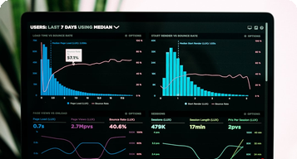


NimbusCore: Product Features
Unified Dashboard
Smart Alerts
Automated Compliance
Single pane of glass for managing all cloud environments.
Proactive notifications to prevent overspending.
Ensure adherence to industry regulations with ease.

Slide 5
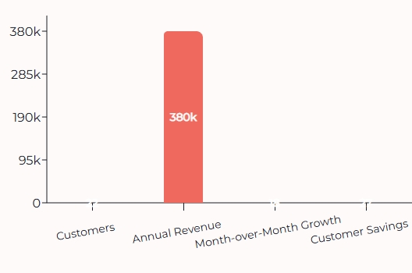
Early Traction and Success
NimbusCore demonstrates impressive early traction with growing customer base, revenue, and significant cost savings for clients.

Slide 6
01
Starter
$1500/month for up to 3 cloud accounts, providing essential cloud management features and cost optimization tools.
NimbusCore: Business Model
02
Growth
$3000/month for up to 10 accounts, including advanced security tools and enhanced support for growing businesses.
NimbusCore employs a B2B SaaS model with recurring monthly subscriptions, offering tiered pricing plans and low churn.
03
Enterprise
Custom pricing for unlimited accounts and priority support, tailored to meet the specific needs of large organizations.

Slide 7
Join Our Growth: The Ask
01
02
03
Product Improvement
Sales & Marketing
Security Certifications
50% for enhancing features and AI capabilities.
30% for expansion in the US and Europe.
20% for completing enterprise certifications.

