Slide 1
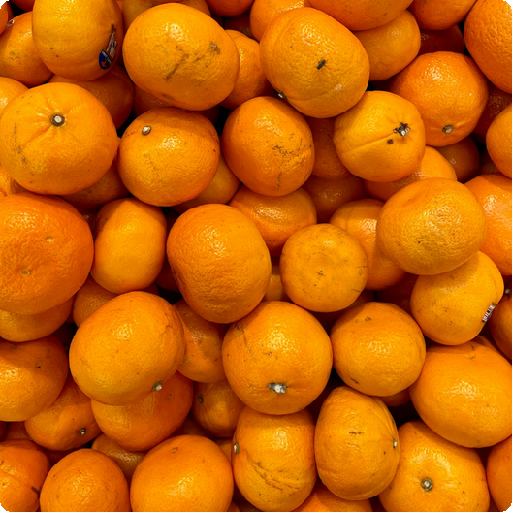
Introduction to Oranges: Overview
Oranges are a vital citrus fruit, rich in vitamins and antioxidants, and are cultivated globally for their diverse uses and health benefits.

Slide 2
01
Vitamin C
A potent antioxidant that supports immune function and skin health, helping the body fight off infections and repair tissue damage.
Nutritional Composition of Oranges
02
Fiber
Aids digestion and promotes a feeling of fullness, assisting in weight management and regulating blood sugar levels effectively.
Oranges are packed with essential nutrients, making them a healthy addition to any diet.
03
Potassium
Supports heart health and helps maintain optimal blood pressure, crucial for cardiovascular function and overall well-being.

Slide 3
01
Immune Boost
High vitamin C content enhances the immune system, protecting against common illnesses, and reducing the severity of cold.
Health Benefits of Eating Oranges
Regular consumption of oranges is linked to numerous health advantages.
02
Heart Health
Antioxidants and potassium contribute to cardiovascular wellness, lowering risks of heart disease, stroke and high blood pressure.

Slide 4
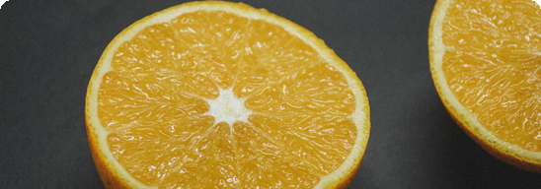
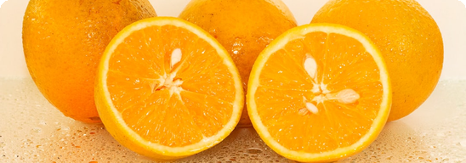
Different Varieties and Uses
Navel Oranges
Valencia Oranges
Popular for fresh eating due to their sweetness.
Ideal for juicing because of their high juice content.

Slide 5
Incorporating Oranges into Your Diet
01
02
03
Fresh Snack
Juicing
Salads
Enjoy a whole orange as a refreshing and nutritious snack, providing a quick energy boost and essential vitamins for health.
Squeeze fresh orange juice for a vitamin-packed beverage, offering a concentrated dose of nutrients, antioxidants, and hydration.
Add orange segments to salads for a burst of flavor, enhancing both sweet and savory dishes, with a citrusy twist.

