Slide 1
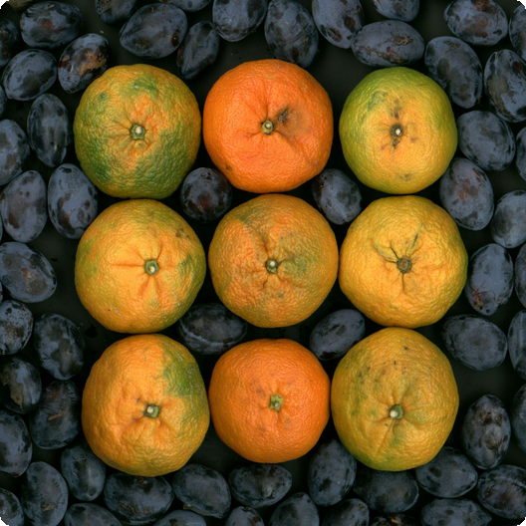
Introduction to Mango
Mangoes are a delicious and nutritious fruit, enjoyed worldwide. They are known for their vibrant flavor and health benefits.

Slide 2
Nutritional Benefits of Mangoes
01
02
03
Rich in Vitamins
High in Fiber
Antioxidant Properties
Excellent source of Vitamin C, Vitamin A, and Vitamin B6, crucial for immune function and vision.
Promotes digestive health and helps maintain healthy cholesterol levels.
Contains antioxidants that help protect against chronic diseases and cell damage.

Slide 3
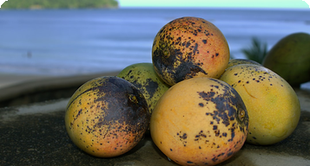
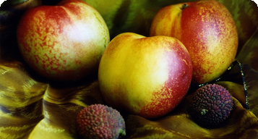
Mango Varieties Around the World
Alphonso
Tommy Atkins
Kent
Known as the 'King of Mangoes' in India, prized for its sweetness and creamy texture.
A popular variety in the US, known for its long shelf life and vibrant color.
Grown in Mexico and Ecuador, it is sweet and less fibrous than other varieties.

Slide 4
01
Desserts
Used in pies, smoothies, ice cream, and other sweet treats for a tropical flavor.
Culinary Uses of Mango
02
Savory Dishes
Added to salads, salsas, and curries for a sweet and tangy flavor contrast.
Mangoes are incredibly versatile and can be used in both sweet and savory dishes.
03
Beverages
Blended into refreshing juices, smoothies, and cocktails, enhancing flavor and nutrition.

Slide 5

Commercial Importance of Mango
Mangoes are a major agricultural commodity, contributing significantly to economies worldwide. Their demand continues to grow.

