Slide 1
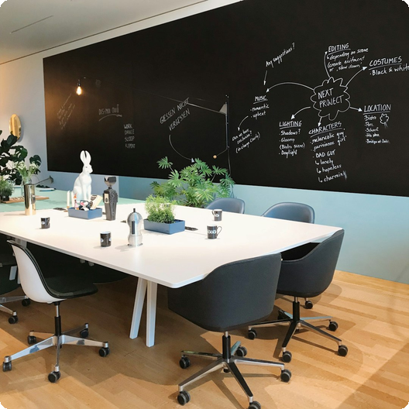
Introduction to DeckGenie
DeckGenie revolutionizes presentation creation with AI-powered design and content generation, enhancing productivity and visual impact.

Slide 2
01
AI-Powered Design
Automated design suggestions ensure visually appealing and professional presentations, saving time and effort on manual design.
Key Features and Benefits
02
Content Generation
Intelligent content suggestions and summaries help create compelling narratives, improving engagement and message delivery effectively.
DeckGenie offers a suite of powerful features designed to streamline presentation creation and enhance overall quality.
03
Customizable Templates
A wide range of customizable templates allows users to tailor presentations to specific needs, ensuring brand consistency and impact.

Slide 3
01
Business Pitches
Create compelling investor presentations that highlight key metrics, market opportunities, and competitive advantages, securing funding effectively.
Use Cases and Applications
DeckGenie is versatile across various professional domains, enhancing presentations for diverse purposes and audiences effectively.
02
Training Modules
Develop engaging training materials with visual aids and interactive elements, enhancing learning outcomes and knowledge retention significantly.

Slide 4
DeckGenie for Professionals
01
02
03
Enhanced Productivity
Improved Visual Appeal
Consistent Branding
Automated features and streamlined workflows significantly reduce presentation creation time, boosting overall professional productivity levels.
AI-driven design suggestions ensure presentations are visually engaging and professional, enhancing audience attention and message retention.
Customizable templates and design elements maintain brand consistency across all presentations, reinforcing brand identity and recognition.

Slide 5
Getting Started with DeckGenie
Start using DeckGenie today to transform your presentations into engaging, professional-quality deliverables, enhancing your communication impact.

