Slide 1
RAKSHASCORE
✓
CYBER RISK ASSESSMENT PLATFORM
SEMESTER 5 · MACHINE LEARNING PROJECT
See your cyber risk.
Fix what matters first.
An AI-assisted platform that scores a small business's security posture, explains every point and turns the gaps into a costed 90-day plan.
RANDOM FOREST + SHAP
STREAMLIT
OFFLINE-FIRST
github.com/mahi1124/rakshascore
NOVEMBER 2026
Notes:
Open with the one-line pitch: RakshaScore turns a security questionnaire into a score a manager can act on. The project is a full application, not just a notebook: trained models, explainability, a remediation engine and a downloadable report.

Slide 2
AGENDA
From questionnaire to action plan
Six short sections: the problem, the product, the model and the engineering.
01
The problem
02
The product
Why small businesses get advice they cannot act on.
One assessment, five management-ready outputs.
03
How it works
04
Model & results
Intake, validation, scoring, explanation, planning.
Four algorithms compared on 10,000 records.
05
Explain & remediate
06
Engineering
SHAP points and modelled score reductions.
Tests, performance, guardrails and what comes next.
RAKSHASCORE · CYBER RISK ASSESSMENT PLATFORM
02
Notes:
Keep the agenda to twenty seconds. Flag that the demo is embedded as screenshots, and that the code and models are in the public repository.

Slide 3
01 · THE PROBLEM
Enterprise threats, startup budgets
Security guidance exists. What is missing is prioritisation.
1
2
3
No dedicated team
Frameworks, not answers
Static, unexplained reports
The owner or an IT generalist is the security function. Nobody has time to interpret a 100-page framework.
CIS Controls, ISO 27001 and NIST CSF describe what good looks like, not which gap to fix on Monday.
Checklists produce a grade without a reason, and recommend actions without quantifying the benefit.
THE GAP
A fast, explainable assessment that says what to fix first — and what fixing it is worth.
RAKSHASCORE · CYBER RISK ASSESSMENT PLATFORM
03
Notes:
Do not quote statistics that are not in the sources. The argument is structural: small teams lack time, frameworks lack prioritisation, and static reports lack explanation. RakshaScore addresses all three.

Slide 4
02 · THE PRODUCT
One assessment. Five decisions.
A 37-question questionnaire becomes a management-ready risk picture.
0–100
4
SHAP
90 days
HTML
Risk score
Risk tiers
The reason
The plan
The evidence
A calibrated score from the trained regressor.
Low, Medium, High and Critical, from the classifier.
Points contributed by every individual answer.
Actions sequenced by effort and modelled impact.
Print-ready report plus CSV register and JSON data.
DESIGNED FOR THE REAL CONSTRAINT
A full run takes seconds and works offline — no API key, no GPU and no consultant required.
RAKSHASCORE · CYBER RISK ASSESSMENT PLATFORM
04
Notes:
The five outputs are the product. Everything else in the deck explains how they are produced and why they can be trusted. Stress that the app runs offline, so a demo never depends on a network key.

Slide 5
03 · HOW IT WORKS
From free text to a costed plan
Five deterministic stages; the language model is optional and never sets the score.
1
2
3
4
5
Intake
Validate
Score
Explain
Plan
Questionnaire, or a free-text description pre-filled by an LLM.
Answers checked against schema.json; defaults recorded as assumptions.
Random Forest predicts the tier; a regressor predicts 0–100.
SHAP attributes the score to each control, then to each domain.
Every fix is re-scored to build the 30/60/90-day roadmap and report.
DETERMINISTIC CORE
OPTIONAL AI LAYER
Scores come from persisted model weights, so the same answers always produce the same score.
The LLM only pre-fills answers and drafts narrative from computed facts — never the score.
RAKSHASCORE · CYBER RISK ASSESSMENT PLATFORM
05
Notes:
Walk the five stages left to right. The key governance point is the split between the deterministic model core and the optional generative layer. If the audience is technical, mention schema validation and assumption tracking.

Slide 6
03 · HOW IT WORKS
Eleven domains. Thirty-three controls.
A control-based questionnaire covering the areas attackers actually exploit.
PRF
IAM
NET
END
ONE RECORD
Business Profile
Identity & Access
Network Security
Endpoint Protection
37
model features
VUL
BCK
GOV
AWR
Vulnerability & Patch
Backup & Recovery
Governance & Resilience
Security Awareness
33
scored controls
DAT
MON
TPR
4
risk tiers
Data Protection
Monitoring & Logging
Third Parties & Incidents
2
trained models
Every control references CIS Controls v8 · ISO/IEC 27001:2022 · NIST CSF (indicative mapping).
RAKSHASCORE · CYBER RISK ASSESSMENT PLATFORM
06
Notes:
Coverage matters for credibility: the questionnaire is not a generic quiz, it is mapped to recognised frameworks. Be precise that the mapping is indicative and is not a compliance certification.

Slide 7
04 · MODEL & RESULTS
Four models compared. Random Forest wins.
10,000 synthetic SMB records · stratified 80/20 split · 5-fold cross-validation
Model
Accuracy
Macro-F1
CLASSIFIER ACCURACY
MACRO-F1
Logistic Regression
93.5%
0.848
95.5%
0.88
Decision Tree
91.9%
0.808
Held-out test set
5-fold CV 0.8895 ± 0.0285
Random Forest
95.5%
0.875
XGBoost
95.3%
0.854
SCORE MAE
SCORE R²
1.66
0.979
Random Forest selected and persisted to models/cyber_risk_best_model_10k.pkl
0–100 regressor error
Variance explained
READ THIS BEFORE QUOTING ACCURACY
The dataset is synthetic: high accuracy shows the model learned the generator's scoring logic, not real-world predictive power.
RAKSHASCORE · CYBER RISK ASSESSMENT PLATFORM
07
Notes:
Lead with the comparison, not the number. Random Forest was selected on macro-F1 as well as accuracy because the Critical class dominates the data. Then state the synthetic-data caveat yourself before anyone asks.

Slide 8
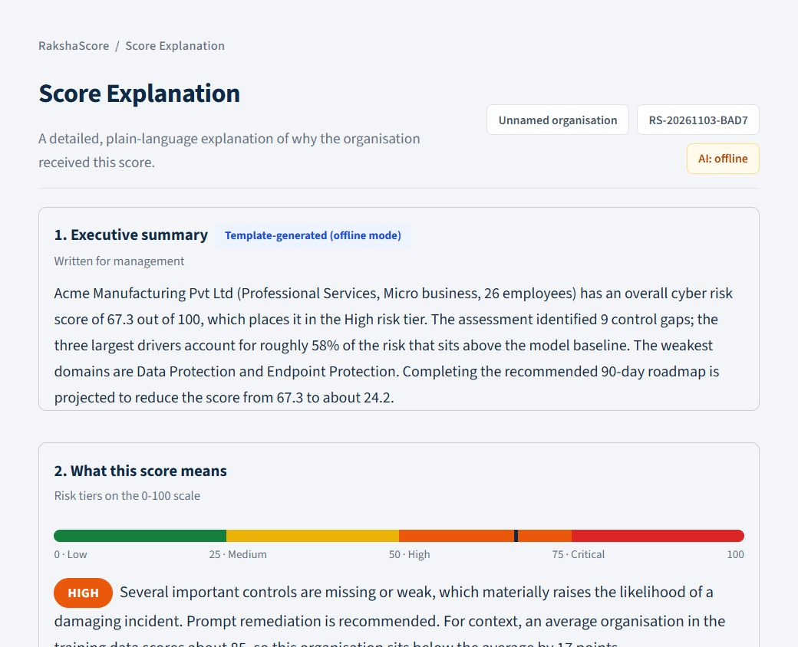
05 · EXPLAINABILITY
Every point has a reason
SHAP attributes the score to each answer, then aggregates it back to a control.
• Baseline 85.0 — the average organisation in the training data.
• Per-answer points — a missing EDR adds 3.4 points; daily backups remove 3.9.
• Reconciles exactly — baseline plus contributions equals the final score.
• Grounded language — drivers are explained from a control knowledge base, not invented.
SCORE DECOMPOSITION
85.0 baseline + Σ contributions = 67.3 final
The same explanation powers the waterfall chart, the driver list and the HTML report.
Score Explanation page · baseline, waterfall and plain-language drivers
RAKSHASCORE · CYBER RISK ASSESSMENT PLATFORM
08
Notes:
Use the waterfall on the right as the visual anchor. Explain that SHAP values are computed on the transformed feature matrix and summed back to the original questions, so a manager sees controls rather than encoded columns.

Slide 9
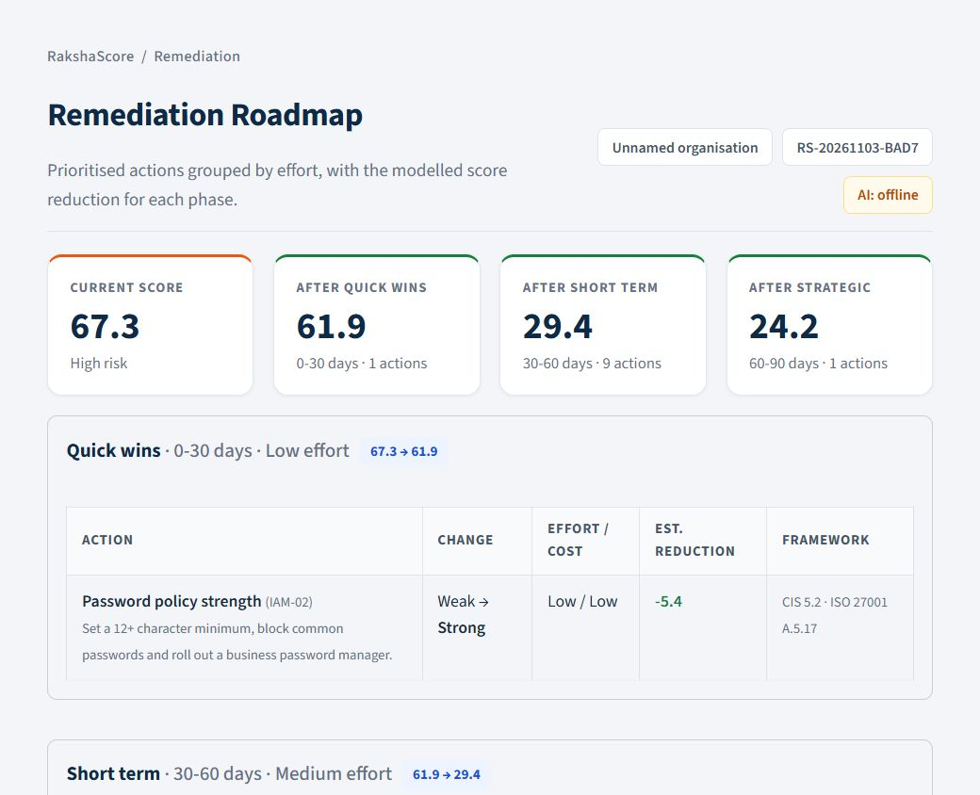
05 · EXPLAINABILITY
Remediation is modelled, not guessed
Every gap is re-scored by changing the answer and re-running the model.
1
Re-score
Try every allowed value for the control.
2
Rank
Keep the changes with the largest modelled drop.
3
Sequence
Group by effort and cost into 0–30, 30–60 and 60–90 days.
PROJECTED AFTER THE 90-DAY ROADMAP
67.3 → 24.2 (−43.1 points)
Remediation Roadmap · phases, changes, effort and modelled reduction
RAKSHASCORE · CYBER RISK ASSESSMENT PLATFORM
09
Notes:
This is the differentiator over a checklist: the plan is generated by the same model that produced the score. If you change an answer, the projection changes consistently. Mention the what-if simulator on the same page.

Slide 10
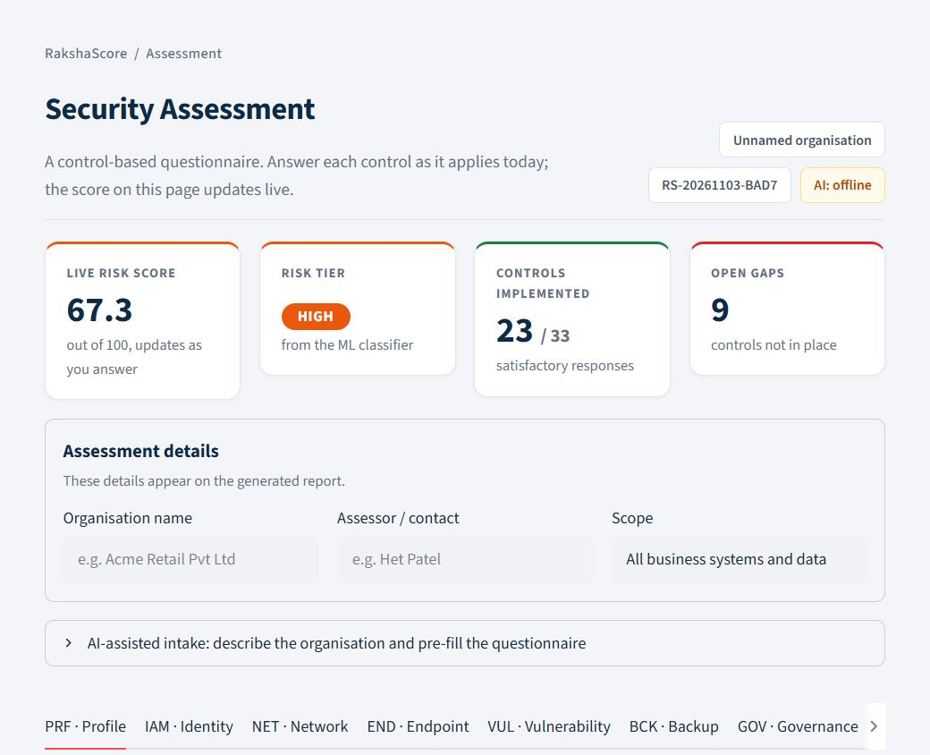
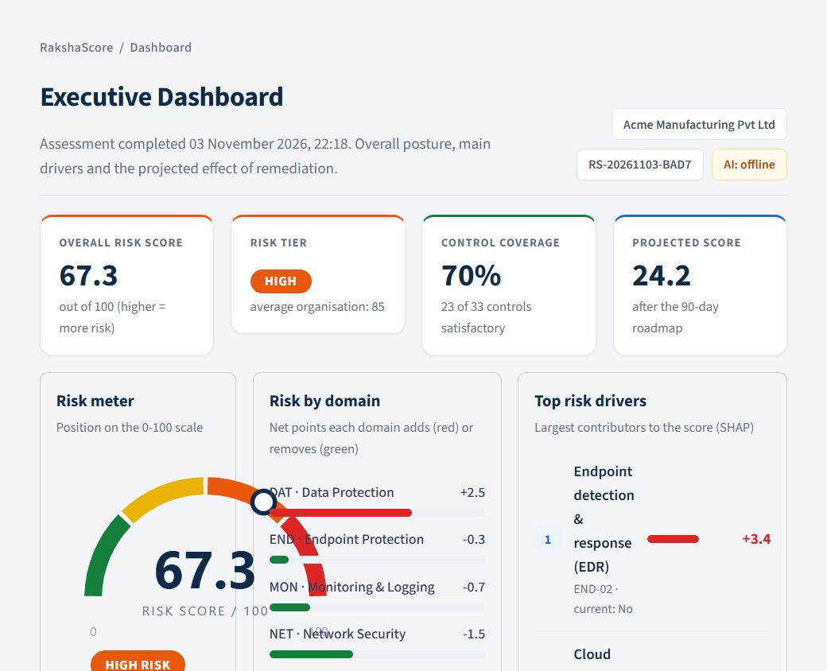
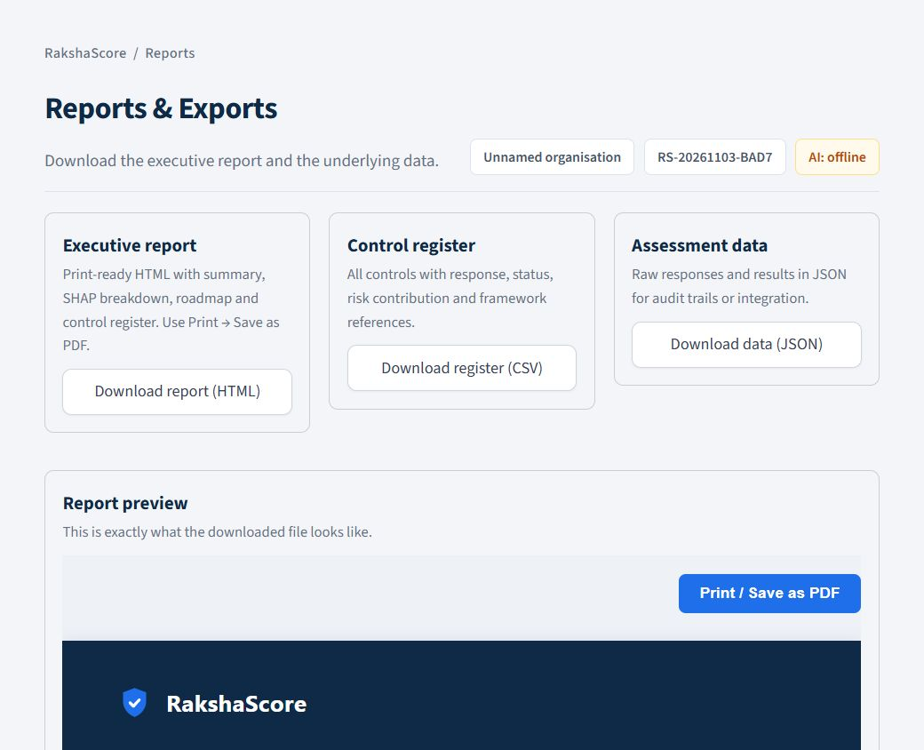
02 · THE PRODUCT
Six pages, one workflow
Assessment, dashboard, explanation, remediation, reports and methodology.
Assessment
Dashboard
Reports
33 controls with live score feedback
Posture, domains and top SHAP drivers
HTML report, CSV register and JSON data
Score Explanation and Remediation turn the numbers into action; Methodology documents the models and limits.
RAKSHASCORE · CYBER RISK ASSESSMENT PLATFORM
10
Notes:
Show the product breadth quickly. The assessment page is the data entry, the dashboard is the executive read, and the report is what leaves the room. Point out that navigation is role-relevant rather than a generic dashboard.

Slide 11
06 · ENGINEERING
Built like a product, not a notebook
Reproducible setup, automated checks and a packaging layout that scales.
STRUCTURE
AUTOMATED TESTS
FASTER PLANNING
18
5.6×
• src/rakshascore — pipeline, insights and one paths module.
• config, data, models, results — separated and reproducible.
• pyproject + pinned requirements — installable with pip install -e .
pytest: schema, extraction, scoring, reports
13 s → 2.3 s of model time
EXTRACTION CHECKS
FROM CLONE TO APP
14/14
1 click
GUARDRAILS
• No secrets in the repository — .env is ignored; keys stay local.
• Schema validation — unknown values are dropped, not guessed.
• Graceful degradation — rules and templates work without an LLM.
Rule-based fallback on labelled cases
run.bat creates the venv and launches
Python 3.12
pandas
scikit-learn
XGBoost
SHAP
Streamlit
pytest
RAKSHASCORE · CYBER RISK ASSESSMENT PLATFORM
11
Notes:
If the audience is academic, emphasise the test suite and the refactor: the project moved from a flat folder to a src layout with a single paths module. The performance fix batches model calls instead of scoring one row at a time.

Slide 12
06 · GUARDRAILS
AI assists. It never decides.
Generative AI is confined to intake and narrative; the score stays deterministic.
WHERE AI HELPS
WHERE AI IS NOT ALLOWED
• Free-text intake — a description of the business pre-fills the questionnaire.
• Narrative drafting — management summaries written from a facts-only JSON.
• Provider choice — Anthropic Claude, Google Gemini or a local Ollama model.
• Human override — every extracted answer remains editable before scoring.
• The score — produced by persisted model weights, not a prompt.
• The explanation — SHAP values from the model, not a generated story.
• The facts — answers are validated against config/schema.json.
• The fallback — rule-based extraction and templates work with no key.
SECURITY POSTURE
Keys live in .env or the session only; prompts receive the minimum facts needed; the repository contains no credentials.
RAKSHASCORE · CYBER RISK ASSESSMENT PLATFORM
12
Notes:
This slide pre-empts the obvious question about AI reliability. The architecture deliberately keeps the model in charge of the score and confines the LLM to language tasks. Offline mode makes the guarantee testable.

Slide 13
HONEST BY DESIGN
What this project does not claim
Stating the limits is part of the engineering, not a disclaimer at the end.
!
Synthetic training data
THE PRINCIPLE
Built from published breach statistics because no public labelled SMB dataset exists. Accuracy reflects the generator's logic, not real-world prediction.
“Trust comes from stating the limits as clearly as the results.”
!
Self-reported answers
Responses are not independently verified. The score is only as honest as the input.
!
Indicative framework mapping
CIS, ISO and NIST references help prioritise work; they are not a compliance audit.
Not a penetration test
Each report repeats the assumptions and limitations for the reader.
!
The result is a decision aid. It does not replace a professional security assessment.
RAKSHASCORE · CYBER RISK ASSESSMENT PLATFORM
13
Notes:
Do not rush this slide. Examiners and practitioners both trust projects more when the author names the weaknesses. The report itself repeats these limits so the end user sees them too.

Slide 14
WHAT'S NEXT
From strong prototype to pilot-ready
A realistic path: harden the product, then validate it with real organisations.
NOW
NEXT
LATER
Shipped
0–3 months
3–12 months
• Six-page Streamlit application
• Explainable scoring and waterfall
• Modelled 30/60/90-day roadmap
• HTML, CSV and JSON exports
• 18 tests, docs and one-click launcher
• Authentication and workspaces
• PDF export and report branding
• CI pipeline and coverage gate
• More labelled extraction cases
• Deployment guide (Docker)
• Partnership for real incident data
• Blind pilot with SMBs
• Benchmark against auditor ratings
• Microsoft 365 / Google Workspace
• Longitudinal score tracking
RAKSHASCORE · CYBER RISK ASSESSMENT PLATFORM
14
Notes:
Be honest that the current version is a prototype. The next step is not more features, it is validation: authentication for real use and a pilot that compares scores with an auditor's judgement.

Slide 15

RAKSHASCORE
✓
CYBER RISK ASSESSMENT PLATFORM
Know your score.
Fix what matters.
A full assessment, explanation and 90-day plan in under ten seconds — online or offline.
github.com/mahi1124/rakshascore
MIT licensed · public repository · double-click run.bat to start
Scan to open the repo
Thank you — questions?
Notes:
Close on the repository. Invite questions about the model, the SHAP implementation or the product decisions. Mention that the deck, generator script and screenshots are in docs/presentation/.

